Slide 1
AP Physics: Chapter 2
One-Dimensional Kinematics

Slide 2
Kinematics
Kinematics is the study of motion, unconcerned with the forces that are influencing that motion.
Today we will begin One-Dimensional Kinematics: The study of linear motion.
Soon we will expand to Two-Dimensional Kinematics, i.e. projectile motion.

Slide 3
How Far? Distance v. Displacement
Distance = scalar quantity indicating length of a path traveled. (“As the wolf runs.”)
Displacement = vector quantity indicating location (both magnitude and direction) relative to some reference point.

Slide 4
Example
You hike 4.0 km east, then 3.0 km north. What distance have you traveled, and what is your displacement, relative to where you started?
7.0 km is the distance you have traveled .
5.0 km, 37° north of east is your displacement relative to where you started.
5.0 km = [(4.0 km)²+(3.0 km)²]^{1/2}
3.0 km
37° = arctan (^{3.0 km}/_{4.0 km})
4.0 km

Slide 5
How fast? Speed v. Velocity
Just as distance and displacement are scalar and vector versions of answering “how far,” there are also vector and scalar versions for answering, “how fast?”
Speed = rate at which position changes with time
Velocity = speed in a given direction.
Examples: 35 mph is a speed; 35 mph north is a velocity.

Slide 6
How fast? Speed v. Velocity
What controls in a car allow the driver to change the car’s speed?
a.) Gas pedal
b.) Gas pedal, brakes
c.) Gas pedal, brakes, steering wheel
d.) Gas pedal, brakes, steering wheel, air conditioner knob

Slide 7
How fast? Speed v. Velocity
What controls in a car allow the driver to change the car’s speed?
a.) Gas pedal
b.) Gas pedal, brakes
c.) Gas pedal, brakes, steering wheel
d.) Gas pedal, brakes, steering wheel, air conditioner knob

Slide 8
How fast? Speed v. Velocity
What controls in a car allow the driver to change the car’s velocity?
a.) Gas pedal
b.) Gas pedal, brakes
c.) Gas pedal, brakes, steering wheel
d.) Gas pedal, brakes, steering wheel, air conditioner knob

Slide 9
How fast? Speed v. Velocity
What controls in a car allow the driver to change the car’s velocity?
a.) Gas pedal
b.) Gas pedal, brakes
c.) Gas pedal, brakes, steering wheel
d.) Gas pedal, brakes, steering wheel, air conditioner knob

Slide 10
Average v. Instantaneous Speed & Velocity
Average Speed is defined as total distance traveled divided by the total time:
v_{avg} = ^{d}/_{Δt}
Average Velocity is defined as total displacement divided by total time:
v_{avg} = ^{Δx}/_{Δt}

Slide 11
Average v. Instantaneous Speed & Velocity
Instantaneous Speed is one’s speed at a particular instant.
Instantaneous Velocity is one’s velocity at a particular instant.

Slide 12
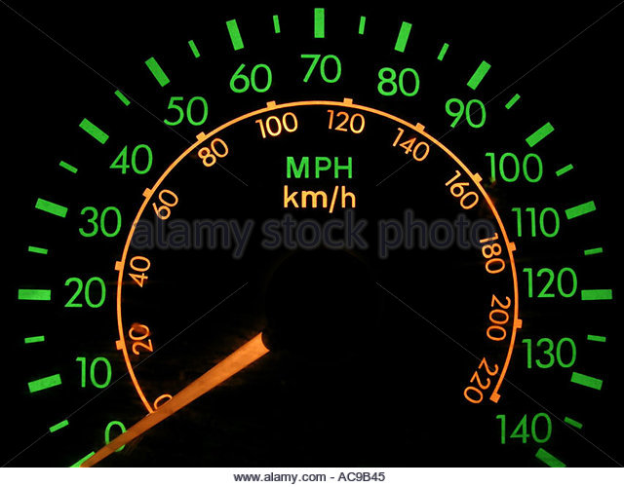
What does this dashboard indicator tell a driver?
a.) average speed
b.) average velocity
c.) instantaneous speed
d.) instantaneous velocity

Slide 13
What does this dashboard indicator tell a driver?
a.) average speed
b.) average velocity
c.) instantaneous speed
d.) instantaneous velocity

Slide 14
If you get a speeding ticket, is it because your instantaneous speed was too fast, or your average speed was too fast?

Slide 15
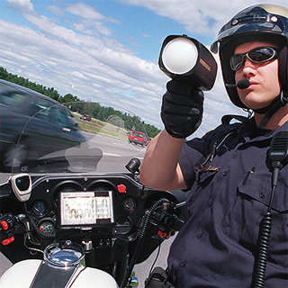
Usually, it’s because your instantaneous speed was too fast.

Slide 16
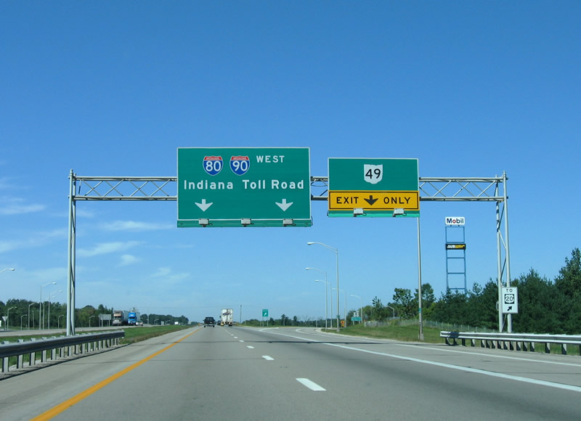
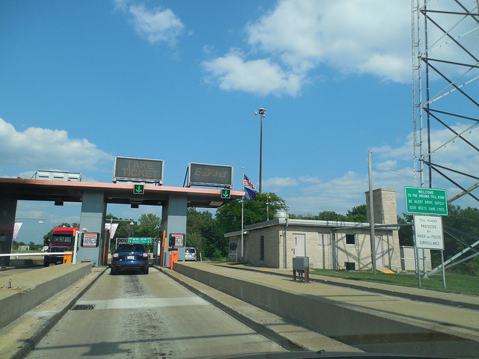
But on a toll road, you can get a ticket if your average speed exceeds the legal limit!

Slide 17
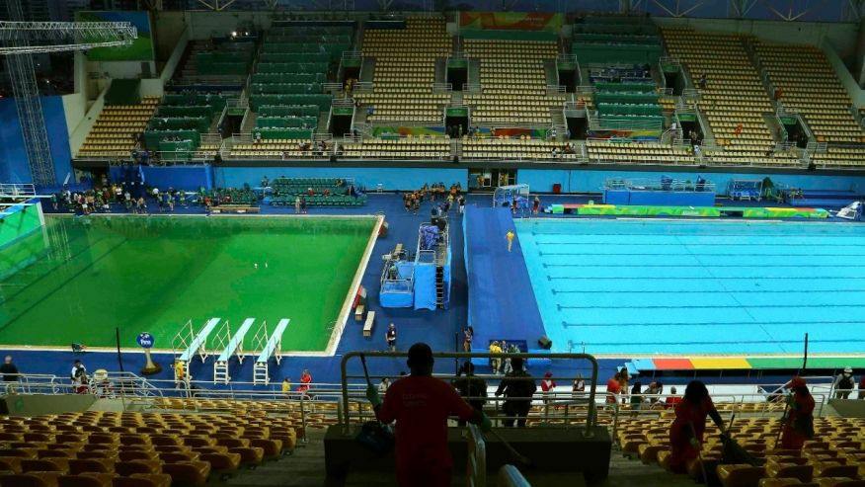
Olympic Controversy
Believe it or not, there was a controversy at the 2016 Rio Olympics that didn’t involve this doofus or uninvited algae trying to make the diving pool celebrate St. Patrick’s Day way too early…
… a controversy involving – linear motion!

Slide 18
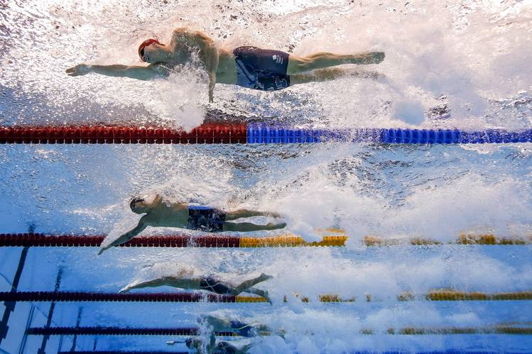
Some data suggests that the water on one side of the Olympic pool had a very small current running through it. The closer a swimmer was to lane 8, the stronger this current.
According to uproxx.com, “For most races, run in both directions, it’s probably negligible, but the 50m, which lacks both the mitigating factors of balanced direction and time, was undeniably affected.”

Slide 19
For races, such as the 100-meter, where swimmers swam both directions across the pool, a small current in the pool would have been _________.
a.) an advantage
b.) a disadvantage
c.) neither an advantage nor disadvantage

Slide 20
For races, such as the 100-meter, where swimmers swam both directions across the pool, a small current in the pool would have been _________.
a.) an advantage
b.) a disadvantage
c.) neither an advantage nor disadvantage

Slide 21
A swimmer would go fast when swimming with the current, and slower when swimming against the current. Since the “upstream” and “downstream” distances are the same, the swimmer will spend more time swimming against the current than they spend swimming with it. Thus the average speed will be less than if there were no current.

Slide 22
Here’s a similar example:
The Flash runs 1200 m at 4.0 × 10² m/s, then turns around and runs back to his starting point at 3.0 × 10² m/s. What was his average speed?

Slide 23
At 400 m/s, it takes 3.0 seconds to go 1200 m
At 300 m/s, it takes 4.0 seconds to go 1200 m
Note: Since the Flash spends more time going 300 m/s than he spends running at 400 m/s, his average speed should be closer to 300 m/s.
Recall v_{avg} = ^{total distance}/_{total time}
In this case, v_{avg} = ^{2400 m}/_{7.0 s} = approx. 340 m/s
This was his average speed. So what was his average velocity?
Zero! By returning to where he started, the Flash’s total displacement is 0 m!

Slide 24
Consider a position v. time graph where the position varies linearly with time.
What does the slope of this line represent?
Rise = Δx
Position (m)
Run = Δt
Pick any two points along the line and then find rise and run…
Time (s)
m = ^{Rise}/_{Run} = ^{Δx}/_{Δt} = velocity
Since slope is constant in this case, so is speed.

Slide 25
What if position doesn’t vary linearly with time?
If the slope of position v. time isn’t constant, then neither is speed.
Position (m)
Time (s)

Slide 26
What if position doesn’t vary linearly with time?
If the slope of position v. time isn’t constant, then neither is speed.
Position (m)
If we want to know the instantaneous speed at a particular moment, we need to know the slope of the line tangent to the curve at that point.
Time (s)
Instantaneous velocity as a function of time is given by:

Slide 27
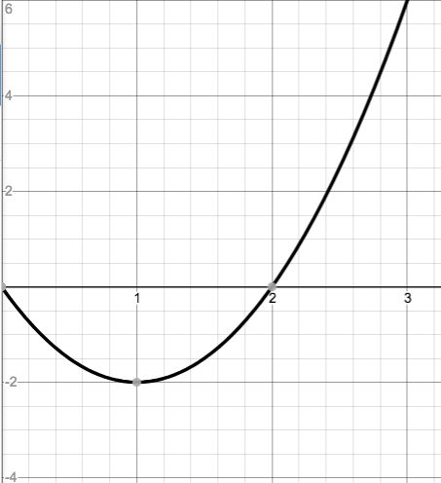
Ex) A particle moves along the x-axis such that x = -4t + 2t², as shown in the position-time graph below:
Determine the following:
The displacement from t = 0 to t = 1s.
The displacement from t = 0 to t = 2s.
The displacement from t = 0 to t = 3s.
The avg. velocity from t = 0 to t = 1s.
The avg. velocity from t = 0 to t = 2s.
The avg. velocity from t = 0 to t = 3s.
The instantaneous velocity at t = 1s.
The instantaneous velocity at t = 2s.
The instantaneous velocity at t = 3s.
x (m)
t (s)

Slide 28
Solutions:
The displacement from t = 0 to t = 1s.
The displacement from t = 0 to t = 2s.
The displacement from t = 0 to t = 3s.

Slide 29
Solutions:
The avg. velocity from t = 0 to t = 1s.
The avg. velocity from t = 0 to t = 2s.
The avg. velocity from t = 0 to t = 3s.

Slide 30
Solutions:
Note: v(t) = ^{dx}/_{dt} = ^{d}/_{dt} [-4t + 2t²] = -4 + 4t
The instantaneous velocity at t = 1s.
The instantaneous velocity at t = 2s.
The instantaneous velocity at t = 3s.

Slide 31
Uniform v. Accelerated Motion
If an object is moving at constant velocity, we say it is experiencing uniform motion (i.e. constant speed in a straight line)
If you’re moving, but not in uniform motion, you must be accelerating
Acceleration is defined as the rate at which velocity changes:
a_{avg} = ^{Δv}/_{Δt}
If acceleration is constant, we don’t need the “avg” subscript, and we can simply write
a = ^{Δv}/_{Δt}
Note: Any change in velocity indicates an acceleration. This means that speeding up, slowing down, and changing direction are all indicators of acceleration!

Slide 32
Instantaneous Acceleration
Instantaneous acceleration is given by:
Since velocity itself is the derivative of position, we can also say
Or, perhaps more simply, a(t) = v’(t) = x’’(t)

Slide 33
Examples of Acceleration
Suppose a stoplight turns turns green and you press on the gas pedal. If you speed up by 5 km/h for every second your foot is on the gas, then your acceleration is 5 (km/h)/s
If an object is falling near the surface of the Earth (and we’re neglecting any air resistance) then Earth’s gravity causes that object to speed up by 9.8 m/s every second that it’s falling. So acceleration due to gravity is 9.8 (m/s)/s, which is usually written 9.8 m/s².
Since acceleration is a vector, direction is important. In many problems we will use the convention that “up” is the positive direction and “down” is therefore negative. Since gravity points down, we often say a_{grav} = -9.8 m/s².

Slide 34
Now consider a velocity v. time graph where the velocity varies linearly with time.
What does the slope of this line represent?
Rise = Δv
Velocity (m/s)
Run = Δt
Pick any two points along the line and then find rise and run…
Time (s)
m = ^{Rise}/_{Run} = ^{Δv}/_{Δt} = acceleration
Since slope is constant in this case, so is acceleration.

Slide 35
Now consider a velocity v. time graph where the velocity varies linearly with time.
What does area under this curve represent?
Let’s do a unit analysis:
The units of area would be (m/s) × (s) which = meters
Area beneath a velocity vs time curve = displacement
Velocity (m/s)
Time (s)
The displacement from time t = a to t = b is given by :

Slide 36
Ex) A particle is moving along the x-axis such that its velocity as a function of time is given by
v_{x}(t) = (40 – 5t²)^{m}/_{s}.
Find the average acceleration for the interval from t = 0 s to t = 2 s.
Find the instantaneous acceleration when t = 2s.
Note: it wasn’t too much work to do the calculus by hand in this example…

Slide 37
… This will NOT always be the case. Don’t hesitate to use your calculator. It is a power tool – it can give you a number in seconds that would take a long time to work out by hand! Case in point…
Ex) A particle moves along the x-axis such that
At t = 0 s, the particle is at position x = 1 m.
A) Find the acceleration of the particle at t = 2 s.
B) Is the particle speeding up at t = 2 s? Explain.
C) Find the time(s) t on the interval 0 s < t < 3 s when the particle changes direction. Justify your answer.
D) Find the total distance traveled from t = 0 to t = 3 s.
E) Find the position of the particle at t = 3 s.

Slide 38
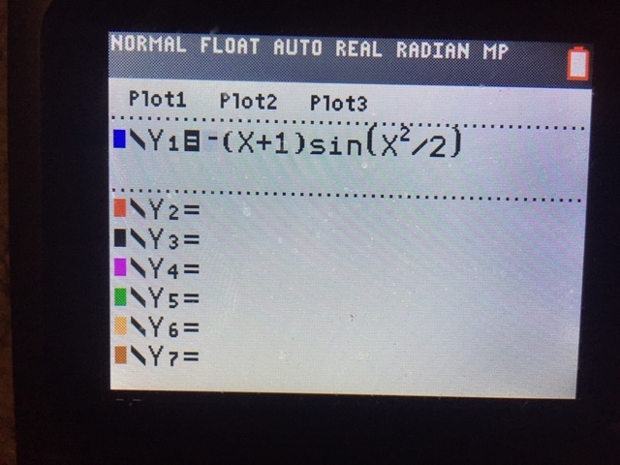
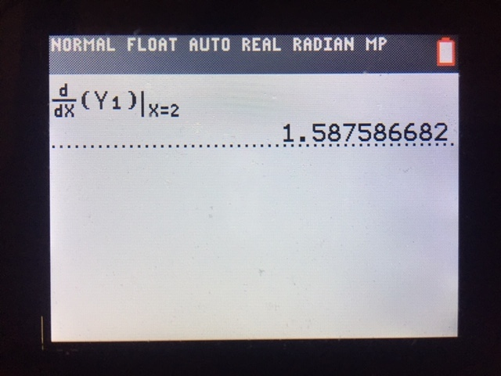
Ex) A particle moves along the x-axis such that
v(t) = –(t+1)sin(t²/2)
At t = 0 s, the particle is at position x = 1 m.
Find the acceleration of the particle at t = 2 s.
How did I get this without showing any work? I plugged the formula for v(t) into Y1 in my calculator. Then I used the nDeriv( function under the “math” menu

Slide 39
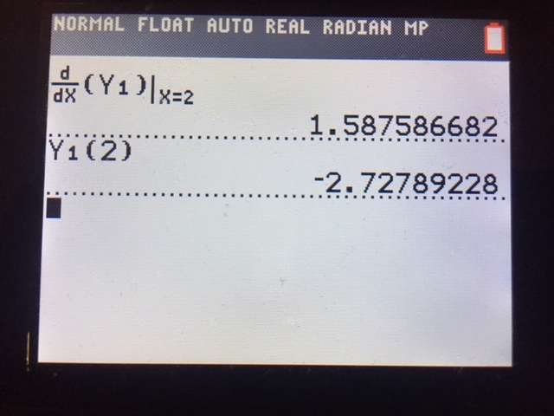
Ex) A particle moves along the x-axis such that
v(t) = –(t+1)sin(t²/2)
At t = 0 s, the particle is at position x = 1 m.
B) Is the particle speeding up at t = 2 s? Explain.
We know from part (A) that the instantaneous acceleration at t = 2 s is 1.558 m/s². The fact that this is positive tells us that the velocity is increasing.
Velocity is negative. Therefore, as it increases, it becomes less negative as it gets closer to zero.
This means speed, which is the absolute value of velocity, is decreasing at t = 2.
But we want to known if the speed is increasing. To determine this we need to know not only the sign of acceleration at this moment, but the sign of velocity too.
Using my calculator: v(2) = –2.728

Slide 40
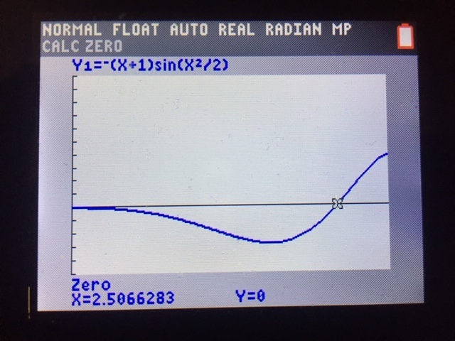
Ex) A particle moves along the x-axis such that
v(t) = –(t+1)sin(t²/2)
At t = 0 s, the particle is at position x = 1 m.
C) Find the time(s) t on the interval 0 s < t < 3 s when the particle changes direction. Justify your answer.
When velocity changes direction its sign should change.
When you graph v(t) from t = 0 to 3, the only point where v changes sign is at t = 2.507 s. At this point the velocity changes from negative to positive. Thus at this time the particle switches moving backwards to forwards.

Slide 41
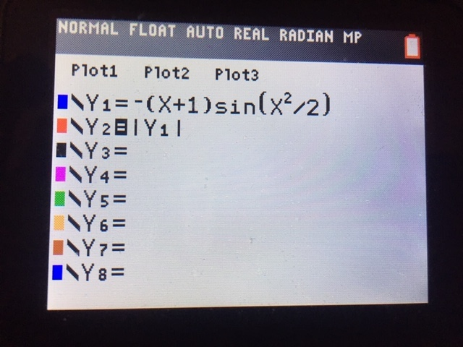
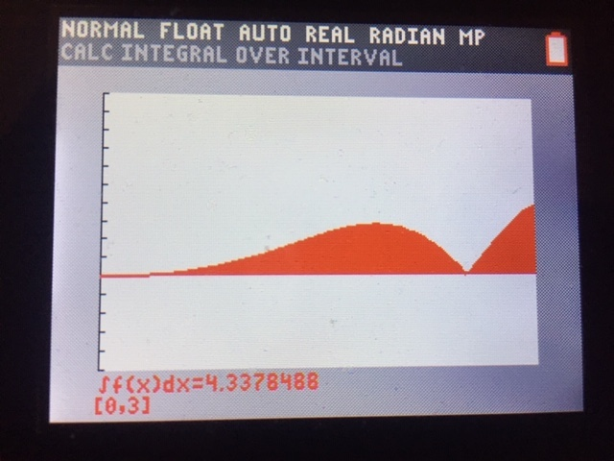
Ex) A particle moves along the x-axis such that
v(t) = –(t+1)sin(t²/2)
At t = 0 s, the particle is at position x = 1 m.
D) Find the total distance traveled from t = 0 to t = 3 s.
Note: Since distance cannot be negative, we must integrate the absolute value of the velocity function.
Put another way: to get distance, we need to integrate the speed function.

Slide 42
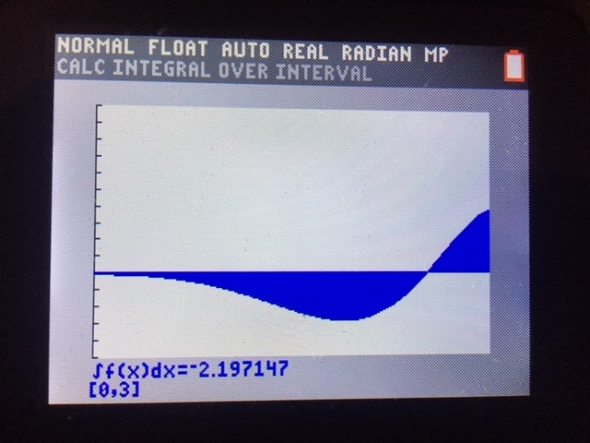
Ex) A particle moves along the x-axis such that
v(t) = –(t+1)sin(t²/2)
At t = 0 s, the particle is at position x = 1 m.
E) Find the position of the particle at t = 3 s.

Slide 43
The Equations of Kinematics
Solving kinematics problems requires a set of equations relating position, velocity, acceleration, and time.
We already have two of the equations we need; both are definitions:
v_{avg} = ^{Δx}/_{Δt} a = ^{Δv}/_{Δt}
Let’s start with the definition of average velocity: v_{avg} = ^{Δx}/_{Δt}
You can rewrite Δx: Δx = x_{f} - x_{i}
where x_{f} = final position and x_{i} = initial position
Similarly, you can rewrite Δt: Δt = t - t_{i}

Slide 44
So now, v_{avg} = x – x_{i}
t - t_{i}
Let t_{i} = 0
So now, v_{avg} = x – x_{i}
t
Solve for x: x = x_{i} + v_{avg}t …(1)
If acceleration is constant, then the average velocity will be halfway between the initial and final velocities: v_{avg} = ½ (v + v_{i}).
Let’s plug this expression for v_{avg} into (1):
x = x_{i} + ½ (v + v_{i})t …(2)

Slide 45
Recall a = ^{Δv}/_{Δt}
Replace: Δv = v – v_{i}
Replace: Δt = t – t_{i} = t (if t_{i} = 0)
So now a = ^{v – vi}/_{t}
Solve for final velocity: v = v_{i} + at …(3)
Recall equation (2): x = x_{i} + ½ (v + v_{i})t
Let’s plug equation (3) into (2):
x = x_{i} + ½ (v_{i} + at + v_{i})t
Simplify: x = x_{i} + v_{i}t + ½ at²

Slide 46
Go back to (3): v = v_{i} + at
Solve for time: t = (v – v_{i})/a
Plug this expression for t into (2): x = x_{i} + ½ (v + v_{i})(v –v_{i})/a
Simplify: x = x_{i} + (v² – v_{i}²) / (2a)
Subtract x_{i} from both sides: x - x_{i} = (v² – v_{i}²) / (2a)
Replace difference of final and initial positions with Δx:
Δx = (v² – v_{i}²) / (2a)
Multiply by 2a: 2a Δx = v² – v_{i}²
Solve for v²: v² = v_{i}² + 2a Δx

Slide 47
Kinematics Problem-Solving
So now we have a full list of kinematics equations…
v_{avg} = ^{Δx}/_{Δt} a_{avg} = ^{Δv}/_{Δt} x = x_{i} + ½ (v + v_{i}) t
v = v_{i} + at x = x_{i} + v_{i}t + ½ at² v² = v_{i}² + 2aΔx
In a given problem, how do you know which one(s) to use? What do you plug in?
Deciding which equation(s) to use should be one of the LAST steps in solving linear motion problems!
Step One: Draw a vector motion diagram before you do anything else!

Slide 48
Components of a Vector Motion Diagram:
A series of dots/pictures of the moving object representing its location at equal time intervals.
A set of distinct arrows representing the velocity vectors of the moving object at each point drawn.
A set of distinct arrows representing the acceleration vectors of the moving object.

Slide 49
Example A) A driver moving at 25 m/s applies the brakes and travels 148 m before coming to a stop at a red light. What was the car’s acceleration?
Velocity:
Acceleration:

Slide 50
Example B) Someone standing on a bridge 12.8 m over a river tosses a pebble up into the air at 17.1 m/s. How long does it take before the pebble splashes in the water?
V
A

Slide 51
Given & Wanted
Next, take an inventory of every piece of information that a problem gives you, both explicitly, as well as implied, and put this information into a table. For each value, include the conventional symbol as well as units.
Then list every piece of information the problem is asking for, again using conventional symbols.

Slide 52
Example A) A driver moving at 25 m/s applies the brakes and travels 148 m before coming to a stop at a red light. What was the car’s acceleration?
Velocity:
Acceleration:
Given
Wanted
v_{i} = 25 m/s
a = ?
Δx = 148 m
v = 0 m/s
Note: The fact that v_{final} = 0 m/s wasn’t explicitly given, but rather must be
inferred given the situation.

Slide 53
Example B) Someone standing on a bridge 12.8 m over a river tosses a pebble up into the air at 17.1 m/s. How long does it take before the pebble splashes in the water?
V
Given
Wanted
v_{i} = 17.1 m/s
t = ?
y_{i} = 12.8 m
A
a = -9.8 m/s²
y = 0 m
Note: Again, these last two values were not explicitly given, but rather were implied.

Slide 54
Now let’s pick a formula
Notice just how much time/effort/thought we’ve already put into each problem before we contemplated how to do the math.
By taking the time to wrap our minds around the problem, we’re now in a much better place to pick the right calculation.
Looking at the Given/Wanted charts, it becomes clearer which kinematics equation(s) to use.
Then it’s just a matter of chugging the numbers!

Slide 55
Example A) A driver moving at 25 m/s applies the brakes and travels 148 m before coming to a stop at a red light. What was the car’s acceleration?
Velocity:
Acceleration:
Given
Wanted
v_{f}² = v_{i}² + 2aΔx
v_{i} = 25 m/s
a = ?
a = (v_{f}² - v_{i}²) / (2Δs)
Δx = 148 m
v_{f} = 0 m/s
a = [(0 m/s)² – (25 m/s)²] / (2 × 148m)
a = - 2.1 m/s²

Slide 56
Example A) Someone standing on a bridge 12.8 m over a river tosses a pebble up into the air at 17.1 m/s. How long does it take before the pebble splashes in the water?
V
Given
Wanted
v_{i} = 17.1 m/s
t = ?
y_{i} = 12.8 m
s = s_{i} + v_{i}t + ½ at²
A
a = -9.8 m/s²
0 = 12.8 + 17.1t – 4.9t²
y = 0 m
Solve using the quadratic formula, or by using a
graphing calculator…
t = 4.12 s

Slide 57
Deriving the Formulae of Kinematics using Calculus
Let a particle move such that initial position is x_{i}, initial velocity is v_{i}, and acceleration is constant a.
But v(0) = v_{i}, so c = v_{i}
But x(0) = x_{i}, so c = x_{i}

