Slide 1
Unit 2: Mechanics Part 3 – Energy

Slide 2
Table of Contents
Work Defined
Work and Machines
Work and Energy
Types of Energy
Conservation of Energy
Energy and Power

Slide 3
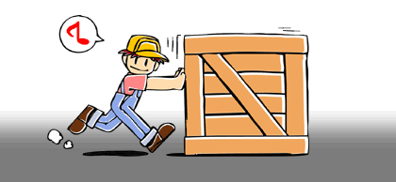
Work defined
F
d
Work = the product for force F exerted and resulting displacement d:
W = Fd

Slide 4
Units:
W = Fd
Joules (J)
meters (m)
Newtons (N)

Slide 5
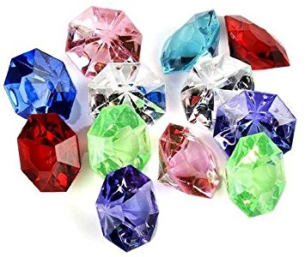
Remember…
If you work hard…
…you can make a lot of money…
… and buy a lot of jewels joules!

Slide 6
So, W = Fd
Recall Newton’s 2nd law:
F = ma.
If you substitute Newton’s 2nd Law into the formula for work you get:
W = mad
A simple, yet elegant proof that work makes you mad!

Slide 7
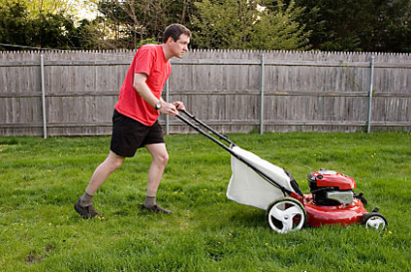
What if F isn’t parallel to d?
d
F

Slide 8
Only the component of F parallel to d contributes to work.
F||
d
θ
So, W = F||d, where F|| = F cos θ
Thus, W = Fd cos θ
F

Slide 9
What if force isn’t constant?
If force is changing as distance changes, then work can be calculated by finding the area under the Force v. Distance curve.
100
Force (N)
If force varies linearly with distance, this area will be a trapezoid.
In this case,
W = ½ (10 m)(50 N + 100 N)
W = 750 J
50
5
10
Distance (m)

Slide 10
Work & Machines
No device can perform more joules of work in order to accomplish a task than the number of joules of work that are input into the machine by the user. (In other words, machines cannot create energy.)
A simple machine, however, is a device that can alter the magnitude or direction of the force it takes to accomplish a task.
Since W = Fd, if a machine lessens the amount of force F necessary to accomplish a task, and W must remain the same (or even greater – but we’ll get to that in a moment!), the price you pay for using the machine is having to exert your force over a longer distance d.

Slide 11
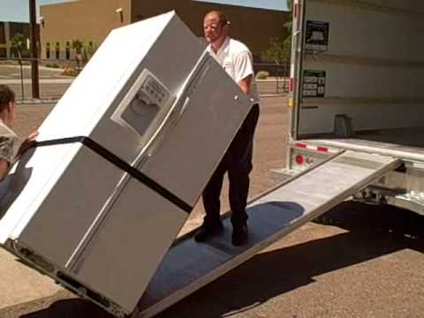
Example of a Simple Machine: The Inclined Plane
Suppose you want to lift a 1000-N refrigerator into the back of a moving truck 0.75 m off the ground.
Without the ramp, you’d have to actually exert 1000 N of force straight up over a distance of 0.75 m.
These values can be considered the output force and output distance of the machine, respectively.
F_{out}
d_{out}

Slide 12
Example of a Simple Machine: The Inclined Plane
The ramp, however, lets the user apply a force much smaller than the actual weight of the fridge.
The price the user pays is having to exert that smaller force over a longer distance, in this case the length of the ramp.
F_{in}
F_{out}
d_{in}
d_{out}

Slide 13
In an ideal machine, W_{out} = W_{in}
If the ramp is 3.0 m long, how much effort force should the user need to input?
Assuming ideal conditions,
F_{out}d_{out} = F_{in}d_{in}
(1000 N)(0.75 m) = F_{in}(3 m)
So, F_{in} = 250 N
F_{in}
F_{out}
d_{in}
d_{out}

Slide 14
Realistically, no machine is ideal
Instead of ideal conditions, suppose the user has to overcome 50 N of friction on the ramp
In this case, the actual input force would be F_{in} = 250 + 50 = 300 N.
F_{in}
F_{out}
d_{in}
d_{out}

Slide 15
Work in v. Work out
W_{in} = F_{in}d_{in}
= (300 N)(3 m)
= 900 J
W_{out} = F_{out}d_{out}
= (1000 N)(0.75 m)
= 750 J
Efficiency is defined as the ratio of useful output work to amount of input work:
η = W_{out}/W_{in}
In this case,
η = 750J/900J = 0.83,
or 83%
F_{in}
F_{out}
d_{in}
d_{out}

Slide 16
Work in v. Work out
83% of the energy exerted by the user translated into actual useful work done; the other 17% was used overcoming friction.
So 900 J of work was input in order to accomplish a 750 J task
Was it worth it?
Probably, unless you want a back injury! 300 N of effort force is still way less than 1000 N!
F_{in}
F_{out}
d_{in}
d_{out}

Slide 17
Mechanical Advantage
The ratio of output force to input force is called mechanical advantage:
MA = F_{out}/F_{in}
In this case,
MA = 1000 N / 300 N
= 3.3
So this machine can be thought to amplify a user’s strength by a factor 3.3
F_{in}
F_{out}
d_{in}
d_{out}

Slide 18
Ideal Mechanical Advantage
Recall, when we assumed this machine was ideal, we computed 250 N as our estimate for input force.
We did this using the known input and output distances.
Ideal Mechanical Advantage is defined as the ratio of the input to output distances:
IMA = d_{in}/d_{out}
In this case,
IMA = 3 m/0.75 m = 4
F_{in}
F_{out}
d_{in}
d_{out}

Slide 19
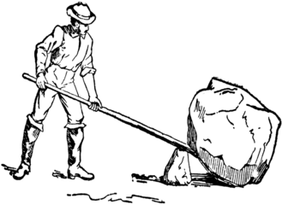
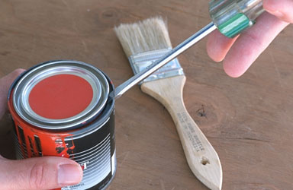
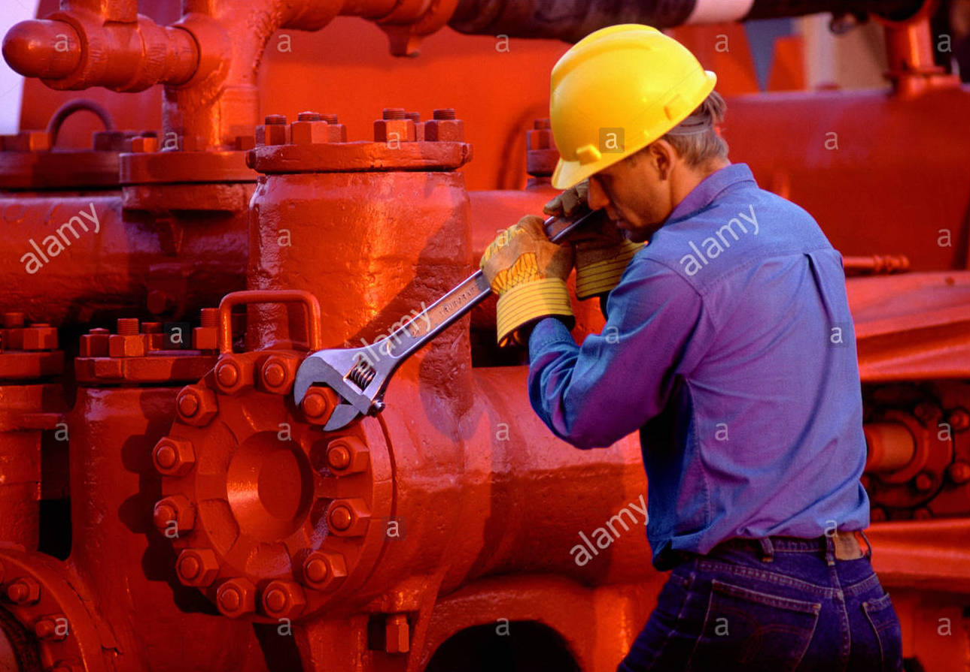
Another example of a simple machine: The Lever
Give me a lever long enough and a place to stand, and I shall move the Earth.
- Archimedes

Slide 20
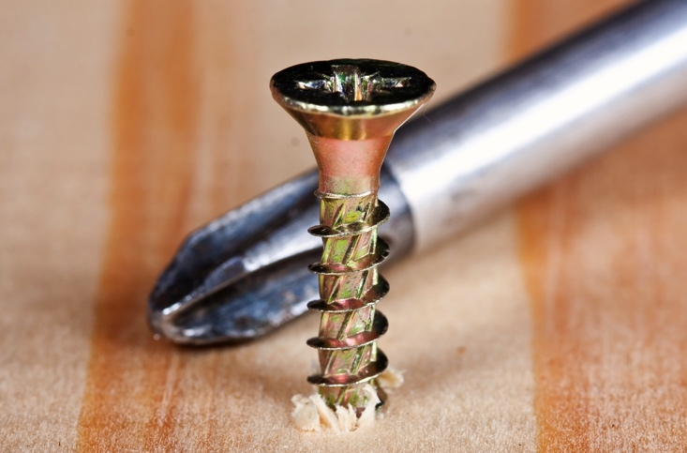
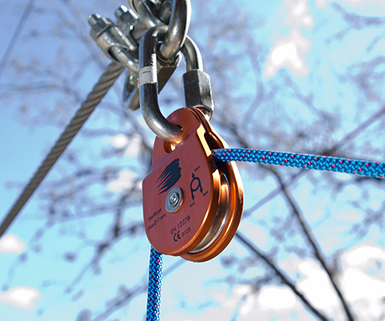
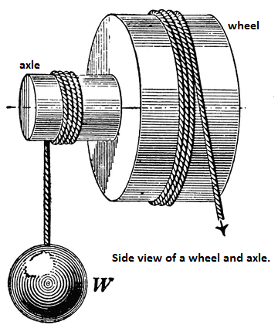
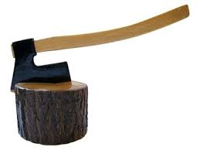
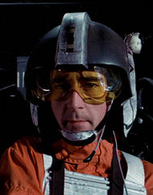
More Simple Machines
Screw
Pulley
Wheel & Axle
Wedge

Slide 21
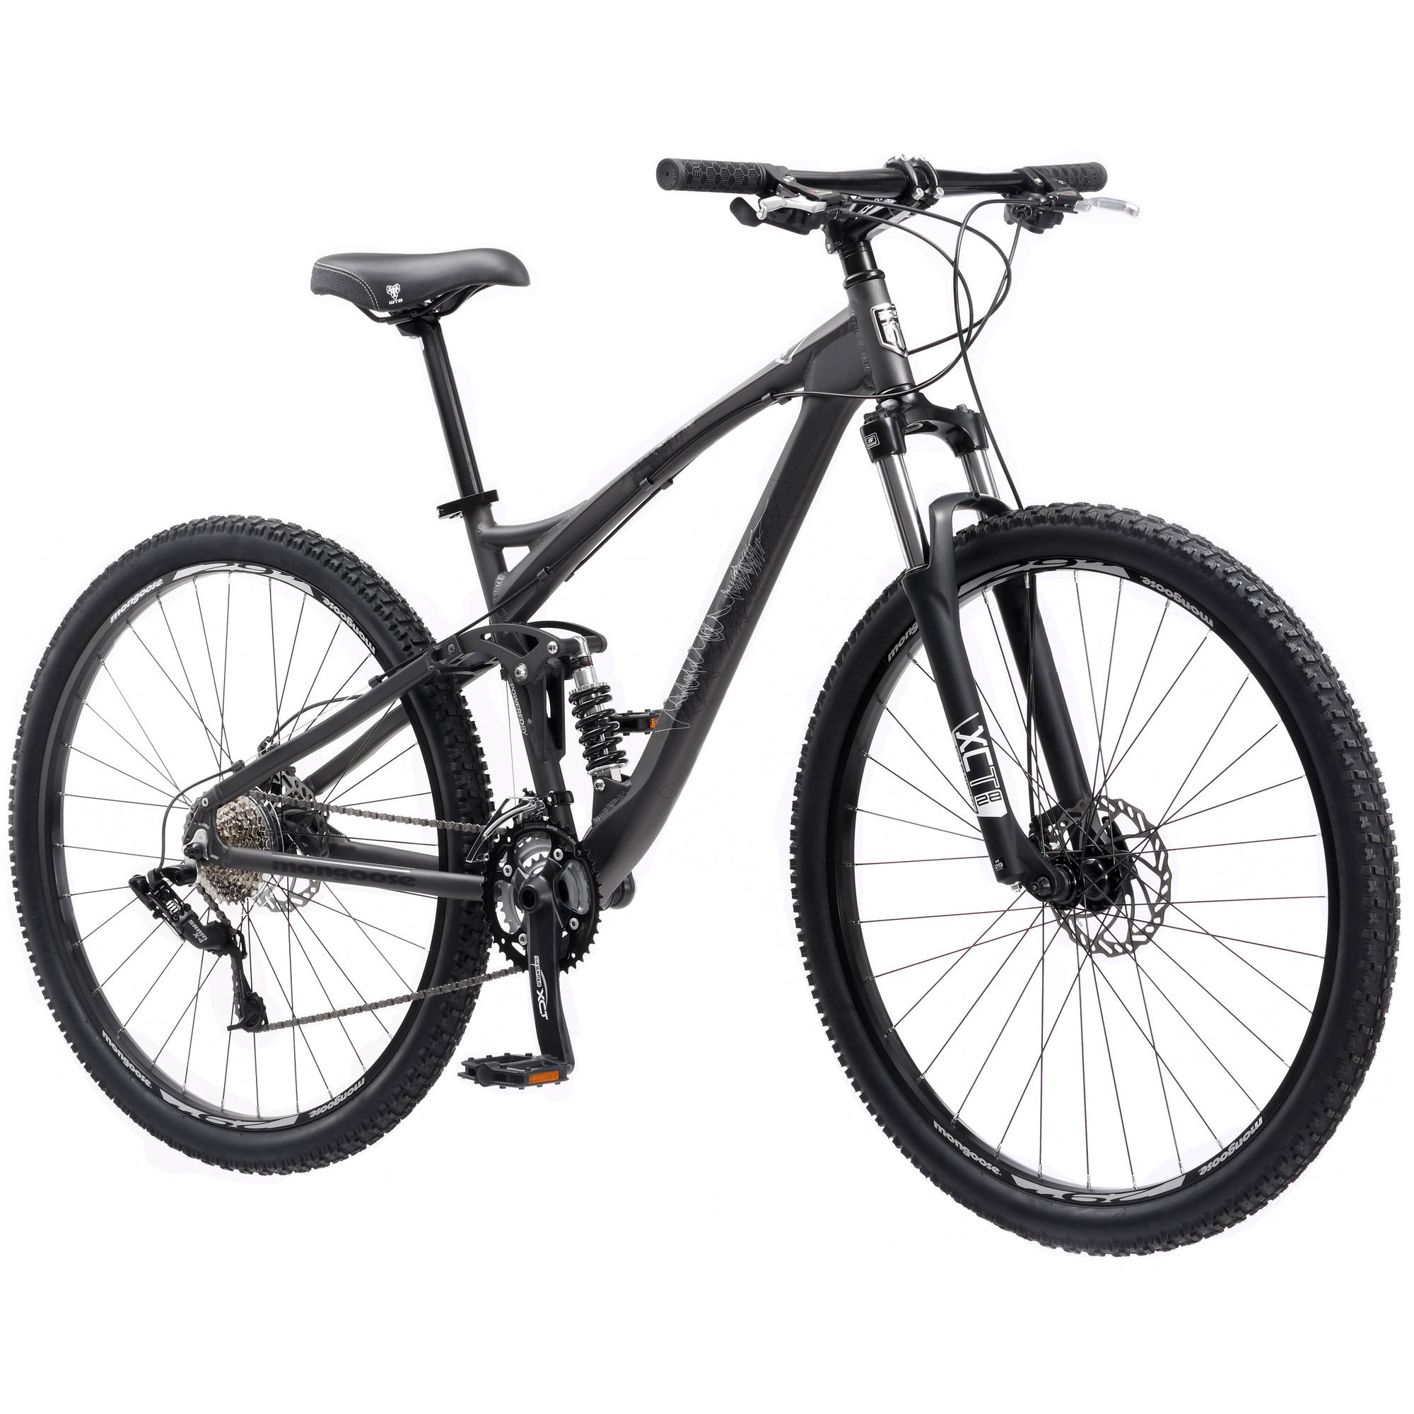
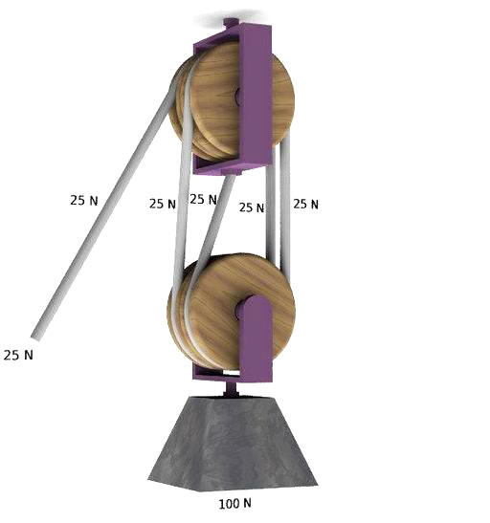
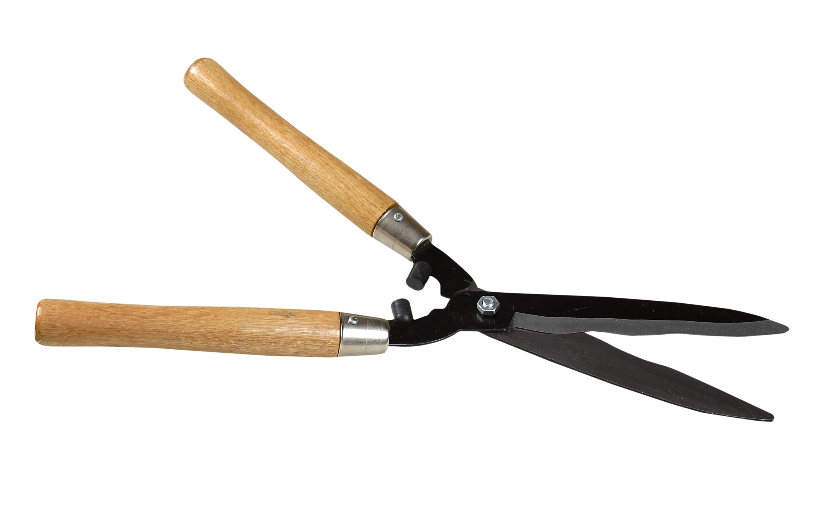
Compound Machines
A compound machine is composed of 2 or more simple machines connected in such a way that the output force of one simple machine becomes the input force of the next component.
Note:
η_{total} = η₁η₂η₃…
MA_{total} = MA₁MA₂MA₃…
IMA_{total} = IMA₁IMA₂IMA₃…

Slide 22
Work & Energy
Energy is defined as the capacity to do work.
Conversely, if work is done on an object, that object has gained energy:
W = ΔE
Like work, energy is measured in Joules

Slide 23
Types of Energy
Mechanical Energy
Kinetic Energy (E_{K}) – energy due to motion
Potential Energy (E_{P}) – energy due to location
Gravitational Potential Energy – energy due to height
Spring Potential Energy – energy due to being on a stretched or compressed spring
Thermal Energy (Q) – energy due to heat (i.e. movement of particles making up the body)
Other forms of energy include radiant energy (i.e. light), chemical energy (Duracells and donuts), nuclear energy, and “rest energy” (i.e. mass).

Slide 24
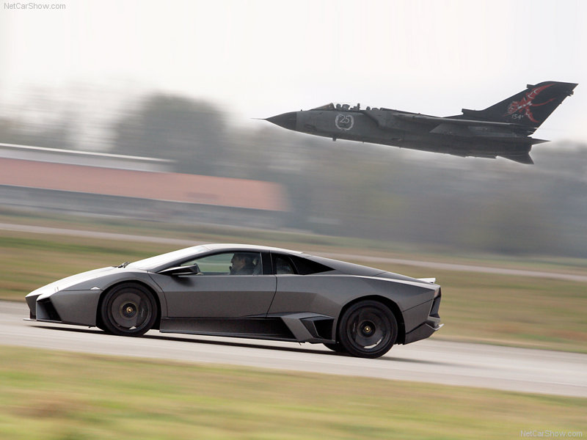
Kinetic Energy
If work is done accelerating an object, that object has gained kinetic energy – the energy of motion.
Recall: v_{f}² = v_{i}² + 2as
But F = ma, so a = F/m
Thus, v_{f}² = v_{i}² + 2(F/m)s
v_{f}² - v_{i}² = 2(F/m)s
Fs = ½mv_{f}² -½mv_{i}²
Here, W = ΔE, i.e. W = E_{K,f} – E_{K,i}
Since Fs = W, E_{K,f} must = ½mv_{f}² and E_{K,i} must = ½mv_{i}²
So the general formula for kinetic energy is
E_{K} = ½mv²

Slide 25
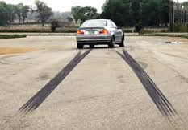
Skidding distance
Car A and Car B are identical except Car B is going twice as fast as Car A. Both cars slam on the brakes at the same time. How far will Car B skid compared to Car A?
a.) The same distance
b.) Twice as far
c. ) Four times as far

Slide 26
Skidding distance
Car A and Car B are identical except Car B is going twice as fast as Car A. Both cars slam on the brakes at the same time. How far will Car B skid compared to Car A?
a.) The same distance
b.) Twice as far
c.) Four times as far

Slide 27
Skidding distance
E_{K} = ½ mv², so if Car B has twice the speed as Car A, it has 4 x the kinetic energy.
Therefore, 4 times as much work must be done stopping it.
W = Fd
Since both cars are identical, both experience the same amount of braking force, so Car B must experience that force for 4 times the distance!

Slide 28
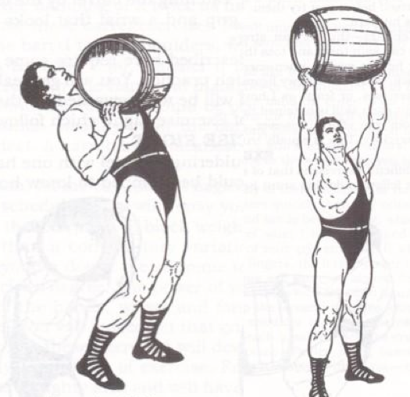
Gravitational Potential Energy
If work is done lifting an object of mass m up a height h, that object has gained gravitational potential energy
Recall W = Fd.
In this case, d = h. The force required to lift mass m is mg.
So the formula for gravitational PE is: E_{P,grav} = mgh

Slide 29
E_{P} is relative
Suppose a 1.0-kg book is on top of a 1.0-m tall desk on the roof of a 100.0-m tall building on top of a 200.0-m tall hill in a city 500.0 m above sea level which is 6,378,000 m from the center of the Earth.
What is the potential energy of the book?
Answer: Relative to what?
Now suppose we move the book from the 1.0-m tall desk to a 1.5-m tall shelf. What is the book’s change in potential energy?
Regardless of where our line of reference is, the book has moved 0.5 m, so ΔE_{P} = mgΔh = (1.0kg)(9.8 m/s²)(0.5m) = 4.9 J
The moral of the story: E_{P} is relative; ΔE_{P} is not.

Slide 30
Spring Potential Energy
It takes work to stretch or compress a spring.
Therefore, if you displace an object on the end of a spring from equilibrium (either by stretching or compressing the spring), you’ve given that object spring potential energy.
Recall the magnitude of spring force is given by Hooke’s Law: F_{spring} = kx
From this formula, one can see that spring force varies linearly with displacement.
kx
Force (N)
Distance (m)
x
Work = area under curve
W = ½(base)(height)
W = ½ (x)(kx)
E_{P,spring} = ½ kx²

Slide 31
Mechanical Energy
Kinetic and potential energy are collectively known as mechanical energy.
Forms of non-mechanical energy include thermal energy (i.e. heat), radiant energy (i.e. light), chemical energy, and nuclear energy (suns and H-bombs)

Slide 32
Consider a 12.000-kg object dropped from the top of a 100.00-m tall building. Consider three moments of its fall: The instant after you let go, the instant it’s halfway down, and the instant before it hits the ground. Assuming the object was in free-fall, complete the table below.
Height h | Distance fallen d | Velocity* v = (2ad)^{½} | Potential Energy E_{P} = mgh | Kinetic Energy E_{K} = ½mv² | Mechanical Energy E_{K} + E_{P}
100 m
50 m
0 m
*Recall v_{f}² = v_{i}² + 2ad. In this case, you can set v_{i} = 0 and solve for v_{f}.

Slide 33
Consider a 12.000-kg object dropped from the top of a 100.00-m tall building. Consider three moments of its fall: The instant after you let go, the instant it’s halfway down, and the instant before it hits the ground. Assuming the object was in free-fall, complete the table below.
Height h | Distance fallen d | Velocity* v = (2ad)^{½} | Potential Energy E_{P} = mgh | Kinetic Energy E_{K} = ½mv² | Mechanical Energy E_{K} + E_{P}
100 m | 0 m
50 m | 50 m
0 m | 100 m
*Recall v_{f}² = v_{i}² + 2ad. In this case, you can set v_{i} = 0 and solve for v_{f}.

Slide 34
Consider a 12.000-kg object dropped from the top of a 100.00-m tall building. Consider three moments of its fall: The instant after you let go, the instant it’s halfway down, and the instant before it hits the ground. Assuming the object was in free-fall, complete the table below.
Height h | Distance fallen d | Velocity* v = (2ad)^{½} | Potential Energy E_{P} = mgh | Kinetic Energy E_{K} = ½mv² | Mechanical Energy E_{K} + E_{P}
100 m | 0 m | 0 m/s
50 m | 50 m | 31.305 m/s
0 m | 100 m | 44.272 m/s
*Recall v_{f}² = v_{i}² + 2ad. In this case, you can set v_{i} = 0 and solve for v_{f}.

Slide 35
Consider a 12.000-kg object dropped from the top of a 100.00-m tall building. Consider three moments of its fall: The instant after you let go, the instant it’s halfway down, and the instant before it hits the ground. Assuming the object was in free-fall, complete the table below.
Height h | Distance fallen d | Velocity* v = (2ad)^{½} | Potential Energy E_{P} = mgh | Kinetic Energy E_{K} = ½mv² | Mechanical Energy E_{K} + E_{P}
100 m | 0 m | 0 m/s | 11,760 J
50 m | 50 m | 31.305 m/s | 5,880 J
0 m | 100 m | 44.272 m/s | 0 J
*Recall v_{f}² = v_{i}² + 2ad. In this case, you can set v_{i} = 0 and solve for v_{f}.

Slide 36
Consider a 12.000-kg object dropped from the top of a 100.00-m tall building. Consider three moments of its fall: The instant after you let go, the instant it’s halfway down, and the instant before it hits the ground. Assuming the object was in free-fall, complete the table below.
Height h | Distance fallen d | Velocity* v = (2ad)^{½} | Potential Energy E_{P} = mgh | Kinetic Energy E_{K} = ½mv² | Mechanical Energy E_{K} + E_{P}
100 m | 0 m | 0 m/s | 11,760 J | 0 J
50 m | 50 m | 31.305 m/s | 5,880 J | 5880 J
0 m | 100 m | 44.272 m/s | 0 J | 11,760 J
*Recall v_{f}² = v_{i}² + 2ad. In this case, you can set v_{i} = 0 and solve for v_{f}.

Slide 37
Consider a 12.000-kg object dropped from the top of a 100.00-m tall building. Consider three moments of its fall: The instant after you let go, the instant it’s halfway down, and the instant before it hits the ground. Assuming the object was in free-fall, complete the table below.
Height h | Distance fallen d | Velocity* v = (2ad)^{½} | Potential Energy E_{P} = mgh | Kinetic Energy E_{K} = ½mv² | Mechanical Energy E_{K} + E_{P}
100 m | 0 m | 0 m/s | 11,760 J | 0 J | 11,760 J
50 m | 50 m | 31.305 m/s | 5,880 J | 5880 J | 11,760 J
0 m | 100 m | 44.272 m/s | 0 J | 11,760 J | 11,760 J
*Recall v_{f}² = v_{i}² + 2ad. In this case, you can set v_{i} = 0 and solve for v_{f}.

Slide 38
Conservation of Mechanical Energy
As we can see, in certain circumstances, such as free-fall or frictionless conditions, mechanical energy is conserved!
Σ(E_{K} + E_{P})_{before} = Σ(E_{K} + E_{P})_{after}

Slide 39
Let’s return to our example of a 12-kg object falling off a 100-m tall building. Now let’s assume the more realistic condition of air-resistance occurs. Which numbers below would we have to change?
Height h | Distance fallen d | Velocity* v = (2ad)^{½} | Potential Energy E_{P} = mgh | Kinetic Energy E_{K} = ½mv² | Mechanical Energy E_{K} + E_{P}
100 m | 0 m | 0 m/s | 11,760 J | 0 J | 11,760 J
50 m | 50 m | 31.305 m/s | 5,880 J | 5880 J | 11,760 J
0 m | 100 m | 44.272 m/s | 0 J | 11,760 J | 11,760 J
*Recall v_{f}² = v_{i}² + 2ad. In this case, you can set v_{i} = 0 and solve for v_{f}.

Slide 40
Let’s return to our example of a 12-kg object falling off a 100-m tall building. Now let’s assume the more realistic condition of air-resistance occurs. Which numbers below would we have to change?
Height h | Distance fallen d | Velocity* v = (2ad)^{½} | Potential Energy E_{P} = mgh | Kinetic Energy E_{K} = ½mv² | Mechanical Energy E_{K} + E_{P}
100 m | 0 m | 0 m/s | 11,760 J | 0 J | 11,760 J
50 m | 50 m | 31.305 m/s | 5,880 J | 5880 J | 11,760 J
0 m | 100 m | 44.272 m/s | 0 J | 11,760 J | 11,760 J
*Recall v_{f}² = v_{i}² + 2ad. In this case, you can set v_{i} = 0 and solve for v_{f}.

Slide 41
All of the red values below would be less than what we calculated when we assumed free-fall. Does that mean energy was, in fact, lost when the object fell?
Height h | Distance fallen d | Velocity* v = (2ad)^{½} | Potential Energy E_{P} = mgh | Kinetic Energy E_{K} = ½mv² | Mechanical Energy E_{K} + E_{P}
100 m | 0 m | 0 m/s | 11,760 J | 0 J | 11,760 J
50 m | 50 m | 31.305 m/s | 5,880 J | 5880 J | 11,760 J
0 m | 100 m | 44.272 m/s | 0 J | 11,760 J | 11,760 J
*Recall v_{f}² = v_{i}² + 2ad. In this case, you can set v_{i} = 0 and solve for v_{f}.

Slide 42
NO! Even thought mechanical energy isn’t always conserved, energy is always conserved. When experiencing air drag, both a falling object and the air around it heat up a bit, so in this case mechanical energy is converted into thermal energy.
Height h | Distance fallen d | Velocity* v = (2ad)^{½} | Potential Energy E_{P} = mgh | Kinetic Energy E_{K} = ½mv² | Mechanical Energy E_{K} + E_{P}
100 m | 0 m | 0 m/s | 11,760 J | 0 J | 11,760 J
50 m | 50 m | 31.305 m/s | 5,880 J | 5880 J | 11,760 J
0 m | 100 m | 44.272 m/s | 0 J | 11,760 J | 11,760 J
*Recall v_{f}² = v_{i}² + 2ad. In this case, you can set v_{i} = 0 and solve for v_{f}.

Slide 43
Conservation of Energy
In general, we can say:
ΔE = W + Q
Heat gained or lost by the system
Change in energy of a system
Work done on the system

Slide 44
Example problems
A) A 3.2-m tall playground slide ends 0.60 m above the ground. Neglecting friction, how fast will a child be moving at the bottom of the slide?
Step One: Draw a diagram illustrating the situation.
(You may incorporate given/wanted information into the diagram or make a separate given/wanted list)

Slide 45
A 3.2-m tall playground slide ends 0.60 m above the ground. Neglecting friction, how fast will a child be moving at the bottom of the slide?
Initial mechanical energy = E_{P,i}
Final mechanical energy = E_{K,f} + E_{P,f}
Σ ME_{before} = Σ Me_{after}
E_{P,i} = E_{K,f} + E_{P,f}
mgh_{i} = ½ mv² + mgh_{f}
gh_{i} = ½ v² + gh_{f}
v =√[2g(h_{f} – h_{i})]
v = √[2(9.8 m/s²)(2.6 m)]
v = 7.1 m/s
WHEEEEE!!!!

Slide 46
Another example…
B) A 5.0-kg mass is attached to a horizontal spring (whose spring constant is 42 N/m). It’s pulled 7.0 cm and released. If the surface is frictionless, how fast will it be moving when it passes back through its equilibrium point?
Step One: Draw a diagram illustrating the situation

Slide 47
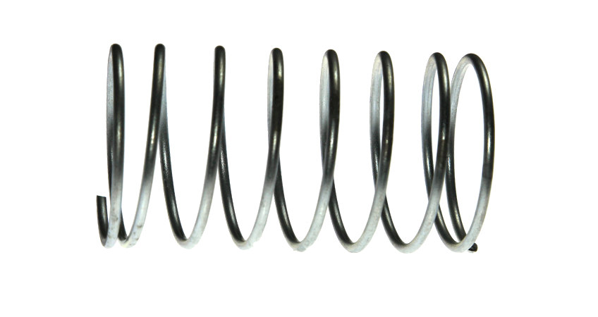
B) A 5.0-kg mass is attached to a horizontal spring (whose spring constant is 42 N/m). It’s pulled 7.0 cm and released. If the surface is frictionless, how fast will it be moving when it passes back through its equilibrium point?
At equilibrium
Pulled back: Initial mechanical energy = E_{P,i}
Σ ME_{before} = Σ Me_{after}
E_{P,i} = E_{K,f}
½ kx² = ½ mv²
½ (42 N/m)(0.07 m)²
= ½ (5.0 kg)v²
v = 0.20 m/s
x
Final mechanical energy = E_{K}

Slide 48
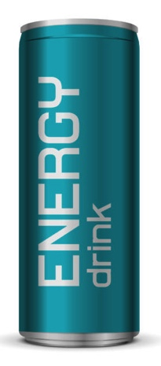
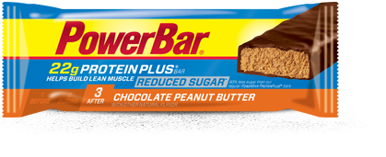
Power & Energy
Power is defined as the rate at which work is done (or the rate at which energy is used or produced)
d
=
dt

Slide 49
Units:
Joules (J)
P = ^{W}/_{t}
Watts (W)
seconds (s)

Slide 50
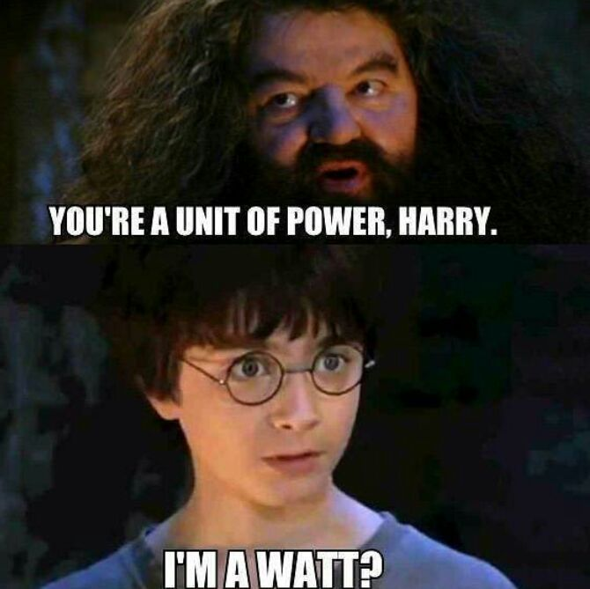

Slide 51
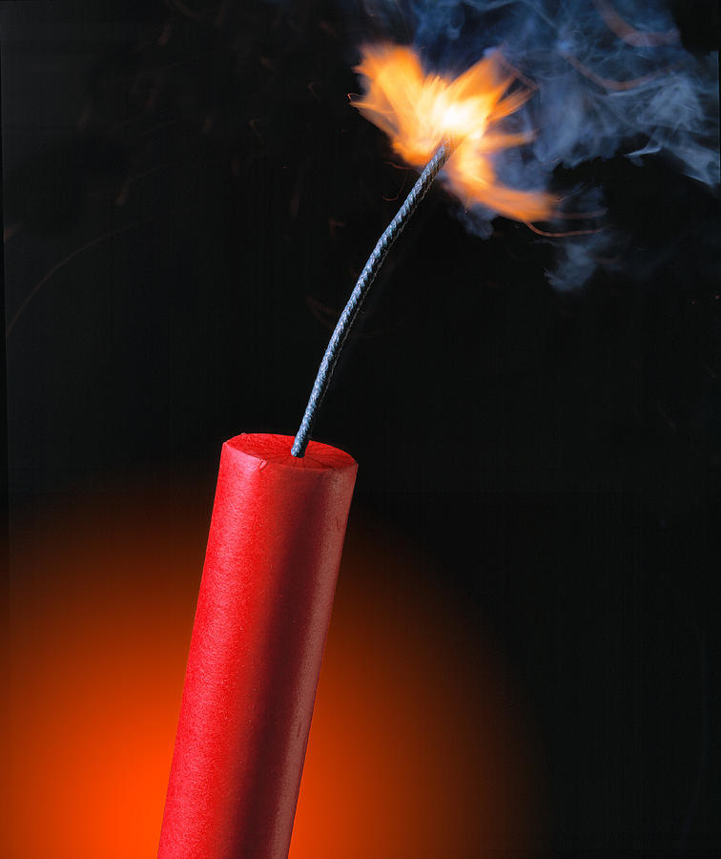
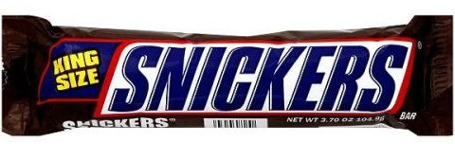
Energy v. Power
Let’s consider two things with nearly equivalent amounts of chemically-stored energy:
528 Calories
504 Calories

Slide 52
Does nearly equivalent energy mean similar power?
No!
Although the Snickers has slightly more energy content than the dynamite, it releases that energy over a much longer timescale.
Let’s assume a Snickers will give you energy for ~ 2 hours and that a stick of dynamite releases its energy in ~ 0.1 sec.

Slide 53
First, convert Calories to Joules:
E_{snickers} = 528 Cal x (^{1000 cal}/_{1 Cal}) x (^{4.184 J}/_{1 cal}) ≈ 2,200,000 J
E_{dynamite} = 504 Cal x (^{1000 cal}/_{1 Cal}) x (^{4.184 J}/_{1 cal}) ≈ 2,100,000 J
Now calculate power:
P_{snickers} = E_{snickers}/t = (2,200,000 J) / (7200 s) ≈ 300 W
P_{dynamite} = E_{dynamite}/t = (2,100,000 J) / (0.1 s) ≈ 21,000,000 W

Slide 54
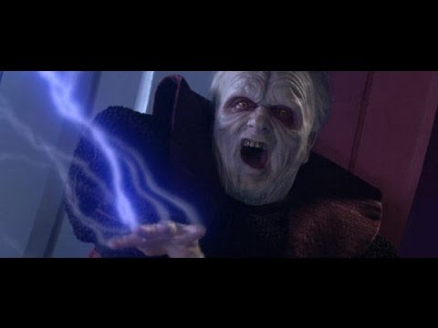
The rate at which work is done or energy is used or produced
UNLIMITED THE RATE AT WHICH WORK IS DONE OR ENERGY IS USED OR PRODUCED!!!

