Slide 1
AP Physics: Chapter 2
One-Dimensional Kinematics

Slide 2
Kinematics
Kinematics is the study of motion, unconcerned with the forces that are influencing that motion.
Today we will begin One-Dimensional Kinematics: The study of linear motion.
Soon we will expand to Two-Dimensional Kinematics, i.e. projectile motion.

Slide 3
How Far? Distance v. Displacement
Distance = scalar quantity indicating length of a path traveled. (“As the wolf runs.”)
Displacement = vector quantity indicating location (both magnitude and direction) relative to some reference point.

Slide 4
Example
You hike 4.0 km east, then 3.0 km north. What distance have you traveled, and what is your displacement, relative to where you started?
7.0 km is the distance you have traveled .
5.0 km, 37° north of east is your displacement relative to where you started.
5.0 km = [(4.0 km)²+(3.0 km)²]^{1/2}
3.0 km
37° = arctan (^{3.0 km}/_{4.0 km})
4.0 km

Slide 5
How fast? Speed v. Velocity
Just as distance and displacement are scalar and vector versions of answering “how far,” there are also vector and scalar versions for answering, “how fast?”
Speed = rate at which position changes with time
Velocity = speed in a given direction.
Examples: 35 mph is a speed; 35 mph north is a velocity.

Slide 6
How fast? Speed v. Velocity
What controls in a car allow the driver to change the car’s speed?
a.) Gas pedal
b.) Gas pedal, brakes
c.) Gas pedal, brakes, steering wheel
d.) Gas pedal, brakes, steering wheel, air conditioner knob

Slide 7
How fast? Speed v. Velocity
What controls in a car allow the driver to change the car’s speed?
a.) Gas pedal
b.) Gas pedal, brakes
c.) Gas pedal, brakes, steering wheel
d.) Gas pedal, brakes, steering wheel, air conditioner knob

Slide 8
How fast? Speed v. Velocity
What controls in a car allow the driver to change the car’s velocity?
a.) Gas pedal
b.) Gas pedal, brakes
c.) Gas pedal, brakes, steering wheel
d.) Gas pedal, brakes, steering wheel, air conditioner knob

Slide 9
How fast? Speed v. Velocity
What controls in a car allow the driver to change the car’s velocity?
a.) Gas pedal
b.) Gas pedal, brakes
c.) Gas pedal, brakes, steering wheel
d.) Gas pedal, brakes, steering wheel, air conditioner knob

Slide 10
Average v. Instantaneous Speed & Velocity
Average Speed is defined as total distance traveled divided by the total time:
v_{avg} = ^{d}/_{Δt}
Average Velocity is defined as total displacement divided by total time:
v_{avg} = ^{Δx}/_{Δt}

Slide 11
Average v. Instantaneous Speed & Velocity
Instantaneous Speed is one’s speed at a particular instant.
Instantaneous Velocity is one’s velocity at a particular instant.

Slide 12
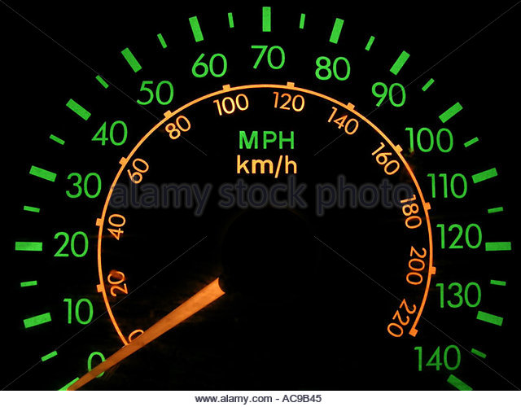
What does this dashboard indicator tell a driver?
a.) average speed
b.) average velocity
c.) instantaneous speed
d.) instantaneous velocity

Slide 13
What does this dashboard indicator tell a driver?
a.) average speed
b.) average velocity
c.) instantaneous speed
d.) instantaneous velocity

Slide 14
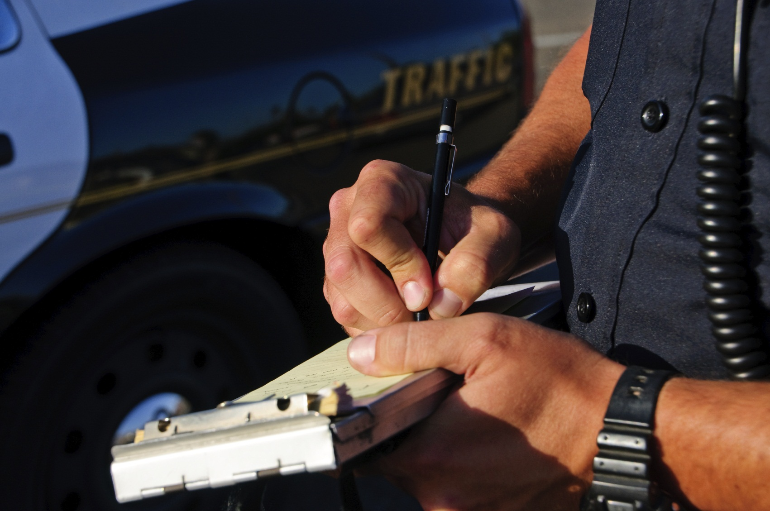
If you get a speeding ticket, is it because your instantaneous speed was too fast, or your average speed was too fast?

Slide 15
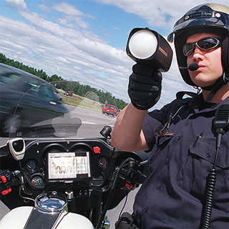
Usually, it’s because your instantaneous speed was too fast.

Slide 16
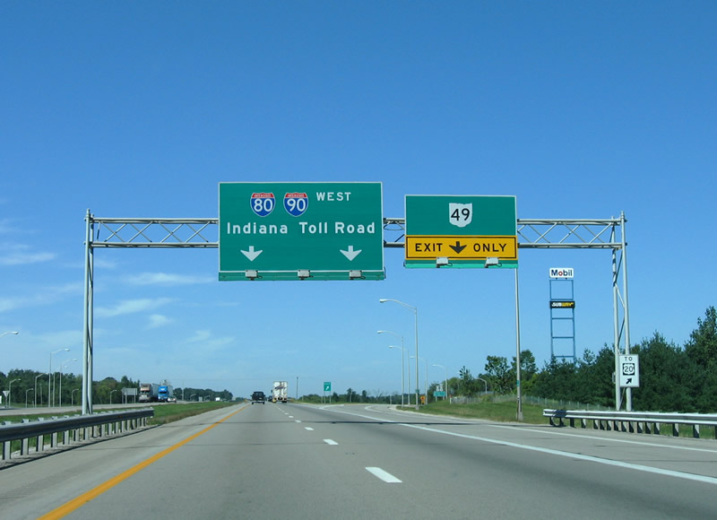
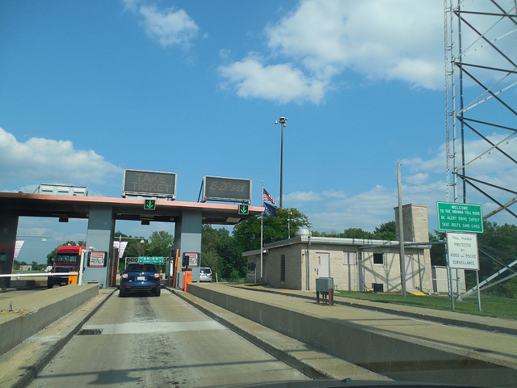
But on a toll road, you can get a ticket if your average speed exceeds the legal limit!

