Slide 1
Unit 2: Mechanics
Part 1B – Projectile Motion

Slide 2
1-D v. 2-D Motion
Consider two cue balls.
One is dropped from a particular height.
At the same moment, the other (identical) cue ball is launched horizontally from the same height.
Which one do you think will hit the ground first – the dropped ball, the horizontally launched ball, or will it be a tie?
Let’s find out!
https://www.youtube.com/watch?v=zMF4CD7i3hg

Slide 3
Projectile Motion
They hit at the same time!
The key to understanding projectile motion: Vertical movement is independent of horizontal movement!
Consider a cue ball dropped from a much larger height, say the edge of a 50-m tall cliff.
Let’s round a_{g} from 9.8 m/s² to 10 m/s² and calculate how far it should have fallen after the first several seconds.
If it’s simply dropped, v_{i} = 0. If you let s_{i} = 0 and plug in a = 10 m/s², then the formula for position s = s_{i} + v_{i}t + ½ at² becomes s = 5t².
t (s) | s (m)
0 | 0
1 | 5
2 | 20
3 | 45

Slide 4
t (s) | s (m)
0 | 0
1 | 5
2 | 20
3 | 45
10 m
20 m
Now imagine throwing the ball horizontally at, say, 15 m/s from the top of the cliff.
30 m
40 m
If there were no gravity, it would travel in a straight line, moving 15 m every second.
But, of course, there is gravity, so what path does the ball actually take?
Answer: A parabolic one.

Slide 5
Imagine firing a cannon.
Like all good cannons, of course, this one has a laser sight.
Ignoring gravity, let’s say here is where the cannonball would be after 1, 2, and 3 seconds.
3 s
Since there is gravity, the real cannon ball again will actually be 5 m, 20 m, and 45 m, respectively beneath these locations.
2 s
Again, the path is a parabola.
45 m
20 m
1 s
5 m

Slide 6
Keep Horizontal and Vertical Motion Separate
The key to understanding projectile motion: Vertical movement is independent of horizontal movement!
The most common mistake I see in projectile motion problems is mixing horizontal and vertical values into the same calculation.
A horizontal velocity has no business being plugged into the same equation as a vertical acceleration.
To avoid this common error I will do two things:
I will use x- and y-subscripts on all variables
I will color-code the vectors in my diagrams and variables in my equations: (X-Direction = RED; Y-Direction = BLUE)

Slide 7
Example Problem 1: (The simplest case - a projectile launched horizontally)
Someone accidentally throws their keys horizontally at 8.0 m/s off of a 62-m tall cliff overlooking the ocean
A) Where will the keys hit the water?
B) How fast will the keys be moving when they hit the water?
Step One: Draw a diagram illustrating the situation

Slide 8
Step Two: Given/Wanted Chart
v_{x} = 8.0 m/s
Given
Wanted
Only after we’ve put in all this time and thought are we ready to start doing calculations!
v_{x} = 8.0 m/s
A) Δs_{x}
s_{yi} = 62 m
t
a_{y} = -9.8 m/s²
B) v
s_{yi} = 62 m
s_{y} = 0 m
v_{y}
v_{yi} = 0 m/s
A) Let’s use vertical motion to find t:
s_{y} = s_{yi} + v_{yi}t + ½ a_{y}t²
0 m = 62 m + (0 m/s)t + ½ (-9.8 m/s²)t²
Δs_{x} = ?
0 m = 62 m – (4.9 m/s²)t²
t = 3.557 s
Now use horizontal motion to find Δs_{x}:
v = ?
v_{x} = s_{x} / t
s_{x} = v_{x} t = (8.0 m/s)(3.557 s) = 28.456 m ≈ 28 m

Slide 9
Step Two: Given/Wanted Chart
v_{x} = 8.0 m/s
Given
Wanted
Now we want to find the final velocity v.
This velocity will be the resultant of the horizontal and vertical velocities. We already know v_{x} Now we need to find v_{y}…
v_{x} = 8.0 m/s
A) Δs_{x}
s_{yi} = 62 m
t
a_{y} = -9.8 m/s²
B) v
s_{yi} = 62 m
s_{y} = 0 m
v_{y}
v_{yi} = 0 m/s
B) Let’s use vertical motion to find v_{y}:
v_{y} = v_{yi} + a_{y}t
v_{x}
v_{y} = (0 m/s) + (-9.8 m/s²)(3.557 s)
Δs_{x} = ?
v_{y} = 34.86 m/s
v_{y}
Now use the Pythagorean Theorem to find v:
v = ?
v² = v_{x}² + v_{y}² = (8.0 m/s)² + (34.86 m/s)²
v = 35.77 m/s ≈ 36 m/s

Slide 10
Example Problem 2: (A projectile launched at an angle)
A model rocket is launched with an initial velocity of 42.0 m/s, 58° above the horizontal.
How high will the model rocket go?
What will the rocket’s hang time be?
B) Where will the rocket land?
Step One: Draw a diagram illustrating the situation
(In the course of drawing the diagram, resolve the x- and y-components of the initial velocity.

Slide 11
v_{y} = 0 m/s @ top
v_{y} = v_{i}sin θ
= (42 m/s)(sin 58)
= 35.62 m/s
Given
Wanted
v_{i} = 42.0 m/s
s_{y,top}
θ = 58°
t_{rise}
v_{x} = 22.26 m/s
t_{hang}
v_{yi} = 35.62 m/s
s_{y} @ top = ?
v_{y,top} = 0 m/s
s_{x}
v_{i} = 42.0 m/s
a_{y} = -9.8 m/s²
θ = 58°
t
v_{x} = v_{i}cos θ =
(42 m/s)(cos 58)
= 22.26 m/s
B) v
v_{y}
s_{x} = ?
A) Start by finding rise time:
Now find vertical position at t = 3.635 s:
v_{y} = v_{yi} + at
( v_{y} = 0 when t = t_{rise} )
s_{y} = s_{yi} + v_{yi}t + ½ at²
0 m/s = 35.62 m/s + (-9.8 m/s²)t_{rise}
s_{y} = 0 m + (35.62 m/s)(3.635 s)
+ ½ (-9.8 m/s2)(3.635 s)²
t_{rise} = 3.635 s
s_{y} = 64.73 m ≈ 65 m

Slide 12
v_{y} = 0 m/s @ top
v_{y} = v_{i}sin θ
= (42 m/s)(sin 58)
= 35.62 m/s
Given
Wanted
v_{i} = 42.0 m/s
s_{y,top}
θ = 58°
t_{rise}
v_{x} = 22.26 m/s
t_{hang}
v_{yi} = 35.62 m/s
s_{y} @ top = ?
v_{y,top} = 0 m/s
s_{x}
v_{i} = 42.0 m/s
a_{y} = -9.8 m/s²
θ = 58°
t
v_{x} = v_{i}cos θ =
(42 m/s)(cos 58)
= 22.26 m/s
B) v
v_{y}
s_{x} = ?
B) Given the symmetry here, t_{hang} should = 2 t_{rise}:
t_{hang} = 2 t_{rise} = 2(3.635 s) = 7.27 s
C) Use horizontal motion to find s_{x}:
v_{x} = s_{x} / t
s_{x} = v_{x} t_{hang} = (22.26 m/s)(7.27 s) = 161.83 m ≈ 160 m

Slide 13
Checking your answer
Apply the formula s = s_{i} + v_{i}t + ½ at² to both x and y-directions:
s_{x} = s_{xi} + v_{xi}t + ½ a_{x}t² = 0 + (22.26 ms/)t + ½ (0 m/s²)t²
s_{x} = 22.26t
s_{y} = s_{yi} + v_{yi}t + ½ a_{y}t² = 0 + (35.62 ms/)t + ½ (-9.8 m/s²)t²
s_{y} = 35.62t – 4. 9t²
Let’s plug these equations into parametric mode on a TI grapher:

Slide 14
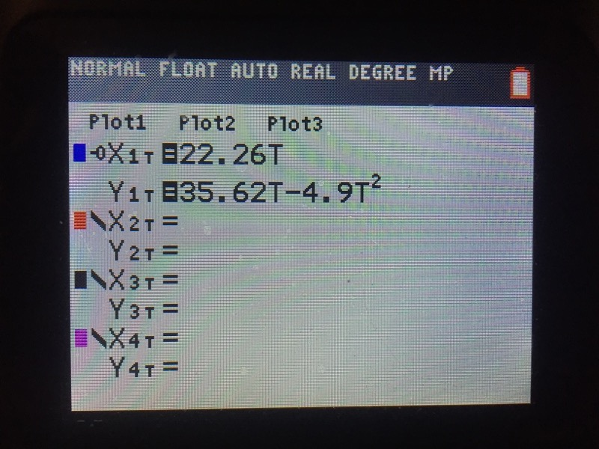

Slide 15
If we’re right, the model rocket starts at x = 0 and lands at x = 162.
If we’re right, the model rocket starts at y = 0 and peaks at y = 65.
If we’re right, the model will land at t = 7.27s.
Let’s hit “zoom” and set the range of x-values from 0 to 162 and the range of y-values from 0 to 65. If we’re right, the graph will almost exactly fit the screen.
Let’s also set the range of t-values from 0 to 7.26. If we’re right then the graph should stop just before hitting the x-axis.

Slide 16
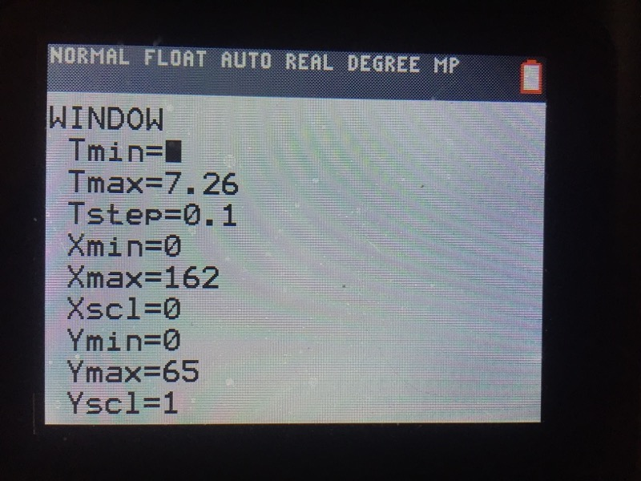

Slide 17
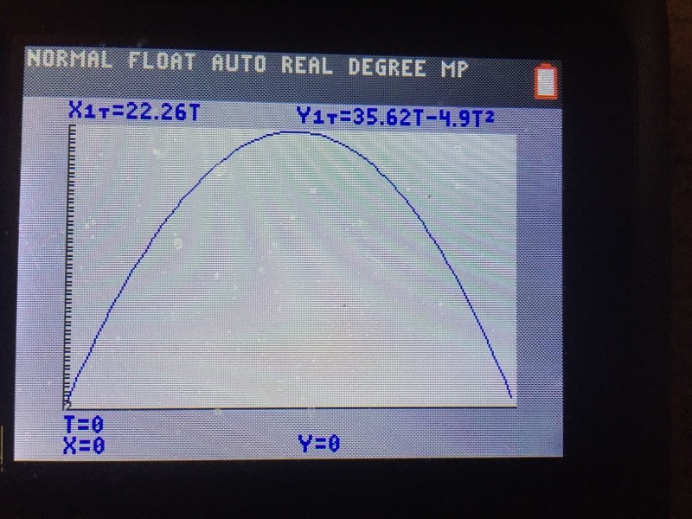

Slide 18
Example Problem 3: (A projectile launched at an angle; asymmetrical path)
A person standing 15.2 m from an 8.2-m tall flat building throws a tennis ball with an initial velocity of 23.0 m/s @ 45.0°. Where on the roof does the ball land?
Step One: Draw a diagram illustrating the situation
(In the course of drawing the diagram, resolve the x- and y-components of the initial velocity.

Slide 19
v_{y} = v_{i}/(√2)
= (23.0 m/s)/(√2)
= 16.26 m/s
Given
Wanted
v_{i} = 23.0 m/s
s_{x}
θ = 45°
t
v_{x} = 16.26 m/s
v_{yi} = 16.26 m/s
v_{i} = 38.0 m/s
s_{yi} = 0 m
8.2 m
s_{y} = 8.2 m
a_{y} = -9.8 m/s²
θ = 45°
t
v_{x} = v_{i}/(√2) = (23.0 m/s)/(√2)
= 16.26 m/s
?
15.2 m
A) Start by finding time:
s_{y} = s_{yi} + v_{yi}t + ½ at²
8.2 m = 0 m + (16.26 m/s)t + ½ (-9.8 m/s)t²
0 = -8.2 m + (16.26 m/s)t - (4.9 m/s)t²
Solve by graphing or using quadratic formula:
t = 0.620 s or t = 2.698 s

Slide 20
v_{y} = v_{i}/(√2)
= (23.0 m/s)/(√2)
= 16.26 m/s
Given
Wanted
v_{i} = 23.0 m/s
s_{x}
θ = 45°
t
v_{x} = 16.26 m/s
v_{yi} = 16.26 m/s
v_{i} = 38.0 m/s
s_{yi} = 0 m
8.2 m
s_{y} = 8.2 m
a_{y} = -9.8 m/s²
θ = 45°
t
v_{x} = v_{i}/(√2) = (23.0 m/s)/(√2)
= 16.26 m/s
?
15.2 m
A) Start by finding time:
Find horizontal position when t = 2.698 s:
s_{y} = s_{yi} + v_{yi}t + ½ at²
v_{x} = s_{x}/t
8.2 m = 0 m + (16.26 m/s)t + ½ (-9.8 m/s)t²
s_{x} = v_{x}t = (16.26 m/s)(2.698 s)
= 43.9 m
0 = -8.2 m + (16.26 m/s)t - (4.9 m/s)t²
Solve by graphing or using quadratic formula:
t = 0.620 s or t = 2.698 s
43.9 m – 15.2 m = 28.7 m from the
edge of the roof

