Slide 1
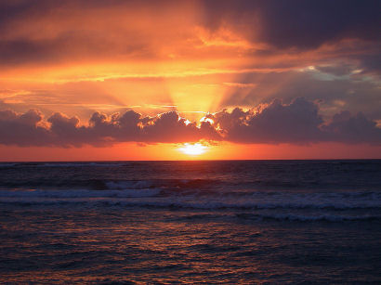
Astronomy
Lecture 3: The Sky, Part II – The Sun and the Ecliptic

Slide 2
Constellations of the Zodiac
As Earth orbits the Sun, the Sun passes in front of various constellations. For example, in November, the Sun obscures the constellation Scorpius.
The constellations that the Sun passes in front of over the course of a year are called the constellations of the zodiac.

Slide 3
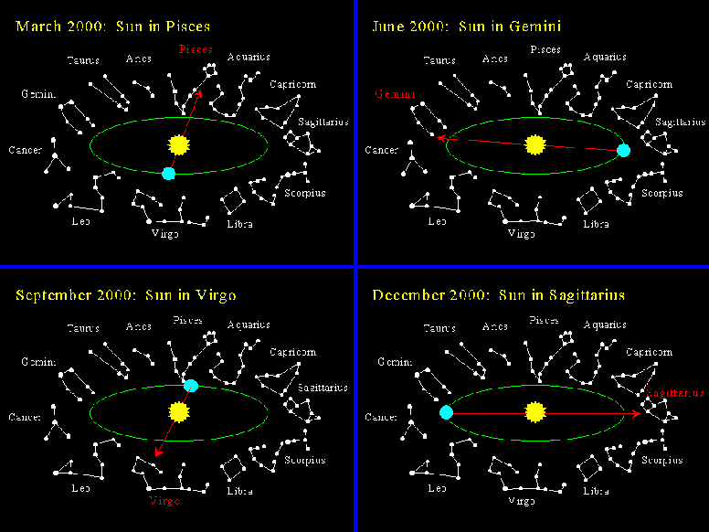

Slide 4
Oh, Phiuchus!
Over the course of a year the Sun passes in front of 13 constellations.
Astrologers do not recognize the constellation Ophiuchus as an official constellation of the zodiac, even though the Sun passes through this constellation every Nov. 30 – Dec. 17.

Slide 5
Changing View of the Night Sky
In different times of the year, we see different stars in the night sky.
In March, for example, the constellation Virgo is high in the sky at midnight.
However, in June (90 days later), Virgo is overhead at sunset (6 hours earlier), and the constellation sets around midnight.
Each successive night the stars rise (and therefore set) 4 minutes earlier:
(4 minutes/day) x (90 days) = 360 min = 6 hrs.
But why would this happen?

Slide 6
Solar Day vs. Sidereal Day
A Solar Day is the time it takes for the Earth to rotate once with respect to the Sun. This is the normal 24 hour day we know and love and the FOX Network bases action/suspense shows upon.
A Sidereal Day is the time it takes for the Earth to rotate once with respect to the background stars in space.
The answer to the 4 minute discrepancy hinges on the fact that Earth is undergoing two distinct movements through space:
Earth is orbiting the Sun.
Earth is rotating on its axis.
Both of these movements are counter-clockwise when viewed from above Earth’s North Pole.

Slide 7
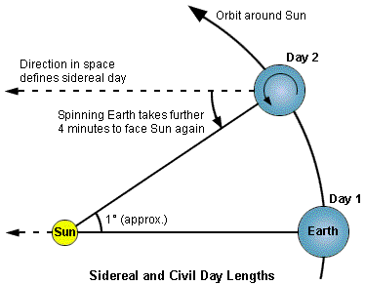
Let’s say at noon on Day 1, you start your stopwatch right when the sun is overhead, and when looking straight up, you’re looking not only in the direction of the Sun, but also straight left, as indicated in the below diagram.
By Day 2, the Earth has moved in its orbit around the Sun by about 1⁰. At 23:56 on your stopwatch, you look straight up, and once again,you’re facing left. One Sidereal day has passed.
However, due to the fact Earth’s moved in its orbit, it takes another 4 minutes for it to rotate the Sun back directly overhead. Only at 24:00 has a full Solar day passed.

Slide 8
The Sun and the Celestial Sphere
The distant stars keep the same Right Ascension and Declination coordinates over the course of time.
However, the Sun, Moon, and planets (the word ‘planet’ even means ‘wanderer’) do not.
If you were to map out the Sun’s path on the Celestial Sphere, what would it look like?

Slide 9
A Tilted Axis
Earth’s spin axis is tilted.
This is why the Earth experiences seasons. When the Northern Hemisphere is tilted toward the Sun, we get more direct sunlight (since the sun is higher in the sky) and the hours of daylight are longer. Hence we experience summer.
At the same time, the Southern Hemisphere experiences winter.
The tilt of Earth’s spin axis also influences the Sun’s path through the celestial sphere.
On the next slide, identify which positions represent summer, fall, winter, and spring. Also, try to determine where the Sun would be during each season – on the Celestial equator, in the Northern Celestial Hemisphere, or in the Southern Celestial Hemisphere.

Slide 10
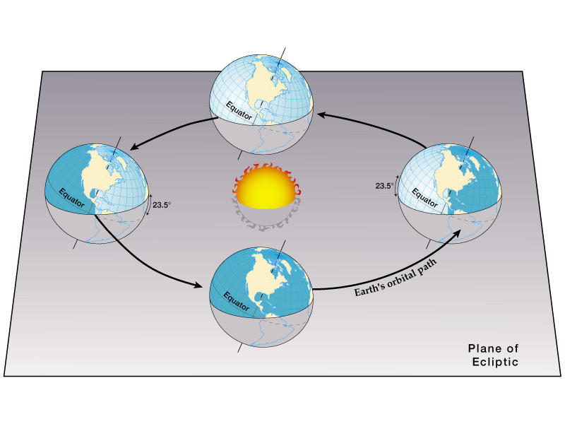

Slide 11
The Sun and the Celestial Sphere
On both the Vernal and Autumnal Equinoxes (the first days of Spring and Fall, respectively), an observer on Earth’s equator could look straight up at noon and see the Sun. Thus, on those days, the Sun lies on the Celestial Equator.
However, on the Summer Solstice (the first day of summer), the Sun lies in the North Celestial Hemisphere. And on the Winter Solstice, it lies in the Southern Celestial Hemisphere.
What are the declinations of the Sun on the first days of spring and fall?
0⁰, since the sun lies on the Celestial Equator on those dates.
What about on the Summer Solstice? Winter Solistice?
+23.5⁰ and –23.5⁰, respectively, since 23.5⁰ is the amount of Earth’s axial tilt.

Slide 12
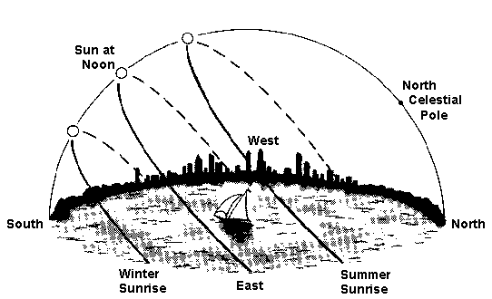

Slide 13
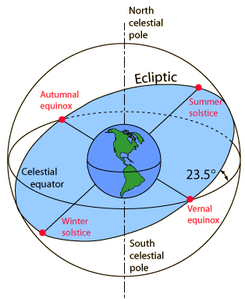
The Ecliptic
Over the course of a year, the Sun completes one full circle about the Celestial Sphere, rising into the North Celestial Hemisphere in the summer, and dipping into the South Celestial Hemisphere in the fall.
If you were to illustrate this path on the Celestial Sphere, it would look like this:
This path is called the Ecliptic.

Slide 14
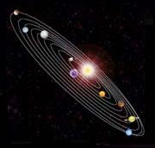
Planets and the Ecliptic
All of the planets’ orbits lie pretty much in the same plane. Thus the planets always appear near the ecliptic in the sky.
This is why planets only appear in constellations of the zodiac. The Sun never passes through the constellation Orion, so neither will Jupiter.

Slide 15
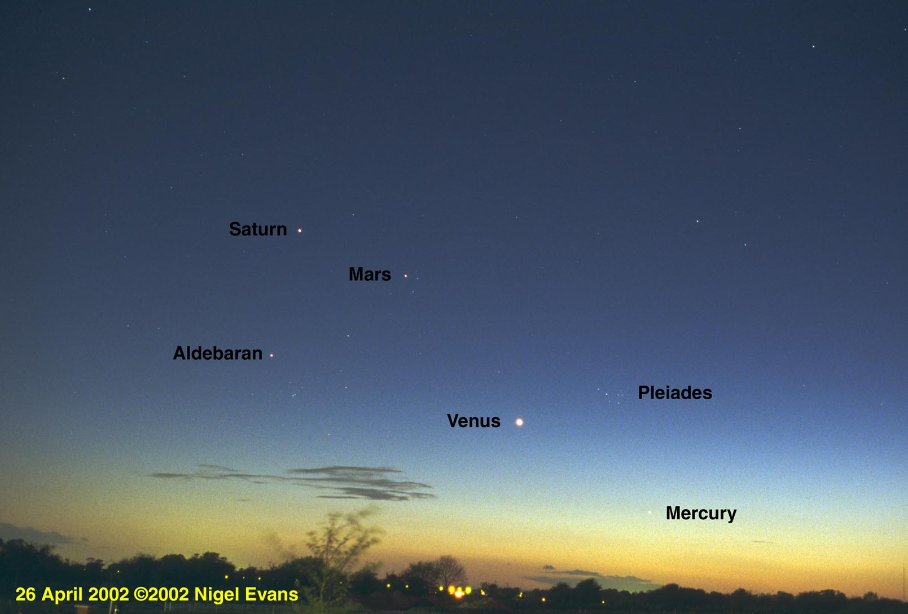

Slide 16
Retrograde Motion
Over the course of one night, one can observe a planet rise the east and set in the west, along with the rest of the stars.
However, over the course of weeks and months, planets wander with respect to the stars.
Usually, this movement is in a slow, west-to-east direction.
However, once in a while, a planet may switch directions and wander east-to-west with respect to the background stars.
This is called ‘retrograde motion’, and it was very difficult for ancient astronomers to explain!

Slide 17
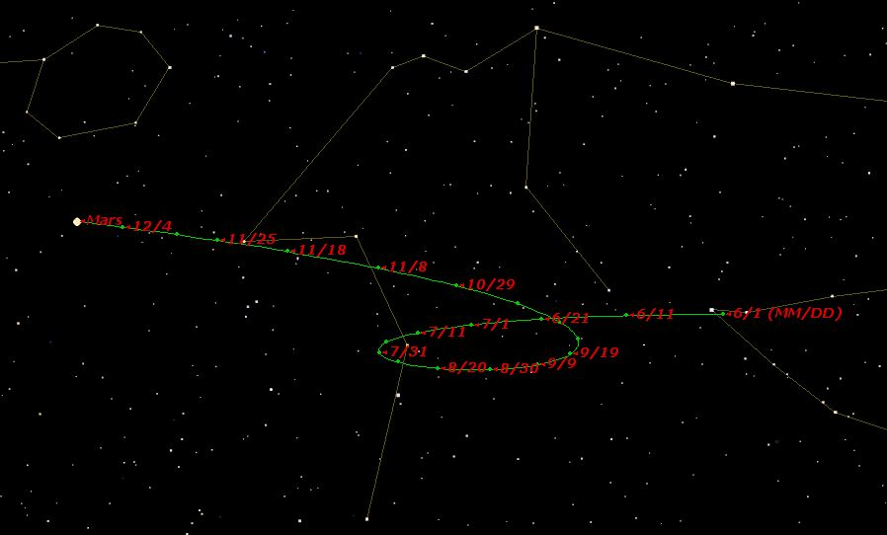
This is the path of Mars through the sky over the course of more than 5 months.

Slide 18
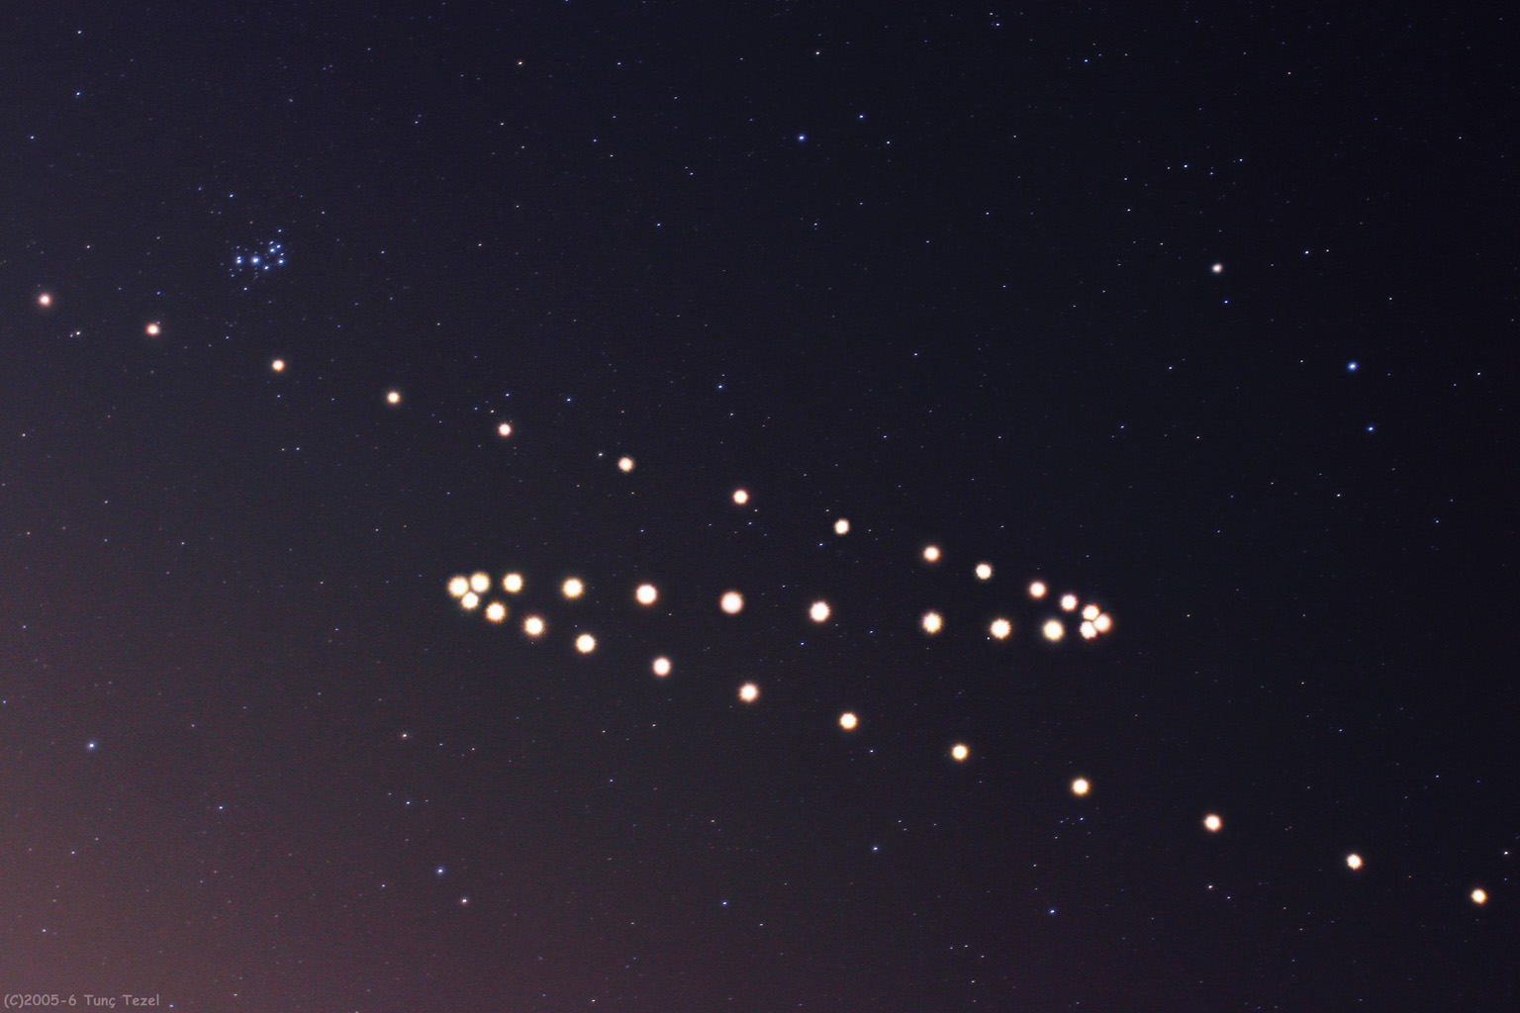
This image is the composite of photographs of Mars taken from July 2005 to February 2006.
We’re now ready for the worksheet: “The Sun, the Ecliptic, and the Celestial Sphere”

