Slide 1
Unit 3: Thermal Physics Part 1 – Thermal Concepts

Slide 2
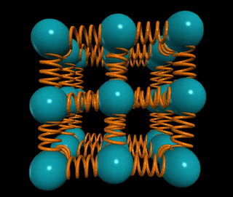
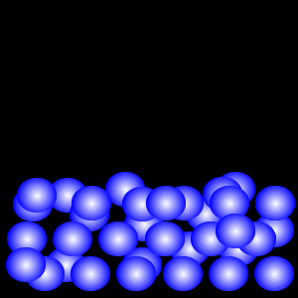
States of Matter
Solid: Particles are bound by bonds, though particles do wiggle and vibrate in place.
Liquid: The binding forces are weaker. The particles can slide around each other, but they can’t expand in volume
Gas: In a gas, the binding forces are even weaker. The particles expand away from each other to fill whatever container is available.

Slide 3
Moving Particles
In all 3 states, the particles are moving.
Thus they all have kinetic energy.
Thermal Energy (aka “Heat”): The sum total of the kinetic energies of all the particles in a body or sample.
Symbol: Q
Units: J (joules)
Temperature: A measure of the average kinetic energy of particles in a body or sample.
Symbol: T
Units: °C or K

Slide 4
Temperature Scales
 | Degrees Fahrenheit (°F) | Degrees Celsius (°C) | Kelvins (K)
Absolute Zero | -460° F | -273° C | 0 K
Freezing temperature of water | 32° F | 0° C | 273 K
“Room temperature” | 68° F | 20° C | 293 K
Boiling point of water | 212° F | 100° C | 373 K

Slide 5
Heat v. Temperature
Consider air in an oven set to 400° F and water in a pot boiling at 212° F on the stove.
Which is hotter? Which has more heat?
A. The oven is hotter and has more heat
B. The water is hotter and has more heat
C. The water is hotter; the oven has more heat
D. The oven is hotter; the water has more heat

Slide 6
Heat v. Temperature
Consider air in an oven set to 400° F and water in a pot boiling at 212° F on the stove.
Which is hotter? Which has more heat?
A. The oven is hotter and has more heat
B. The water is hotter and has more heat
C. The water is hotter; the oven has more heat
D. The oven is hotter; the water has more heat

Slide 7
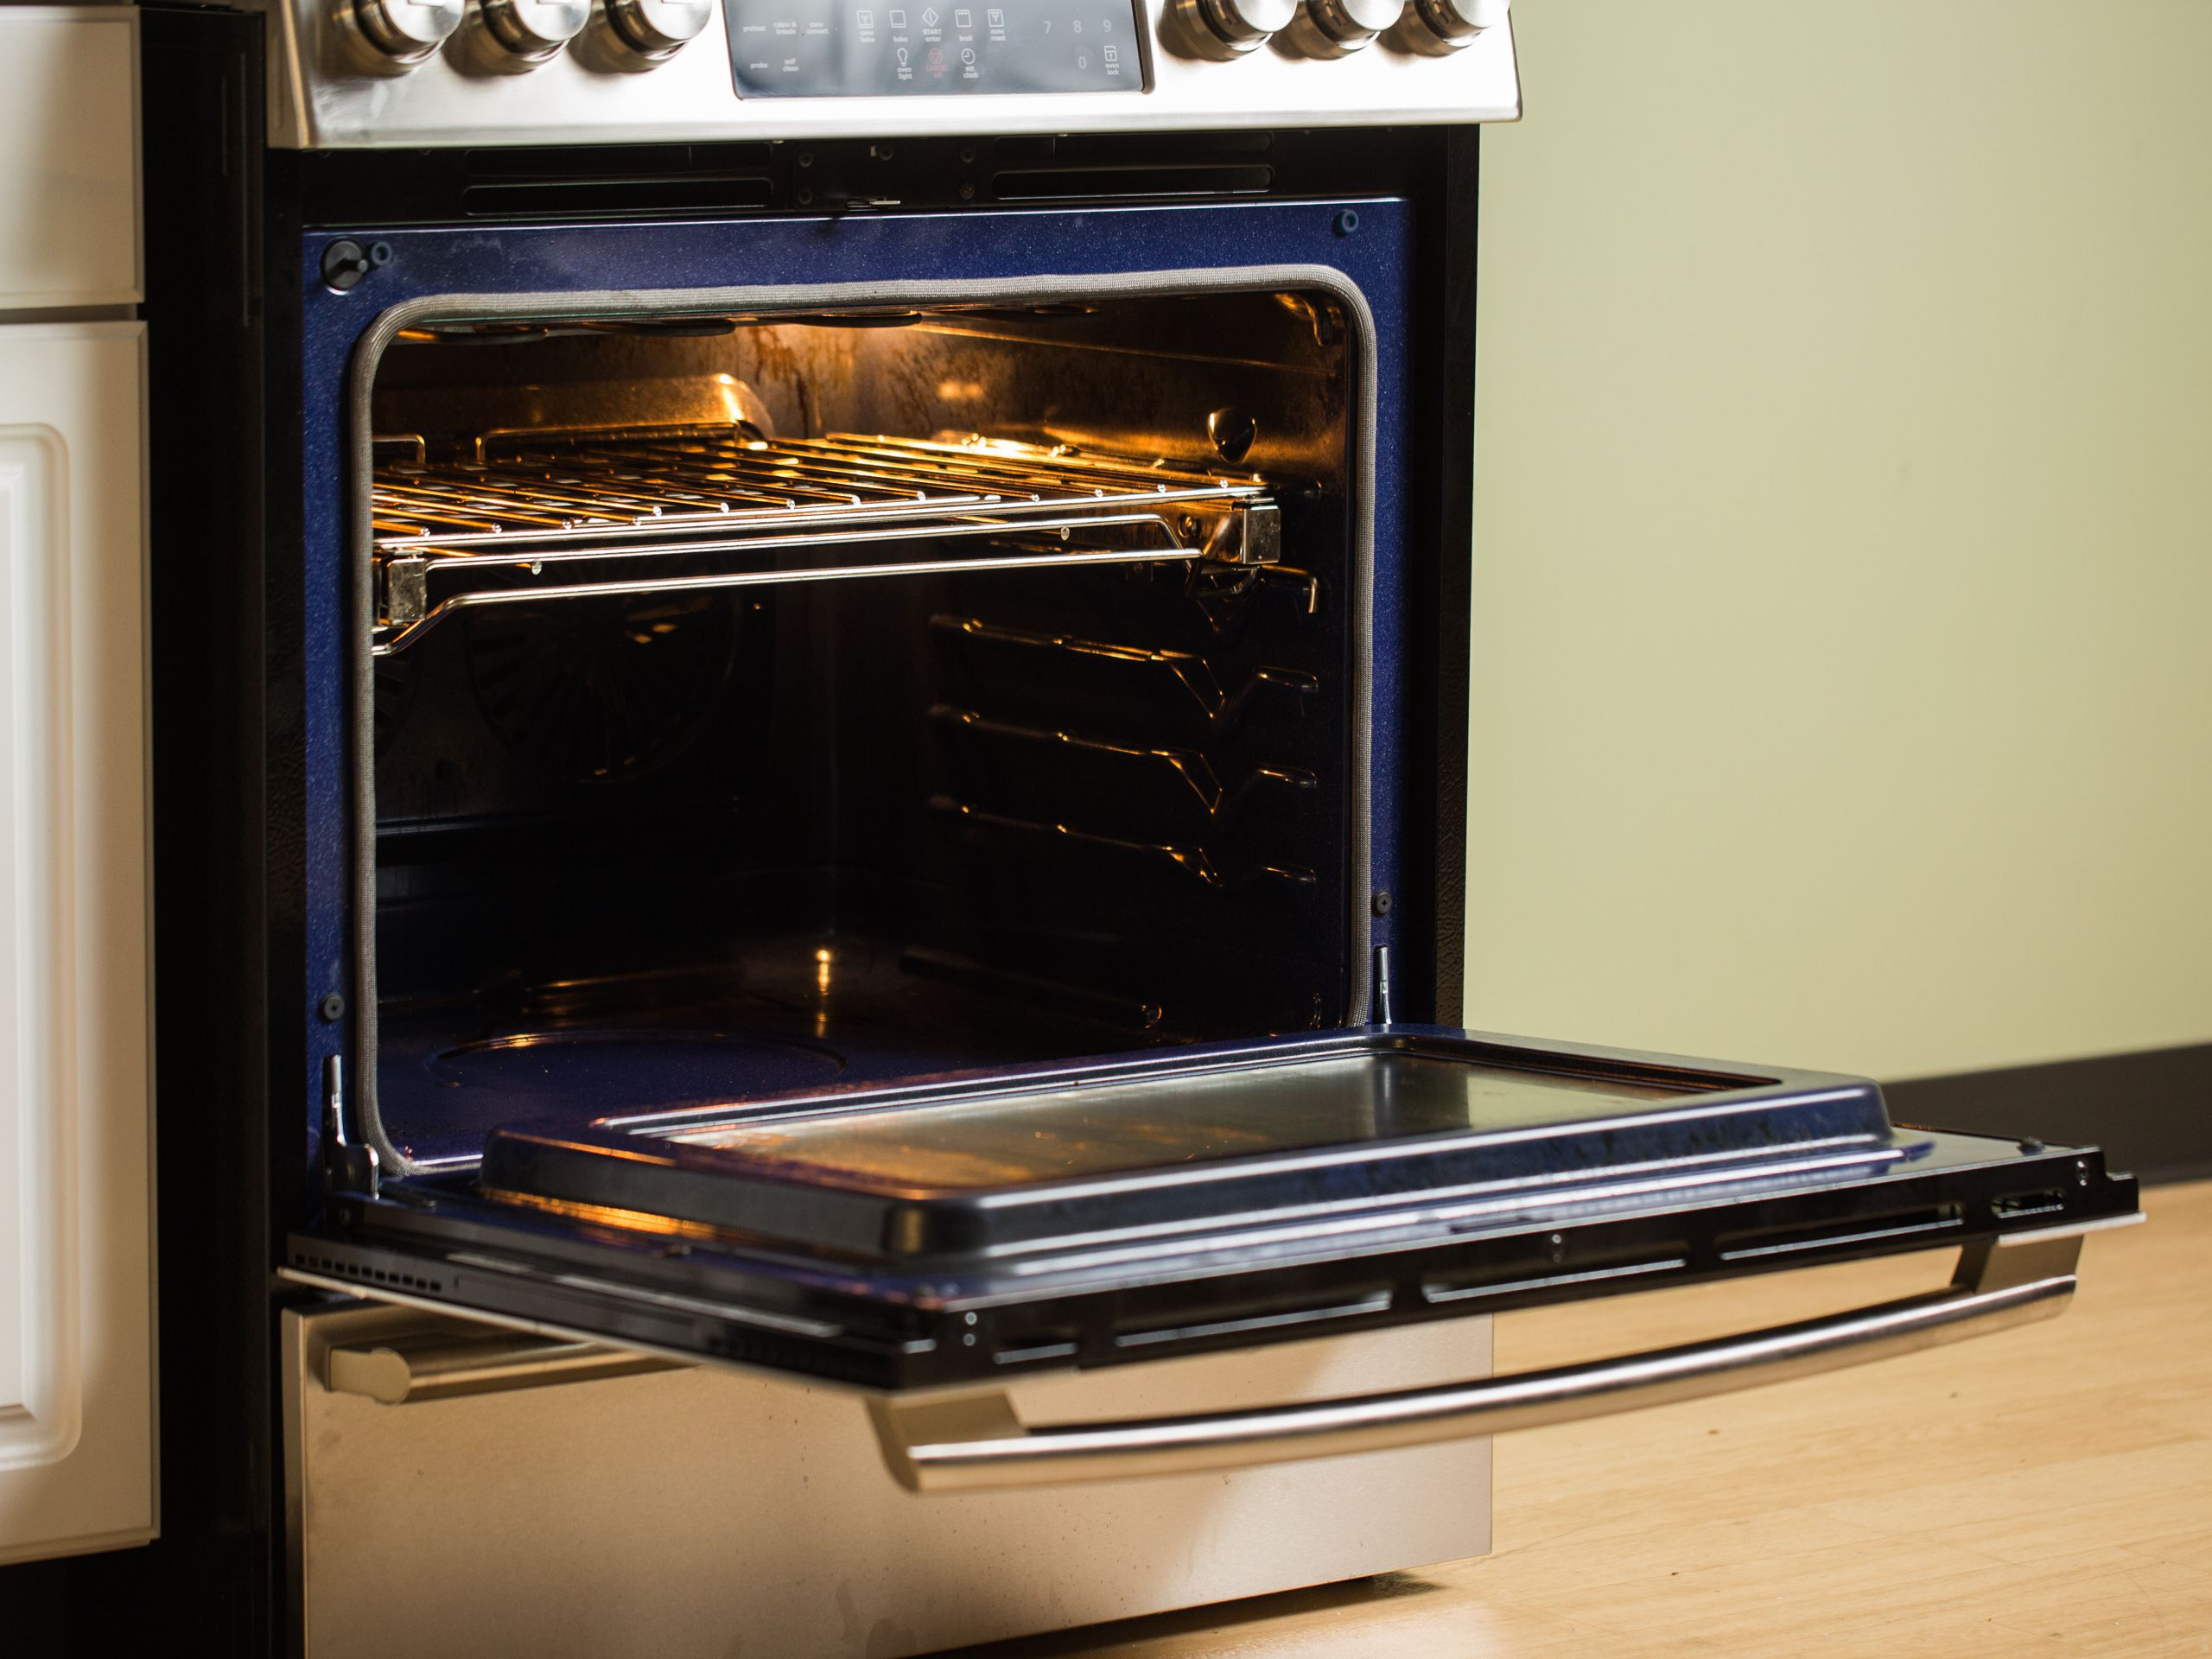
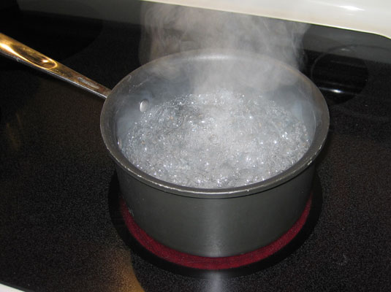
The Oven v. the Stove
The oven has a higher temperature than the water, so it’s hotter. This means the average individual particle in the air in the oven has more kinetic energy than the average individual molecule of water in the pot.
But there are a lot more molecules of water in the pot than there are particles of air in the oven. So while the average kinetic energy is higher in the oven, the total energy (and therefore heat) is greater in the water.

Slide 8
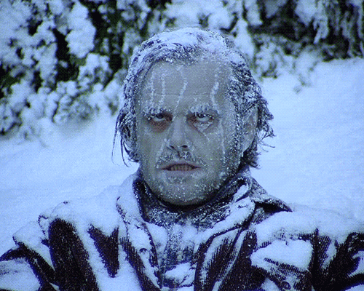
The corona of the Sun is a 1,000,000 K plasma
Yet someone right here would freeze to death because the particles in the corona are too few and far between

Slide 9
Thermal Equilibrium
When two objects of different temperature are brought together, thermal energy will flow from the hotter object to the cooler one until they reach the same temperature.
At this point, we say the system has reached thermal equilibrium.

Slide 11
When you change the thermal energy of a body, two things can happen:
Its temperature can change
Its phase can change.
If temperature changes:
The amount of thermal energy required to raise a mass m by a temperature ΔT is directly proportional to both m and ΔT:
Q ~ mΔT
Include a constant of proportionality to make this an equation:
Q = mcΔT
where c = “specific heat capacity”
Units: ^{J}/_{kg °C} or ^{J}/_{kg K}
Note: specific heat is a measure of how much energy it takes to heat 1 kg of a material by 1 °C

Slide 12
Specific Heat of Common Substances
Material | Specific Heat (J/kg K) | Material | Specific Heat (J/kg K)
Aluminum | 897 | Lead | 130
Brass | 376 | Methanol | 2450
Carbon | 710 | Silver | 235
Copper | 385 | Steam | 2020
Glass | 840 | Water (liquid) | 4180
Ice | 2060 | Zinc | 388
Iron | 450

Slide 13
If phase changes:
The amount of thermal energy required to change the phase of a mass m is directly proportional to m :
Q ~ m
Include a constant of proportionality to make this an equation:
Q = Hm
where H = H_{v} (“heat of vaporization”) , or
H = H_{f} (“heat of fusion”),
depending on what phase changes.
Units: ^{J}/_{kg} or ^{J}/_{kg}

Slide 14
Heats of Fusion and Vaporization of Common Substances
Material | Heat of Fusion (H_{f}) | Heat of Vaporization (H_{v})
Copper | 2.05 x 10⁵ | 5.07 x 10⁶
Mercury | 1.15 x 10⁴ | 2.72 x 10⁵
Gold | 6.30 x 10⁴ | 1.64 x 10⁶
Methanol | 1.09 x 10⁵ | 8.78 x 10⁵
Iron | 2.66 x 10⁵ | 6.29 x 10⁶
Silver | 1.04 x 10⁵ | 2.36 x 10⁶
Lead | 2.04 x 10⁴ | 8.64 x 10⁵
Water | 3.34 x 10⁵ | 2.26 x 10⁶

Slide 15
Example 1) How much energy does it take to heat 5.0 kg of ice from -12.0°C to 15°C?
Q_{total} = Q_{heat ice} + Q_{melt ice} + Q_{heat liquid water}
= mc_{ice}ΔT_{ice} + mH_{f} + mc_{liquid water}ΔT_{liquid water}
= (5.0 kg)(2200 J/kg°C)(12°C)
+ (5.0 kg)(334,000 J/kg)
+ (5.0 kg)(4180 J/kg°C)(15°C)
= 2,117,000J
≈ 2.2 MJ

Slide 16
Example 2) A copper bar with mass 285 g and temperature of 81°C is placed in a vat containing 785 g of water at 17°C. What’s the final temperature?
(Note default assumptions: No energy lost to surroundings; unless stated otherwise, assume containers incur negligible energy loss/gain)
Q_{lost by Cu} = Q_{gained by water}
m_{Cu}c_{Cu}ΔT_{Cu} = m_{water}c_{water}ΔT_{water}
(0.285 kg)(385 J/kg°C)(81°C – T_{final})
= (0.785 kg)(4180 J/kg°C)(T_{final} - 17°C)
Solve for T_{final}: 19°C

Slide 17
Example 3) 1.37 kg of molten lead at its melting point of 327°C is placed in a vat containing 6.20 kg of water at 15.0 °C. What is the final temperature once thermal equilibrium is reached?
(Note: There is a phase change this time)
Q_{lost by Pb} = Q_{gained by water}
Q_{freeze Pb} + Q_{cool Pb} = Q_{heat water}
m_{Pb}H_{f} + m_{Pb}c_{Pb}ΔT_{Pb} = m_{water}c_{water}ΔT_{water}
(1.37 kg)(23,000 J/kg) + (1.37 kg)(128 J/kg°C)(327°C – T_{final})
= (6.2 kg)(4180 J/kg°C)(T_{final} - 15°C)
Solve for T_{final}: 18.3°C

Slide 18
Student practice:
Example 4) How much heat is needed to change 3.00 x 10² g of ice at -30.0°C to steam at 130.0°C?
Example 5) A 100.0-g block at 100.0°C is placed in 100.0 g of water at 10.0°C. The final temperature after thermal equilibrium is reached is 25.9°C. Identify the material the block is made of.
Example 6) A 325-g iron block at 100.0°C is placed in a 181-g glass bowl containing 422 g of water at 8.0°C. What is the final temperature after everything has reached thermal equilibrium?
Example 7) A 71-g ice cube at -11.0°C is placed in a 325-g cup of water at 22.0°C. What is the final temperature?
Answers: 4) 940,000 J; 5) Aluminum; 6) 14.5°C; 7) 2.8°C

