Slide 1
GOAL SETTING
6th Grade Physical Education

Slide 2
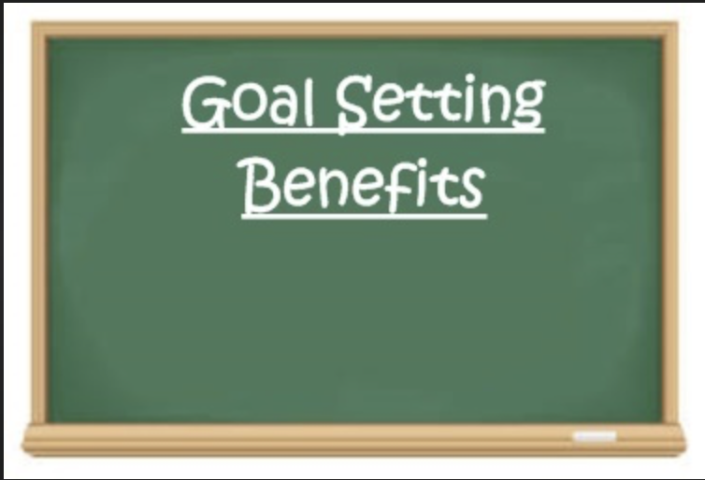

Slide 3
SELF EVALUATION

Slide 4
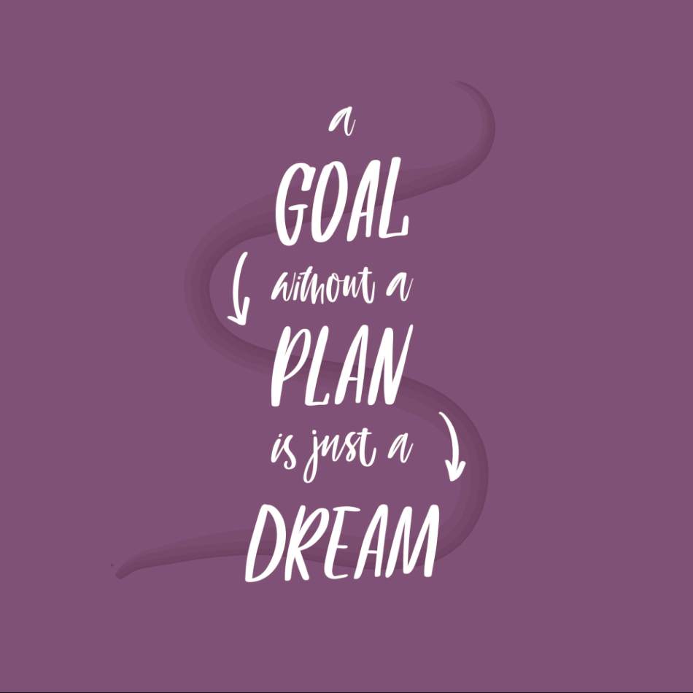
*fitness Test *Daily Run *Aerobic Run *Timed Mile *Exercise Room *Increase Strength *Increase skill in activity
Goal ideas

Slide 5
6th Grade Physical Education

Slide 11
SMART GOAL SETTING

