Slide 1
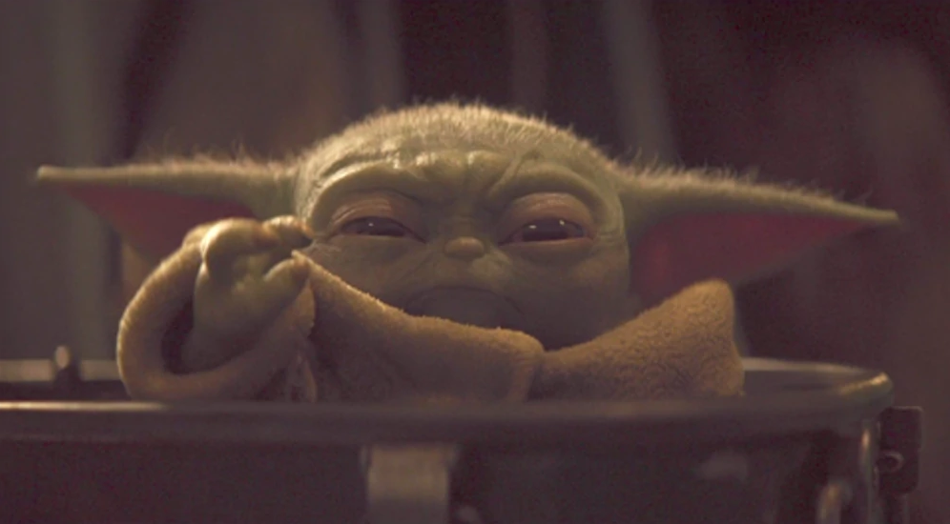
Unit 2: Mechanics
Part 2 – Force

Slide 2
Table of Contents
Defining Force
Units of Force; Mass v. Weight
Long Range Forces and “Force Fields”
Examples of Force
Newton’s Laws of Motion
Force Problem-Solving

Slide 3
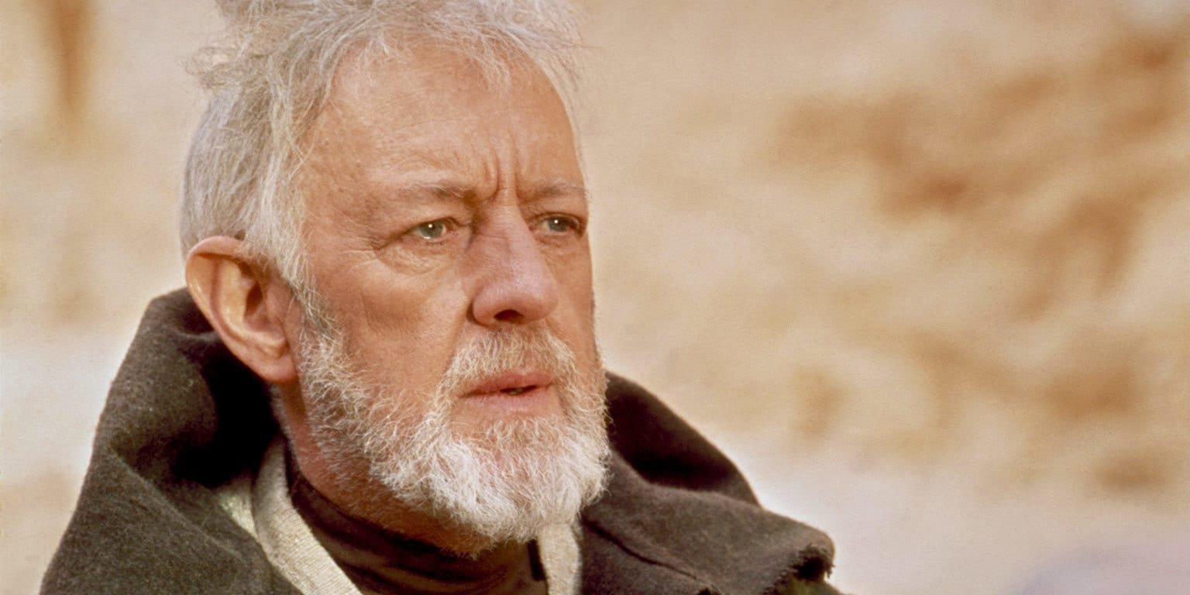
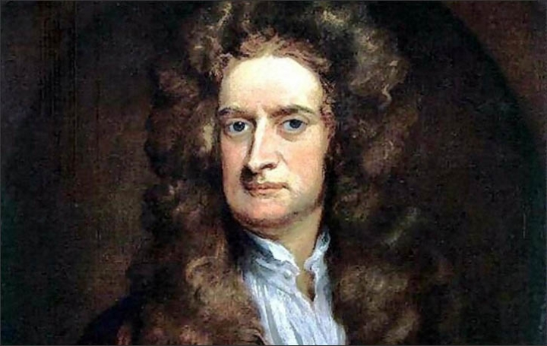
Force Defined
Nope! It is a push or pull that either causes or prevents acceleration!
It is an energy field created by all living things. It surrounds us… penetrates us… binds the galaxy together.

Slide 4
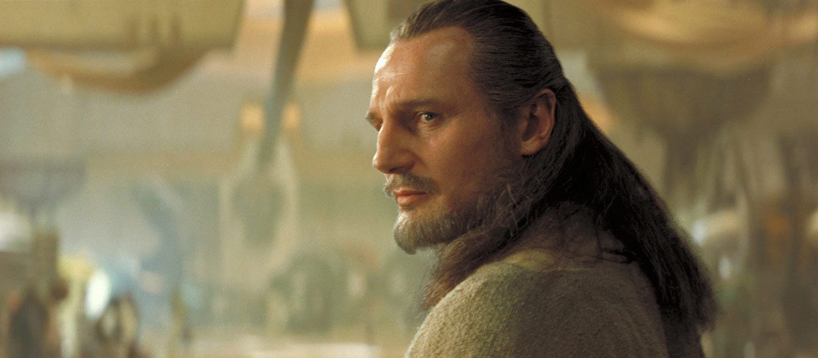
YES I’M SURE!!!
Are you sure it doesn’t have something to do with midichlorians?

Slide 5
About Force
Direction matters, so force is a vector.
The metric unit of force is the newton.
1 lb. ≈ 4.45 N

Slide 6
Contact v. Long Range Forces
Forces can be categorized as “contact forces” or “long range forces”
Examples of contact forces: pushing a wheelbarrow, pulling a sled with a rope, friction between two surfaces.
Examples of long-range forces include gravity, electrical attraction and repulsion, and magnets.

Slide 7
Long Range Forces & “Force Fields”
How can long-range forces work? (Sometimes this is called “spooky action at a distance”)
When an apple becomes dislodged from a branch, how does it “know” which way to fall?
An idea that made physicists comfortable with long-range forces: “Force fields”
A “force field” is a region in space where, if you possess the right property, you feel force.
For a “gravitational field”, this property is mass
Loose apples might not be in contact with the Earth, but they can be touching Earth’s gravitational field, which surrounds the planet.

Slide 8
Mass v. Weight
Mass is the amount of “stuff” an object is made of – it’s a measure of the amount of matter present.
Direction doesn’t apply, so it is a scalar quantity.
The SI (metric) unit for mass is the kilogram.
Weight is the amount of gravitational force acting on an object.
Since weight is an example of force, it is measured in newtons.
Note: WEIGHT IS NOT THE SAME THING AS MASS!!!
Weight depends not only on mass, but also the strength of the gravitational field present

Slide 9
Mass ≠ Weight
Consider a 70-kg person.
On Earth, they would weigh about 700 N (or about 150 lb).
Elsewhere in the Universe, where gravitational field strength is different, that person would weigh different amounts.
But since they’re always made out of the same amount of matter, their mass will always be the same!
Location | Mass | Weight
Earth | 70 kg | 700 N
The Moon | 70 kg | 120 N
Jupiter | 70 kg | 2100 N
Intergalactic void | 70 kg | 0 N

Slide 10
Don’t even use the word “convert”.
It’s common to acknowledge that mass and weight aren’t the same thing, but then talk about “converting” from one to the other.
This is an incorrect use of the term “convert”.
You can convert, for example, from miles to cm, since both are units of length, and the size of a cm relative to a mile never changes.
Similarly, you can convert from, say, days to seconds, since both are units of time, and the number of seconds in a day is a constant.
You cannot convert mass to weight since one is a measure of matter present and one is a measure of force due to gravity.
Sure, on Earth 60 kg weighs about 600 N, but that’s only on Earth!
What you can do is calculate mass given weight (or vice versa), but only if you also know gravitational field strength.

Slide 11
Gravitational Field Strength
In general, force field strength is defined as force felt per unit quantity that lets you feel that force.
For gravity, the property that lets you feel gravitational force is mass
So gravitational field strength is defined as gravitational force per unit mass:
g = ^{F}/_{m}
where g = gravitational field strength
F = an object’s weight in newtons
m = that same object’s mass in kg
You can experimentally determine that the gravitational field strength at the surface of the Earth is about 9.8 N/kg.

Slide 12
Gravitational Field Strength & Gravitational Acceleration
So the gravitational field strength at the surface of the Earth is about 9.8 N/kg.
That number seems awfully familiar…
Recall: acceleration due to gravity at the surface of the Earth is 9.8 m/s².
It is no coincidence that these two numbers are the same.
It turns out ( and we’ll see why when we discuss Newton’s 2nd Law) that gravitational acceleration is equivalent to gravitational field strength!

Slide 13
The Normal Force
Gravitational force (F_{g}) is just one example of a force.
Another is the “normal force”.
The normal force is the support force an object feels due to being pressed into a surface.
The word “normal” here refers to the geometrical definition: perpendicular to a surface.
I denote normal force F_{N}

Slide 14
Examples of the Normal Force
F_{N} =F_{g,perp} < F_{g}
F_{N} = F_{g}
For an object resting on an inclined surface, the normal force will be equal in magnitude to the perpendicular component of the gravitational force. (Note: there is less support from an inclined surface than a flat one, so F_{N} is smaller.
F_{g,perp}
For an object resting on a flat surface, the magnitude of the normal force equals the magnitude of the gravitational force.
F_{g}
F_{g}

Slide 15
Examples of the Normal Force
If someone is leaning on an object resting on a flat surface, the normal force is now greater in magnitude than the gravitational force since the object is being pressed more strongly into the surface.
F_{N,floor}
F_{N} > F_{g}
F_{N,wall}
If someone is leaning on the wall while also standing on the floor, they actually feel two normal forces.
F_{g}

Slide 16
Spring Force
Another example of a force is the “spring force”
Spring force = force due to the stretching or compressing of a spring away from an equilibrium position.

Slide 17
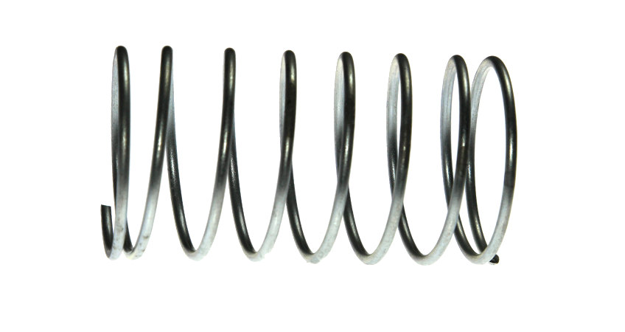
Consider a mass, resting on a frictionless surface, attached to a wall-mounted horizontal spring.
When at the equilibrium position, the spring exerts no force.
When compressed a bit to the left, the spring exerts a small force back toward the right.
F_{s}
x
F_{s}
When stretched considerably to the right, the spring exerts a substantial force back toward the left.
x

Slide 18
Hooke’s Law
Note: Spring force is always proportional to displacement, but in the opposite direction.
So, F_{s} ~ –x
Insert a constant of proportionality:
F_{s} = –kx
This equation is known as “Hooke’s Law”
k = “spring constant” and is a measure of how rigid the spring is.

Slide 19
Friction Forces
Friction Force is a force resisting motion due to two irregular surfaces attempting to slide past one another.
Dynamic Friction (aka “Kinetic Friction”) – denoted f_{d} – is a friction force resisting the continuation of motion.
Static Friction – denoted f_{s} – is a friction force resisting the commencement of motion.

Slide 20
Calculating Friction Force
The more an object is pressed into a surface, the more friction force it experiences: f ~ F_{N}
Include a constant of proportionality: f = μF_{N}
f_{d} = μ_{d}F_{N} f_{s} = μ_{s}F_{N}
μ_{d}= “coefficient of dynamic friction”
μ_{s}= “coefficient of static friction”
In both cases, μ (pronounced “myoo”) is a measure of how slick the meeting of two surfaces is. The larger the value of μ, the more friction force occurs.
It’s easier to keep something moving than it is to get something moving. In general, for the same two surfaces, μ_{s} > μ_{d}

Slide 21
Here are some of the other kinds of forces one may encounter…
Tension – denoted F_{T} – force due to being stretched or pulled in the context of a rope, string, or cable.
Thrust – denoted F_{thrust} – force due to the ejection of exhaust, such as with rockets.
Drag Force – denoted F_{Drag} – Force of resistance due to movement through a medium. The faster the speed, the greater the drag. Often modeled using the proportionalities F_{Drag} ~ v or F_{Drag} ~ v², depending on the object and the medium. (We’ve ignored this force when doing projectile calculations.)
Buoyant Force – denoted F_{Buoy} – upward force due to submersion in a fluid. Since pressure is stronger at greater depths, the force of the fluid pushing on a submerged object is greatest at the bottom. Thus the direction of the force is upward. (Note: The IB Physics text refers to buoyant force as “upthrust” even though it doesn’t have anything to do with thrust as described above.
Net Force – denoted F_{net} – the vector sum (i.e. resultant) of all the forces acting on a body.

Slide 22
Newton’s 3 Laws of Motion connect the ideas of force to the concepts of movement. Before we begin our study of these laws, let’s spend a little time on the man himself, Isaac Newton.

Slide 23
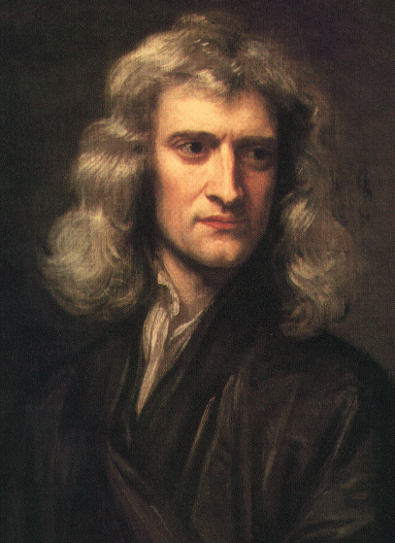
Sir Isaac Newton (1643-1727)
Born December 25, 1642
Or January 4, 1643
Arrogant, vindictive jerk
Loathed interacting with other people
Obsessed with alchemy, numerology, the occult, and biblical prophecy
Suffered from temporary insanity, possibly due to mercury poisoning
Arguably the most brilliant man who ever lived, he ushered mankind into a new era of mathematics and physics.
And, as a child, he once built a UFO

Slide 24
The more I have studied him, the more Newton has receded from me. It has been my privilege at various times to know a number of brilliant men, men whom I acknowledge without hesitation to be my intellectual superiors. I have never, however, met one against whom I was unwilling to measure myself, so that it seemed reasonable to say that I was half as able as the person in question, or a third or a fourth, but in every case a finite fraction. The end result of my study of Newton has served to convince me that with him there is no measure. He has become for me wholly other, one of the tiny handful of supreme geniuses who have shaped the categories of the human intellect, a man not finally reducible to the criteria by which we comprehend our fellow beings.
- Richard Westfall, biographer of Isaac Newton

Slide 25
Newton’s Contributions to Math & Science
Developed (Invented? Discovered?) calculus
Codified 3 Laws of Motion
Discovered Law of Universal Gravitation
Revolutionized understanding of light, color, and optics
Invented reflecting telescope
Developed Law of Cooling
Invented world’s tastiest fig cookies

Slide 26
Beyond Math & Science
Wrote more about the Bible than any other subject
Used scripture to calculate the earliest time the world would end: 2060
Member of Parliament
First scientist to be knighted
Ward of the Mint

Slide 27
Newton’s 1st Law
Newton’s 1st Law (The Law of Inertia): An object at rest will remain at rest, and an object in motion will remain moving in a straight line at constant speed unless acted upon by an external force.
Inertia – The tendency of an object to resist changes in velocity (i.e. tendency to resist acceleration).
Inertia is measured by mass.
Here’s a great video of a young Sheldon Cooper demonstrating the Law of Inertia with his train set:
https://www.youtube.com/watch?v=AA3l9joZfkw

Slide 28
Developing Newton’s 2nd Law
Lab/Demo Activity: Constant Mass, Changing Force
As mass is transferred from the cart to the end of the string, the force pulling on the end of the string increases, resulting in increasing acceleration of the cart along the table.
This experiment demonstrates that acceleration is directly proportional to force: a ~ F

Slide 29
Developing Newton’s 2nd Law
Lab/Demo Activity: Constant Force, Changing Mass
As mass is added to the cart, its acceleration decreases.
This demonstrates acceleration is inversely proportional to mass: a ~ ¹/_{m.}

Slide 30
Developing Newton’s 2nd Law
Acceleration is directly proportional to Force: a ~ F
Acceleration is inversely proportional to mass: a ~ ¹/_{m}
Therefore: a ~ ^{F}/_{m}
If a is measured in m/s², m in kg, and F in newtons, the constant of proportionality = 1.
a = ^{F}/_{m} , or F = ma

Slide 31
Newton’s 2nd Law
F_{net} = ma
Note: F_{net} and a are vectors pointing the same direction; m is a scalar multiplier
Note: The net force F_{net} represents the vector sum of all forces acting on a body.

Slide 32
Special Case: Gravity
F_{grav} = ma_{grav}
An object’s weight in newtons is equal to its mass in kg multiplied by by acceleration due to gravity 9.8 m/s² (assuming you’re on Earth).

Slide 33
Consistent Acceleration
Solving for a yields:
a_{grav} = F_{grav} / m
Note: you can’t increase the mass m of an object without also increasing the weight F_{grav} by the same factor. (For example, a rock that has 5 times the mass of another rock also weighs 5 times as much)
Thus the ratio of weight-to-mass will always equal the same value, and (absent air resistance) all objects will fall at the same rate

Slide 35
Equilibrium
Equilibrium is defined as the condition of having F_{net} = 0.
Does equilibrium mean acceleration is zero?
Yes! If F_{net} = ma, and F_{net} = 0 (and you have any mass at all), then a must = 0.
Does equilibrium mean velocity is zero?
No! Force goes hand-in-hand with acceleration, but not velocity.
If net force = 0, velocity must be constant, but it doesn’t have to be zero.

Slide 36
Terminal Velocity
An excellent example of a case where F_{net} = 0 but velocity doesn’t is terminal velocity.
When a skydiver jumps, they initially experience what is called “free fall”
Free fall = condition where the only (non-negligible) force present is gravity
In free fall, a = 9.8 m/s².
As the skydiver falls faster and faster, air drag becomes stronger and can no longer be ignored. As this happens, acceleration decreases
Eventually air drag is so strong that it balances the downward force of gravity.
At this point, acceleration is now 0, but the skydiver most definitely still has velocity!

Slide 37
Skydiver at Terminal Velocity
F_{Drag}
At terminal velocity, F_{drag} = F_{g}
Thus F_{net} = 0
Thus a = 0
But v ≠ 0 (If it were, every skydiver would start hovering and never land!)
Typical v_{Terminal} ≈ 120 mph (depending on the size, shape, and mass of the skydiver)
F_{g}

Slide 38
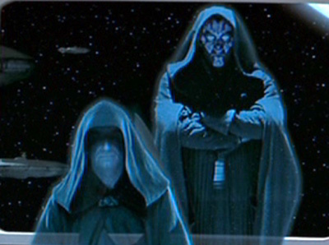
Newton’s 3rd Law
Most common wording:
“For every force there is an equal and opposite reaction force.”
A better, more precise, and less misleading wording:
“Whenever object A exerts a force on object B, object B simultaneously exerts a force back on object A, equal in magnitude, but opposite in direction”
Forces, therefore, always come in pairs.
Like the Sith, they are.
These forces are called “action/reaction pairs”

Slide 39
Implications of Newton’s 3rd Law
Why would using your fist to hit a brick wall with a force of 200 N hurt?
Because the wall would exert 200 N of force back on your hand!
Why would using your fist to hit a tissue with a force of 200 N not hurt?
Trick question! You can’t hit a tissue with that much force because the tissue isn’t physically capable of exerting 200 N of force back on you!

Slide 40
Implications of Newton’s 3rd Law
When you jump up into the air, which experiences the greatest force: you or the Earth?
By Newton’s 3rd Law, they experience the same force!
They why doesn’t the Earth rebound downward as much as you jump upward?
The answer: Newton’s 2nd Law!
Earth has much more mass, and therefore experiences much less acceleration than you do when you experience the same force.
F_{you on Earth} = F_{Earth on You}
But F = ma, so a_{Earth}m_{Earth} = a_{You}m_{You}

Slide 41
(a_{Earth})m_{Earth} = a_{You}(m_{You})

Slide 42
The Horse and Cart Problem
Here’s how the argument goes:
A horse pulls on a cart.
By Newton’s 3rd Law, the cart pulls back on the horse.
If these forces are equal and opposite, why don’t they cancel each other out?
And if they cancel out, how does the horse and cart move?
Here’s the answer to this paradox:
THEY DON’T CANCEL EACH OTHER OUT BECAUSE THE TWO FORCES ARE ON TWO DIFFERENT BODIES!
One force is on the cart; the other force is on the horse.
The only force that can cancel a force on a cart is another force on the cart.

Slide 43
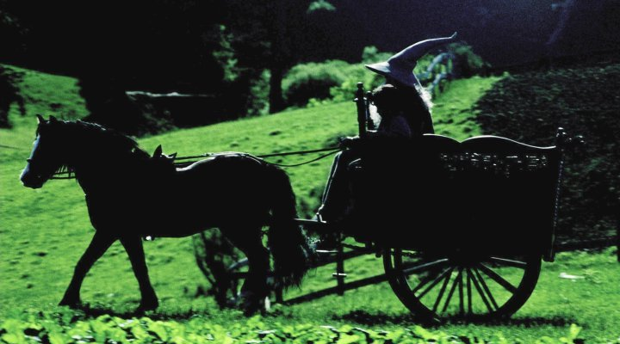
Let’s color code: Forces on cart = BLUE; Forces on horse = RED
Action-Reaction Pair
F_{Cart-on-horse}
F_{horse-on-cart}
F_{Ground}
F_{Friction}
F_{net, Horse} = F_{ground} – F_{Cart-on-horse}
F_{net, Cart} = F_{Cart-on-horse} - F_{Friction}

Slide 44
Now, if you consider the Horse/Cart system to be one body, you can ignore the action-reaction pair as internal forces.
Action-Reaction Pair
F_{Cart-on-horse}
F_{horse-on-cart}
F_{Ground}
F_{Friction}
F_{net, Horse/Cart System} = F_{Ground} – F_{Friction}

Slide 45
The Importance of Free-Body Diagrams
The key to problems connecting force and motion is the drawing of an accurate “free-body diagram”:
All forces on a body are drawn (roughly) to scale and labeled.
To the side, F_{net} is expressed in terms of the forces labeled in the diagram.
This formula for F_{net}, which is needed in order to correctly set up the problem is NOT a law of physics – it’s something that is situation-specific. You NEED to have drawn the diagram to get the right formula!
Once you know F_{net}, you can divide by mass to get acceleration, and it becomes a kinematics problem.

Slide 46
Examples
A) A child exerts a 36 N horizontal force as she pulls a 52-N sled across a sidewalk at a constant speed. What is friction force acting on the sled?
F_{normal}
Velocity = constant
implies
a = 0
implies
F_{net} = 0
implies
ΣF_{up} = ΣF_{down} and ΣF_{left} = Σf_{right}
so
F_{normal} = F_{grav} and F_{friction} = F_{pull}
F_{friction}
F_{pull}
F_{grav}

Slide 47
B) A mover exerts a 72 N horizontal force to accelerate a 26.1-kg oak cabinet across a pinewood floor. How long will it take to cross a 35-m long hallway?
F_{normal}
In this case,
F_{net} = F_{push} – F_{friction}
F_{friction}
F_{push}
F_{grav}

Slide 48
C) A thrust of 157 N accelerates a 9.5-kg model rocket upward. How much will it accelerate?
F_{thrust}
In this case,
F_{net} = F_{thrust} – F_{grav}
F_{grav}

Slide 49
D) What is the apparent weight of a 75-kg person in an elevator that’s accelerating up at 1.5 m/s²?
F_{Normal}
In this case,
F_{net} = F_{Normal} – F_{grav}
F_{grav}

Slide 50
If there are forces in multiple directions, it can help to color code the forces in the free body diagram
Example: A cart being pushed up an inclined plane:
F_{Normal}
F_{push}
F_{grav, ||}
F_{Net} = F_{push} – F_{grav, ||}
F_{grav, perp}
F_{grav}

Slide 51
The Next Steps…
After drawing the free body diagram and obtaining your relationship for net force…
… Make a given/wanted list. (Though sometimes you might want to work on your free-body diagram and given/wanted list at the same time)
Write any equation(s) you use out symbolically first
Solve for your unknown.
And as always, ask yourself “Does this answer make sense?” before boxing your final answer.
So let’s actually do some problems…

Slide 52
Ex E) What is the tension in the cable supporting a 535-kg elevator rising at a constant velocity of 1.7 m/s?
Given
Wanted
m = 535 kg
F_{T}
F_{T}
v = 1.7 m/s
a = 0 m/s²
F_{net} = 0 N means
F_{T} = F_{g}
F_{net} = 0 N
g = 9.8 m/s²
F_{T} = F_{g}
F_{T} = mg
F_{T} = (535 kg)(9.8 m/s²)
F_{T} = 5243 N ≈ 5200 N
F_{grav}

Slide 53
Ex F) What is the tension in the cable supporting the same elevator if it next slows to a halt over the course of 1.3 s?
Rising and slowing down means the acceleration vector is pointing down.
Given
Wanted
m = 535 kg
F_{T}
F_{T}
t = 1.3 s
F_{net}
F_{T}
Since a points downward, F_{net} should too.
g = 9.8 m/s²
a
v_{i} = 1.7 m/s
v = 0 m/s
F_{net}
= F_{g} – F_{T}
So our plan is to use kinematics to find a.
Then use Newton’s 2nd Law to find F_{net}.
Then use the formula we got from our free body diagram to find F_{T}.
Since F_{net} points downward, Fg should be drawn longer than F_{T}.
F_{net} must be the difference between F_{g} and F_{T}.
F_{g}

Slide 54
Ex F) What is the tension in the cable supporting the same elevator if it next slows to a halt over the course of 1.3 s?
Given
Wanted
First, find acceleration using kinematics:
v = v_{i} + at
a = (v-v_{i})/t = (0 – 1.7 ^{m}/_{s})/(1.3 s)
a = -1.308 m/s²
Next, use magnitude of acceleration and Newton’s 2nd Law to find F_{net}:
F_{net} = ma = (535 kg)(1.308 m/s²) = 699.6 N
m = 535 kg
F_{T}
F_{T}
t = 1.3 s
F_{net}
F_{T}
g = 9.8 m/s²
a
v_{i} = 1.7 m/s
v₀ = 0 m/s
F_{net}= F_{g} – F_{T}
F_{g}
Finally, find F_{T} using the equation from our free-body diagram:
F_{T} = F_{g} – F_{net} = mg – F_{net} = (535 kg)(9.8 m/s²) – 699.6 N = 4500N

Slide 55
Ex G) A 3.7-kg underwater camera is held in place by a cable attached from above. If there’s a 12-N buoyant force, what’s the tension in the cable?
Given
Wanted
F_{net} = 0 N
means
Σ F_{up} =Σ F_{down}
which means
F_{T} + F_{Buoy} = F_{g}
m = 3.7 kg
F_{T}
F_{T}
F_{Buoy} = 12 N
F_{Buoy}
g = 9.8 m/s²
F_{T} + F_{Buoy} = F_{g}
F_{T} = F_{g} - F_{Buoy}
F_{T} = mg - F_{Buoy}
F_{T} = (3.7 kg)(9.8 m/s²) – 12 N
F_{T} = 24.26 N ≈ 24 N
F_{grav}

Slide 56
Ex H) How long will it take a skier, starting from rest, to go down the first 100.0 m of a hill sloped at 23° if the coefficient of dynamic friction = 0.15?
F_{Net} = F_{g, ||} – f_{d}
F_{N}
Given
Wanted
f_{d}
θ = 23°
t
s_{i} = 0 m
a
F_{g, ||}
s = 100 m
F_{net}
F_{g, perp}
θ
μ = 0.15
θ = 23°
g = 9.8 m/s²
θ
F_{g}

Slide 57
Ex H) How long will it take a skier, starting from rest, to go down the first 100.0 m of a hill sloped at 23° if the coefficient of dynamic friction = 0.15?
F_{net} = F_{g,||} – f_{d}
F_{net} = F_{g,||} – μF_{N}
F_{net} = F_{g,||} – μF_{g,perp}
F_{net} = F_{g}sin θ – μF_{g}cos θ
F_{net} = mg sin θ – μmg cos θ
F_{net} = mg(sin θ – μ cos θ)
ma = mg(sin θ – μ cos θ)
a = g(sin θ – μ cos θ)
a = (9.8 m/s²)(sin 23 – 0.15 cos 23)
a = 2.476 m/s²
F_{net}
F_{N}
f_{d}
F_{g, ||}
F_{g, perp}
θ
θ = 23°
θ
F_{g}

Slide 58
Ex H) How long will it take a skier, starting from rest, to go down the first 100.0 m of a hill sloped at 23° if the coefficient of dynamic friction = 0.15?
a = 2.476 m/s²
s = s_{i} + v_{i}t + ½ at²
But s_{i} and v_{i} both = 0, so
s = ½ at²
Solve for t:
t = √(2s/a)
t = √(2×100 m/2.4716 m/s²)
t = 9.0 s
F_{net}
F_{N}
f_{d}
F_{g, ||}
F_{g, perp}
θ
θ = 23°
θ
F_{g}

Slide 59
Solving Multi-Body Problems
Some problems may involve more than one object connected together, and you may be asked to calculate the internal force between two of those bodies.
In problems like this:
Treat the system as a whole and use a free-body diagram to determine the acceleration of the whole system.
Know that each part of the system has the same acceleration, but now consider only one body in the system. Draw another free body diagram focused just on this object.

Slide 60
Ex I) A 142-N pulling force is applied as shown to a series of crates connected by ropes. If the coefficient of dynamic friction is 0.25, what is the tension between crates B and C?
A
20.0 kg
B
10.0 kg
C
50.0 kg
First, consider the system as a whole:
F_{net} = F_{pull} – f_{d}
F_{net} = F_{pull} – μF_{N}
F_{net} = F_{pull} – μF_{g}
F_{net} = F_{pull} – μmg
ma = F_{pull} – μmg
(35 kg)a = 142 N – 0.25(35 kg)(9.8 m/s²)
a = 1.607 m/s²
F_{N}
35.0 kg
f_{d}
F_{pull}
F_{g}

Slide 61
Ex I) A 142-N pulling force is applied as shown to a series of crates connected by ropes. If the coefficient of dynamic friction is 0.25, what is the tension between crates B and C?
A
20.0 kg
B
10.0 kg
C
5.0 kg
Second, consider just Crate C:
a = 1.607 m/s²
F_{net} = F_{pull} – f_{d} – F_{T}
F_{T} = F_{pull} – f_{d} – F_{net}
F_{T} = F_{pull} – μmg – ma
F_{T} = 142 N – 0.25(5 kg)(9.8 m/s²) – (5 kg)(1.607 m/s²)
F_{T} = 120 N
F_{N}
5.0 kg
F_{T}
f_{d}
F_{pull}
F_{g}

Slide 62
Ex J) A 12-kg box is resting on top of 27-kg crate. The crate is pulled with a force of 221 N. If the coefficient of dynamic friction is 0.17, what is the minimum coefficient of static fiction between the crate and the box if the box doesn’t fall off?
F_{N}
F_{net} = F_{pull} – f_{d}
F_{net} = F_{pull} – μF_{N}
F_{net} = F_{pull} – μF_{g}
ma = F_{pull} – μmg
(39 kg)a = 221 N – 0.15(39 kg)(9.8 m/s²)
a = 4.20 m/s²
A
12 kg
B
27 kg
f_{d}
F_{pull}
F_{g}
First, consider the system as a whole.

Slide 63
Ex J) A 12-kg box is resting on top of 27-kg crate. The crate is pulled with a force of 221 N. If the coefficient of dynamic friction is 0.17, what is the minimum coefficient of static fiction between the crate and the box if the box doesn’t fall off?
Second, consider the box on top only:
a = 4.20 m/s²
F_{net} = f_{s}
ma = μmg
a = μg
μ = a/g = (4.2 m/s²)/(9.8 m/s²)
μ = 0.43
F_{N}
f_{s}
A
12 kg
F_{g}

