Slide 1
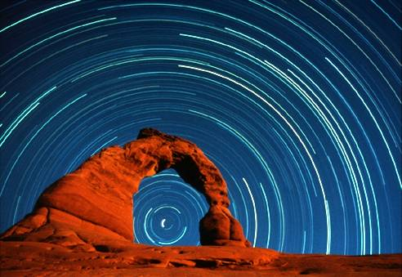
Astronomy
Lecture 2: The Sky, Part I – The Celestial Sphere

Slide 2
Constellations
A constellation is a specific grouping of stars in the sky.
The International Astronomical Union (IAU) has officially divided the sky into 88 constellations. Most of them Greek in origin (with some Egyptian and Chinese among others as well).
Here are some examples of constellations…

Slide 3
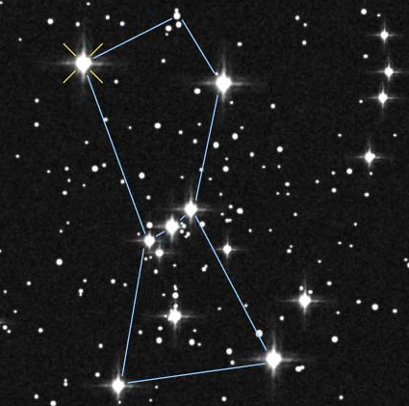
Orion, the Hunter
Easy to spot in the evening sky in the Northern Hemisphere in Fall & early Winter

Slide 4
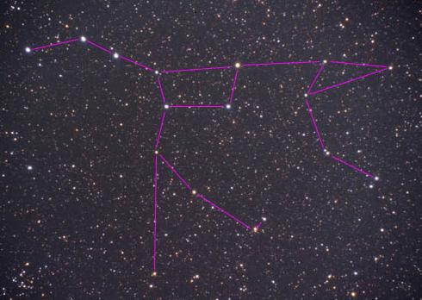
Ursa Major, the Great Bear
Prominent constellation in the northern hemisphere

Slide 5
Star names
Most bright stars’ names are Arabic in origin (Algol, Betelgeuse, for example).
Stars are also named for the constellation they are in, and how bright they are.
Deneb, the brightest star in the constellation Cygnus, is also known as Alpha Cygni (α Cyg), since it is the brightest star in the constellation. The second brightest star is Beta Cygni (β Cyg), and so on.

Slide 6
Asterisms
An asterism is an easily recognized pattern of stars.
An asterism can be part of a constellation, or it can be composed of stars from more than one constellation.
Here are some examples of some asterisms…

Slide 7
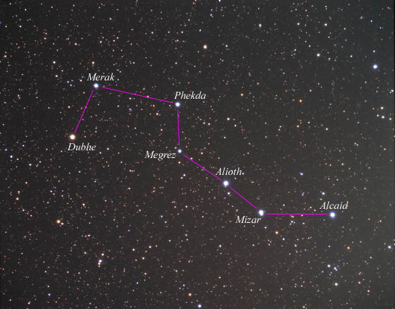
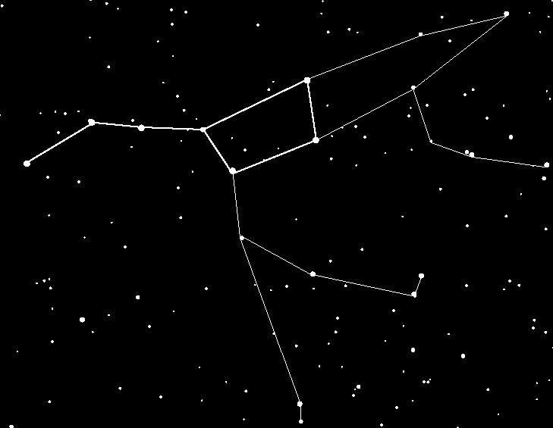
The Big Dipper
The Big Dipper is not a constellation at all – it is a section of the constellation Ursa Major.

Slide 8
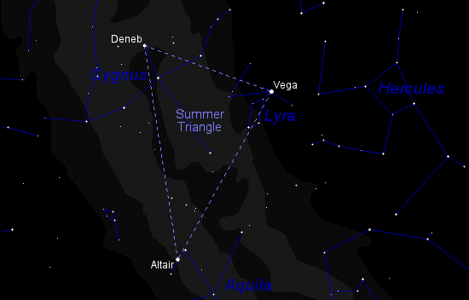
The Summer Triangle
The stars of the Summer Triangle, visible in the Northern Hemisphere on summer evenings, are Vega, Deneb, and Altair, the brightest stars in the constellations Lyra, Cygnus, and Aquilla, respectively.

Slide 9
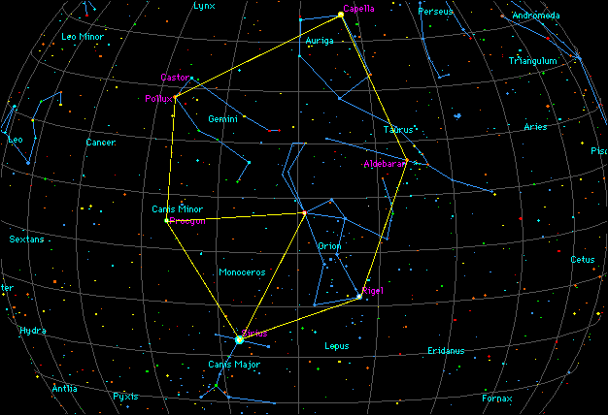
The Winter Hexagon
The stars of the Winter Hexagon: Rigel, Sirius, Procyon, Pollux, Capella, and Aldebaran belong to the constellations Orion, Canis Major, Canis Minor, Gemini, Auriga, and Taurus, respectively.

Slide 10
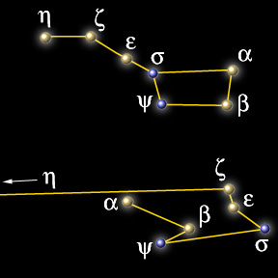
Star in Constellations
In general, stars in the same constellation or asterism are not close together. Some are much farther from Earth than others. They only appear to be close from our point of view.
From a different point of view, the stars that make up the Big Dipper, for example, would look quite different.

Slide 11
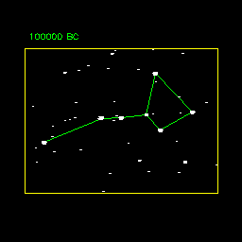
Stars in Motion
Constellations and asterism will not last forever. Their shapes change with time due to the motion of the stars.

Slide 12
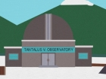
AND NOW A FEW SLIDES ABOUT THE CONSTELLATIONS FROM THE PLANETARIUM AT THE TANTALUS V. OBSERVATORY…

Slide 13
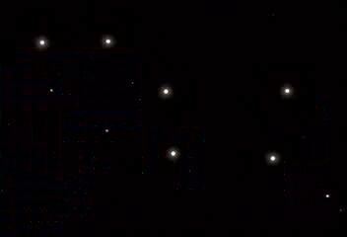

Slide 14
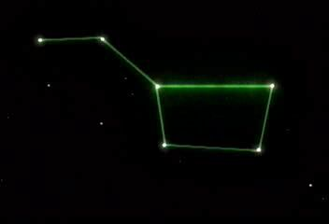

Slide 16
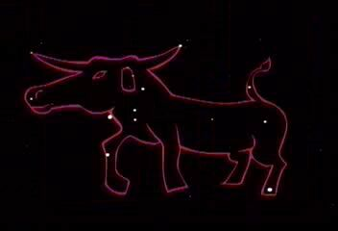

Slide 18
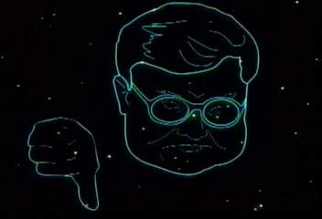

Slide 21
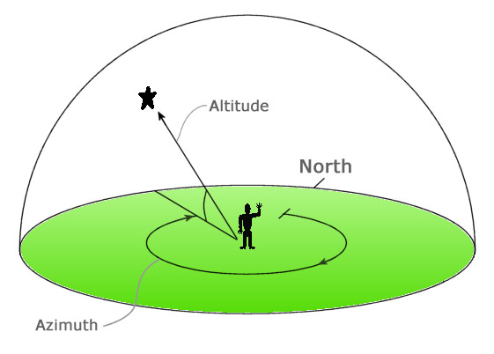
Locations in the Sky
Altitude: The angular measure of the height of something in the sky. Anything on the horizon has an altitude of 0⁰. Straight up = 90⁰.
Azimuth: The angular measure of how far away from North a spot in the sky is. Due North is defined to be 0⁰. East = 90⁰. South = 180⁰. West = 270⁰.

Slide 22
Question
What is the altitude & azimuth of a weather balloon, if it is flying 10 km above a spot 17.3 km away, to the South-East?
South-East => azimuth = 135⁰.
Altitude = tan⁻¹ (10/17.3) = 30⁰.

Slide 23
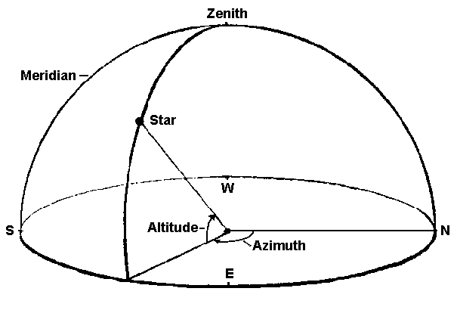
More definitions…
Zenith: The point in the sky directly above your head. (If a bird at your zenith poops, you’re in trouble!)
Meridian: An imaginary line through the sky that starts at the horizon due south, goes up through your zenith, and down to the Northern horizon.
(Imagine being at the center of a giant transparent dome, with a stripe painted from due south to due north.)

Slide 24
More questions…
Does everyone have the same zenith?
No – the spot in the sky above your head isn’t quite the same spot above someone else’s, but if you’re refering to something very far away (like a plane or a cloud or a star) it doesn’t matter much. If you’re refering to something close (a pigeon or a hat) it does make a difference.
Does anyone have the same meridian?
Yes – Anyone due north or south of each other would have the same meridan.
How often, and when, does the Sun cross the Meridan?
Once a day, at noon. At this time, the Sun is at its highest point it reaches during the day, and it crosses from the eastern half of the sky to the western half.

Slide 25
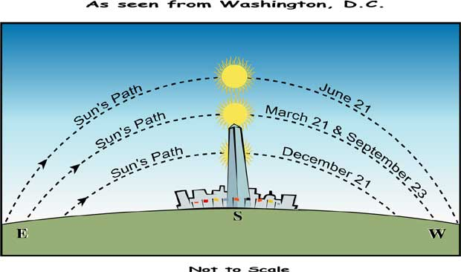

Slide 26
Fixed coordinates?
If the star Regulus is at altitude 32⁰ and azimuth 151⁰ right now, will it stay there, or do those numbers change?
They will change as the Earth rotates on its axis:
For example, the Sun rises in the East: alt = 0⁰, azimuth = 90⁰ give-or-take depending on the time of the year)
The Sun reaches its highest point at noon (altitude depends on time of year, but certainly higher than 0⁰, azimuth = 180)
and it sets in the west (alt = 0⁰; azimuth = 270⁰, give or take)

Slide 27
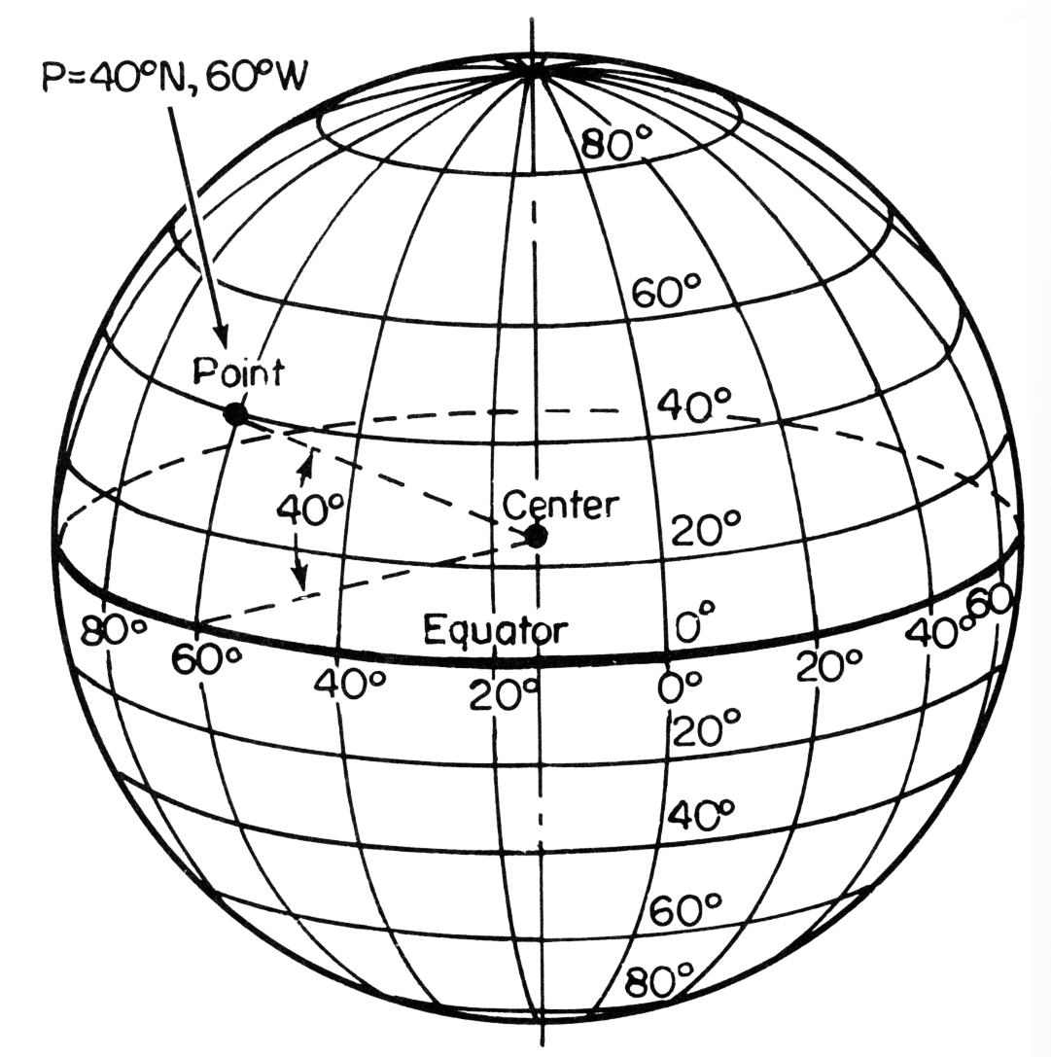
What about Latitude & Longitude?
Let’s say that Dr. Evil’s secret volcano lair is located on an island at latitude 40⁰ North and longitude 60⁰ West on the Earth. Will these coordinates stay the same as time passes?
Yes – As Earth rotates, our coordinate system of latitude & longitude rotate with it. Latitude and longitude are fixed coordinates.

Slide 28
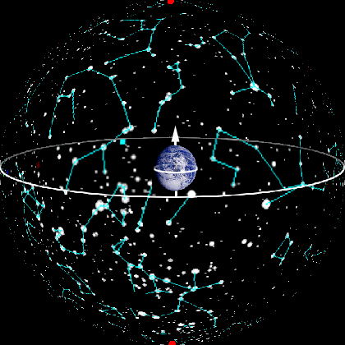
Latitude & Longitude for the sky…
So we need a coordinate system for objects in the sky which rotates with the Earth – a kind of celestial latitude & longitude.
To achieve this coordinate system, first imagine that everything in the night sky lies on a giant Celestial Sphere, surrounding the Earth.

Slide 29
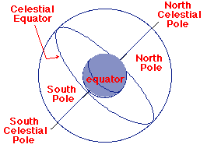
Projections
Now imagine projecting a line starting at Earth’s north pole, going straight up, until it hits the Celestial Sphere. This is is the North Celestial Pole (NCP).
You can similarly imagine the South Celestial Pole and Celestial Equators as projections of Earth’s south pole and equator.

Slide 30
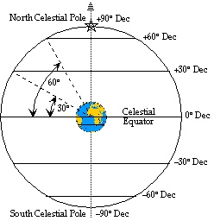
Declination: Celestial Latitude
You can also project lines of latitude onto the Celestial Sphere.
Instead of refering to the ‘latitude’ of a star, however, astronomers use the word ‘declination.’
What star lies near declination +90⁰?
Polaris – the North Star.

Slide 31
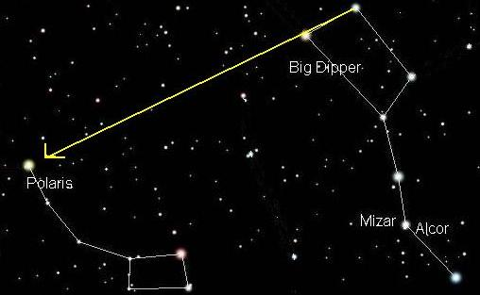

Slide 32
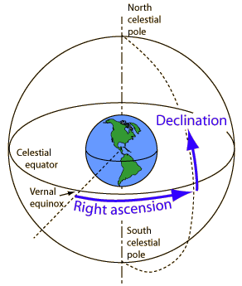
Right Ascension: Celestial Longitude
The Celestial counterpart to longitude is called ‘right ascension.’
It is measured in “hours”, but in this context, hours are units of angular size, not units of time.
One full circle = 360⁰ = 24 hours.
So 1 hour = 15⁰.

Slide 33
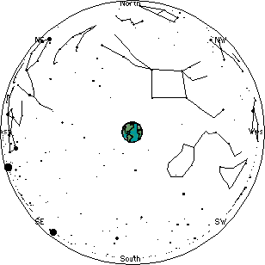
As the World turns…
…the coordinate system of R.A. & dec rotate along with it. Or, as it seems from our point of view, the Earth seems stationary, while the celestial sphere rotates about us.

Slide 34
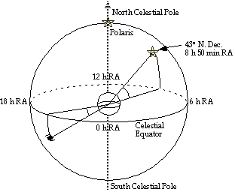
Stellar Coordinates
So, just as any city on Earth can be located with latitude & longitude, any star can be found with declination and right ascension.

Slide 35
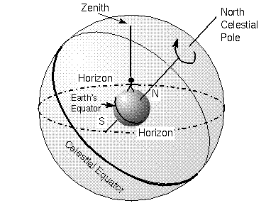
Viewing the Celestial Sphere
Anywhere on Earth, you can only see at most half of the Celestial Sphere at any given time. Why?
The Earth is blocking the other half! We can only see what is above the horizon.

Slide 36
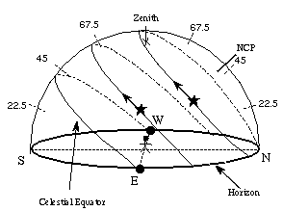
Star Paths through the Sky
As the Earth rotates, the stars appear to travel through the sky in paths parallel to the Celestial Equator.
Some stars rise very high, some peak very low in the sky.

Slide 37
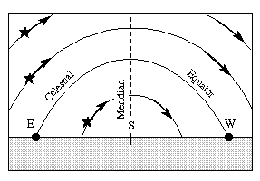
Looking South
If we look south, star paths look like this.
What would the paths look like if we looked North?

Slide 38
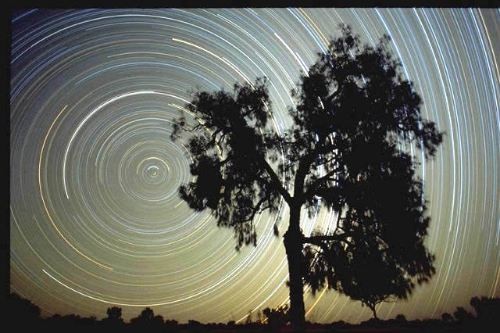
The North Celestial Pole acts like a pivot point in the sky, about which all other stars seem to revolve. The star nearest the NCP is Polaris.

Slide 39
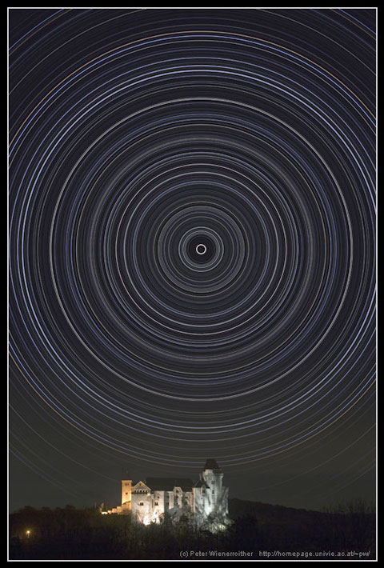
Photoshop Strikes Again!
How can you tell this photograph is a fake?
For a star trail to make a complete circle, the camera would have to have been exposing film for a full Earth rotation – 24 hours. It should have been daylight for part of this time, over-exposing the film, and rendering the star trails invisible

Slide 40
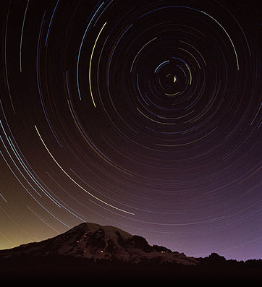
How long was this exposure?
Star trails seem to cover roughly 60⁰ of arc.
This represents about 1/6 of a whole rotation (360⁰).
A whole rotation of the Earth takes 24 hours.
So 1/6 of this time would be about 4 hours.

Slide 41
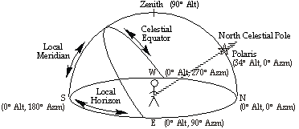
The View from North America
Observe the diagram below. Note that objects near the celestial equator rise in the East and set in the West. Objects near the NCP get low enough to the horizon to set.

Slide 42
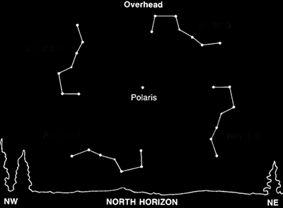
The Big Dipper Never Sets
If you live far North enough, the Big Dipper is always visible in the night sky, no matter the time of year.

Slide 43
Beyond the Horizon
Just as the region around the Northernmost part of the Celestial Sphere is always in view (from N. America), the Southernmost region is always beneath the horizon. There are stars and constellations which you simply will never see from Livermore.

Slide 45
Santa’s View
Predict what Santa’s night sky should look like, from his home at the North Pole.
Where would Polaris be in the sky?
What would the paths of the stars look like?
How much of the Celestial Sphere would never be visible?

Slide 46
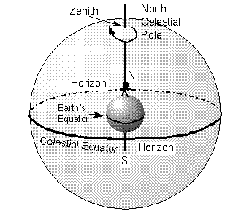

Slide 47
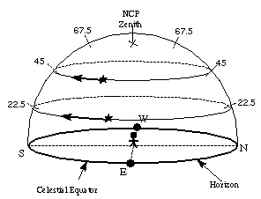
The View from the North Pole
Polaris would lie at your zenith.
The Celestial Equator would lie on your horizon.
Stars would appear to move horizontally in the sky.
You would not be able to see ANY of the southern Celestial Hemisphere.
Time for “Worksheet – The Sky”!

