Slide 1
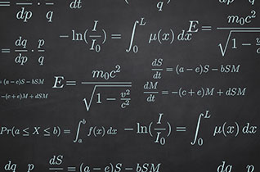
Calculus Crash Course for Physics
Rushin’ through the Basics!

Slide 2
The Two Main Problems of Calculus:
The Tangent line problem – Find the instantaneous slope of a curve by finding the line tangent to the curve at that point
The Area problem – finding the area bound beneath some curve

Slide 3
Why the Tangent Line Problem is important to physics
Slopes always indicate the rate at which one variable is changing as another variable is changing too.
The rate at which quantities like position, velocity, force, mass, and energy change with time are important values to know when performing certain physics calculations.
Calculus will allow us to measure these rates even if they are not constant but instead are continuously changing.

Slide 4
Consider a position v. time graph where the position varies linearly with time.
What does the slope of this line represent?
Position (m)
Time (s)

Slide 5
Consider a position v. time graph where the position varies linearly with time.
What does the slope of this line represent?
Rise = Δx
Position (m)
Run = Δt
Pick any two points along the line and then find rise and run…
Time (s)

Slide 6
Consider a position v. time graph where the position varies linearly with time.
What does the slope of this line represent?
Rise = Δx
Position (m)
Run = Δt
Pick any two points along the line and then find rise and run…
Time (s)

Slide 7
Consider a position v. time graph where the position varies linearly with time.
What does the slope of this line represent?
Rise = Δx
Position (m)
Run = Δt
Pick any two points along the line and then find rise and run…
Time (s)
Since slope is constant in this case, so is speed.

Slide 8
What if position doesn’t vary linearly with time?
If the slope of position v. time isn’t constant, then neither is speed.
Position (m)
Time (s)

Slide 9
What if position doesn’t vary linearly with time?
If the slope of position v. time isn’t constant, then neither is speed.
Position (m)
If we want to know the instantaneous speed at a particular moment, we need to know the slope of the line tangent to the curve at that point.
Time (s)

Slide 10
The Derivative
Let f(x) be some function.
We want to find a new function, related to f(x), which indicates the slopes of tangent lines drawn to f(x).
This new function is called “the derivative” of f(x), and is denoted f’(x).
The act of finding the derivative of a function is called “differentiation”.
Let’s do a graphical example, exploring the slopes of tangent lines drawn to a curve which happens to be a cubic function.

Slide 11
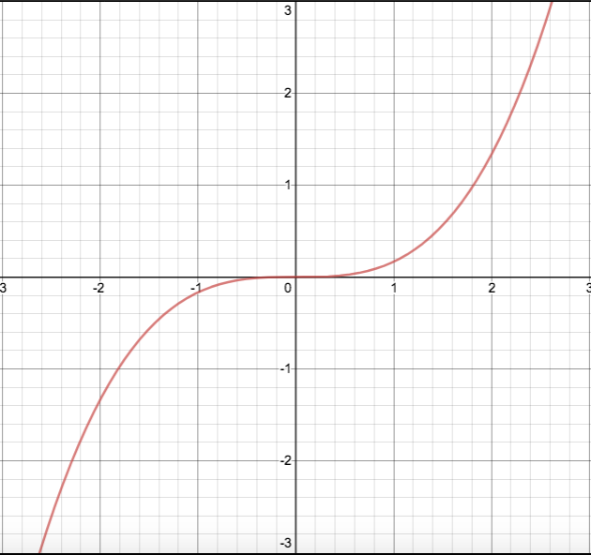
Let f(x) = (¹/₆)x³
The graph of f(x) is shown here.

Slide 12
Let f(x) = (¹/₆)x³
The graph of f(x) is shown here.
Let’s draw lines tangent to f(x) at several points.

Slide 13
Let f(x) = (¹/₆)x³
The graph of f(x) is shown here.
Let’s draw lines tangent to f(x) at several points.

Slide 14
Let f(x) = (¹/₆)x³
The graph of f(x) is shown here.
Let’s draw lines tangent to f(x) at several points
A careful analysis shows that:
when x is -2 or 2 the slope is 2
when x is -1 or 1 the slope is ½
when x = 0, the slope is 0.
m = 2
m = ¹/₂
m = 0
m = ¹/₂
m = 2

Slide 15
Let f(x) = (¹/₆)x³
The graph of f(x) is shown here.
Let’s draw lines tangent to f(x) at several points
A careful analysis shows that:
when x is -2 or 2 the slope is 2
when x is -1 or 1 the slope is ½
when x = 0, the slope is 0.
m = 2
m = ¹/₂
m = 0
m = ¹/₂
m = 2
Thus the derivative of f(x) must pass through the points (-2, 2), (-1, ½), (0,0), (1, ½), and (2,2)

Slide 16
What curve passes through the points (-2, 2), (-1, ½), (0,0), (1, ½), and (2, 2)?

Slide 17
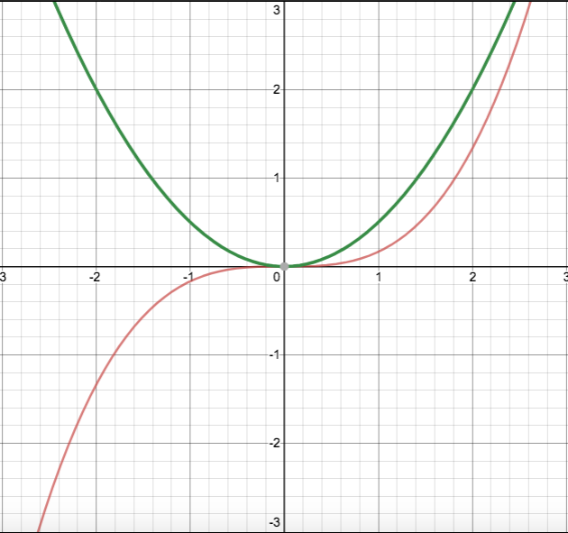
What curve passes through the points (-2, 2), (-1, ½), (0,0), (1, ½), and (2, 2)?
A parabola!

Slide 18
What curve passes through the points (-2, 2), (-1, ½), (0,0), (1, ½), and (2, 2)?
A parabola!
It turns out that
f ’(x) = (½)x².
So the derivative of a 3rd degree polynomial was a 2nd degree polynomial.
Let’s try this again!

Slide 19
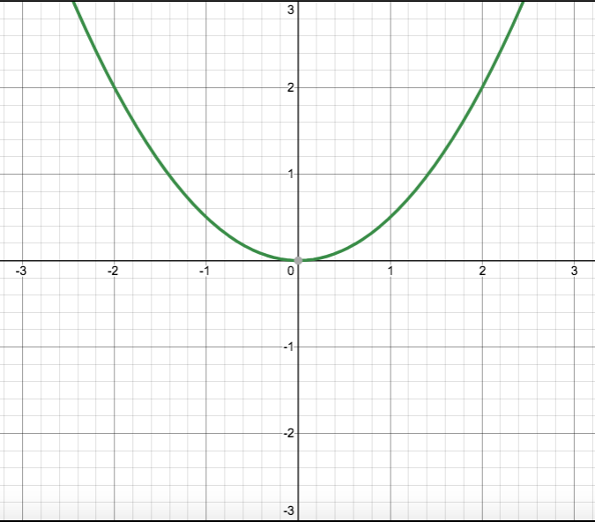
This time, let’s start with f’(x) = (¹/₂)x²
The graph of f’(x) is shown here.
Now let’s find its derivative!
The derivative of a derivative is called the “second derivative” and is denoted f’’(x)

Slide 20
Let’s pick some points to draw some tangent lines.

Slide 21
Let’s pick some points to draw some tangent lines.

Slide 22
Let’s pick some points to draw some tangent lines.
A careful analysis shows:
when x = -2, m = -2
when x = -1, m = -1
when x = 0, m = 0
when x = 1, m = 1
when x = 2, m = 2
m = -2
m = 2
m = -1
m = 1
m = 0

Slide 23
Let’s pick some points to draw some tangent lines.
A careful analysis shows:
when x = -2, m = -2
when x = -1, m = -1
when x = 0, m = 0
when x = 1, m = 1
when x = 2, m = 2
m = -2
m = 2
m = -1
m = 1
m = 0
So the derivative of our parabola (which means the second derivative of our original cubic function) must pass through the points (-2,-2), (-1,-1), (0,0), (1,1), and (2,2).

Slide 24
So what function passes through the points (-2,-2), (-1,-1), (0,0), (1,1), and (2, 2)?

Slide 25
So what function passes through the points (-2,-2), (-1,-1), (0,0), (1,1), and (2, 2)?
The line y = x

Slide 26
We’ve just shown graphically that the derivative of a particular 3rd degree polynomial is a 2nd degree polynomial, and that the derivative of that 2nd degree polynomial turns out to be a 1st degree polynomial.
This was not a special case!
It turns out that whenever you take the derivative of a polynomial, the result is a polynomial of 1 degree less.

Slide 27
The Rule for Differentiating Polynomials
It turns out:
If f(x) = ax^{n}, then f’(x) = anx^{n-1}
where x is a variable,
a and n are constants,
and n ≠ 0,
(The proof for this rule is left as an activity for a calculus course.)

Slide 28
The Rule for Differentiating Polynomials
“If there’s only one term, technically it’s a monomial, and not a polynomial,” you might be tempted to point out.
However, there’s another rule in calculus which states that the derivative of a function is equal to the derivatives of its original terms:
If f(x) = a(x) + b(x) + c(x),
then f ’(x) = a’(x) + b’(x) + c’(x)

Slide 29
What about Zero-Degree Polynomials?
The rule:
If f(x) = ax^{n}, then f’(x) = anx^{n-1}
only applies if n ≠ 0,
If n = 0, then f(x) = a is constant function whose graph is simply a flat line with zero slope at all points. Thus f ‘(x) in this case is simply 0.

Slide 30
Example Problem
Let f(x) be given by
Determine the derivative f ’(x).

Slide 31
Example Problem
Let f(x) be give by
Determine the derivative f ’(x).

Slide 32
Note: There are lots of different ways of denoting derivatives, all of which mean the same thing
Original Function | Derivative as a Function | Derivative evaluated for some value k
y | y’ | y’(k)
y | ^{dy}/_{dx} | ^{dy}/_{dx}|_{k} or ^{dy}/_{dx}|_{x=k}
f(x) | f ’(x) | f ‘(k)
f(x) | ^{d}/_{dx}[f(x)] | ^{d}/_{dx}[f(x)] |_{k} or ^{d}/_{dx}[f(x)] |_{x=k}

Slide 33
Another Example Problem
Let y be function of x given by
Determine the derivative ^{dy}/_{dx}.

Slide 34
Let’s start by rewriting the function into a more “derivative-friendly” format where the terms are all of the form ax^{n}:
becomes
Now we’re ready to differentiate.

Slide 35
How to check your answer with a TI calculator
Hit the “y=“ button and enter your original function in Y₁.
You’re going to tell it to graph the derivative of Y₁ in Y₂:
Hit the “math” button
Choose nDeriv(
When prompted to enter a variable in the denominator after the “d” choose x. (You’re telling the calculator the name of the variable you’re working with)
When your cursor is inside the parentheses, hit the “vars” button, select “Y-VARS”, choose “Function” and then choose “Y₁”
At the end choose x=x (You’re telling the calculator you’re interested in all values of x, not just one particular value)
In Y₃, enter the function that you think is the derivative of Y₁.
Highlight the equal sign in Y₁ and hit enter in order to turn off the graph for Y₁. You only want to graph Y₂ and Y₃.
Here’s what your “y=“ screen should look like:

Slide 37
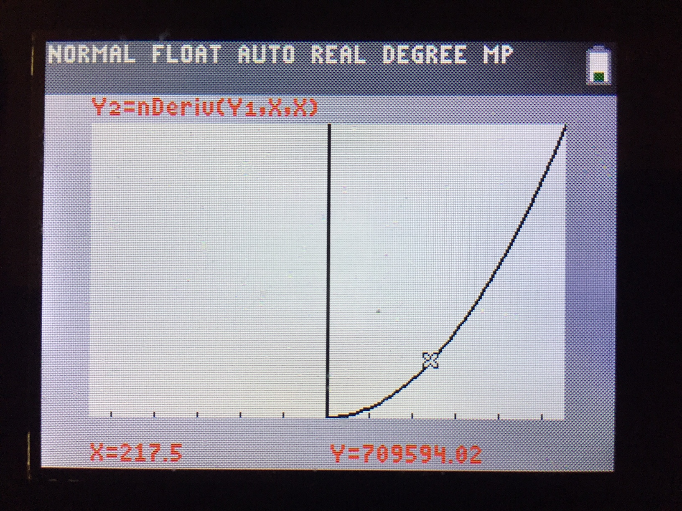
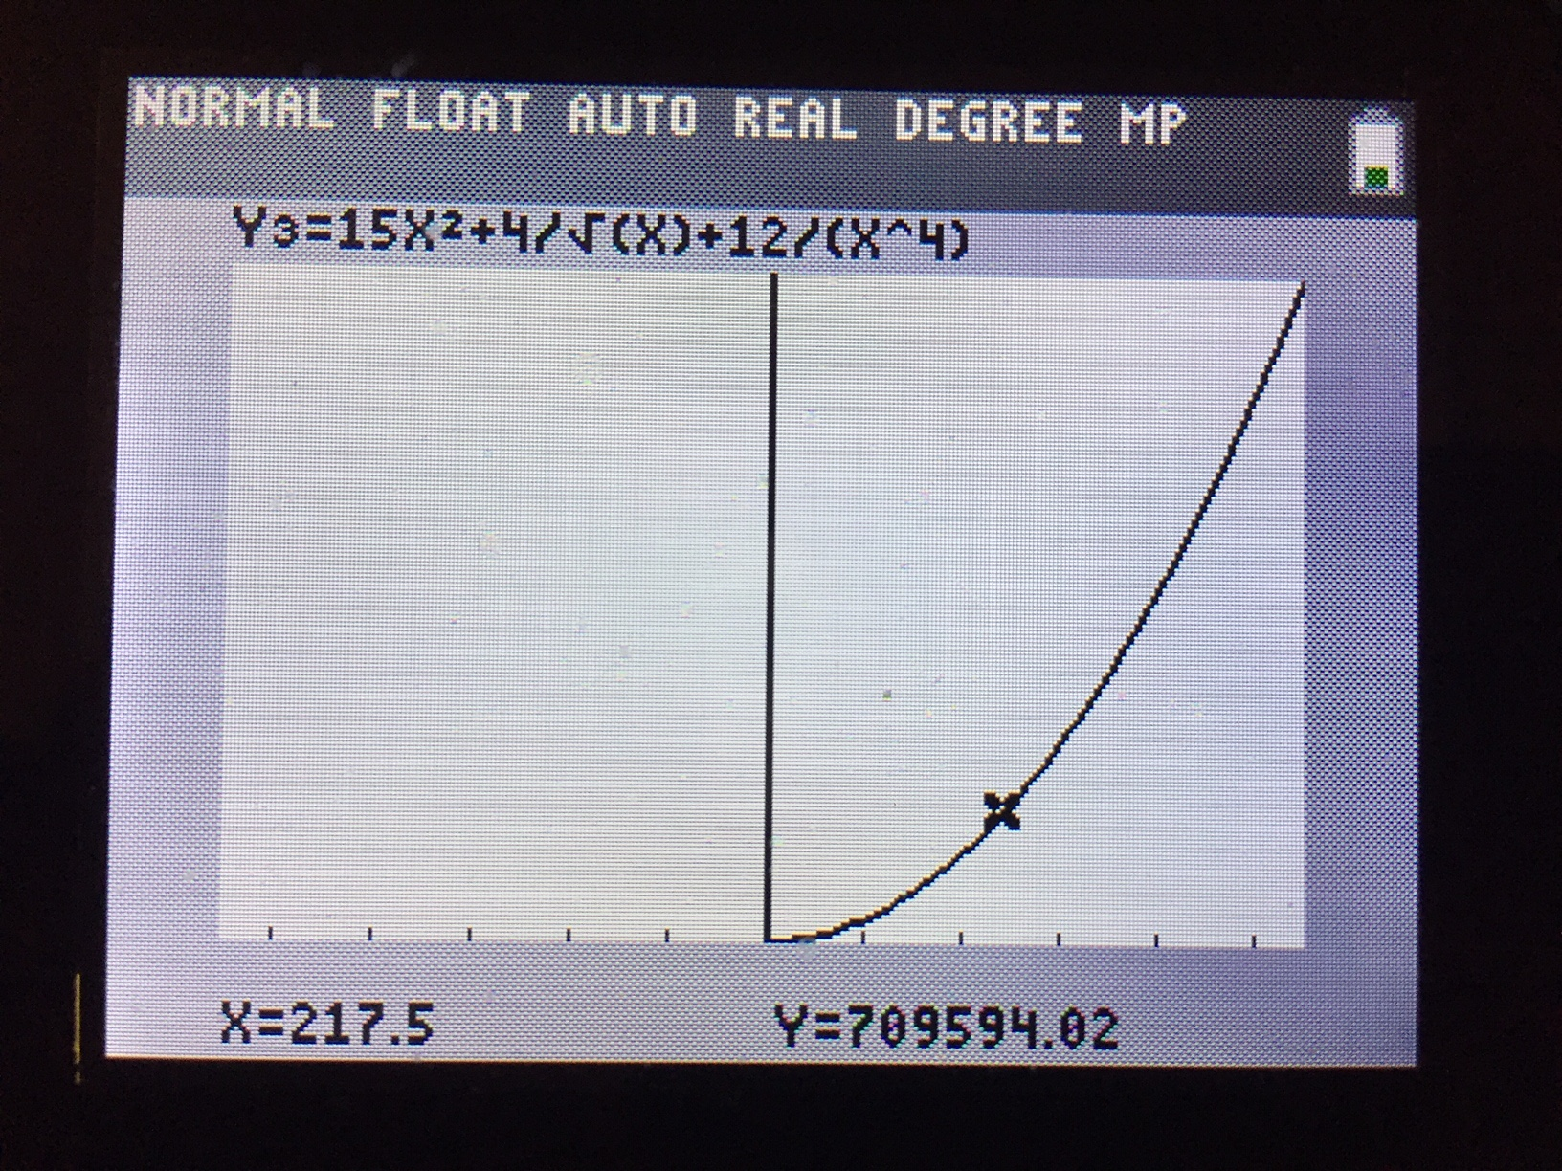
Hit the “zoom” button, scroll down, and choose “ZoomFit” in order to choose appropriate scales for your axes.
Graph your functions.
Use the “trace” button to trace along your graph. Toggle back and forth between tracing along Y₂ and Y₃. If you did the problem correctly, they will be the same graph.

Slide 38
Sine curves
We’re all set for polynomials!
Lots of phenomena in physics are cyclical, which means they are well represented by sine curves.
What’s the derivative of sin x?
Let’s approach this question graphically…

Slide 39
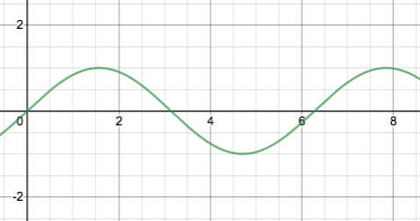
Let f(x) = sin x

Slide 40
Let f(x) = sin x
Let’s draw tangent lines to the graph at the points where x = 0, 0.5π, π, 1.5π, and 2π

Slide 41
Let f(x) = sin x
Let’s draw tangent lines to the graph at the points where x = 0, 0.5π, π, 1.5π, and 2π

Slide 42
Let f(x) = sin x
m = 1
m = 1
m = 0
m = -1
m = 0
Careful analysis shows: when x = 0, slope = 1; when x = 0.5π, slope = 0; when x = π, slope = -1; when x = 1.5π, slope = 0, and when x = 2π, slope = 1.

Slide 43
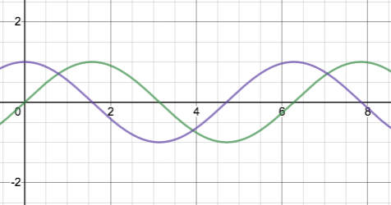
So what function passes through the points (0, 1), (0.5π, 0), (π, -1), (1.5π, 0), and (2π, 1)? The answer: cos x

Slide 44
So what function passes through the points (0, 1), (0.5π, 0), (π, -1), (1.5π, 0), and (2π, 1)? The answer: cos x
We’ve just demonstrated graphically that if f(x) = sin x, then f ‘(x) = cos x.
A similar graphical approach can show that if f(x) = cos x, then f ‘(x) = - sin x.

Slide 45
Antidifferentiaion
Let’s turn things around.
Suppose you’re given f ’(x) = 20x³ – 6x and asked to find a corresponding function f(x). In other words, you’re asked to find an antiderivative.
Consider exponents first. When differentiating, exponents always decrease by 1, so going backwards, the exponents must increase by 1. Therefore, your antiderivative will be of the form f(x) = __x⁴ - ___x² where the blanks are coefficients.
To find the coefficients, imagine taking the derivative of f(x) and ask yourself, “What do you multiply by 4 to get 20?” and “What do you multiply by 2 to get 6?”
Thus f(x) = 5x⁴ – 3x² is an antiderivative of f ’(x) = 20x³ – 6x

Slide 46
Note: I was careful to call f(x) = 5x⁴ – 3x² an antiderivative of f ’(x) = 20x³ – 6x and not the antiderivative.
You could add or subtract any constant to f(x) and not change what its derivative would be since the derivative of any constant is zero.
If you took the derivative of 5x⁴ – 3x² + 7 or 5x⁴ – 3x² – 42 or 5x⁴ – 3x² + 1,701, you’d get the same result: 20x³ – 6x.
This make sense when you think about it graphically. Adding or subtracting a constant just shifts a graph vertically on the x-y plane, but doesn’t change the value of the slope at any point.

Slide 47
Don’t forget the “+ c”!!!
Therefore, if we want to be as generic as possible when asked to find the antiderivative of f ’(x) = 20x³ – 6x we would say the answer is f(x) = 5x⁴ – 3x² + c, where c is a constant.
f(x) = 5x⁴ – 3x² + c is said to be the “general antiderivative” of f ’(x) = 20x³ – 6x.
In the absence of any other information or instructions, always include “+ c” whenever you find an antiderivative!

Slide 48
Indefinite Integration
The act of finding a function’s antiderivative is called “integration”, specifically “indefinite integration”.
(We’ll get to “definite integration” soon….)
Here are three ways to ask the same thing:
f ’(x) = 20x³ – 6x . Find f(x).
Find the integral of 20x³ – 6x.
Evaluate:

Slide 49
Anatomy of an Indefinite Integral
The integral sign –
It lets you know
that you’ll be taking
an antiderivative
This part just lets you
know that the variable
we’re working with is x.
At this point it is
helpful to think of the
“dx” as punctuation, like
the period at the end of
the integral’s sentence.
The “integrand” –
the function that
you will be finding
the antiderivative of

Slide 50
Example Problem
Evaluate the following integral
such that the result passes through the point (2, 5).

Slide 51
Solution
We know that when x = 2, y = 5, so we can say:
So, the final answer is:

Slide 52
Back to the Area Problem
So what does all this have to do with the other big problem of calculus – the area problem?
And what is a “definite integral”?
We’re almost there!
To get there, let’s revisit the related concepts of velocity, distance, and time.
Recall: Velocity is the derivative of a position v. time curve.

Slide 53
Revisiting Velocity, Distance and Time
Velocity is defined as a change in position divided by the time it took to change position:
Solving for change in position yields:
Note: This only works if velocity is constant during the interval Δt.
Let’s consider this graphically…

Slide 54
When velocity is constant, change in position is given by Δx = v•Δt
Graphically, this calculation represents the area of the rectangle beneath the vel. vs time curve.
velocity (m/s)
Time (s)
What if velocity isn’t constant?

Slide 55
Consider a situation where velocity varies directly with time.
Change in position can still be calculated by finding the area under the curve.
velocity (m/s)
In the case the region is a trapezoid, whose area is given by a simple formula from geometry.
Time (s)

Slide 56
Now let’s consider a situation where velocity varies with time in a nonlinear fashion. (Forgive me if this seems a jerk move.)
How do we calculate the area under a curve like this?
Recall that velocity is the derivative of a position function.
Therefore, position must be the antiderivative of the velocity function!
velocity (m/s)
Time (s)
To calculate the area under a curve, we will use a “definite integral” and the Fundamental Theorem of Calculus

Slide 57
The Fundamental Theorem of Calculus
The area between the graphs of f(x) the x-axis and between the values of x = a and x = b is given by:
where F(x) is the antiderivative of f(x), and a and b are the “lower limit of integration” and “upper limit of integration” respectively.

Slide 58
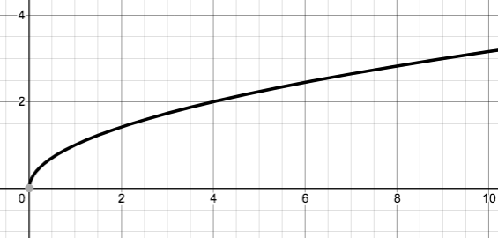
Example Problem
Find the area of the region bounded by the graphs of y = √x, the x-axis, and the vertical lines x = 1 and x = 9.

Slide 59
Set up the definite integral:
Rewrite integrand:
Find the antiderivative:(Note: the “+c” isn’t needed here)
Evaluate the antiderivative at the upper and lower limits of integration and subtract:

Slide 60
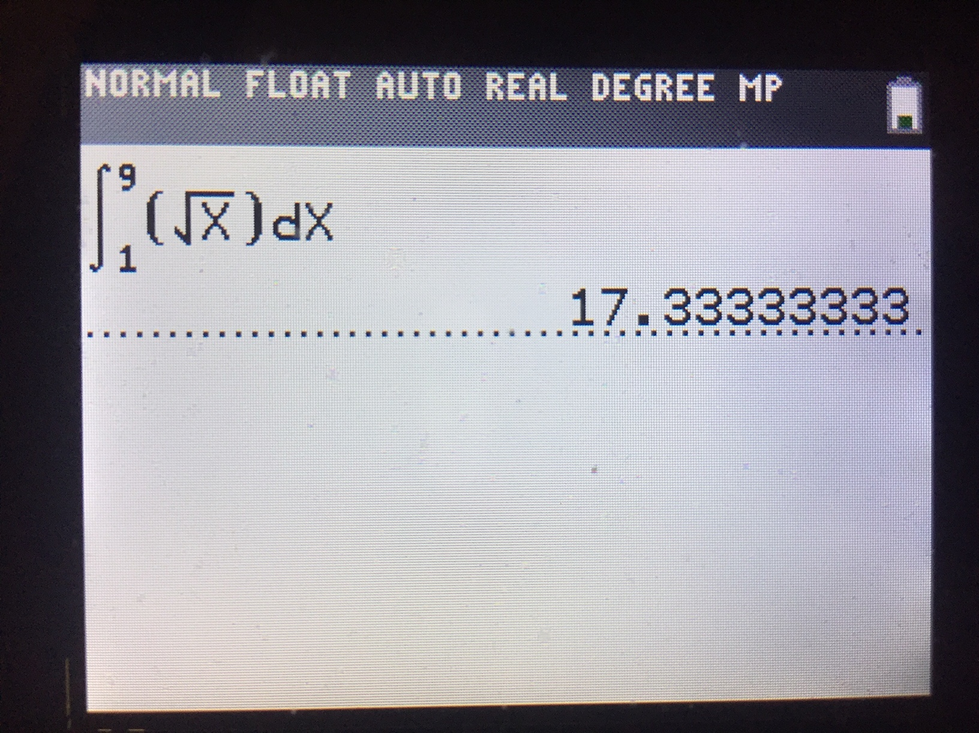
Checking your answer
Once again you can check your answer using your graphing calculator.
If you have a TI grapher, hit the “math” button and choose “fnint(“

Slide 61
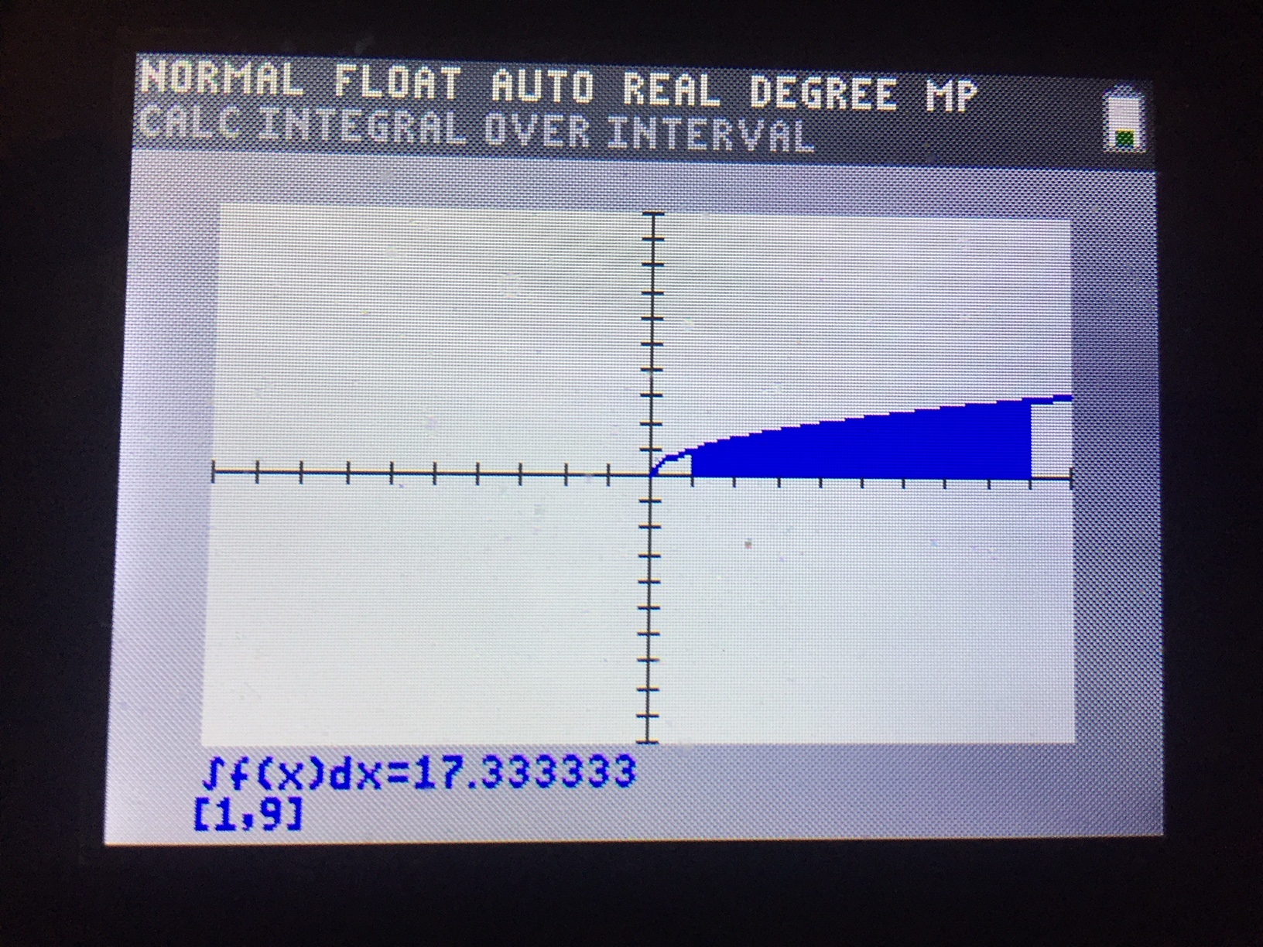
Or, if you want to check your answer in more graphical (and in my opinion, spiffier) way:
Hit the “y=“ button and enter the function you’re finding the area under as Y₁. (Make sure you’re zoomed such that your axes have appropriate upper and lower limits.)
Hit the “2nd” and “trace” buttons for the “calc” menu. The choose the integration option.
Input the lower and upper limits of integration.
The region you’re find the area of will get shaded in and the answer will appear on the screen.

Slide 62
A few things to consider…
Any area that occurs beneath the x-axis is considered negative.
With this in mind, what’s the best way to approach this problem?
Evaluate the integral:

Slide 63
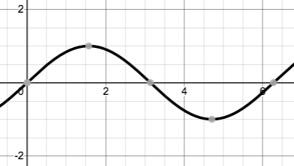
One could go through the steps of find the antiderivative and evaluating it at the upper and lower limits of integration, and they would get the correct answer.
However let’s look at the graph:
One can reason that the area above the x-axis from 0 to π is equal to the area below the x-axis from π to 2π.
Since the area below the x-axis is considered negative, you can conclude the total answer is 0.

Slide 64
Your Goal
In this class your goal is not simply to determine the right answer to a question.
Your goal should be to find the most efficient path to that answer!
Sometimes a problem that would take a long time using calculus (or perhaps couldn’t even be done using calculus!) can be done very quickly using a little geometry or simple reasoning, as was the case in the previous example.
Since the AP exam is a timed exam, you will want to be well-practiced at finding the most expeditious way of doing problems!

