Slide 1
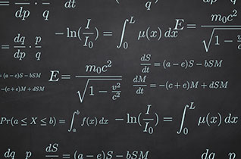
Calculus Crash Course for Physics
Rushin’ through the Basics!

Slide 2
The Two Main Problems of Calculus:
The Tangent line problem – Find the instantaneous slope of a curve by finding the line tangent to the curve at that point
The Area problem – finding the area bound beneath some curve

Slide 3
Why the Tangent Line Problem is important to physics
Slopes always indicate the rate at which one variable is changing as another variable is changing too.
The rate at which quantities like position, velocity, force, mass, and energy change with time are important values to know when performing certain physics calculations.
Calculus will allow us to measure these rates even if they are not constant but instead are continuously changing.

Slide 4
Consider a position v. time graph where the position varies linearly with time.
What does the slope of this line represent?
Position (m)
Time (s)

Slide 5
Consider a position v. time graph where the position varies linearly with time.
What does the slope of this line represent?
Rise = Δx
Position (m)
Run = Δt
Pick any two points along the line and then find rise and run…
Time (s)

Slide 6
Consider a position v. time graph where the position varies linearly with time.
What does the slope of this line represent?
Rise = Δx
Position (m)
Run = Δt
Pick any two points along the line and then find rise and run…
Time (s)

Slide 7
Consider a position v. time graph where the position varies linearly with time.
What does the slope of this line represent?
Rise = Δx
Position (m)
Run = Δt
Pick any two points along the line and then find rise and run…
Time (s)
Since slope is constant in this case, so is speed.

Slide 8
What if position doesn’t vary linearly with time?
If the slope of position v. time isn’t constant, then neither is speed.
Position (m)
Time (s)

Slide 9
What if position doesn’t vary linearly with time?
If the slope of position v. time isn’t constant, then neither is speed.
Position (m)
If we want to know the instantaneous speed at a particular moment, we need to know the slope of the line tangent to the curve at that point.
Time (s)

Slide 10
The Derivative
Let f(x) be some function.
We want to find a new function, related to f(x), which indicates the slopes of tangent lines drawn to f(x).
This new function is called “the derivative” of f(x), and is denoted f’(x).
The act of finding the derivative of a function is called “differentiation”.
Let’s do a graphical example, exploring the slopes of tangent lines drawn to a curve which happens to be a cubic function.

Slide 11
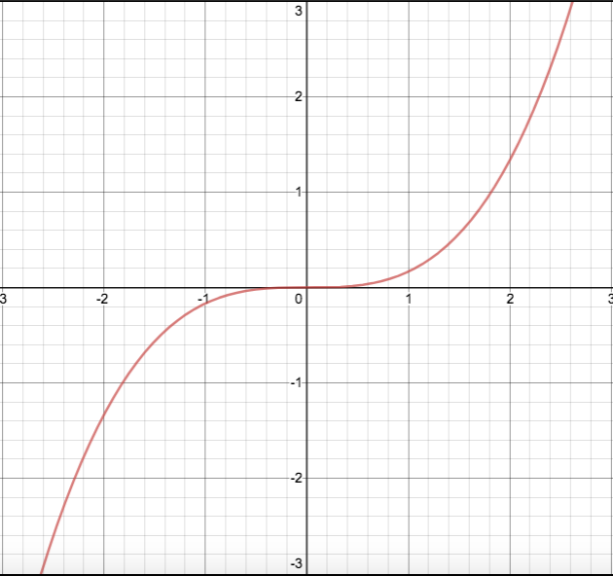
Let f(x) = (¹/₆)x³
The graph of f(x) is shown here.

Slide 12
Let f(x) = (¹/₆)x³
The graph of f(x) is shown here.
Let’s draw lines tangent to f(x) at several points.

Slide 13
Let f(x) = (¹/₆)x³
The graph of f(x) is shown here.
Let’s draw lines tangent to f(x) at several points.

Slide 14
Let f(x) = (¹/₆)x³
The graph of f(x) is shown here.
Let’s draw lines tangent to f(x) at several points
A careful analysis shows that:
when x is -2 or 2 the slope is 2
when x is -1 or 1 the slope is ½
when x = 0, the slope is 0.
m = 2
m = ¹/₂
m = 0
m = ¹/₂
m = 2

Slide 15
Let f(x) = (¹/₆)x³
The graph of f(x) is shown here.
Let’s draw lines tangent to f(x) at several points
A careful analysis shows that:
when x is -2 or 2 the slope is 2
when x is -1 or 1 the slope is ½
when x = 0, the slope is 0.
m = 2
m = ¹/₂
m = 0
m = ¹/₂
m = 2
Thus the derivative of f(x) must pass through the points (-2, 2), (-1, ½), (0,0), (1, ½), and (2,2)

Slide 16
What curve passes through the points (-2, 2), (-1, ½), (0,0), (1, ½), and (2, 2)?

Slide 17
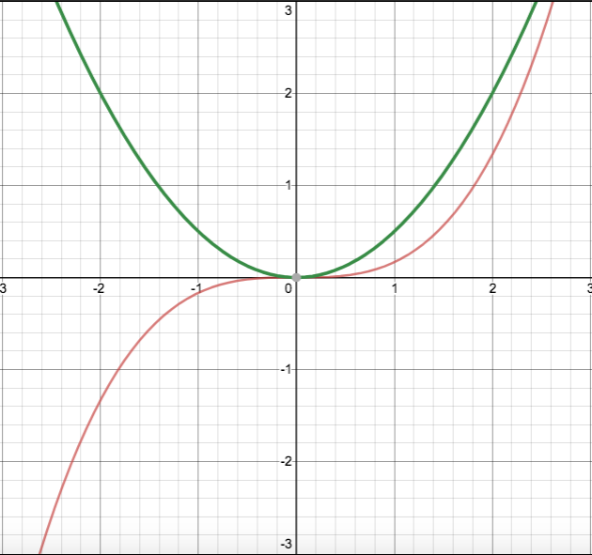
What curve passes through the points (-2, 2), (-1, ½), (0,0), (1, ½), and (2, 2)?
A parabola!

Slide 18
What curve passes through the points (-2, 2), (-1, ½), (0,0), (1, ½), and (2, 2)?
A parabola!
It turns out that
f ’(x) = (½)x².
So the derivative of a 3rd degree polynomial was a 2nd degree polynomial.
Let’s try this again!

Slide 19
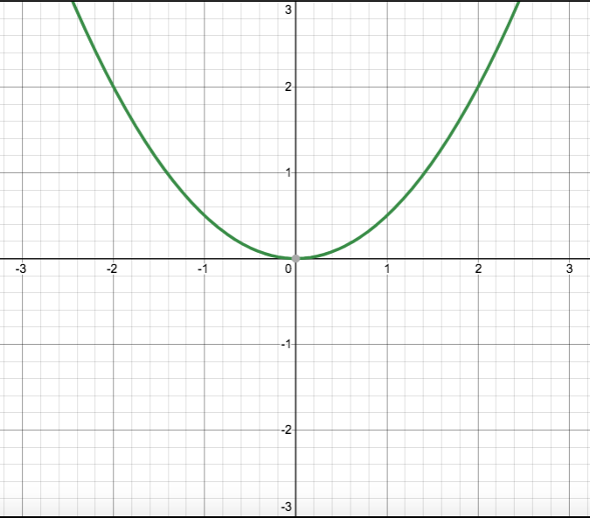
This time, let’s start with f’(x) = (¹/₂)x²
The graph of f’(x) is shown here.
Now let’s find its derivative!
The derivative of a derivative is called the “second derivative” and is denoted f’’(x)

Slide 20
Let’s pick some points to draw some tangent lines.

Slide 21
Let’s pick some points to draw some tangent lines.

Slide 22
Let’s pick some points to draw some tangent lines.
A careful analysis shows:
when x = -2, m = -2
when x = -1, m = -1
when x = 0, m = 0
when x = 1, m = 1
when x = 2, m = 2
m = -2
m = 2
m = -1
m = 1
m = 0

Slide 23
Let’s pick some points to draw some tangent lines.
A careful analysis shows:
when x = -2, m = -2
when x = -1, m = -1
when x = 0, m = 0
when x = 1, m = 1
when x = 2, m = 2
m = -2
m = 2
m = -1
m = 1
m = 0
So the derivative of our parabola (which means the second derivative of our original cubic function) must pass through the points (-2,-2), (-1,-1), (0,0), (1,1), and (2,2).

Slide 24
So what function passes through the points (-2,-2), (-1,-1), (0,0), (1,1), and (2, 2)?

Slide 25
So what function passes through the points (-2,-2), (-1,-1), (0,0), (1,1), and (2, 2)?
The line y = x

Slide 26
We’ve just shown graphically that the derivative of a particular 3rd degree polynomial is a 2nd degree polynomial, and that the derivative of that 2nd degree polynomial turns out to be a 1st degree polynomial.
This was not a special case!
It turns out that whenever you take the derivative of a polynomial, the result is a polynomial of 1 degree less.

