Slide 1
Welcome to PTSOS!
Fall Workshop Sept. 16, 2023:
Mechanics - Kinematics, Force, and Momentum
Dan Burns
PASCO Curriculum Developer
Physics Teacher, Los Gatos HS (retired)
Tom Shefler
Physics Teacher, Granada HS
Abigail Plemmons
Physics Teacher, Granada HS
David Rakestraw
Lawrence Livermore National Laboratory

Slide 2
To access Tom’s PTSOS files:
Livermoreschools.org/page/4476

Slide 3
PTSOS – 1D Kinematics
Linear Motion

Slide 4
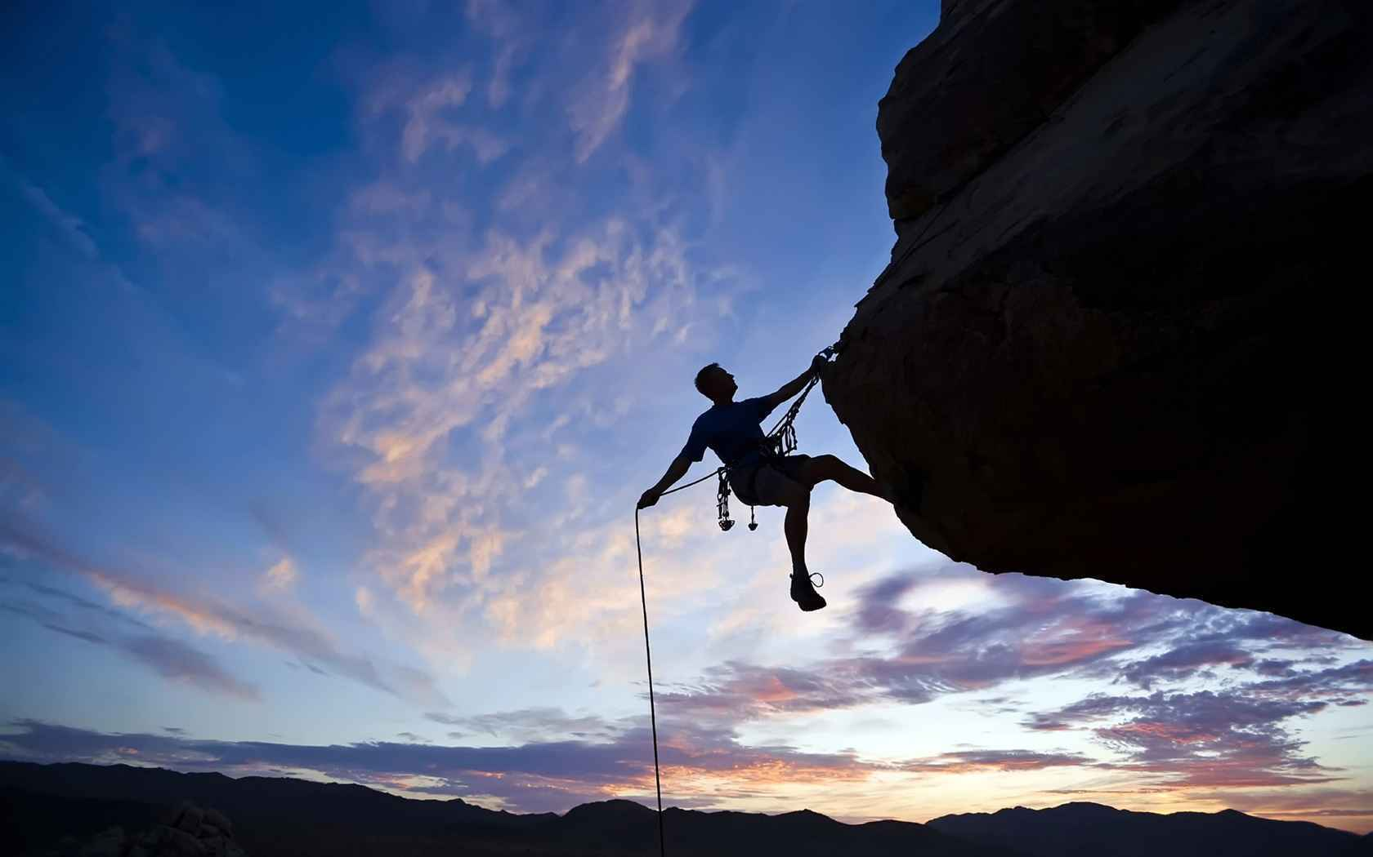
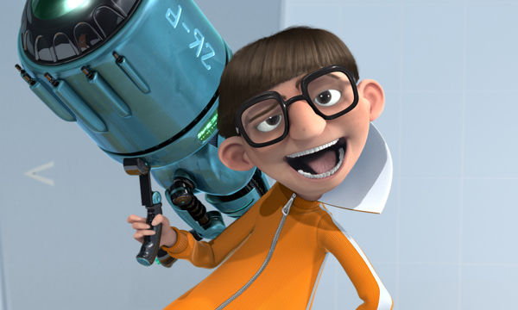
How Far? Distance v. Displacement
Distance = scalar quantity indicating length of a path traveled. (“As the wolf runs.”)
Displacement = vector quantity indicating location (both magnitude and direction) relative to some reference point.

Slide 5
Example
You hike 4.0 km east, then 3.0 km north. What distance have you traveled, and what is your displacement, relative to where you started?
7.0 km is the distance you have traveled .
5.0 km, 37° north of east is your displacement relative to where you started.
5.0 km = [(4.0 km)²+(3.0 km)²]^{1/2}
3.0 km
37° = arctan (^{3.0 km}/_{4.0 km})
4.0 km

Slide 6
How fast? Speed v. Velocity
Just as distance and displacement are scalar and vector versions of answering “how far,” there are also vector and scalar versions for answering, “how fast?”
Speed = rate at which position changes with time
Velocity = speed in a given direction.
Examples: 35 mph is a speed; 35 mph north is a velocity.

Slide 7
How fast? Speed v. Velocity
What controls in a car allow the driver to change the car’s speed?
a.) Gas pedal
b.) Gas pedal, brakes
c.) Gas pedal, brakes, steering wheel
d.) Gas pedal, brakes, steering wheel, air conditioner knob

Slide 8
How fast? Speed v. Velocity
What controls in a car allow the driver to change the car’s speed?
a.) Gas pedal
b.) Gas pedal, brakes
c.) Gas pedal, brakes, steering wheel
d.) Gas pedal, brakes, steering wheel, air conditioner knob

Slide 9
How fast? Speed v. Velocity
What controls in a car allow the driver to change the car’s velocity?
a.) Gas pedal
b.) Gas pedal, brakes
c.) Gas pedal, brakes, steering wheel
d.) Gas pedal, brakes, steering wheel, air conditioner knob

Slide 10
How fast? Speed v. Velocity
What controls in a car allow the driver to change the car’s velocity?
a.) Gas pedal
b.) Gas pedal, brakes
c.) Gas pedal, brakes, steering wheel
d.) Gas pedal, brakes, steering wheel, air conditioner knob

Slide 11
Average v. Instantaneous Speed & Velocity
Average Speed is defined as total distance traveled divided by the total time:
v_{avg} = ^{d}/_{Δt}
Average Velocity is defined as total displacement divided by total time:
v_{avg} = ^{Δx}/_{Δt}

Slide 12
Average v. Instantaneous Speed & Velocity
Instantaneous Speed is one’s speed at a particular instant.
Instantaneous Velocity is one’s velocity at a particular instant.

Slide 13
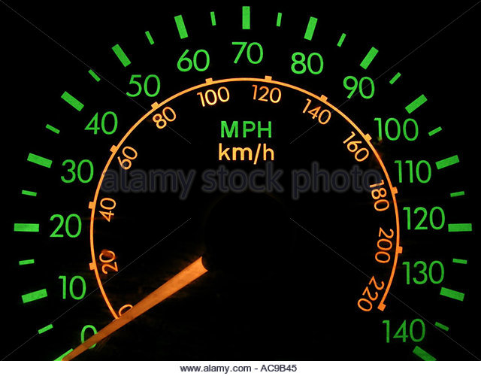
What does this dashboard indicator tell a driver?
a.) average speed
b.) average velocity
c.) instantaneous speed
d.) instantaneous velocity

Slide 14
What does this dashboard indicator tell a driver?
a.) average speed
b.) average velocity
c.) instantaneous speed
d.) instantaneous velocity

Slide 15
If you get a speeding ticket, is it because your instantaneous speed was too fast, or your average speed was too fast?

Slide 16
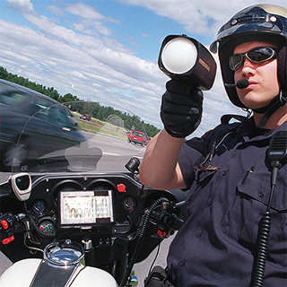
Usually, it’s because your instantaneous speed was too fast.

Slide 17
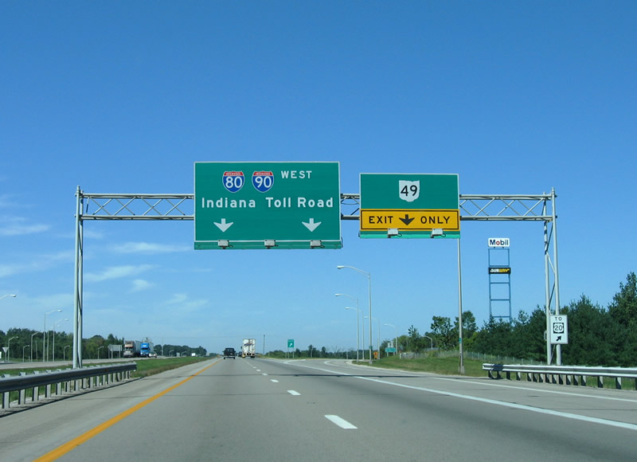
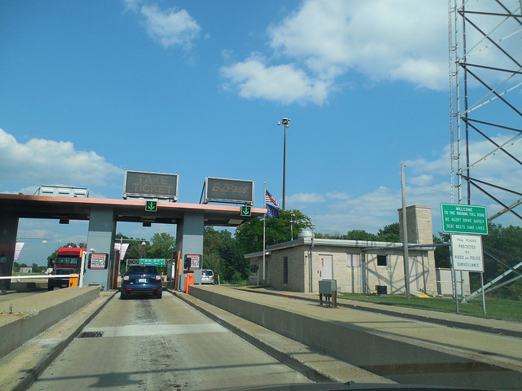
But on a toll road, you can get a ticket if you average speed exceeds the legal limit!

Slide 18
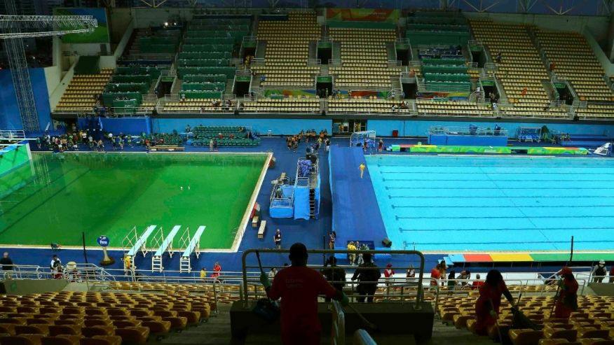
Olympic Controversy
Believe it or not, there was a controversy at the 2016 Rio Olympics that didn’t involve this doofus or uninvited algae trying to make the diving pool celebrate St. Patrick’s Day way too early…
… a controversy involving – linear motion!

Slide 19
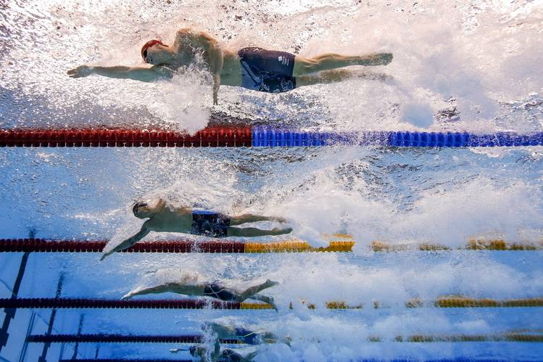
Some data suggests that the water on one side of the Olympic pool had a very small current running through it. The closer a swimmer was to lane 8, the stronger this current.
According to uproxx.com, “For most races, run in both directions, it’s probably negligible, but the 50m, which lacks both the mitigating factors of balanced direction and time, was undeniably affected.”

Slide 20
For races, such as the 100-meter, where swimmers swam both directions across the pool, a small current in the pool would have been _________.
a.) an advantage
b.) a disadvantage
c.) neither an advantage nor disadvantage

Slide 21
For races, such as the 100-meter, where swimmers swam both directions across the pool, a small current in the pool would have been _________.
a.) an advantage
b.) a disadvantage
c.) neither an advantage nor disadvantage

Slide 22
A swimmer would go fast when swimming with the current, and slower when swimming against the current. Since the “upstream” and “downstream” distances are the same, the swimmer will spend more time swimming against the current than they spend swimming with it. Thus the average speed will be less than if there were no current.

Slide 23
Here’s a similar example:
The Flash runs 1200 m at 4.0 × 10² m/s, then turns around and runs back to his start point at 3.0 × 10² m/s. What was his average speed?

Slide 24
At 400 m/s, it takes 3.0 seconds to go 1200 m
At 300 m/s, it takes 4.0 seconds to go 1200 m
Note: Since the Flash spends more time going 300 m/s than he spends running at 400 m/s, his average speed should be closer to 300 m/s.
Recall v_{avg} = ^{total distance}/_{total time}
In this case, v_{avg} = ^{2400 m}/_{7.0 s} = approx. 340 m/s
This was his average speed. So what was his average velocity?
Zero! By returning to where he started, the Flash’s total displacement is 0 m!

Slide 25
Approaches to Problem-Solving
There are a lot of kinematics equations…
v_{avg} = ^{Δd}/_{Δt} a_{avg} = ^{Δv}/_{Δt} v_{f} = v_{i} + at
d = d_{i} + v_{i}t + ½ at² v_{f}² = v_{i}² + 2aΔd
Students can easily freeze, unsure how to begin when faced with a word problem that requires them to apply one or more of these equations.
Which one do they use? What do they plug in?
One strategy: require students to draw a vector motion diagram before they do anything else.

Slide 26
Components of a Vector Motion Diagram:
A series of dots/pictures of the moving object representing its location at equal time intervals.
A set of distinct arrows representing the velocity vectors of the moving object at each point drawn.
A set of distinct arrows representing the acceleration vectors of the moving object.

Slide 27
Example A) A driver moving at 25 m/s applies the brakes and travels 148 m before coming to a stop at a red light. What was the car’s acceleration?
Velocity:
Acceleration:

Slide 28
Example B) Someone standing on a bridge 12.8 m over a river tosses a pebble up into the air at 17.1 m/s. How long does it take before the pebble slashes in the water?
V
A

Slide 29
Given & Wanted
Next, I have students take an inventory of every piece of information that a problem gives them, both explicitly, as well as implied, and put this information into a table. For each value, they are to include the conventional symbol as well as units.
Then I have students list every piece of information the problem is asking for, again using conventional symbols.

Slide 30
Example A) A driver moving at 25 m/s applies the brakes and travels 148 m before coming to a stop at a red light. What was the car’s acceleration?
Velocity:
Acceleration:
Given
Wanted
v_{i} = 25 m/s
a = ?
Δd = 148 m
v_{f} = 0 m/s
Note: The fact that v_{f} = 0 m/s wasn’t explicitly given, but rather must be
inferred given the situation.

Slide 31
Example B) Someone standing on a bridge 12.8 m over a river tosses a pebble up into the air at 17.1 m/s. How long does it take before the pebble slashes in the water?
V
Given
Wanted
v_{i} = 17.1 m/s
t = ?
A
d_{i} = 12.8 m
a = -9.8 m/s²
d = 0 m
Note: Again, these last two values were not
explicitly given, but rather were implied.

Slide 32
Now let’s pick a formula
I ask students to notice just how much time/effort/thought we’ve already put into each problem before we contemplated how to do the math.
By taking the time to wrap our minds around the problem, we’re now in a much better place to pick the right calculation.
Looking at the Given/Wanted charts, it becomes clearer which kinematics equation(s) to use.
Then it’s just a matter of chugging the numbers!

Slide 33
Example A) A driver moving at 25 m/s applies the brakes and travels 148 m before coming to a stop at a red light. What was the car’s acceleration?
Velocity:
Acceleration:
Given
Wanted
v_{f}² = v_{i}² + 2aΔd
v_{i} = 25 m/s
a = ?
a = (v_{f}² - v_{i}²) / (2Δd)
Δd = 148 m
v_{f} = 0 m/s
a = [(0 m/s)² – (25 m/s)²] / (2 × 148m)
a = - 2.1 m/s²

Slide 34
Example A) Someone standing on a bridge 12.8 m over a river tosses a pebble up into the air at 17.1 m/s. How long does it take before the pebble slashes in the water?
V
Given
Wanted
v_{i} = 17.1 m/s
t = ?
d = d_{i} + v_{i}t + ½ at²
A
d_{i} = 12.8 m
0 = 12.8 + 17.1t – 4.9t²
a = -9.8 m/s²
d = 0 m
Solve using the
quadratic formula,
or by using a
graphing calculator…
t = 4.12 s

Slide 35
1-D Kinematics Activities

Slide 36
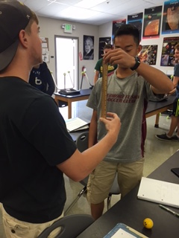
What is Your Reaction Time?
One student holds a small ruler, with the numbering scale beginning at the bottom.
Another student holds their hand ready to catch the ruler when dropped.
Based on how far the ruler falls between the moment it’s let go and the moment it’s caught, one can calculate reaction time using the formula d = ½ at².

Slide 37
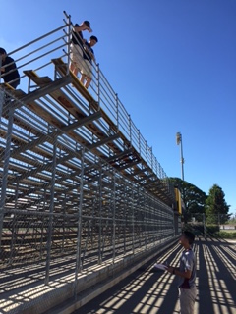
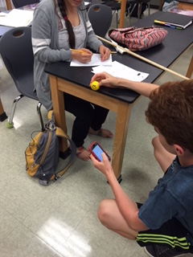
Free-Fall Acceleration: Plotting 2d vs. t²
In this activity, students drop a small object (a rubber ball, for example) a known distance, and time the fall.
In this activity, students drop a small object (a rubber ball, for example) a known distance, and time the fall.
Solving d = ½ at² for a yields a = 2d/t², so students find that if they plot twice the fallen distance on the y-axis and the square of the time it took to fall on the x-axis, the slope of the best-fit line should equal acceleration due to gravity

Slide 38
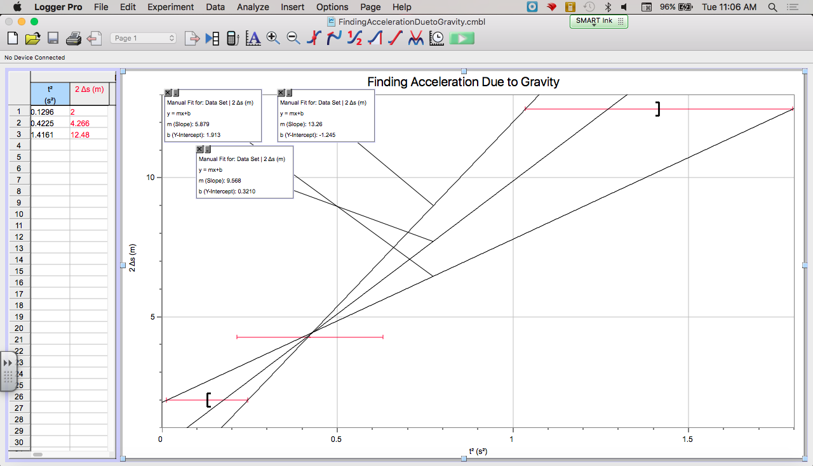

Slide 39
Analyzing GoldenEye
https://www.youtube.com/watch?v=dLF3XDHKm9Y

Slide 40
PTSOS – 2D Kinematics
Projectile Motion

Slide 41
Approaches to Problem-Solving
The key to projectile-motion problem-solving is keeping horizontal motion distinct from vertical motion.
Students often incur errors, for example, by including a velocity in the x-direction in the same equation as acceleration due to gravity, which is in the y-direction.
One method: Color-code everything, both in diagrams, and in equations.

Slide 42
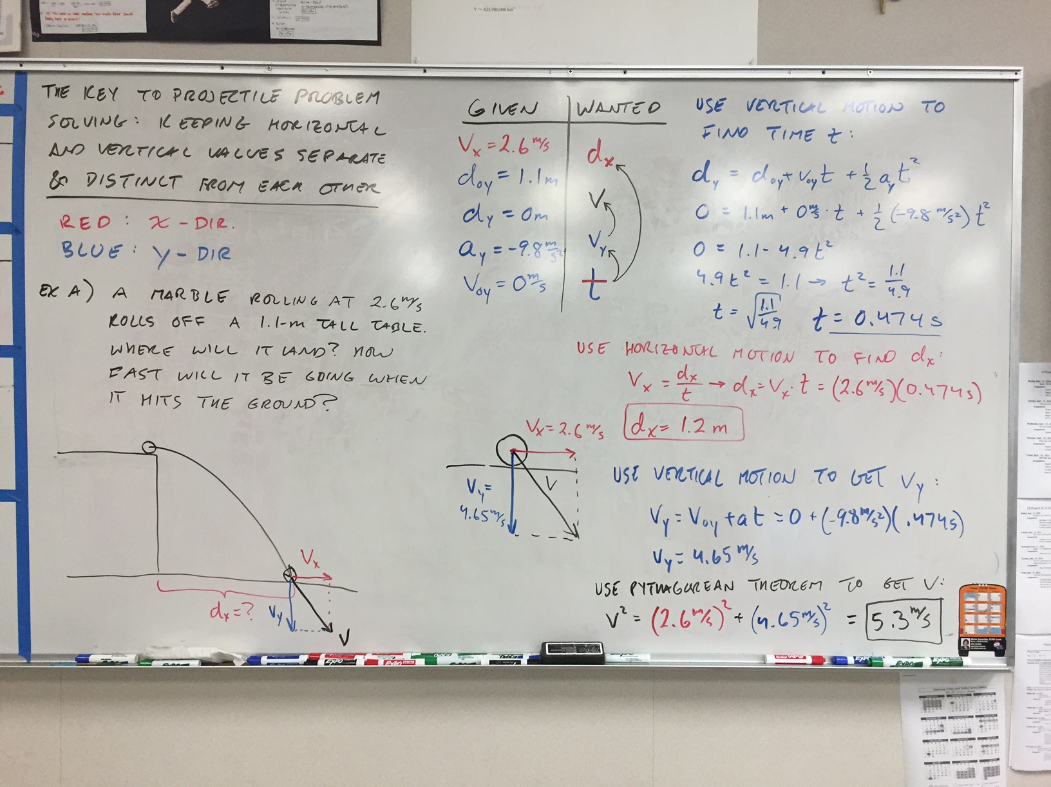

Slide 43
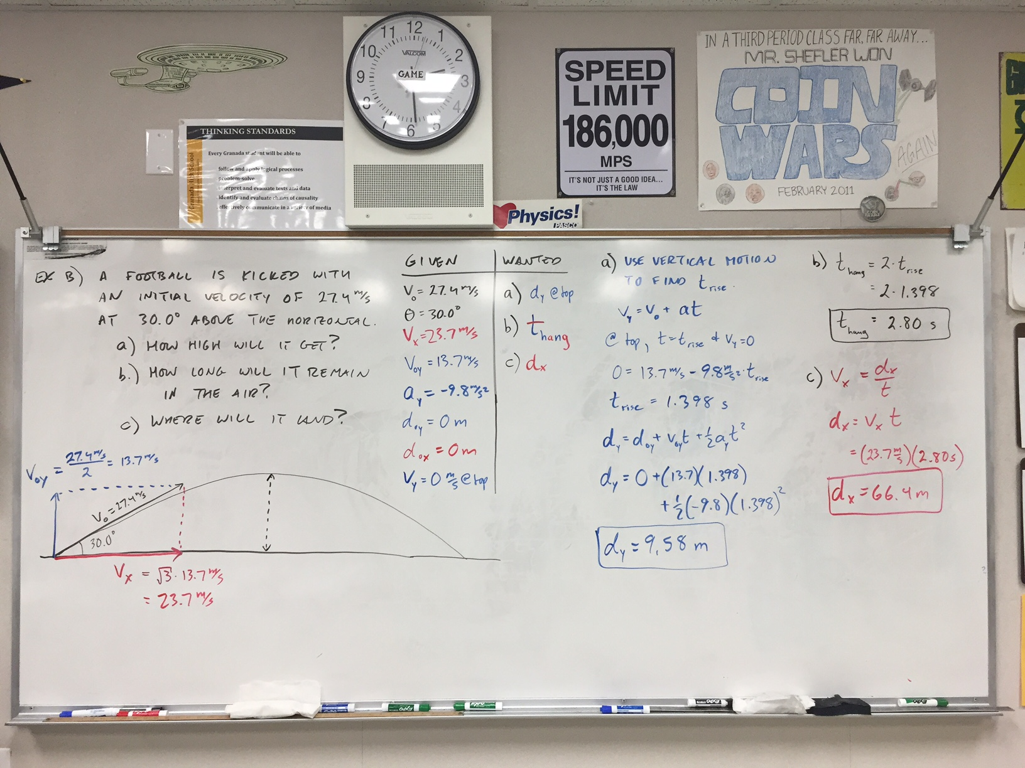

Slide 44
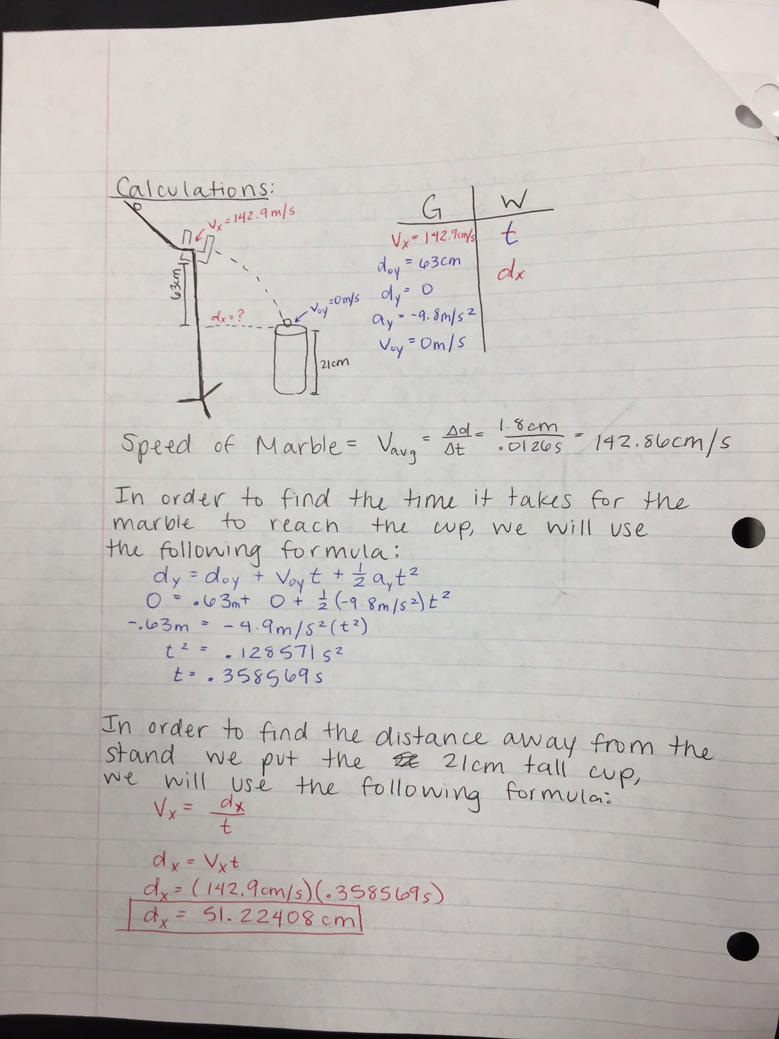
Sample of student work

Slide 45
2-D Kinematics Activities
Demo: Vertical Acceleration Demonstrator
Demo: Monkey v. Hunter (see next slide)
Lab Activity: Bull’s Eye
Lab Activity: Male Bovine Ocular Organ
Lab Activity: Air Rockets
Online Lab Activity: PhET Projectile Simulation (see slide after next)

Slide 46
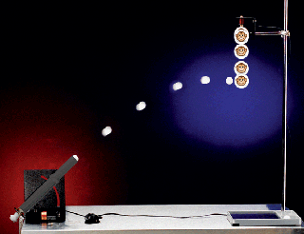
Demo: Monkey & Hunter
http://www.arborsci.com/monkey-and-hunter
https://www.youtube.com/watch?v=cxvsHNRXLjw

Slide 47
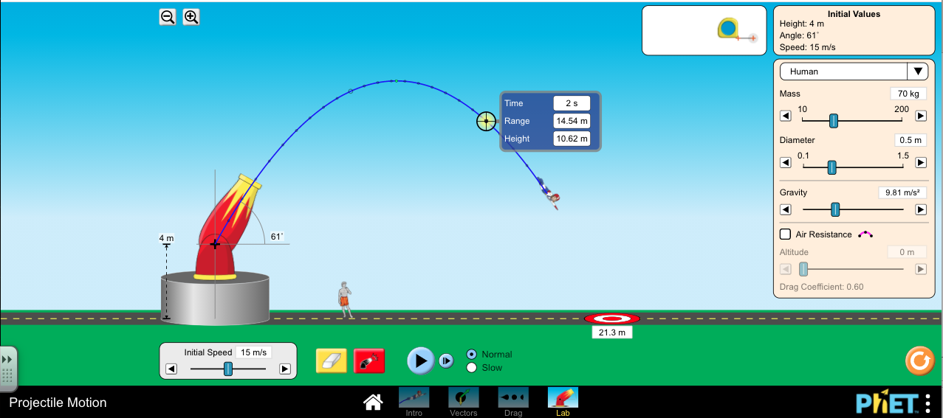
PhET Projectile Simulation
https://phet.colorado.edu/sims/html/projectile-motion/latest/projectile-motion_en.html

Slide 48
PTSOS – Newton’s Laws

Slide 49
Newton’s 1st Law Demos
Wagon and Ball
Inertia Force Experiment (Mini-”Table Cloth” demo)
Ballistics Cart

Slide 50
Developing Newton’s 2nd Law
Lab/Demo Activity: Constant Mass, Changing Force
As mass is transferred from the cart to the end of the string, the force pulling on the end of the string increases, resulting in increasing acceleration of the cart along the table.

Slide 51
Developing Newton’s 2nd Law
Lab/Demo Activity: Constant Force, Changing Mass
As mass is added to the cart, it’s acceleration decreases.

Slide 52
Developing Newton’s 2nd Law
Acceleration is directly proportional to Force: a ~ F
Acceleration is inversely proportional to mass: a ~ ¹/_{m}
Therefore: a ~ ^{F}/_{m}
If a is measured in m/s², m in kg, and F in newtons, the constant of proportionality = 1.
a = ^{F}/_{m} , or F = ma

Slide 53
Newton’s 2nd Law
F_{net} = ma
Note: F_{net} and a are vectors pointing the same direction; m is a scalar multiplier
Note: The net force F_{net} represents the vector sum of all forces acting on a body.

Slide 54
Special Case: Gravity
F_{grav} = ma_{grav}
An object’s weight in newtons is equal to its mass in kg multiplied by by acceleration due to gravity 9.8 m/s² (assuming you’re on Earth).

Slide 55
Consistent Acceleration
Solving for a yields:
a_{grav} = F_{grav} / m
Note: you can’t increase the mass m of an object without also increasing the weight F_{grav} by the same factor. (For example, a rock that has 5 times the mass of another rock also weighs 5 times as much)
Thus the ratio of weight-to-mass will always equal the same value, and (absent air resistance) all objects will fall at the same rate

Slide 57
Approaches to Problem-Solving
The key to problems connecting force and motion is often the drawing of an accurate free-body diagram:
All forces on a body are drawn (roughly) to scale and labeled.
To the side, F_{net} is expressed in terms of the forces labeled in the diagram.
Once you know F_{net}, you can divide by mass to get acceleration, and it becomes a kinematics problem.

Slide 58
Examples
A) A child exerts a 36 N horizontal force as she pulls a 52-N sled across a sidewalk at a constant speed. What is friction force acting on the sled?
F_{normal}
Velocity = constant
implies
a = 0
implies
F_{net} = 0
implies
ΣF_{up} = ΣF_{down} and ΣF_{left} = Σf_{right}
so
F_{normal} = F_{grav} and F_{friction} = F_{pull}
F_{friction}
F_{pull}
F_{grav}

Slide 59
B) A mover exerts a 72 N horizontal force to accelerate a 26.1-kg oak cabinet across a pinewood floor. How long will it take to cross a 35-m long hallway?
F_{normal}
In this case,
F_{net} = F_{push} – F_{friction}
F_{friction}
F_{push}
F_{grav}

Slide 60
C) A thrust of 157 N accelerates a 9.5-kg model rocket upward. How much will it accelerate?
F_{thrust}
In this case,
F_{net} = F_{thrust} – F_{grav}
F_{grav}

Slide 61
D) What is the apparent weight of a 75-kg person in an elevator that’s accelerating up at 1.5 m/s²?
F_{Normal}
In this case,
F_{net} = F_{Normal} – F_{grav}
F_{grav}

Slide 62
If there are forces in multiple directions, it can help to color code the forces in the free body diagram
Example: A cart being pushed up an inclined plane:
F_{Normal}
F_{push}
F_{grav, x}
F_{Net} = F_{push} – F_{grav, x}
F_{grav, y}
F_{grav}

Slide 63
Force & Motion Activities

Slide 64
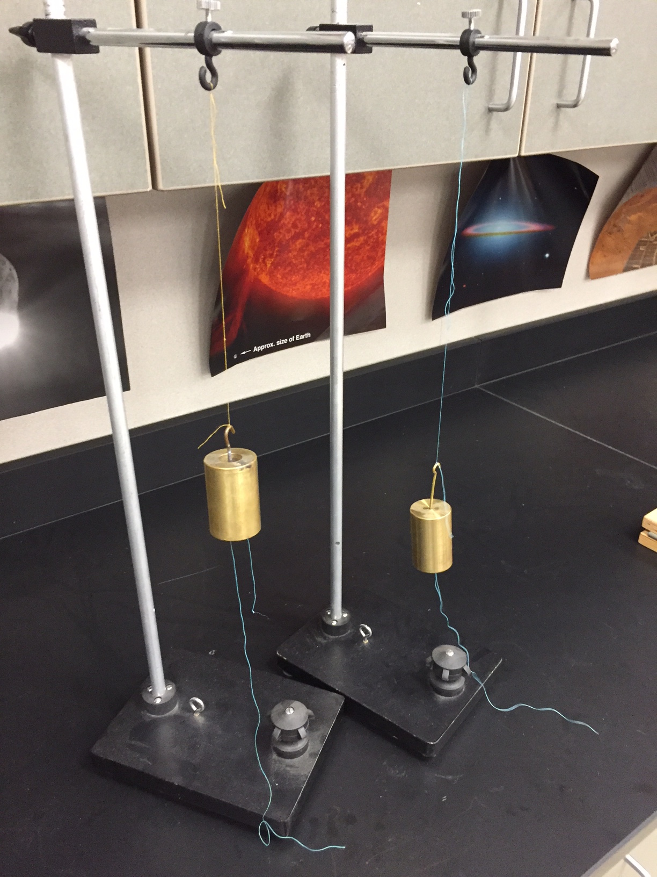
Demo: Which Thread Will Break?
Use two 500-g masses with hooks on both ends.
Tie thread to both hooks and hang the masses from above.
Have students predict which thread will break, the one above the mass, or the one below, if you pull on the bottom thred.

Slide 65
Demo: Which Thread Will Break?
If you pull slowly, the thread above the mass will break, since it feels tension due to both your pull as well as the weight of the 500 g.
If you pull quickly enough, however, the bottom thread will break before the force of your pull can be transmitted (at the speed of sound) up the thread to the top.

Slide 66
From the “Space Junk” Science on Saturday:

Slide 67
SMART Carts & Newton’s 2nd Law
Constant Mass & Changing Force – Show increasing the force on a system of constant mass leads to a proportionally increased acceleration
Constant Force & Changing Mass – Show Increasing the mass of a cart leads to proportionally decreased acceleration
Confirming Newton’s 2nd Law – Use sensors for both acceleration and force to show direction proportionality and that the slope of a force v. acceleration plot = mass!
Using Newton’s 2nd Law – Predict the tension force and acceleration of a known weight pulling a cart of known mass and then confirm with SMART Carts!

Slide 68
Other Newton’s 2nd Law Lab Ideas
Confirming Newton’s 2nd Law with an Atwood Machine
Using Newton’s 2nd Law to predict the acceleration of a cart going down a ramp

Slide 69
Newton’s 3rd Law Demos
Balloon vs. Fan Cart
Balloon Helicopter

Slide 70
PTSOS – Impulse & Momentum
Why do Airbags Work?

Slide 71
Definitions
Impulse: Product of force and the time over which that force occurred
I = F × Δt
Momentum: Produce of mass and velocity
p = mv
How are these concepts connected?

Slide 72
The Impulse-Momentum Theorem
Start with Newton’s 2nd law: F = ma
Recall: a = ^{Δv}/_{Δt}
So F = m (^{Δv}/_{Δt})
Multiply both sides by Δt:
F Δt = m Δv
I = Δp
The impulse experienced by a body is equal to it’s change in momentum!

Slide 73
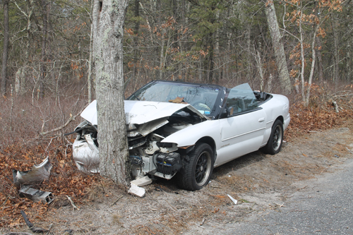
Example:
Suppose a 70.-kg person, driving at 20. m/s, strikes a tree and comes to a stop in 0.10 seconds. What force is experienced by the driver?
I = Δp
F Δt = m Δv
F = (m Δv)/Δt
F = (70 kg × 20 ^{m}/_{s})÷(0.1 s)
F = 14,000 N
But, what aren’t we taking into account?

Slide 74
Air Bags!

Slide 75
Which quantity does an air bag change in our calculation?
Δt
m
Δv

Slide 76
Which quantity does an air bag change in our calculation?
Δt
m
Δv

Slide 77
Suppose an airbag extended the driver’s crash from 0.10 s to 1.0 s. How much force would the driver experience now?
I = Δp
F Δt = m Δv
F = (m Δv)/Δt
F = (70 kg × 20 ^{m}/_{s})÷(1.0 s)
F = 1,400 N

Slide 78
SMART Cart Activity: Confirming Impulse-Momentum Theorem
Determine the mass of your SMART Cart first.
Pull a SMART Cart, starting from rest, part of the way across the track, monitoring force, time, and velocity.
Plot force v. time. Use SPARKvue to find the area under the curve during the time interval you were pulling in order to determine the impulse you imparted to the SMART Cart.
Use the velocity of the SMART Cart at the end of your pull along with known mass to calculate change in momentum.

Slide 79
SMART Cart Activity: Confirming Work-Kinetic Energy Theorem
Determine the mass of your SMART Cart first.
Pull a SMART Cart, starting from rest, part of the way across the track, monitoring force, position, and velocity.
Plot force v. position. Use SPARKvue to find the area under the curve during the time interval you were pulling in order to determine the work you did to the SMART Cart.
Use the velocity of the SMART Cart at the end of your pull along with known mass to calculate change in kinetic energy.

