Slide 1
Unit 1: Measurements & Uncertainties
Part 2 – Uncertainty & Error

Slide 2
Table of Contents
Types of Uncertainty
Calculating Uncertainty
Propagated Uncertainty

Slide 3
Physics is an experimental science.
No measurement can be infinitely accurate – there will always be some uncertainty.
Types of Uncertainty:
Systematic Error – Uncertainty due to an incorrectly calibrated instrument
Random Error – Uncertainty due to human imperfection or difficulty reading instruments.

Slide 4
Systematic Uncertainty
Note: Systematic Errors will always be biased in the same direction.
Examples:
Using a ruler on a hot day – The ruler will expand in the heat, so all measurements will be too small.
Using a scale which reads 0.5 grams even when empty – Every measurement will be too large.
Doing more measurements won’t help with systematic errors.

Slide 5
Random Uncertainty
In contrast, random errors can be biased in either direction.
Examples:
Timing an event with a stopwatch
Estimating a length which falls between the tick marks of a ruler
In the first case, random uncertainty is due to the procedure used – the accuracy of a stopwatch is limited by the reaction time of the user.
In the second case, random uncertainty is due to the equipment used – the accuracy is limited by the precision of the ruler. This type of random uncertain is called a “reading uncertainty” since there is a limit to how accurately you can read the measurment.

Slide 6
Reading Uncertainty
Note: Reading Uncertainties are always equal to half the smallest unit of precision indicated on the device used for measuring.
Example: If you use a ruler with tick marks every mm, your measurements should be recorded ±0.5 mm or ±0.05 cm

Slide 7
Some vocab
Suppose a value is recorded as a = a₀ ± Δa
a₀ = the best estimate or mean value
Δa = the absolute uncertainty
Δa/a₀ = the fractional uncertainty
(Δa/a₀) × 100% = percent uncertainty

Slide 8
Example
Suppose a length is determined to be: L = 42.6 cm ±0.1 cm
The best estimate for this length is 42.6 cm
The absolute uncertainty for this length is 0.1 cm
The fraction uncertainty here = ^{0.1 cm}/_{42.6 cm} = 0.0023
The %-uncertainty = (^{0.1 cm}/_{42.6 cm})×100% = 0.23%
Note: Δa and a₀ must have the same units to calculate fractional and %-uncertainty.
Also note: We will use the convention that any final absolute uncertainty can have only one significant figure

Slide 9
Propagation of Uncertainty
If you measure a value, and then use that value to calculate something, the uncertainty in the initial value will propagate into uncertainty in the final result.
How bad the final uncertainty is depends on how bad the initial uncertainties were that went into the calculation, and what type of calculation did you do.
The following xkcd cartoon nicely summarizes things….

Slide 10
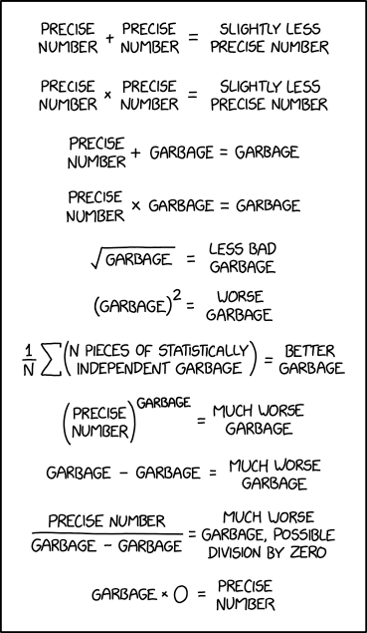

Slide 11
How to Calculate Propagated Uncertainty
Let a, b, and c be directly measured values such that:
a = a₀ + Δa
b = b₀ + Δb
c = c₀ + Δc
If Q is a new quantity calculated from a, b, and/or c, there are two rules for how to determine uncertainty in Q:
Rule #1: If Q is calculated by adding or subtracting a, b, and c, then the absolute uncertainty of Q equals the sum of the absolute uncertainties of a, b, and c:
Example: If Q = a + b – c , then ΔQ = Δa + Δb + Δc

Slide 12
How to Calculate Propagated Uncertainty
Rule #2: If Q is calculated by multiplying or dividing a, b, and c, then the fractional uncertainty of Q equals the sum of the fractional uncertainties of a, b, and c:
Example: If Q = ^{ab}/_{c} , then ΔQ = Δa + Δb + Δc
Q₀
a₀
b₀
c₀
Since any expression written as an exponent can also be written as a product (for example, a⁴ = a×a×a×a) one can show the following corollary to Rule #2:
If Q = a^{n}, then ΔQ = |n|×Δa
Q₀
a₀

Slide 13
Example Problem A
The dimensions of a rectangle are measured to be 8.0 cm ± 0.1 cm and 13.0 cm ± 0.05 cm. Find the perimeter and area of the rectangle, including absolute error.
Let’s find perimeter first:
P₀ = L₀ + L₀ + w₀ + w₀ = 2(8.0 cm) + 2(13.0 cm) = 42.0 cm
Since we’re adding to get P, we use Rule #1:
ΔP₀ = ΔL₀ + ΔL₀ + Δw₀ +Δ w₀ = 2(0.1 cm) + 2(0.05 cm) = 0.3 cm
So P = 42.0 cm ± 0.3 cm

Slide 14
Now let’s find area:
A₀ = L₀ w₀ = (8.0 cm)(13.0 cm) = 104 cm²
Since we’re multiplying to get A, we use Rule #2:
^{ΔA}/_{A0} = ^{ΔL}/_{L0} + ^{Δw}/_{w0}
^{ΔA}/_{104 cm^2} = ^{0.1 cm}/_{8.0 cm} + ^{0.05 cm}/_{13.0 cm}
Solving for ΔA yields 1.7 cm².
But final absolute uncertainties should have only one significant figure, so ΔA ≈ 2 cm²
So A = 104 cm² ± 2 cm²

Slide 15
Example Problem B
A mass is measured to be 4.4 kg ± 0.2 kg and its speed is measured to be 18 m/s ± 2 m/s. The formula for kinetic energy is K = ½mv², where K = kinetic energy in joules if mass m is measured in kg and velocity v is measured in m/s. Find the kinetic energy of the mass, including absolute uncertainty.
Let’s find best estimate first:
K₀ = ½ m₀v₀² = ½ (4.4 kg)(18 m/s)² = 712.8 J

Slide 16
Since we’re multiplying to get K, we use Rule #2:
^{ΔK}/_{K0} = ^{Δm}/_{m0} + 2^{Δv}/_{v0} (Note: the 2 is due to the exponent on the v)
^{ΔK}/_{712.8 J} = ^{0.2 kg}/_{4.4 kg} + 2(^{2 m/s}/_{18 m/s})
Solving for ΔK yields 190.8 J.
But final absolute uncertainties should have only 1 sig fig.
So ΔK = 200 J
Since our uncertain in energy ΔK is measured in hundreds of joules, it doesn’t make sense to report our best estimate K₀ for energy to a greater level of precision than that.
K₀ = 712.8 J ≈ 700 J
So our final answer is: K = 700 J ± 200 J

