Slide 1
Welcome to PTSOS!
Spring Workshop Mar. 19, 2022:
Oscillation, Waves, Sound, Light, Electricity & Magnetism
Dan Burns
PASCO Curriculum Developer
Teacher, Los Gatos HS (retired)
Tom Shefler
Physics Teacher, Granada HS
Abigail Plemmons
Physics Teacher, Granada HS
David Rakestraw
Lawrence Livermore National Laboratory

Slide 2
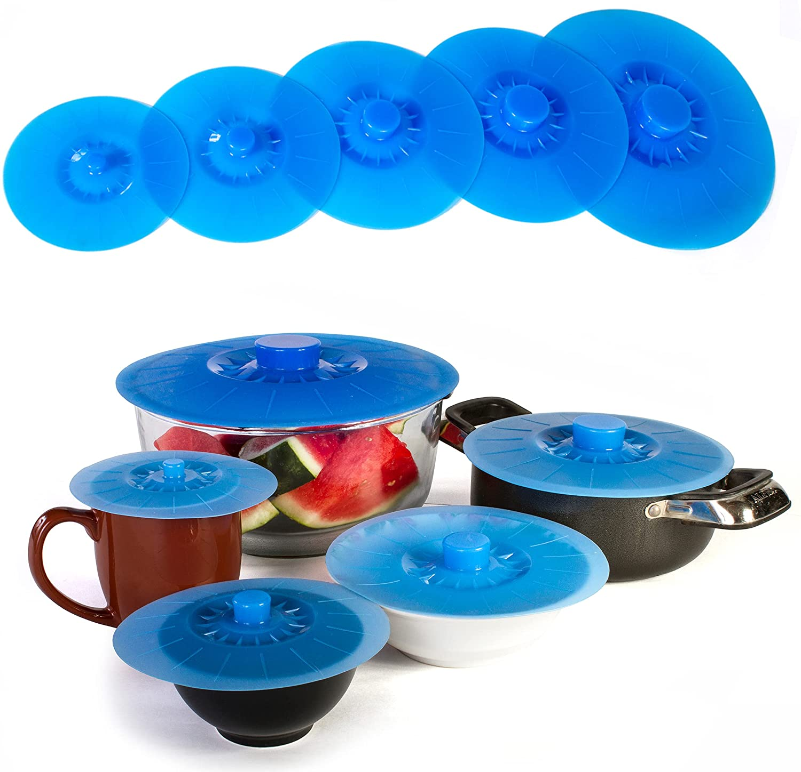
Let’s Start the Day with some Pressure!
Suction Lid Demo:
Atmospheric Pressure = 14.7 psi.
Use area of suction lid to calculate force of Earth’s atmosphere on it!

Slide 3
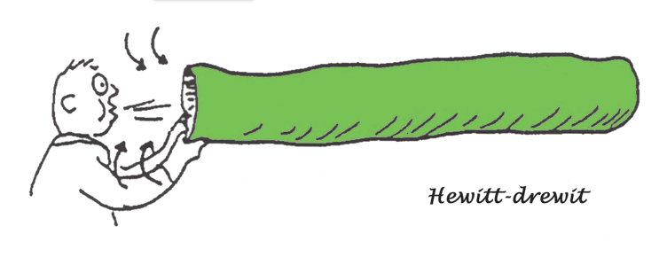
Demo: Bernoulli Bag
Bernoulli bags can be purchased from Arbor Scientific:
http://www.arborsci.com/bernoulli-bags

Slide 4
Physics:
Oscillations & Waves

Slide 5
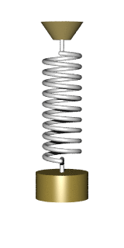
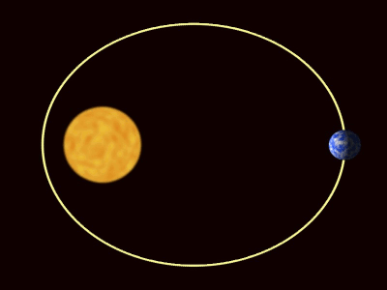
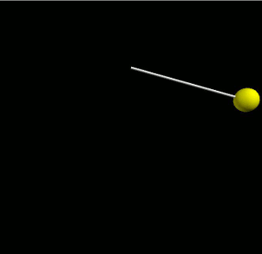
Oscillations
Periodic Motion: Movement that repeats in cycles with regular intervals.
Examples:
A planet orbiting the Sun
Mass swinging on the end of a string (pendulum)
Mass oscillating on the end of a spring

Slide 6
Simple Harmonic Oscillation
Special type of periodic motion: Simple Harmonic Motion
In Simple Harmonic Motion (SHM), oscillation is due to a restoring force
If mass is displaced from an equilibrium position, a force occurs, pulling the mass back toward the equilibrium position
The magnitude of this force is directly proportional to the magnitude of displacement but opposite in direction:
F ~ -x
(And since F = ma, a ~ -x too)

Slide 7
Which of these examples of periodic motion also serve as examples of Simple Harmonic Motion?
Examples:
A planet orbiting the Sun
Mass swinging on the end of a string (pendulum)
Mass oscillating on the end of a spring

Slide 8
Which of these examples of periodic motion also serve as examples of Simple Harmonic Motion?
Examples:
A planet orbiting the Sun
Mass swinging on the end of a string (pendulum)
Mass oscillating on the end of a spring

Slide 9
Ways to Quantify SHM
Period (T) – the amount of time one complete cycle takes.
Amplitude (x_{max} or θ_{max}) – The maximum displacement away from an equilibrium position.
Frequency (f) – A measure of how often each cycle repeats.
Note: frequency is the inverse of period: f = ¹/_{T}.
Units of frequency: sec⁻¹ (or Hz)

Slide 10
Equations
Here are equations for the periods of a pendulum and oscillating spring:
T_{pendulum} = 2π √(^{L}/_{g})
T_{spring} = 2π √(^{m}/_{k})
Note: mass affects the spring but NOT the pendulum.
Also note: neither is influenced by amplitude.

Slide 11
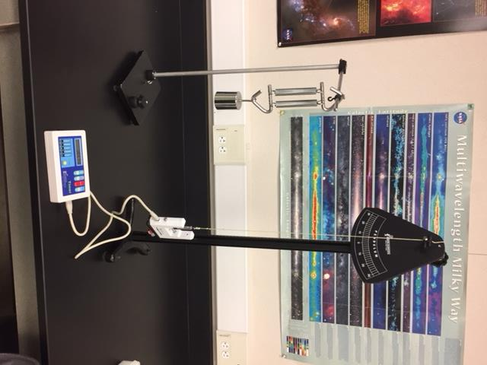
Oscillation Lab Ideas
What Affects the Period of a Pendulum?
Using a Pendulum to Measure g
Using Oscillation and Hooke’s Law to Determine Spring Constants

Slide 12
Hallmarks of Simple Harmonic Motion
Period & amplitude are constant
Period is independent of amplitude
Displacement, velocity, and acceleration are all sine (or cosine) curves

Slide 13
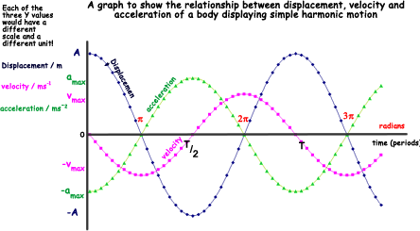
Note: velocity = 0 when displacement is a min or max
Also note: acceleration ~ -displacement

Slide 14
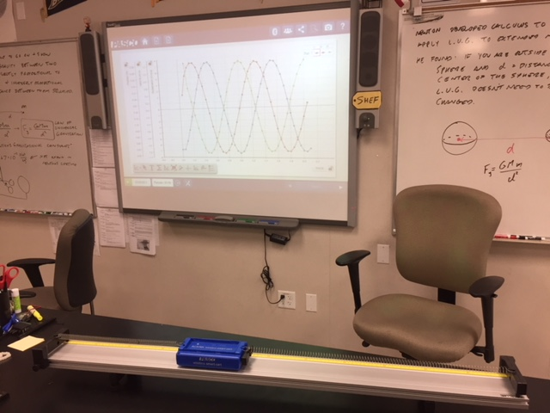
Smart Cart Demo

Slide 15
Waves
A wave is a rhythmic disturbance in which energy is conveyed through a medium
In the case of electromagnetic waves (i.e. light), the medium is space itself.
Though the energy of pulse or wave propagates through space, matter itself does NOT travel with the wave.

Slide 16
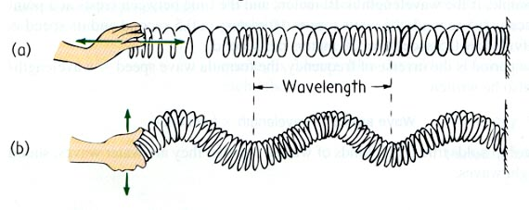
Longitudinal Wave: Wave in which particles in the medium vibrate in a direction parallel to the direction of wave propagation
Transverse Wave: Wave in which particles in the medium vibrate in a direction perpendicular to the direction of wave propagation.

Slide 17
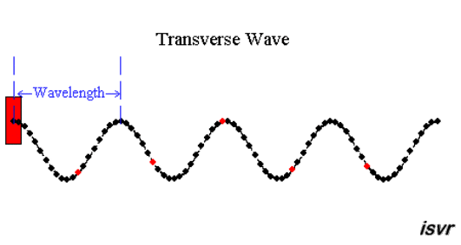
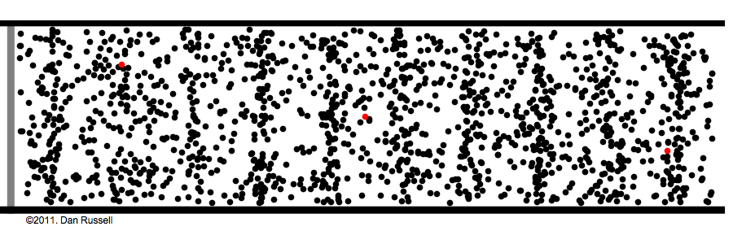
Longitudinal Wave

Slide 18
Earth Science Connection: Whether earthquake waves are longitudinal or transverse provides a window into Earth’s interior.
P-waves, which are pressure waves, can travel through liquid, but s-waves cannot.
Thus, when an earthquake occurs somewhere on Earth, if geologists around the world monitor the event and share their data, they can deduce the size of Earth’s liquid center!

Slide 19
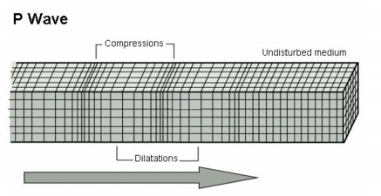
P-Waves
P stands for “primary” or “pressure”.
These are longitudinal waves. This means that disturbed particles vibrate in the same direction as the motion of the wave.
In other words, the crests travel as compressions.
Sound waves are another example of longitudinal waves.

Slide 20
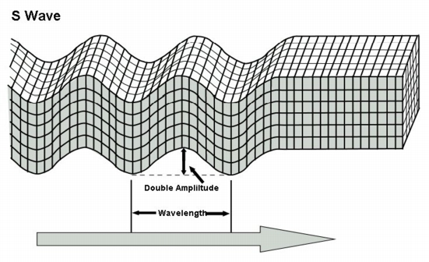
S-Waves
S stands for “secondary” or “seismic”.
S-waves are transverse waves, which means that disturbed particles vibrate in a direction perpendicular to the direction of wave travel, like ripples in a pond, or people “doing the wave” in a stadium.

Slide 21
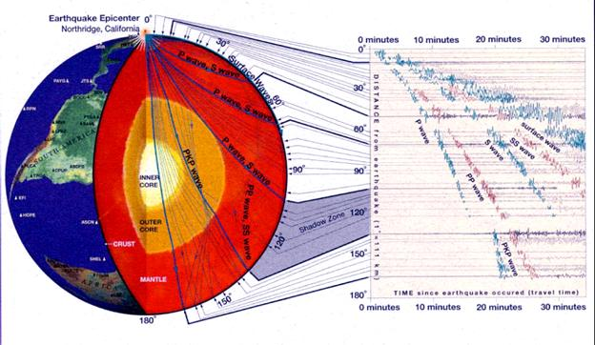

Slide 22
Slinky Science activities for students:
http://swift.sonoma.edu/education/slinky_booklet/
This booklet, developed by NASA and Sonoma State University, includes activities where students explore wave propagation, standing waves, interference, and the relationships between wavelength, energy, and frequency of a wave, all using slinkies!

Slide 23
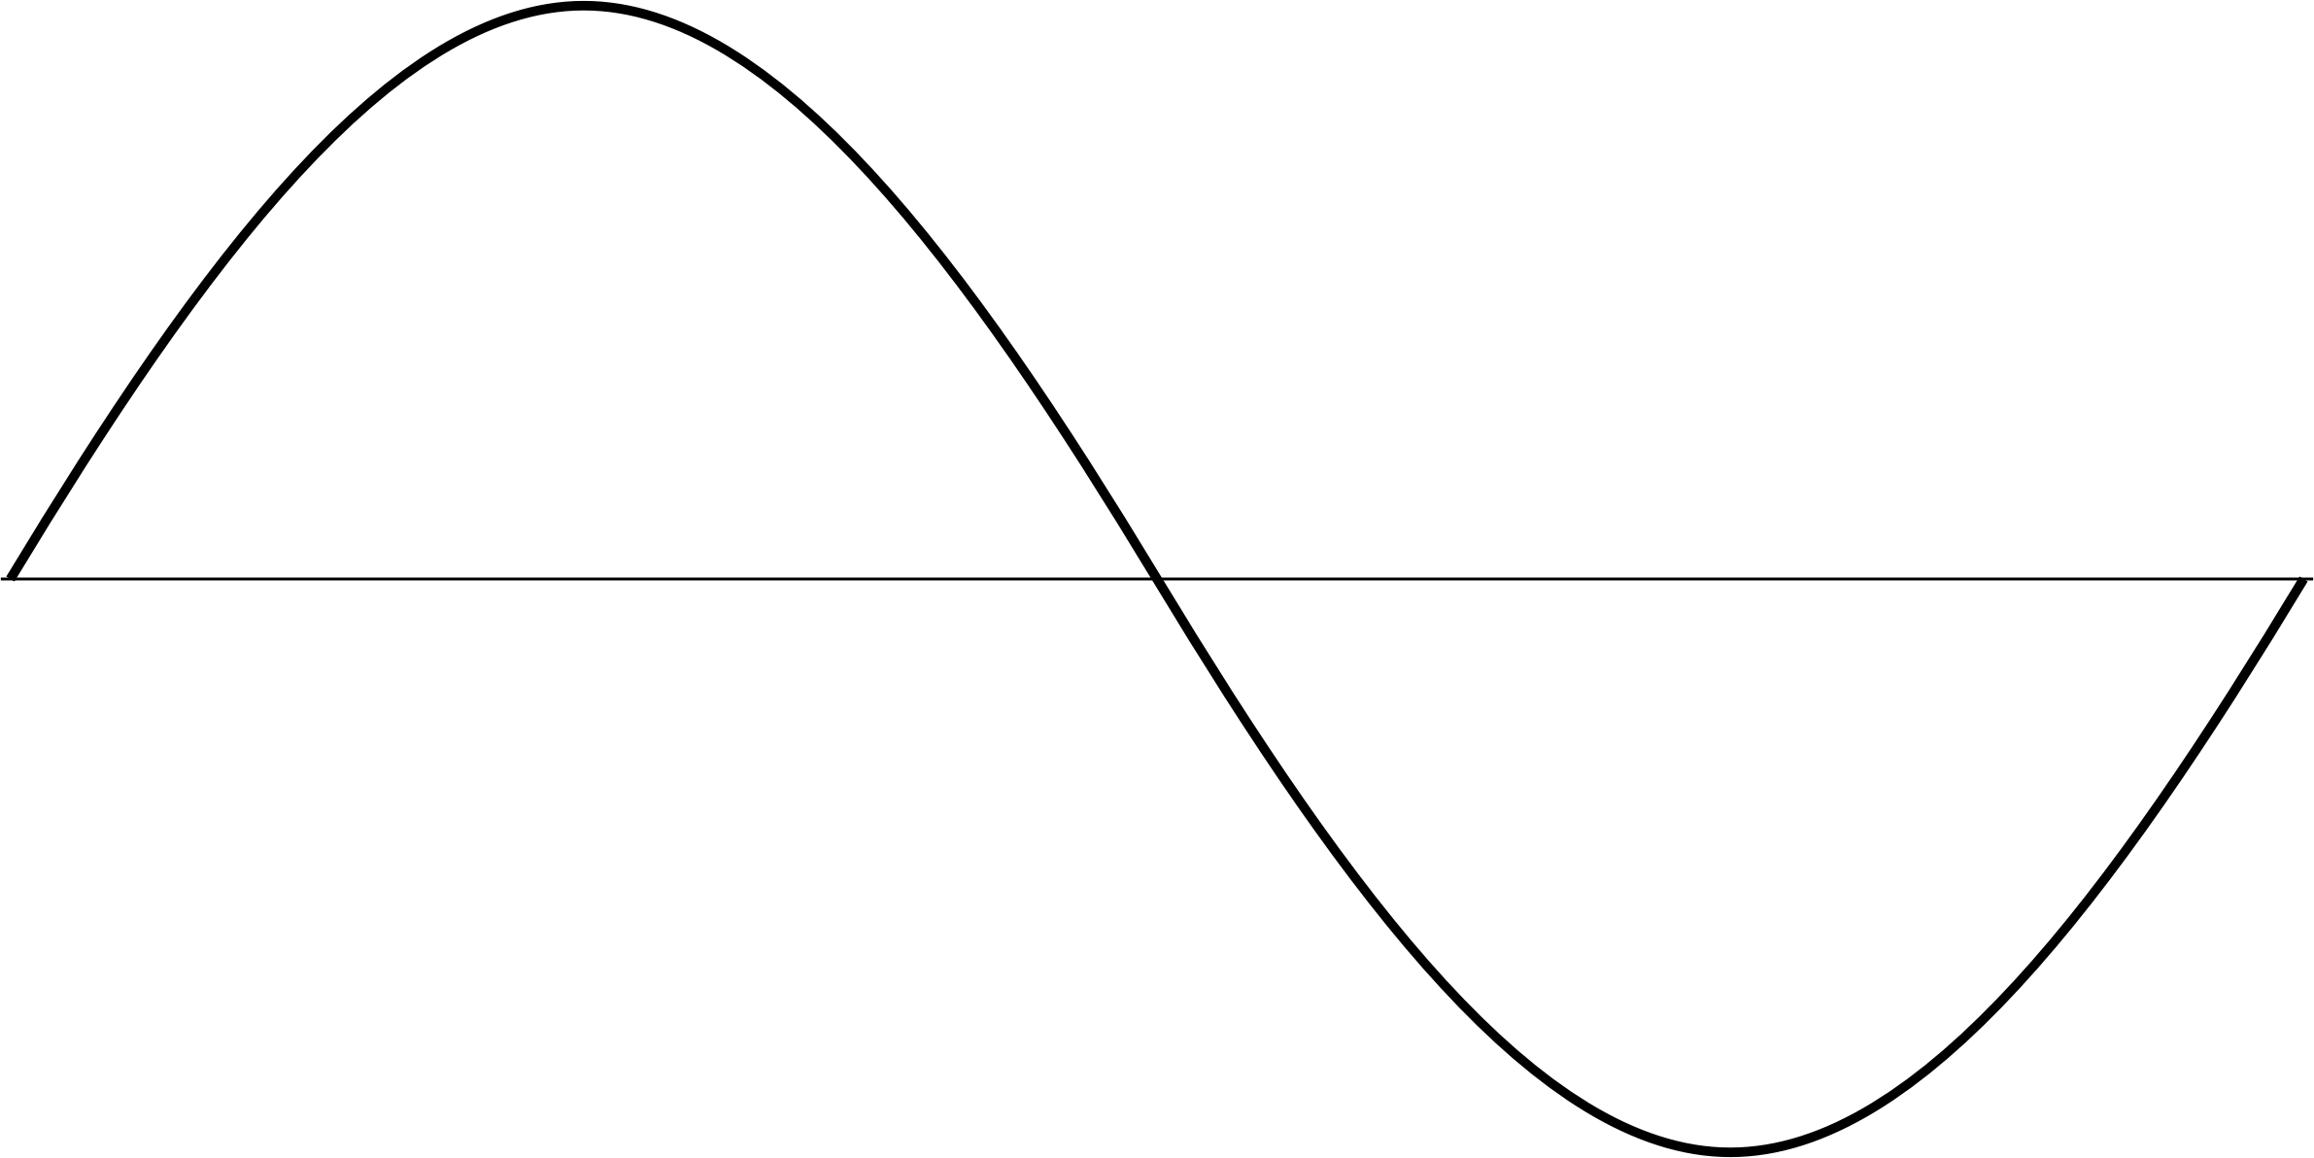
Representing Waves with Sine Curves
Crest: High point of a wave
Trough: Low point of a wave

Slide 24
Representing Waves with Sine Curves
Amplitude: Distance from wave’s midpoint to either crest or trough

Slide 25
Representing Waves with Sine Curves
λ
λ
λ
Wavelength: Length of one complete cycle

Slide 26
Other Wave Properties
Period: The amount of time it takes for one complete cycle to pass by a stationary point.
Symbol: T
Unit: seconds
Wave Speed: The speed of any given crest or trough of the wave.
Symbol: v
Unit: m/s
Frequency: The rate at which complete cycles pass by a stationary point. (For example: The number of crests that pass by a given spot per unit time)
Symbol: f
Unit: s⁻¹, or Hz

Slide 27
Wave equations
Basic formula for speed: v = ^{d}/_{t}
For a wave, the relevant distance is wavelength and time is period, so
v = λ/T
Frequency is the inverse of period, so
f = ¹/_{T}
If you substitute this expression into the equation for wave speed, you can write
v = λf

Slide 28
Example Problem: A sound wave has frequency 280 Hz and speed 343 m/s. a) What is the wavelength? b) What is the period? c) How long would it take to hear an echo from a canyon wall 250 away?
v = λf, so λ = ^{v}/_{f} = ^{343 m/s}/_{288 Hz} = 1.2 m
T = 1/_{f} = ¹/_{288 Hz} = 0.0036 s
v = ^{d}/_{t} = ^{500 m}/_{343 m/s} = 1.5 s (Note: 500 m is the round trip distance)

Slide 29
Principle of Superposition:
You will never see these two guys in the same location!
Oops! Wrong Principle of Superposition!

Slide 30
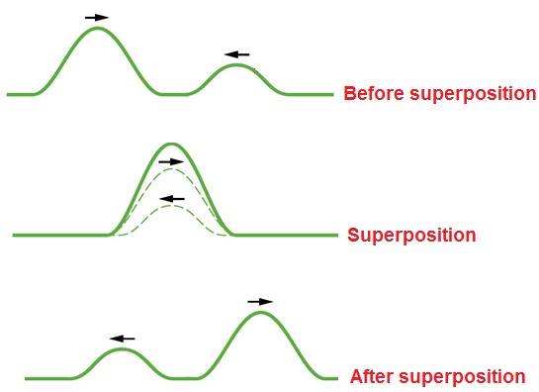
Principle of Superposition:
When two waves or pulses occupy the same position in space, their amplitudes add together.

Slide 31
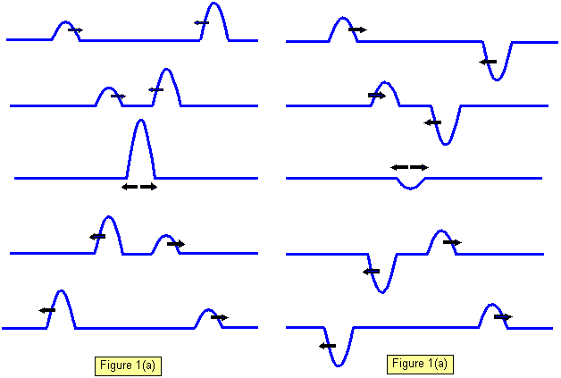
When one wave or pulse reinforces another, resulting in greater amplitude, constructive interference occurs.
When one wave or pulse – either totally or partially – cancels out another, destructive interference occurs.

Slide 32
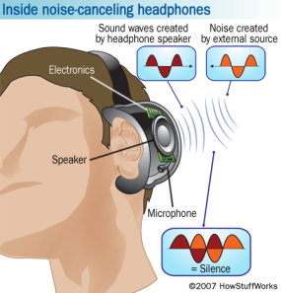

Slide 33
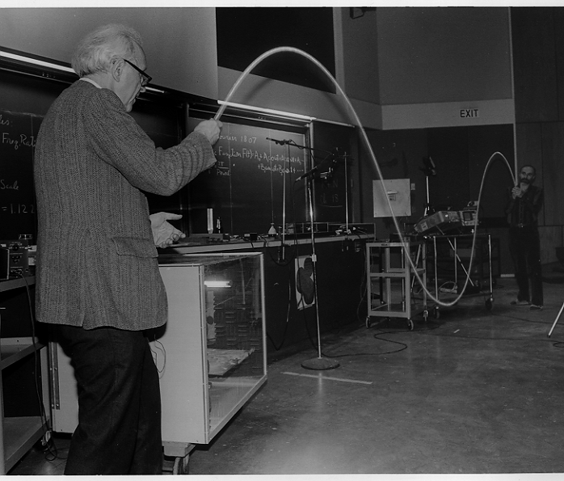
Standing Waves
If a wave interferes just right with its own reflection, a standing wave can occur.
A standing wave features nodes (where destructive interference constant occurs) and anti-nodes (where constructive interference constantly occurs.

Slide 34
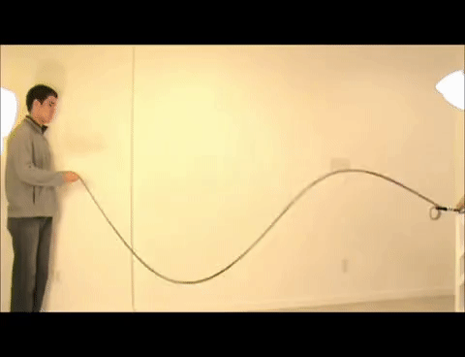
Anti-Node
Node

Slide 35
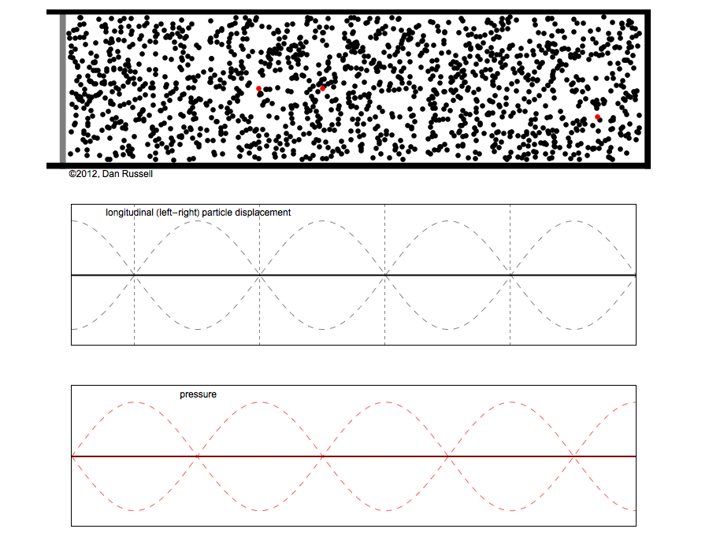

Slide 36
Resonance
Most rigid, elastic bodies will vibrate at a natural frequency if disturbed.
This frequency will depend on the shape and composition of the body.
If an object is pushed at regular intervals such that the regularity of the force = the natural frequency of vibration, then amplitude of vibration will increase.
This phenomenon is called Resonance.

Slide 37
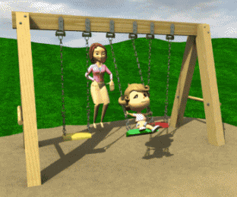
Suppose the natural frequency of a child playing on a swing is 0.50 Hz. That is, the period of oscillation is 2.0 s.
How often should the child’s mother push the child?
Every 2.0 s, duh!
Would pushing half as often, i.e. every 4.0 s work?
Sure!
How about twice as often?
Absolutely not!

Slide 38
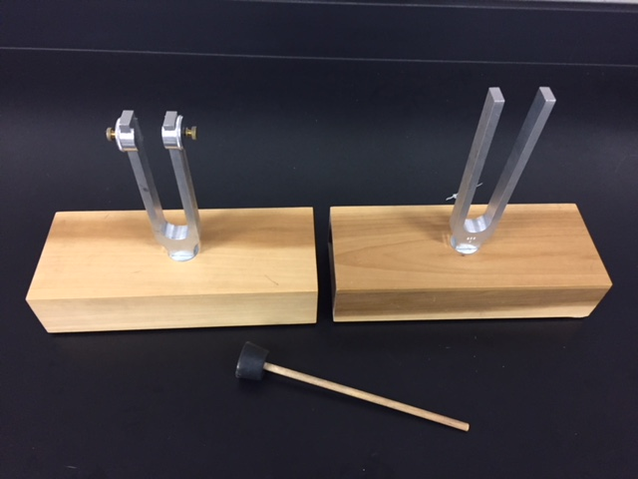
Resonance Demo

Slide 39
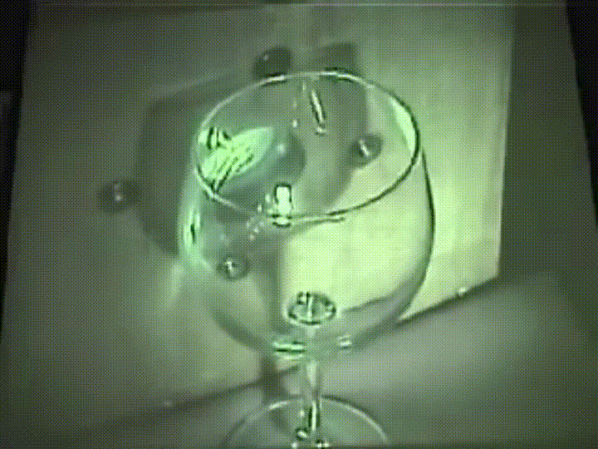
More Examples of Resonance…

Slide 40
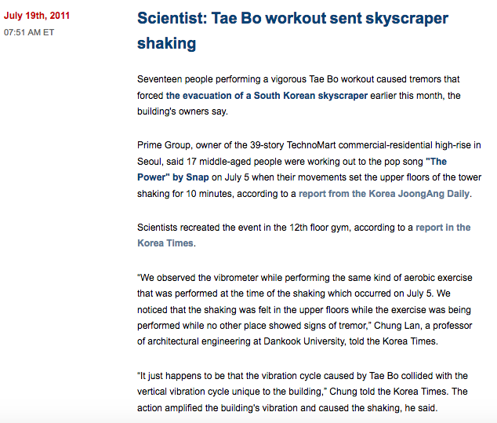

Slide 41
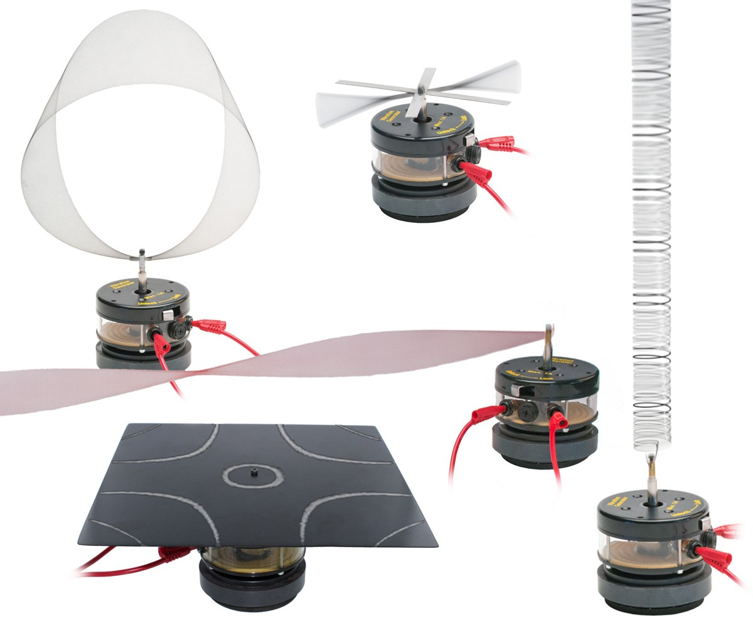
Standing Wave & Resonance Demos with Arbor Scientific
http://www.arborsci.com/shop-by-topic/waves-sound/wave-motion/mechanical-wave-value-pack

Slide 42
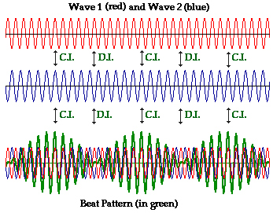
Finding the Beat
If two tuning forks with different frequencies are sounded together, a beat is heard.

Slide 43
Finding the Beat
The frequency of the beat is equal to the difference in the frequencies of the two tuning forks:
F_{beat} = F_{higher} – F_{lower}
Since the period of a recurrent phenomenon is equal to 1 over the frequency, this formula may be rewritten:

Slide 44
Earth Science Connection: Using the Beat to Measure Orbital Periods
This formula doesn’t just apply to sounds or musical notes – it applies to any recurring period phenomena, from cars whose turn signals blink at different rates, to planets orbiting the sun.
It was known for centuries that the Sun, Earth, and Mars align every 779 days.
(How could a patient person discover this?)
Answer: This is often Mars rises exactly at sunset.
Each such alignment can be thought of as a beat – the coinciding of two recurring phenomena, in this case, the orbits of two planets.

Slide 45
A Martian Year
So, T_{beat} = 779 days.
T_{short} must = T_{earth} since Earth is closer to the Sun than mars, so T_{short} = 365 days.
Finally T_{long} = T_{mars}.
T_{mars} = 687 days.

Slide 46
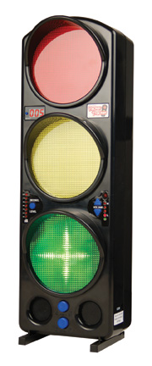
The Yacker Tracker: Demonstrating the Decibel Scale

Slide 47
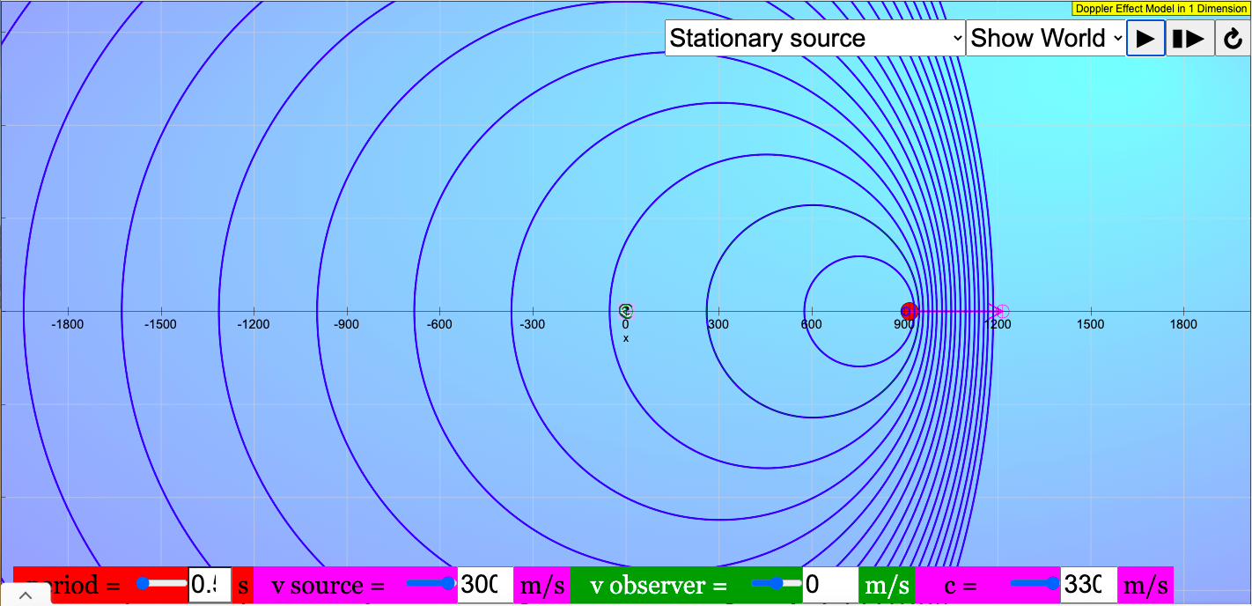
Illustrating the Doppler Effect and Sonic Booms
https://iwant2study.org/lookangejss/04waves_14sound/ejss_model_dopplerxywee01/dopplerxywee01_Simulation.xhtml

Slide 48
Light, Color & Spectroscopy
Polarized Light Demos
Color Spotlight Demo
White Lightning Stick & Mysterious Glowing Ball

Slide 49
Reflection & Refraction
Diffuse v. Specular Reflection
How much do you see in a mirror?
Curved mirrors: Flashlights and “holograms”
Laser Refraction Tank Demo
Total Internal Reflection Demos
Lab: Speed of Light in Jell-O©
Assorted reflection & refraction toys

Slide 50
Question: If you are looking at yourself in a mirror, and then back away from the mirror, what should happen?
A) You should see more of your reflection.
B) You should see less of your reflection.
C) You should see the same amount of your reflection.
D) You should see yourself winning the Quidditch Cup.
E) You’re a vampire, and this is a trick question.

Slide 51
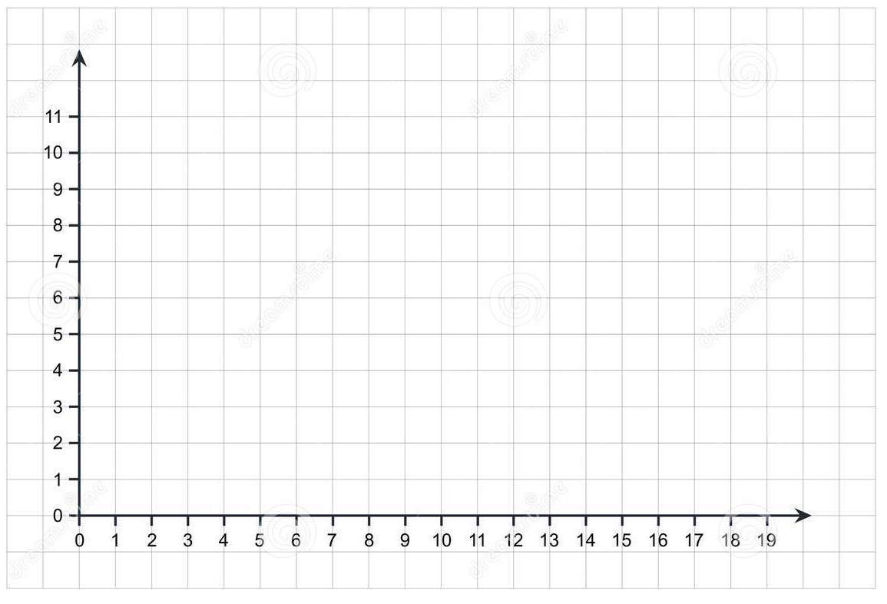
Mirror

Slide 52
Mirror

Slide 53
Mirror

Slide 54
Question: If you are looking at yourself in a mirror, and then back away from the mirror, what should happen?
A) You should see more of reflection.
B) You should see less of reflection.
C) You should see the same amount of your reflection.
D) You should see yourself winning the Quidditch Cup.
E) You’re a vampire, and this is a trick question.

Slide 55
So how large a mirror would you need to see your whole reflection?
A) More than your exact height
B) Your exact height
C) Half your height
D) Less than half your height
E) It depends on how far you are from the mirror.

Slide 56
Mirror
Original
Reflected Image
You only need mirror here.

Slide 57
Mirror
Original
Reflected Image
H
H’
E
M₁
M₂
F
F’

Slide 58
Mirror
Original
Reflected Image
H
H’
E
M₁
ΔEM₁M₂
~
ΔEH’F’
Each side of the smaller triangle is half the length of the corresponding side of the larger triangle.
M₂
F
F’

Slide 59
Mirror
Original
Reflected Image
So this = half the person’s height

Slide 60
So how large a mirror would you need to see your whole reflection?
A) More than your exact height
B) Your exact height
C) Half your height
D) Less than half your height
E) It depends on how far you are from the mirror.

Slide 61
Reflection & Refraction
Diffuse v. Specular Reflection
How much do you see in a mirror?
Curved mirrors: Flashlights and “holograms”
Laser Refraction Tank Demo
Total Internal Reflection Demos
Lab: Speed of Light in Jell-O©
Assorted reflection & refraction toys

Slide 62
Diffraction & Interference
Seeing around a corner?
“Plucking an eyelash” demo
Labs: Grooves on a CD; Width of a human hair
An aside: The Michelson Interferometer & Gravitational Waves

Slide 63
The Michelson Interferometer
Invented by Albert Michelson, the interferometer is a device used for performing incredibly sensitive and tiny measurements using the principle of interference.
(Michelson, recall, was the American who won the Nobel Prize for measuring the speed of light with his rotating mirror experiment)
Initially used in the famous 1887 Michelson-Morley Experiment, the interferometer was intended to demonstrate the existence of the luminiferous aether – a mysterious substance thought to fill space and was the medium which conveyed light the way air conveys sound.
By showing that the aether didn’t exist, Michelson and Morley laid the groundwork for Einstein to come up with the Theory of Special Relativity less than 20 years later.
Michelson interferometers are still used today in countless experiments and materials-testing facilities, and were key in one of the biggest scientific breakthroughs of the last century: the discovery of gravitational waves!
The interferometer operates by splitting a ray of light, sending the two resulting beams down different paths, then bringing them back together and observing the resulting interference.

Slide 64
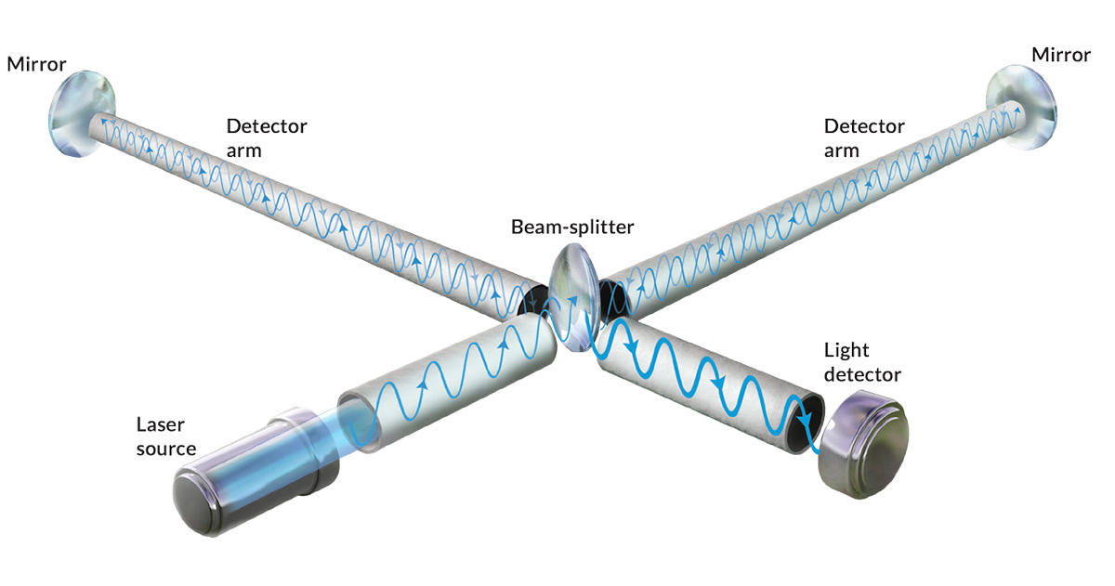
How Interfero-metry Works
A single monochromatic light beam is fired, which is then split into two separate beams which travel along perpendicular paths.
After traveling through long detection arms, these beams then reflect off of distant mirrors.
The beams come back and recombine into one beam again before striking a light detector.

Slide 65
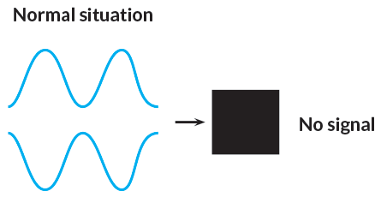
How Interfero-metry Works
If both beams travel precisely equal distances, they should recombine out of phase, destructively interfering and cancelling each other out.

Slide 66
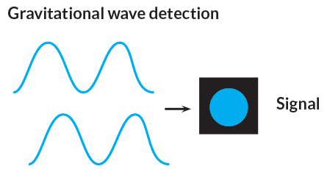
How Interfero-metry Works
However, if something changed the length of one or both of the detection arms, the beams would recombine out of phase, not cancel each other out, and a signal would be detected.

Slide 67
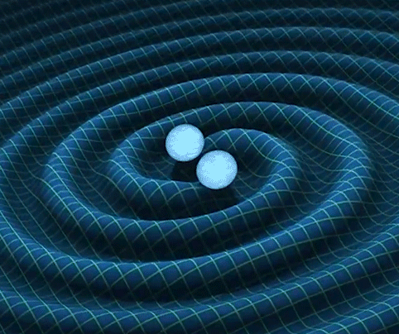
Ripples in the Fabric of Space-Time
In 1915 Einstein published his General Theory of Relativity and put forth:
Gravity is caused by the warping or stretching of space and time, which may be thought of as a fabric.
Changes in gravity travel through space at the speed of light.
The next year, in 1916, Einstein predicted what he called gravitationswellen. Just as moving electric charges result in the emission of electromagnetic radiation, Einstein argued that movement of masses should result in gravitational radiation, i.e. ripples in the fabric of space. This phenomenon would manifest itself as stretches and compressions of space itself.
But, even if one were to monitor lengths of thousands of kilometers, the strongest possible gravity waves (thought to be produced by merging black holes) would still result in changes in distance less than the width of an atomic nucleus!
How do you possibly measure something like that???

Slide 68
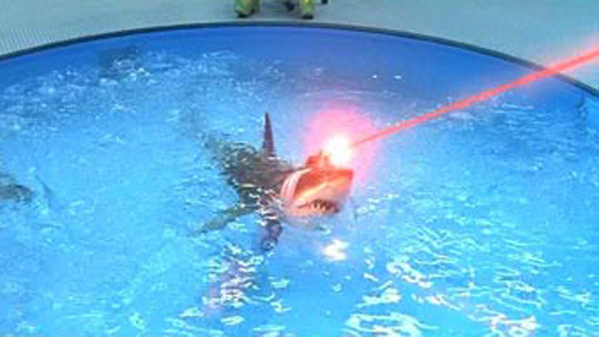
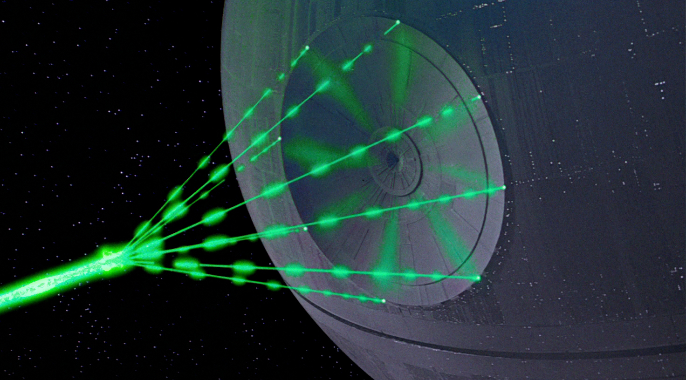
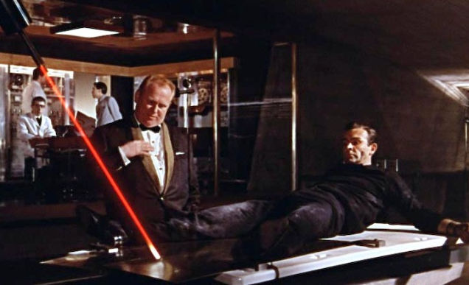
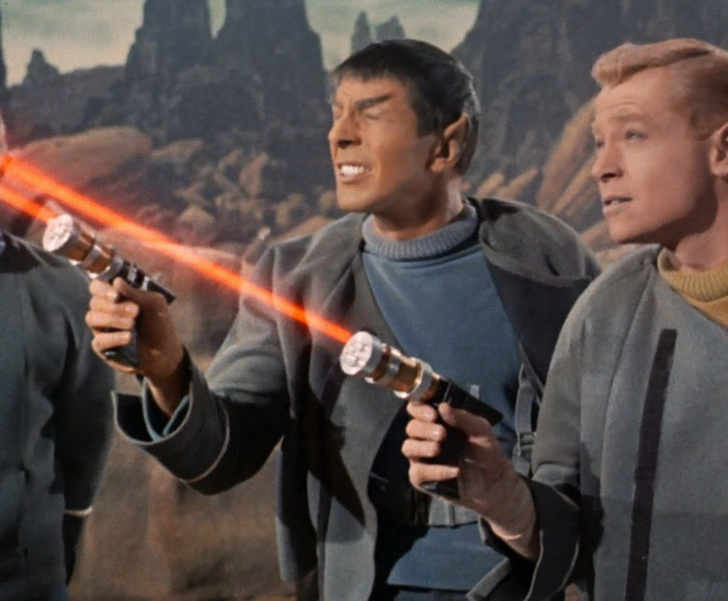
As is so often the case, the answer is: LASERS!

Slide 69
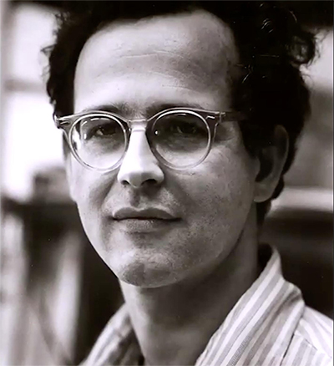
Laser Interferometry
The idea of using interfering lasers to detect gravity waves was first published by Soviet scientists Mikhail Gertsenshtein and V.I. Pustovoit in 1962.
However, they never made it past building prototype devices, and the their work was never published beyond the Soviet Union.
Four years later, in 1966, the same idea – using laser interferometry to detect gravitational waves – was conceived by MIT physicist Rainer Weiss.
An experimental physicist who was forced to teach a class on general relativity, Weiss came up with the idea while writing a homework assignment!
Weiss, 1970

Slide 70
An Interferometer in Action…

Slide 71
A New Frontier!
In 2016, LIGO (The Laser Interferometry Gravitational Wave Observatory) announced the first confirmed detection of gravitational waves - the death cry of two black holes (each dozens of times more massive than the Sun) colliding with each other millions and millions of light-years away!
LIGO, and similar facilities around the world, have continued to make more and more discoveries like this over the last few years.
This has opened up an whole new way for scientists to sense (and try to make sense!) of the Universe!

Slide 72
Click below to hear physicist Brian Green give more details about this incredible discovery as a guest on The Late Show with Stephen Colbert:
https://www.youtube.com/watch?v=ajZojAwfEbs

Slide 73
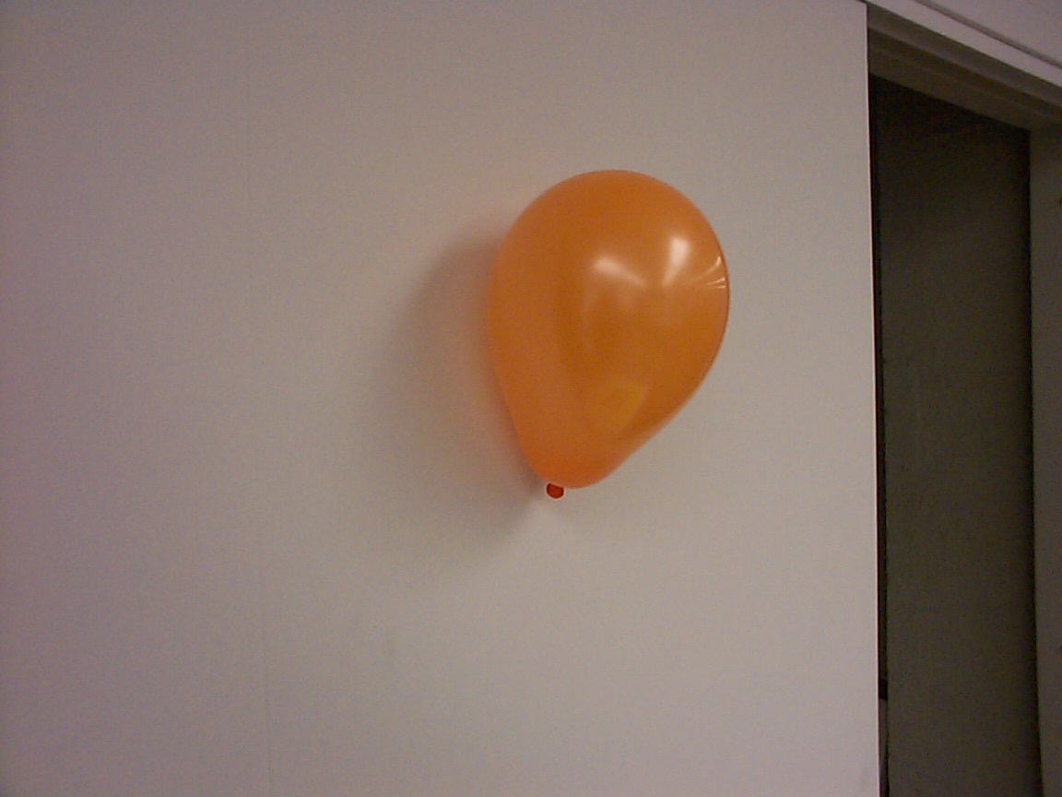
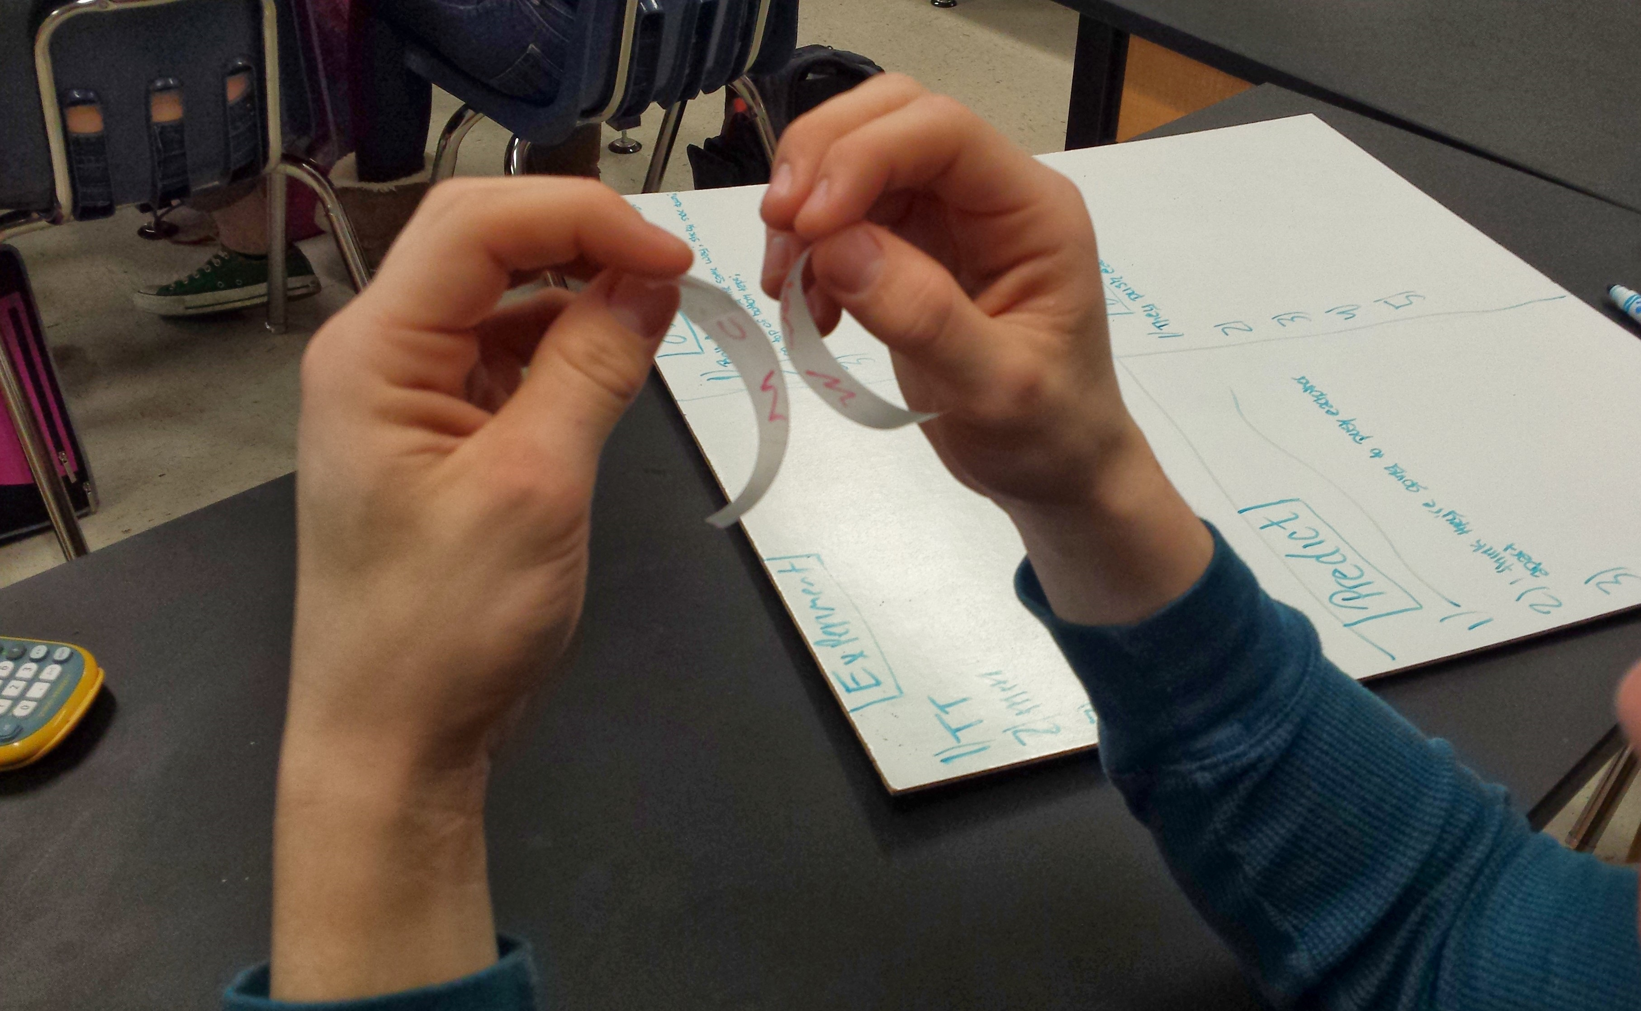
High Tech Electrostatics Demos!

Slide 74
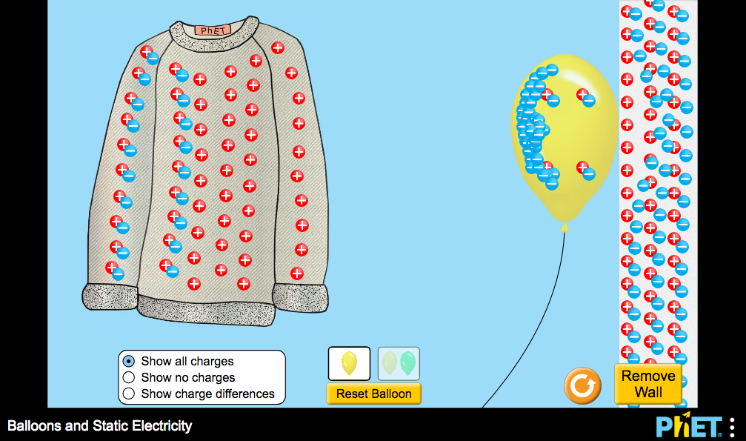
PhET: Balloons and Static Electricity
https://phet.colorado.edu/en/simulations/balloons-and-static-electricity

Slide 75
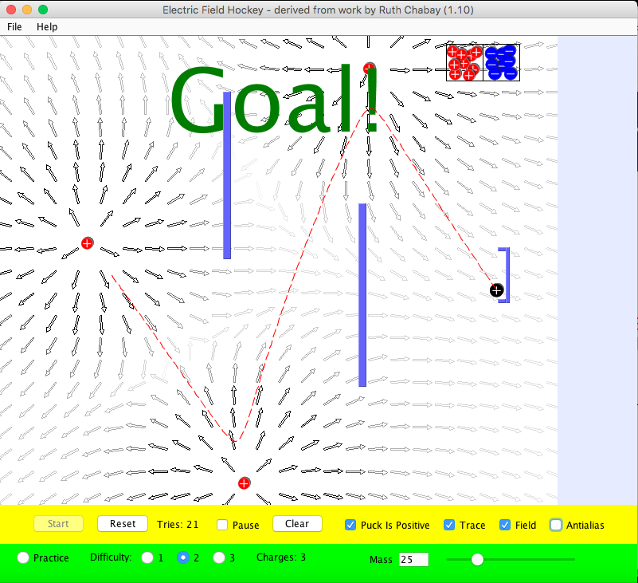
PhET: Electric Field Hockey
https://phet.colorado.edu/en/simulations/electric-hockey

Slide 76
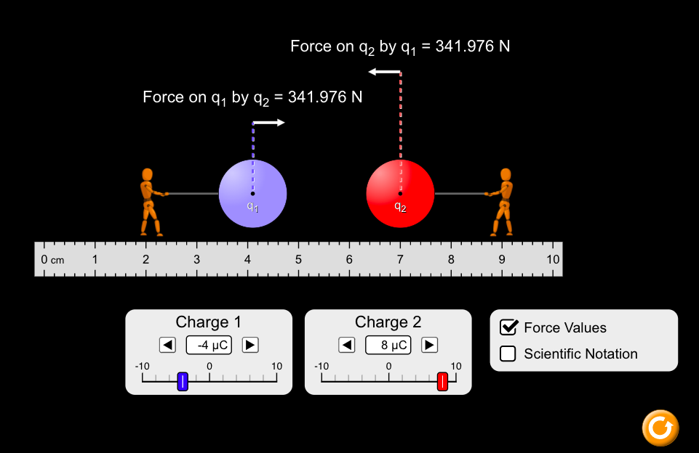
PhET: Coulomb’s Law
https://phet.colorado.edu/sims/html/coulombs-law/latest/coulombs-law_en.html

Slide 77
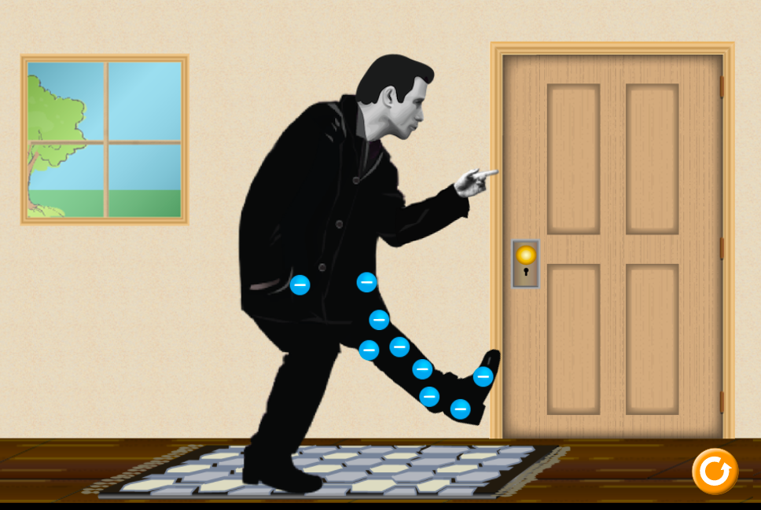
PhET: John Travoltage
https://phet.colorado.edu/en/simulations/john-travoltage

Slide 78
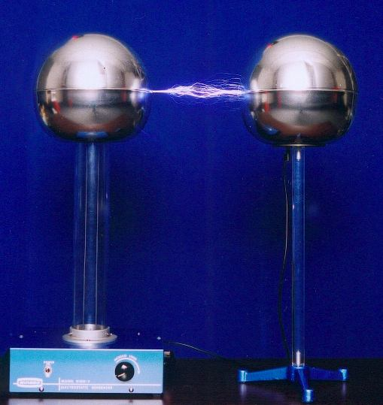
Van de Graaff Fun!

Slide 79
Consider the following combination circuit in which each resistor is the filament of an identical light bulb.
What would happen if you removed light 1? Light 2? Light 3?
1
2
3

Slide 80
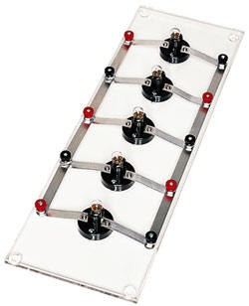
Circuit Demo: Series v. Parallel
http://www.arborsci.com/series-parallel-bulb-board

Slide 81
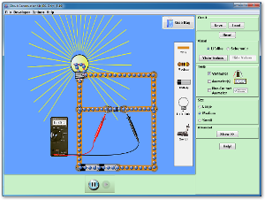
PhET DC Circuit Simulation
https://phet.colorado.edu/en/simulation/legacy/circuit-construction-kit-dc

Slide 82
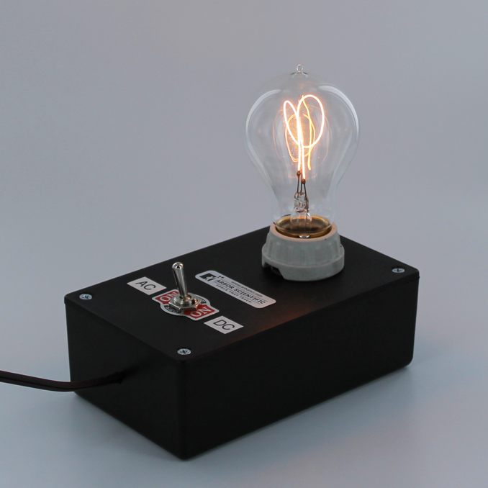
Current Demo: AC v. DC
http://www.arborsci.com/electricity-and-magnetism-light-bulb-demo

Slide 83
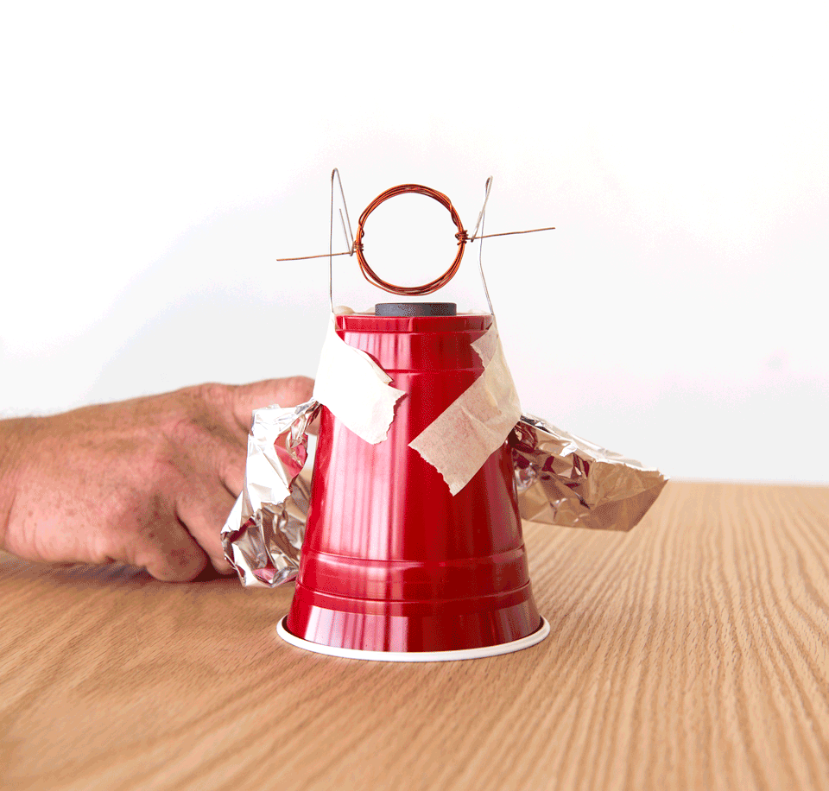
Activity: Building a Stripped-Down Motor
https://www.exploratorium.edu/snacks/stripped-down-motor

