Slide 1
Welcome to PTSOS!
Winter Workshop Jan. 21, 2023:
Energy and Collisions, Circular Motion, Rotation, Gravitation,
Thermal Physics, Oscillations
Dan Burns
PASCO Curriculum Developer
Teacher, Los Gatos HS (retired)
Tom Shefler
Physics Teacher, Granada HS
Abigail Plemmons
Physics Teacher, Granada HS

Slide 2
PTSOS – Work, Energy, & Power

Slide 3
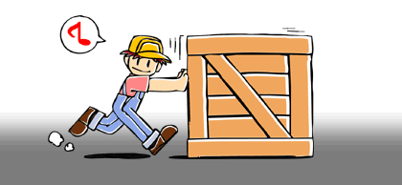
Work defined
F
d
Work = the product for force F exerted and resulting displacement d:
W = Fd

Slide 4
Units:
W = Fd
Joules (J)
meters (m)
Newtons (N)

Slide 5
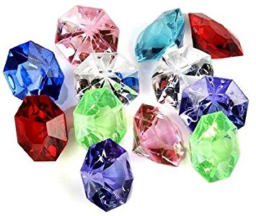
Remember…
If you work hard…
…you can make a lot of money…
… and buy a lot of jewels joules!

Slide 6
So, W = Fd
Recall Newton’s 2nd law:
F = ma.
If you substitute Newton’s 2nd Law into the formula for work you get:
W = mad
A simple, yet elegant proof that work makes you mad!

Slide 7
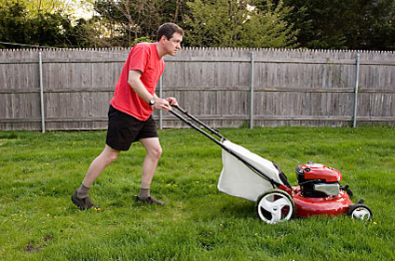
What if F isn’t parallel to d?
d
F

Slide 8
Only the component of F parallel to d contributes to work.
F||
d
θ
So, W = F||d, where F|| = F cos θ
Thus, W = Fd cos θ
F

Slide 9
Work & Machines
No device can perform more joules of work in order to accomplish a task than the number of joules of work that are input into the machine by the user. (In other words, machines cannot create energy.)
A simple machine, however, is a device that can alter the magnitude or direction of the force it takes to accomplish a task.
Since W = Fd, if a machine lessens the amount of force F necessary to accomplish a task, and W must remain the same (or even greater – but we’ll get to that in a moment!), the price you pay for using the machine is having to exert your force over a longer distance d.

Slide 10
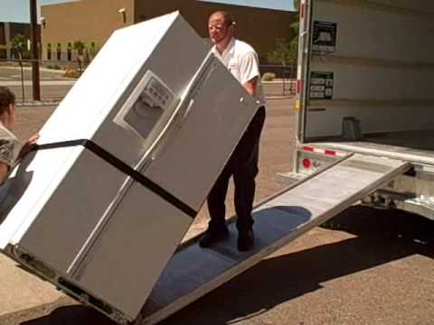
Example of a Simple Machine: The Inclined Plane
Suppose you want to lift a 1000-N refrigerator into the back of a moving truck 0.75 m off the ground.
Without the ramp, you’d have to actually exert 1000 N of force straight up over a distance of 0.75 m.
These values can be considered the output force and output distance of the machine, respectively.
F_{out}
d_{out}

Slide 11
Example of a Simple Machine: The Inclined Plane
The ramp, however, lets the user apply a force much smaller than the actual weight of the fridge.
The price the user pays is having to exert that smaller force over a longer distance, in this case the length of the ramp.
F_{in}
F_{out}
d_{in}
d_{out}

Slide 12
In an ideal machine, W_{out} = W_{in}
If the ramp is 3.0 m long, how much effort force should the user need to input?
Assuming ideal conditions,
F_{out}d_{out} = F_{in}d_{in}
(1000 N)(0.75 m) = F_{in}(3 m)
So, F_{in} = 250 N
F_{in}
F_{out}
d_{in}
d_{out}

Slide 13
Realistically, no machine is ideal
Instead of ideal conditions, suppose the user has to over come 50 N of friction on the ramp
In this case, the actual input force would be F_{in} = 250 + 50 = 300 N.
F_{in}
F_{out}
d_{in}
d_{out}

Slide 14
Work in v. Work out
W_{in} = F_{in}d_{in}
= (300 N)(3 m)
= 900 J
W_{out} = F_{out}d_{out}
= (1000 N)(0.75 m)
= 750 J
Efficiency is defined as the ratio of useful output work to amount of input work:
η = W_{out}/W_{in}
In this case,
η = 750J/900J = 0.83,
or 83%
F_{in}
F_{out}
d_{in}
d_{out}

Slide 15
Work in v. Work out
83% of the energy exerted by the user translated into actual useful work done; the other 17% was used overcoming friction.
So 900 J of work was input in order to accomplish a 750 J task
Was it worth it?
Probably, unless you want a back injury! 300 N of effort force is still way less than 1000 N!
F_{in}
F_{out}
d_{in}
d_{out}

Slide 16
Mechanical Advantage
The ratio of output force to input force is called mechanical advantage:
MA = F_{out}/F_{in}
In this case,
MA = 1000 N / 300 N
= 3.3
So this machine can be thought to amplify a user’s strength by a factor 3.3
F_{in}
F_{out}
d_{in}
d_{out}

Slide 17
Ideal Mechanical Advantage
Recall, when we assumed this machine was ideal, we computed an 250 N as our estimate for input force.
We did this using the known input and output distances.
Ideal Mechanical Advantage is defined as the ratio of the input to output distances:
IMA = d_{in}/d_{out}
In this case,
IMA = 3 m/0.75 m = 4
F_{in}
F_{out}
d_{in}
d_{out}

Slide 18
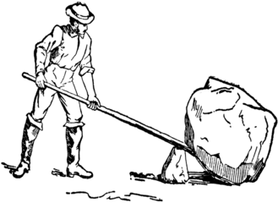
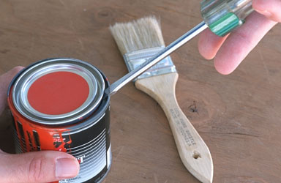
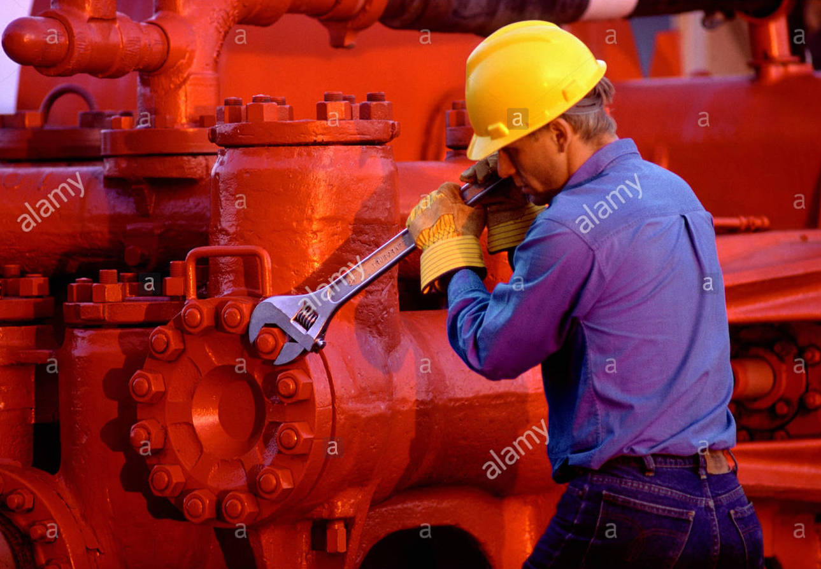
Another example of a simple machine: The Lever
Give me a lever long enough and a place to stand, and I shall move the Earth.
- Archimedes

Slide 19
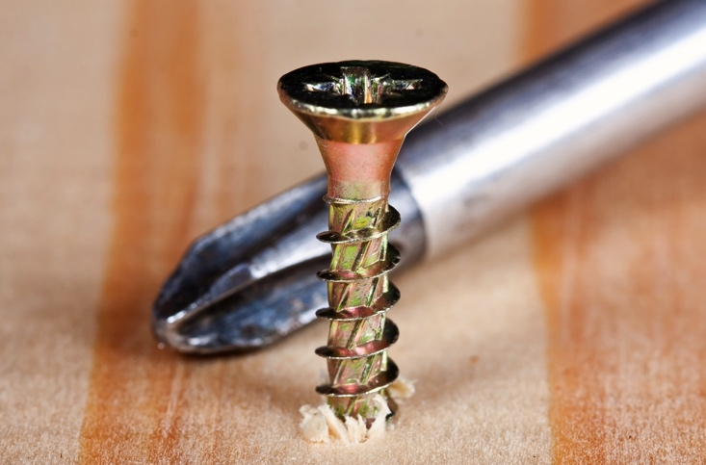
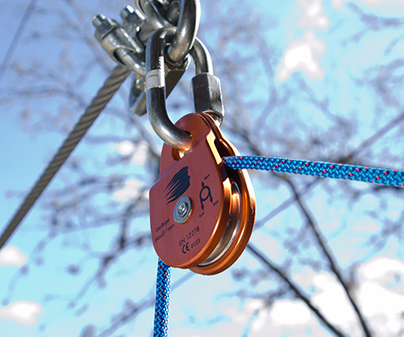
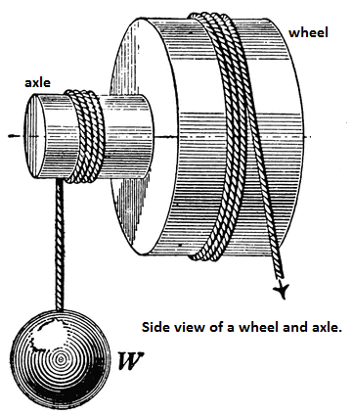
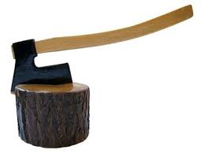
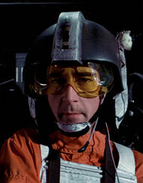
More Simple Machines
Screw
Pulley
Wheel & Axle
Wedge

Slide 20
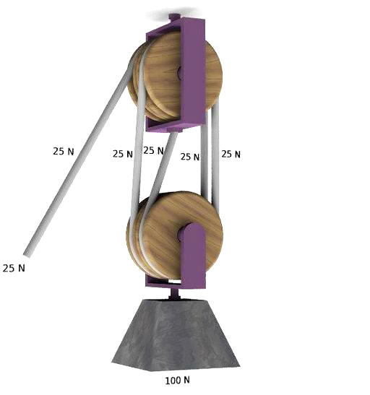
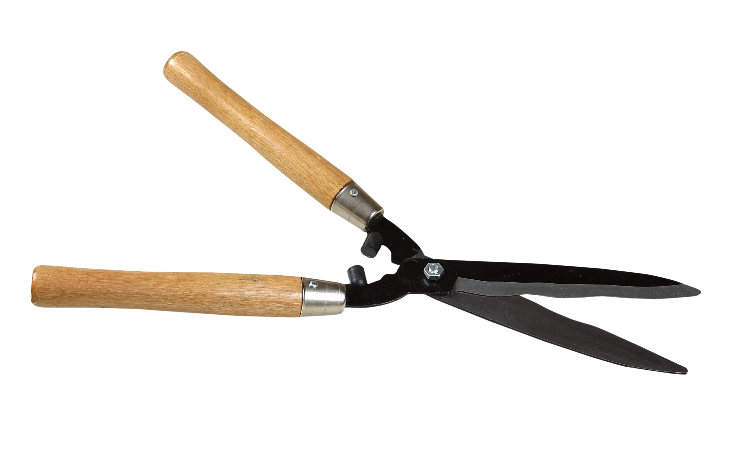
Compound Machines
A compound machine is composed of 2 or more simple machines connected in such a way that the output force of one simple machine becomes the input force of the next component.
Note:
η_{total} = η₁η₂η₃…
MA_{total} = MA₁MA₂MA₃…
IMA_{total} = IMA₁IMA₂IMA₃…

Slide 21
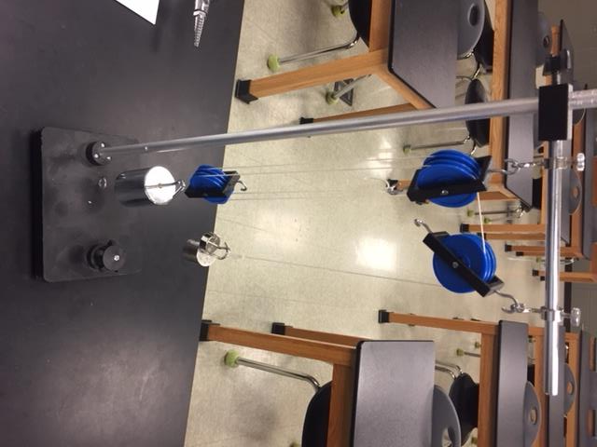
Demo: Compound Pulley System

Slide 22
Work & Energy
Energy is defined as the capacity to do work.
Conversely, if work is done on an object, that object has gained energy:
W = ΔE
Like work, energy is measured in Joules

Slide 23
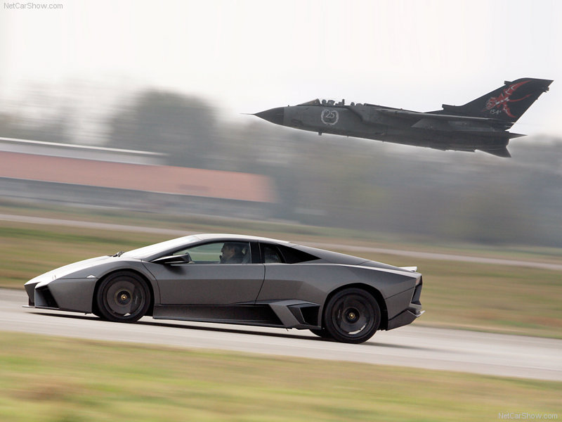
Kinetic Energy
If work is done accelerating an object, that object has gained kinetic energy – the energy of motion.
Recall: v_{f}² = v_{i}² + 2ad
But F = ma, so a = F/m
Thus, v_{f}² = v_{i}² + 2(F/m)d
v_{f}² - v_{i}² = 2(F/m)dM
Fd = ½mv_{f}² -½mv_{i}²
Here, W = ΔK, i.e. W = K_{f} - K_{i}
Since Fd = W, K_{f} must = ½mv_{f}² and K_{i} must = ½mv_{i}²
So the general formula for kinetic energy is
K = ½mv²

Slide 24
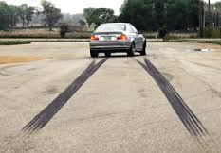
Skidding distance
Car A and Car B are identical except Car B is going twice as fast as Car A. Both cars slam on the brakes at the same time. How far will Car B skid compared to Car A?
a.) The same distance
b.) Twice as far
c. ) Four times as far

Slide 25
Skidding distance
Car A and Car B are identical except Car B is going twice as fast as Car A. Both cars slam on the brakes at the same time. How far will Car B skid compared to Car A?
a.) The same distance
b.) Twice as far
c.) Four times as far

Slide 26
Skidding distance
K = ½ mv², so if Car B has twice the speed as Car A, it has 4 x the kinetic energy.
Therefore, 4 times as much work must be done stopping it.
W = Fd
Since both cars are identical, both experience the same amount of braking force, so Car B must experience that force for 4 times the distance!

Slide 27
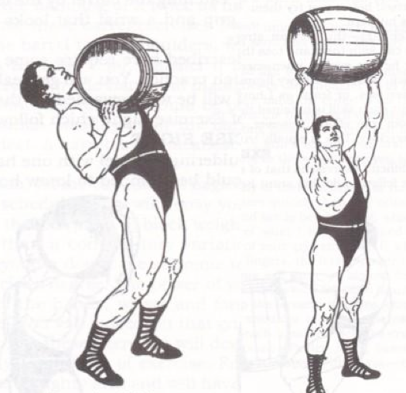
Gravitational Potential Energy
If work is done lifting an object of mass m up a height h, that object has gained gravitational potential energy
Recall W = Fd.
In this case, d = h. The force required to lift mass m is mg.
So the formula for gravitational PE is: U = mgh

Slide 28
U is relative
Suppose a 1.0-kg book is on top of a 1.0-m tall desk on the roof of a 100.0-m tall building on top of a 200.0-m tall hill in a city 500.0 m above sea level which is 6,378,000 m from the center of the Earth.
What is the potential energy of the book?
Answer: Relative to what?
Now suppose we move the book from the 1.0-m tall desk to a 1.5-m tall shelf. What is the book’s change in potential energy?
Regardless of where our line of reference is, the book has moved 0.5 m, so ΔU = mgΔh = (1.0kg)(9.8 m/s²)(0.5m) = 4.9 J
The moral of the story: U is relative; ΔU is not.

Slide 29
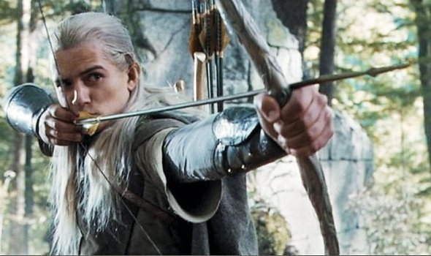
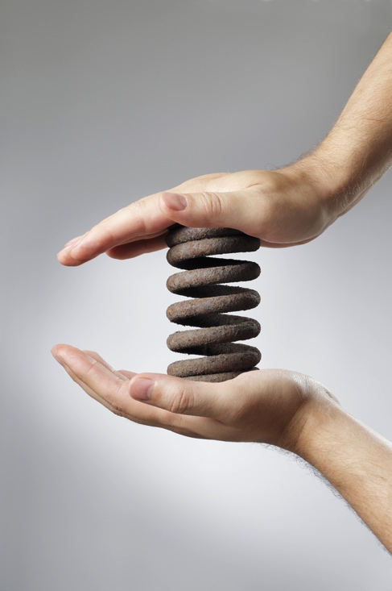
Potential Energy also comes in other forms

Slide 30
Mechanical Energy
Kinetic and potential energy are collectively known as mechanical energy.
Forms of non-mechanical energy include thermal energy (i.e. heat), radiant energy (i.e. light), chemical energy (donuts and Duracels), and nuclear energy (suns and H-bombs)

Slide 31
Consider a 12.000-kg object dropped from the top of a 100.00-m tall building. Consider three moments of its fall: The instant after you let go, the instant it’s halfway down, and the instant before it hits the ground. Assuming the objecct was in free-fall, complete the table below.
Height h | Distance fallen d | Velocity* v = (2ad)^{½} | Potential Energy U = mgh | Kinetic Energy K = ½mv² | Mechanical Energy K + U
100 m
50 m
0 m
*Recall v_{f}² = v_{i}² + 2ad. In this case, you can set v_{i} = 0 and solve for v_{f}.

Slide 32
Consider a 12.000-kg object dropped from the top of a 100.00-m tall building. Consider three moments of its fall: The instant after you let go, the instant it’s halfway down, and the instant before it hits the ground. Assuming the objecct was in free-fall, complete the table below.
Height h | Distance fallen d | Velocity* v = (2ad)^{½} | Potential Energy U = mgh | Kinetic Energy K = ½mv² | Mechanical Energy K + U
100 m | 0 m
50 m | 50 m
0 m | 100 m
*Recall v_{f}² = v_{i}² + 2ad. In this case, you can set v_{i} = 0 and solve for v_{f}.

Slide 33
Consider a 12.000-kg object dropped from the top of a 100.00-m tall building. Consider three moments of its fall: The instant after you let go, the instant it’s halfway down, and the instant before it hits the ground. Assuming the objecct was in free-fall, complete the table below.
Height h | Distance fallen d | Velocity* v = (2ad)^{½} | Potential Energy U = mgh | Kinetic Energy K = ½mv² | Mechanical Energy K + U
100 m | 0 m | 0 m/s
50 m | 50 m | 31.305 m/s
0 m | 100 m | 44.272 m/s
*Recall v_{f}² = v_{i}² + 2ad. In this case, you can set v_{i} = 0 and solve for v_{f}.

Slide 34
Consider a 12.000-kg object dropped from the top of a 100.00-m tall building. Consider three moments of its fall: The instant after you let go, the instant it’s halfway down, and the instant before it hits the ground. Assuming the objecct was in free-fall, complete the table below.
Height h | Distance fallen d | Velocity* v = (2ad)^{½} | Potential Energy U = mgh | Kinetic Energy K = ½mv² | Mechanical Energy K + U
100 m | 0 m | 0 m/s | 11,760 J
50 m | 50 m | 31.305 m/s | 5,880 J
0 m | 100 m | 44.272 m/s | 0 J
*Recall v_{f}² = v_{i}² + 2ad. In this case, you can set v_{i} = 0 and solve for v_{f}.

Slide 35
Consider a 12.000-kg object dropped from the top of a 100.00-m tall building. Consider three moments of its fall: The instant after you let go, the instant it’s halfway down, and the instant before it hits the ground. Assuming the objecct was in free-fall, complete the table below.
Height h | Distance fallen d | Velocity* v = (2ad)^{½} | Potential Energy U = mgh | Kinetic Energy K = ½mv² | Mechanical Energy K + U
100 m | 0 m | 0 m/s | 11,760 J | 0 J
50 m | 50 m | 31.305 m/s | 5,880 J | 5880 J
0 m | 100 m | 44.272 m/s | 0 J | 11,760 J
*Recall v_{f}² = v_{i}² + 2ad. In this case, you can set v_{i} = 0 and solve for v_{f}.

Slide 36
Consider a 12.000-kg object dropped from the top of a 100.00-m tall building. Consider three moments of its fall: The instant after you let go, the instant it’s halfway down, and the instant before it hits the ground. Assuming the objecct was in free-fall, complete the table below.
Height h | Distance fallen d | Velocity* v = (2ad)^{½} | Potential Energy U = mgh | Kinetic Energy K = ½mv² | Mechanical Energy K + U
100 m | 0 m | 0 m/s | 11,760 J | 0 J | 11,760 J
50 m | 50 m | 31.305 m/s | 5,880 J | 5880 J | 11,760 J
0 m | 100 m | 44.272 m/s | 0 J | 11,760 J | 11,760 J
*Recall v_{f}² = v_{i}² + 2ad. In this case, you can set v_{i} = 0 and solve for v_{f}.

Slide 37
Conservation of Mechanical Energy
As we can see, in certain circumstances, such as free-fall or frictionless conditions, mechanical energy is conserved!
Σ(K + U)_{before} = Σ(K + U)_{after}
Time for Cut Short & Phet roller coaster demos!

Slide 38
Let’s return to our example of a 12-kg object fall off a 100-m tall building. Now let’s assume the more realistic condition of air-resistance occurs. Which numbers below would we have to change?
Height h | Distance fallen d | Velocity* v = (2ad)^{½} | Potential Energy U = mgh | Kinetic Energy K = ½mv² | Mechanical Energy K + U
100 m | 0 m | 0 m/s | 11,760 J | 0 J | 11,760 J
50 m | 50 m | 31.305 m/s | 5,880 J | 5880 J | 11,760 J
0 m | 100 m | 44.272 m/s | 0 J | 11,760 J | 11,760 J
*Recall v_{f}² = v_{i}² + 2ad. In this case, you can set v_{i} = 0 and solve for v_{f}.

Slide 39
Let’s return to our example of a 12-kg object fall off a 100-m tall building. Now let’s assume the more realistic condition of air-resistance occurs. Which numbers below would we have to change?
Height h | Distance fallen d | Velocity* v = (2ad)^{½} | Potential Energy U = mgh | Kinetic Energy K = ½mv² | Mechanical Energy K + U
100 m | 0 m | 0 m/s | 11,760 J | 0 J | 11,760 J
50 m | 50 m | 31.305 m/s | 5,880 J | 5880 J | 11,760 J
0 m | 100 m | 44.272 m/s | 0 J | 11,760 J | 11,760 J
*Recall v_{f}² = v_{i}² + 2ad. In this case, you can set v_{i} = 0 and solve for v_{f}.

Slide 40
All of the red values below would be less than what we calculated when we assumed free-fall. Does that mean energy was, in fact, lost when the object fell?
Height h | Distance fallen d | Velocity* v = (2ad)^{½} | Potential Energy U = mgh | Kinetic Energy K = ½mv² | Mechanical Energy K + U
100 m | 0 m | 0 m/s | 11,760 J | 0 J | 11,760 J
50 m | 50 m | 31.305 m/s | 5,880 J | 5880 J | 11,760 J
0 m | 100 m | 44.272 m/s | 0 J | 11,760 J | 11,760 J
*Recall v_{f}² = v_{i}² + 2ad. In this case, you can set v_{i} = 0 and solve for v_{f}.

Slide 41
NO! Even thought mechanical energy isn’t always conserved, energy is always conserved. When experiencing air drag, both a falling object and the air around it heat up a bit, so in this case mechanical energy is converted into thermal energy.
Height h | Distance fallen d | Velocity* v = (2ad)^{½} | Potential Energy U = mgh | Kinetic Energy K = ½mv² | Mechanical Energy K + U
100 m | 0 m | 0 m/s | 11,760 J | 0 J | 11,760 J
50 m | 50 m | 31.305 m/s | 5,880 J | 5880 J | 11,760 J
0 m | 100 m | 44.272 m/s | 0 J | 11,760 J | 11,760 J
*Recall v_{f}² = v_{i}² + 2ad. In this case, you can set v_{i} = 0 and solve for v_{f}.

Slide 42
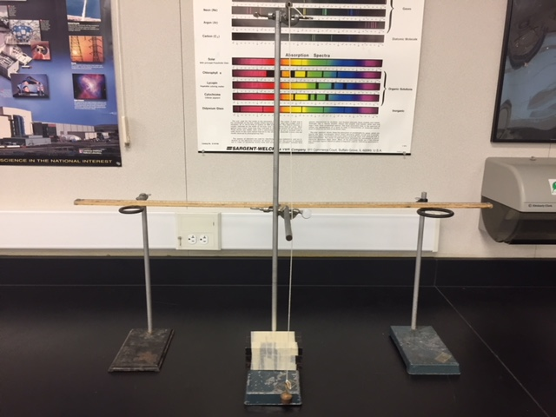
Demo: Cut Short

Slide 43
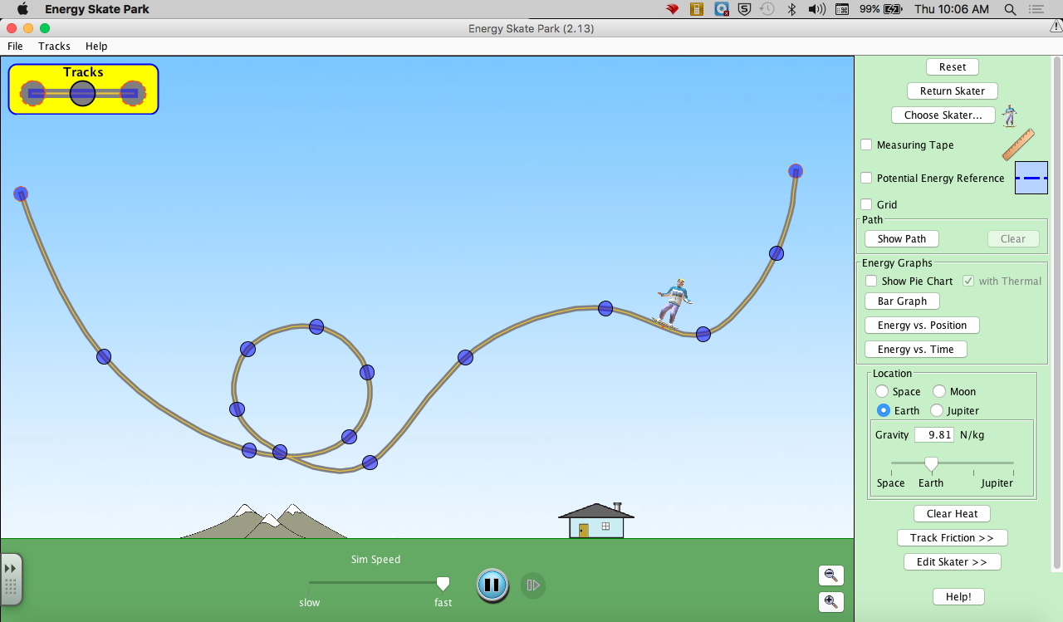
PhET: Energy Skate Park
https://phet.colorado.edu/en/simulation/legacy/energy-skate-park

Slide 44
Energy Conservation Activity: Racing Marbles
If two marbles are released simultaneously on Ramp A and Ramp B, which marble will win the race?

Slide 45
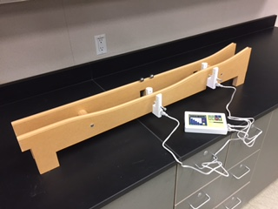
Energy Conservation Lab: Racing Marbles
If you attached photogate timers, you can determine the marbles’ exact speeds before and after the “dip” and compare how much kinetic energy was actually gained with how much theory would predict based on change of height.
http://www.arborsci.com/racing-marbles-lab

Slide 46
Energy Conservation Lab: Racing Marbles
In AP Physics C: Mechanics, we revisit this lab after covering rotational dynamics. This time, I tell students to assume the marble rolls without slipping, and take rotational kinetic energy into account. This gives best results, but you get pretty good results just considering linear KE.
http://www.arborsci.com/racing-marbles-lab

Slide 47
Energy Conservation Lab: Racing Marbles
If you attached photogate timers, you can determine the marbles’ exact speeds before and after the “dip” and compare how much kinetic energy was actually gained with how much theory would predict based on change of height.
http://www.arborsci.com/racing-marbles-lab

Slide 48
The Racing Marbles Lab can be purchased from
Arbor Scientific:
http://www.arborsci.com/racing-marbles-lab
They sell photogate timers too:
http://www.arborsci.com/timer-and-photogates

Slide 49
Conservation of Energy
In general, we can say:
ΔE = W + Q
Heat gained or lost by the system
Change in energy of a system
Work done on the system

Slide 50
Energy and Collisions
Elastic Collision – collision in which NO mechanical energy is lost; a perfect bounce occurs
Inelastic Collision – collision in which some mechanical energy is lost and converted to another form.
It takes energy to deform something, generate heat, or make objects stick together. If any of these things occur as a result of a collision, the collision must have been inelastic.

Slide 51
Example: A 0.16-kg 6-ball, moving at 3.0 m/s, strikes a stationary 8-ball. If the collision is elastic, what are both billiard balls’ velocities after the collision?
Two unknowns means we need two equations to solve:
Use conservation of momentum (always true in collisions) and conservation of kinetic energy, since we’re told collision is elastic
Before:
v_{8,I} = 0 m/s
v_{6,I} = 3.0 m/s
6
8
m₆ = 0.16 kg
m₈ = 0.16 kg
After:
v₆ = ?
v_{8,} = ?
6
8
m₆ = 0.16 kg
m₈ = 0.16 kg

Slide 52
Momentum is conserved:
Σp_{before} = Σp_{after}
m₆v_{6,i} = m₆v₆ + m₈v₈
(0.16 kg)(3.0 m/s) = (0.16 kg) v₆ + (0.16 kg) v₈

Slide 53
Momentum is conserved:
Σp_{before} = Σp_{after}
m₆v_{6,i} = m₆v₆ + m₈v₈
(0.16 kg)(3.0 m/s) = (0.16 kg) v₆ + (0.16 kg) v₈
3.0 m/s = v₆ + v₈ …Call this Equations #1

Slide 54
Momentum is conserved:
Σp_{before} = Σp_{after}
m₆v_{6,i} = m₆v₆ + m₈v₈
(0.16 kg)(3.0 m/s) = (0.16 kg) v₆ + (0.16 kg) v₈
3.0 m/s = v₆ + v₈ …Call this Equations #1
Kinetic energy is conserved:
ΣK_{before} = Σk_{after}
½ m₆v_{6,i}² = ½ m₆v₆² + ½ m₈v₈²
½ (0.16 kg)(3.0 m/s)² = ½ (0.16 kg) v₆² + ½ (0.16 kg) v₈²

Slide 55
Momentum is conserved:
Σp_{before} = Σp_{after}
m₆v_{6,i} = m₆v₆ + m₈v₈
(0.16 kg)(3.0 m/s) = (0.16 kg) v₆ + (0.16 kg) v₈
3.0 m/s = v₆ + v₈ …Call this Equations #1
Kinetic energy is conserved:
ΣK_{before} = Σk_{after}
½ m₆v_{6,i}² = ½ m₆v₆² + ½ m₈v₈²
½ (0.16 kg)(3.0 m/s)² = ½ (0.16 kg) v₆² + ½ (0.16 kg) v₈²
9.0 m²/s² = v₆² + v₈² …Call this Equations #2

Slide 56
So now we have a system of equations to solve:
(1): 3 = v₆ + v₈
(2): 9 = v₆² + v₈²
Solve (1) for v₆: v₆ = 3 - v₈
Plug this into (2): 9 = (3 - v₈)² + v₈²
9 = 9 - 6v₈ + v₈² + v₈²
0 = - 6v₈ + 2v₈²
0 = 2v₈ (v₈ – 3)
v₈ = 0 or 3
If v₈ = 0 m/s, v₆ = 3 m/s; If v₈ = 3 m/s, v₆ = 0 m/s

Slide 57
So now we have a system of equations to solve:
(1): 3 = v₆ + v₈
(2): 9 = v₆² + v₈²
Solve (1) for v₆: v₆ = 3 - v₈
Plug this into (2): 9 = (3 - v₈)² + v₈²
9 = 9 - 6v₈ + v₈² + v₈²
0 = - 6v₈ + 2v₈²
0 = 2v₈ (v₈ – 3)
v₈ = 0 or 3
If v₈ = 0 m/s, v₆ = 3 m/s; If v₈ = 3 m/s, v₆ = 0 m/s
This doesn’t make sense, physically (unless the 6-ball totally misses the 8-ball)

Slide 58
So in an elastic collision between two objects of equal mass, all of the momentum and energy must be transferred to the struck body.

Slide 59
But perfect elastic collisions aren’t realistic. Let’s revisit our billiard problem…

Slide 60
Again, suppose 0.16-kg 6-ball, moving at 3.0 m/s, strikes a stationary 8-ball. Now, if we we assume 15% of the initial kinetic energy is lost in the collision, what are both billiard balls’ velocities after the collision?
Before:
v_{8,I} = 0 m/s
v_{6,I} = 3.0 m/s
6
8
m₆ = 0.16 kg
m₈ = 0.16 kg
After:
v₆ = ?
v_{8,} = ?
6
8
m₆ = 0.16 kg
m₈ = 0.16 kg

Slide 61
Again, momentum is conserved:
Σp_{before} = Σp_{after}
m₆v_{6,i} = m₆v₆ + m₈v₈
(0.16 kg)(3.0 m/s) = (0.16 kg) v₆ + (0.16 kg) v₈

Slide 62
Again, momentum is conserved:
Σp_{before} = Σp_{after}
m₆v_{6,i} = m₆v₆ + m₈v₈
(0.16 kg)(3.0 m/s) = (0.16 kg) v₆ + (0.16 kg) v₈
3.0 m/s = v₆ + v₈ …Call this Equations #1

Slide 63
Again, momentum is conserved:
Σp_{before} = Σp_{after}
m₆v_{6,i} = m₆v₆ + m₈v₈
(0.16 kg)(3.0 m/s) = (0.16 kg) v₆ + (0.16 kg) v₈
3.0 m/s = v₆ + v₈ …Call this Equations #1
But now, only 85% of kinetic energy is conserved:
(0.85) ΣK_{before} = Σk_{after}
(0.85) ½ m₆v_{6,i}² = ½ m₆v₆² + ½ m₈v₈²
(0.85) ½ (0.16 kg)(3.0 m/s)² = ½ (0.16 kg) v₆² + ½ (0.16 kg) v₈²

Slide 64
Again, momentum is conserved:
Σp_{before} = Σp_{after}
m₆v_{6,i} = m₆v₆ + m₈v₈
(0.16 kg)(3.0 m/s) = (0.16 kg) v₆ + (0.16 kg) v₈
3.0 m/s = v₆ + v₈ …Call this Equation #1
But now, only 85% of kinetic energy is conserved:
(0.85) ΣK_{before} = Σk_{after}
(0.85) ½ m₆v_{6,i}² = ½ m₆v₆² + ½ m₈v₈²
(0.85) ½ (0.16 kg)(3.0 m/s)² = ½ (0.16 kg) v₆² + ½ (0.16 kg) v₈²
7.65 m²/s² = v₆² + v₈² …Call this Equation #2

Slide 65
So now our system of equations is:
(1): 3 = v₆ + v₈
(2): 7.65 = v₆² + v₈²
Solve (1) for v₆: v₆ = 3 - v₈
Plug this into (2): 7.65 = (3 - v₈)² + v₈²
7.65 = 9 - 6v₈ + v₈² + v₈²
0 = 2v₈² - 6v₈ + 1.35
Solve by graphing or using the quadratic formula:
v₈ = 2.75 or 0.25
If v₈ = 2.75 m/s, v₆ = 0.25 m/s; If v₈ = 0.25 m/s, v₆ = 2.75 m/s

Slide 66
So now our system of equations is:
(1): 3 = v₆ + v₈
(2): 7.65 = v₆² + v₈²
Solve (1) for v₆: v₆ = 3 - v₈
Plug this into (2): 7.65 = (3 - v₈)² + v₈²
7.65 = 9 - 6v₈ + v₈² + v₈²
0 = 2v₈² - 6v₈ + 1.35
Solve by graphing or using the quadratic formula:
v₈ = 2.75 or 0.25
If v₈ = 2.75 m/s, v₆ = 0.25 m/s; If v₈ = 0.25 m/s, v₆ = 2.75 m/s
This doesn’t make sense, physically

Slide 67
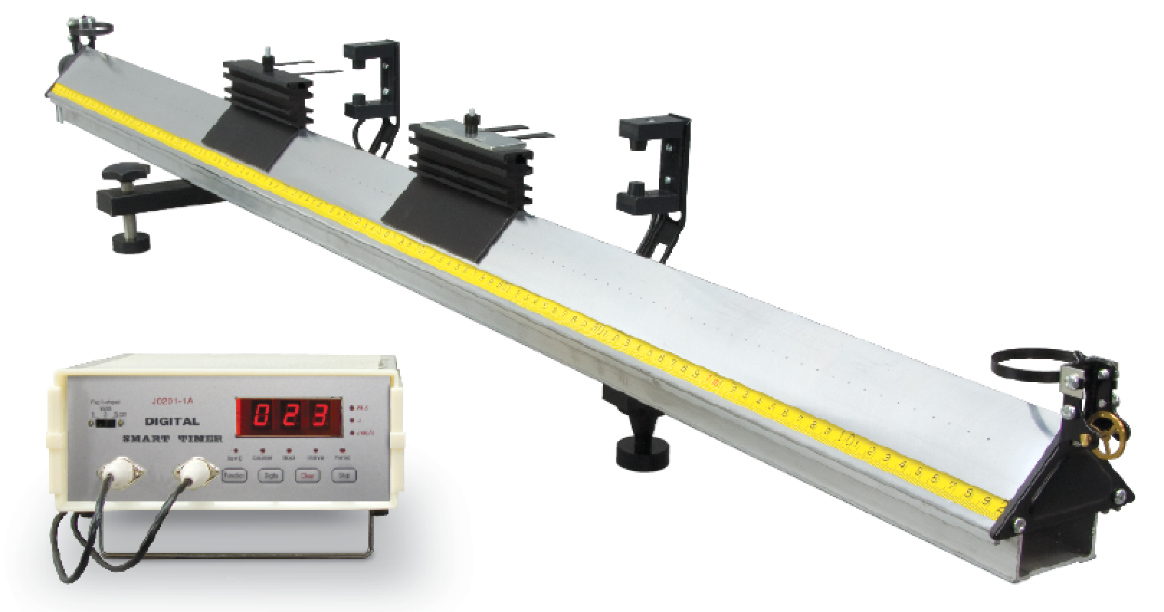
Collision Experiments

Slide 68
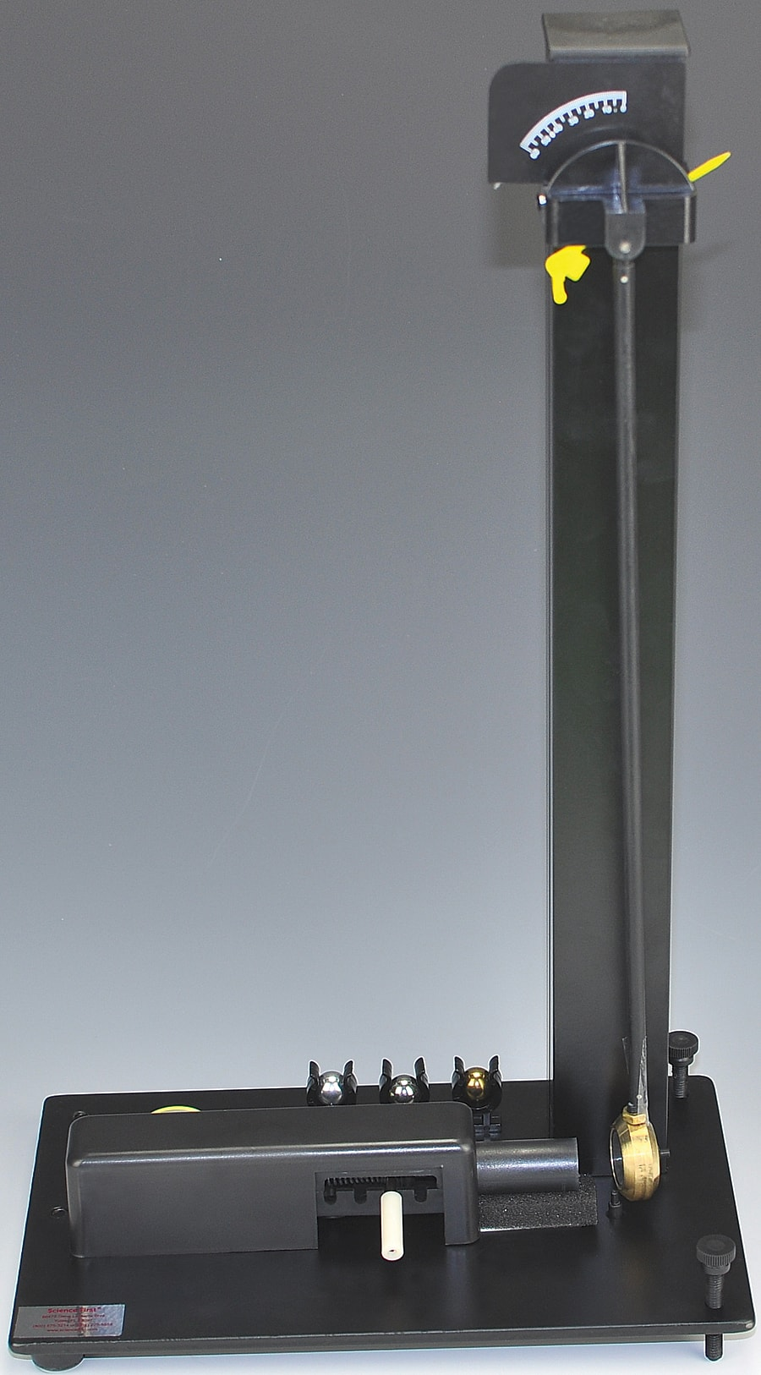
Lab: The Ballistics Pendulum
Students fire a marble from a spring-loaded launcher into the bob of a pendulum, which catches the marble.
Students use the maximum angle the pendulum swings up to, along with momentum and energy conservation concepts, to calculate the initial velocity of the marble.
Students then confirm the launch velocity by calculating where to place a target (such as a cup or bucket) to catch the marble, reviewing projectile motion.

Slide 69
Lab: The Ballistics Pendulum
Students use the max angle of the pendulum to calculate change of height after the bob catches the marble.
Students then use energy conservation to find the speed of the bob right after it caught the marble.
You can’t use energy conservation before and after the bob catches the marble because its and inelastic collision, so students use conservation of momentum to calculate the speed of the marble before it was caught.

Slide 70
Lab: The Ballistics Pendulum – Going Further
Students confirm their initial velocity by calculating where to catch the marble in a cup or bucket.
If you assume the spring in the launcher is extended to its equilibrium position when the pin isn’t pulled back (which may or may not be a great assumption, depending on your launcher), you can also revisit concepts of spring potential energy, Hooke’s Law, the impulse-momentum theorem, and power.
Students can predict what values will change if they use a marble of different mass, and then confirm exerimentally.

Slide 71
Ballistics Pendulums can be purchased from Flinn Scientific
https://www.flinnsci.com/ballistic-pendulum-economy-choice/ap7110/

Slide 72
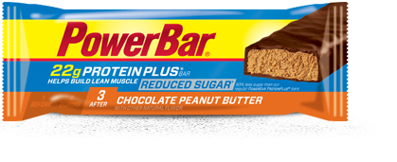
Power & Energy
Power is defined as the rate at which work is done (or the rate at which energy is use or produced)
d
=
dt

Slide 73
Units:
Joules (J)
P = ^{W}/_{t}
Watts (W)
seconds (s)

Slide 74
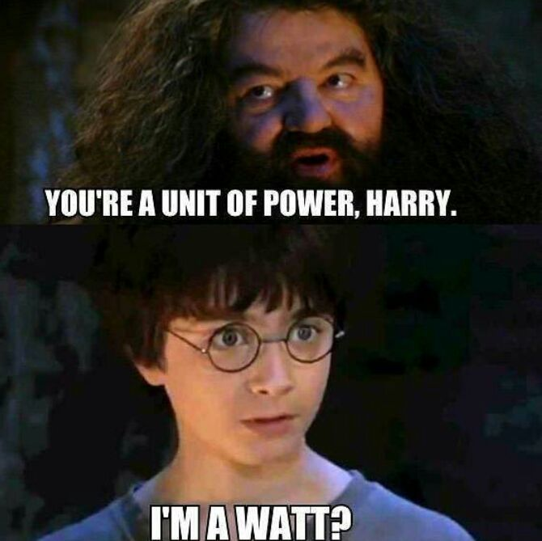

Slide 75
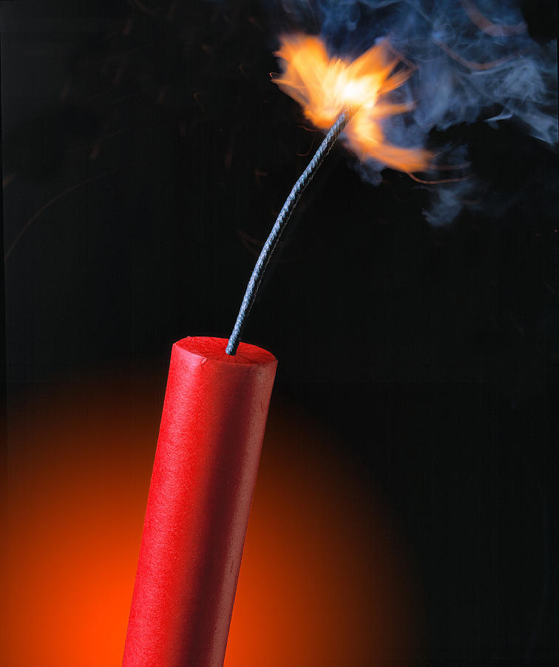
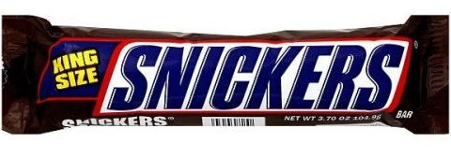
Energy v. Power
Let’s consider two things with nearly equivalent amounts of chemically-stored energy:
528 Calories
504 Calories

Slide 76
Does nearly equivalent energy mean similar power?
No!
Although the Snickers has slightly more energy content than the dynamite, it releases that energy over a much longer timescale.
Let’s assume a Snickers will give you energy for ~ 2 hours and that a stick of dynamite releases its energy in ~ 0.1 sec.

Slide 77
First, convert Calories to Joules:
E_{snickers} = 528 Cal x (^{1000 cal}/_{1 Cal}) x (^{4.184 J}/_{1 cal}) ≈ 2,200,000 J
E_{dynamite} = 504 Cal x (^{1000 cal}/_{1 Cal}) x (^{4.184 J}/_{1 cal}) ≈ 2,100,000 J
Now calculate power:
P_{snickers} = E_{snickers}/t = (2,200,000 J) / (7200 s) ≈ 300 W
P_{dynamite} = E_{dynamite}/t = (2,100,000 J) / (0.1 s) ≈ 21,000,000 W

Slide 78
Physics:
Gravitation & Orbits

Slide 79
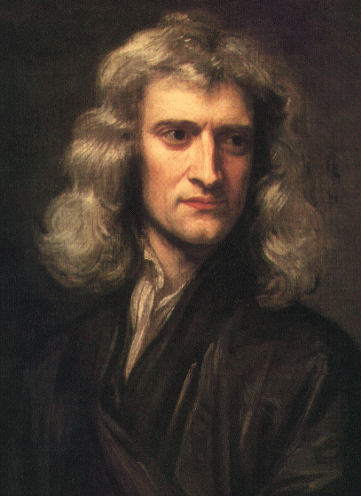
Sir Isaac Newton (1643-1727)
Born December 25, 1642
Or January 4, 1643
Arrogant, vindictive jerk
Loathed interacting with other people
Obsessed with alchemy, numerology, the occult, and biblical prophecy
Suffered from temporary insanity, possibly due to mercury poisoning
Arguably the most brilliant man who ever lived, he ushered mankind into a new era of mathematics and physics.
And, as a child, he once built a UFO

Slide 80
The more I have studied him, the more Newton has receded from me. It has been my privilege at various times to know a number of brilliant men, men whom I acknowledge without hesitation to be my intellectual superiors. I have never, however, met one against whom I was unwilling to measure myself, so that it seemed reasonable to say that I was half as able as the person in question, or a third or a fourth, but in every case a finite fraction. The end result of my study of Newton has served to convince me that with him there is no measure. He has become for me wholly other, one of the tiny handful of supreme geniuses who have shaped the categories of the human intellect, a man not finally reducible to the criteria by which we comprehend our fellow beings.
- Richard Westfall, biographer of Isaac Newton

Slide 81
Newton’s Contributions to Math & Science
Developed (Invented? Discovered?) calculus
Codified 3 Laws of Motion
Discovered Law of Universal Gravitation
Revolutionized understanding of light, color, and optics
Invented reflecting telescope
Developed Law of Cooling
Invented world’s tastiest fig cookies

Slide 82
Beyond Math & Science
Wrote more about the Bible than any other subject
Used scripture to calculate the earliest time the world would end: 2060
Member of Parliament
First scientist to be knighted
Ward of the Mint

Slide 83
Newton’s Laws of Motion
Newton’s 1st Law (The Law of Inertia): An object at rest will remain at rest, and an object in motion will remain moving in a straight line at constant speed unless acted upon by an external force.
Newton’s 2nd Law: Force = (mass)x(acceleration), i.e. F = ma. (Note: the more massive something is, the larger force you must exert upon it to get it to accelerate.)
Newton’s 3rd Law: When two bodies interact, they exert equal and opposite forces on one another. (For example, when you stand on the ground, your feet exert a certain force upon the ground. The ground, however, exerts and equal and opposite force back on your feet!)

Slide 84
Newton and Gravity
Since antiquity, it was taken for granted that the Moon orbits the Earth in a circular path without question. That’s the way it was.
However, according to Newton’s 1st Law, a force must be acting on an object if it is moving a path that is not a straight line.
Newton’s epiphany: The force that keeps the Moon in orbit is the same force that makes apples fall from trees – gravity!

Slide 85
Law of Universal Gravitation
Newton showed that if you have two point masses, m₁ and m₂, separated by a distance d, there is a gravitational force between the masses. This force is directly proportional to each of the masses, and inversely proportional to the square of the distance:
or
Where G = Newton’s Gravitational Constant
= 6.67 x 10⁻¹¹ N m²/kg²

Slide 86
Spheres and the Law of Universal Gravitation
Note: the L.U.G. doesn’t account for an object’s size, only its mass.
The formula assumes that all an object’s mass is located at a single point, instead of spread out over a large volume – not a realistic assumption.
For example, the Earth, Moon, and Sun are not point masses, they are large spheres.
Newton’s next step was to try to expand his formula to explain the gravitational force caused by massive spheres.

Slide 87
Enter Calculus
Newton found that the mathematical techniques available to him were insufficient for explaining the gravitational force caused by a spherical mass.
He needed a technique where he could find the cumulative effect of the gravitational pull of each tiny chunk of a sphere.
Thus was born the branch of mathematics known as integral calculus!

Slide 88
Newton’s Conclusions
After working out the mathematical details, Newton showed that an object some distance away from a sphere with mass m feels the exact same gravitational force as if all of the mass m were concentrated at the center of the sphere.
Also, it turns out that an object inside a giant spherical shell would feel no gravitational force anywhere inside the shell.

Slide 89
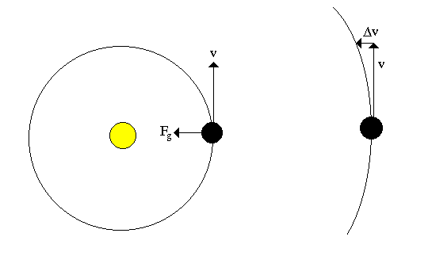
How Gravity Makes an Orbit
Without gravity, an object would want to move in a straight line.
Gravity, however, attracts an object inward.
This inward force leads to a constant change of direction, or Δv.
If the tangential speed v is fast enough, a circular orbit is the result.

Slide 90
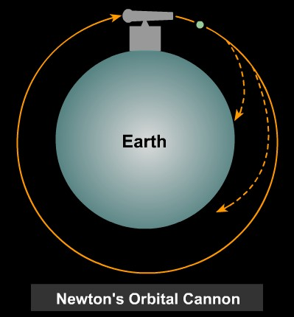
The Moon is Falling!!!
Any object that is orbit, such as the Moon, is in a state of constant falling toward the Earth.
However, such an object has such a fast tangential (i.e. sideways) speed, that by the time it has fallen far enough to hit the Earth, it has also moved so far sideway that it has missed.

Slide 91
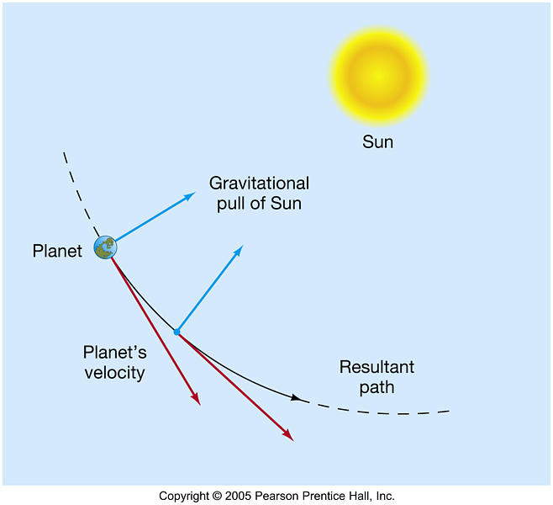
Similarly, it is interesting to note that the Earth is likewise in a permanent state of falling into, and constantly missing, the Sun!

Slide 92
Orbits and “Weightlessness”
Why do astronauts float in the Space Shuttle?
Common misconception: The Space Shuttle is so far from Earth that gravity weakens and disappears.
Fact: The Shuttle isn’t that far from the Earth, certainly not far enough to neglect gravity.
The real reason for weightless ness: Like the Moon, the Space Shuttle and everything on it are in state of free-fall when in orbit. (And like the Moon, the Shuttle has a fast enough tangential speed that it is in a state of constantly missing the Earth.)

Slide 93
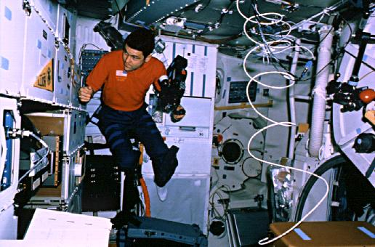
If you were in an elevator, and the the cable snapped, what would you experience as the elevator fell?
Even though you felt weightless, is it true that you don’t weigh anything inside a falling elevator?
Similarly, astronauts are falling along with the shuttle as it orbits. Since the astronauts and shuttle move together, the astronauts can float and appear “weightless.”

Slide 94
Weight and Gravitational Acceleration
Consider an object with mass m on the surface of a planet with mass M and radius r. According to the L.U.G., the weight of that object would be:
Note: r replaces d in the formula, since the distance to the center of mass of the planet is equal to the planet’s radius.
Also, recall Newton’s 2nd Law: F = ma.
If this expression is equated to the formula for gravitational force above, notice that the mass m of the object cancels, and you’re left with:
or

Slide 95
Note: The weight of an object depends on its mass, but it’s acceleration does not!
The fact that all objects fall at the same rate was first observed by Galileo during his house arrest!

Slide 96
Force and Circular Motion
In general, when something is moving in a circular path, you know a force must be acting upon it. If not, the object would be moving in a straight line, or it would be stationary.
Any force which keeps something moving in a circle is known as a centripetal force. The mathematical expression for this is:
Where m is the mass of the object, v is its tangential speed, and r is the radius of its path.

Slide 97
Newton’s great insight was that it is gravity that causes orbits. Thus you can equate the formulae for centripetal and gravitational forces:
Note: You can cancel the m’s and some r’s and solve for orbital speed v:

Slide 98
Orbital Period
Basic velocity formula: v = ^{d}/_{t}.
For an orbit, d would be the circumference (2πr) and t would be the period (p), so v = ^{2πr}/_{p}.
Plugging this into the orbital velocity formula, you get

Slide 99
Square both sides:
Algebra happens…
Look familiar? What if we replace r with an a?

Slide 100
Kepler’s 3rd Law Derived!
Kepler showed that the square of the period of an orbit is proportional to the cube of the semi-major axis based on analyzing data empirically, but he had no idea why the relationship was true.
By showing that gravity was a centripetal force, Newton was able to explain and derive Kepler’s 3rd Law.

Slide 101
Newton’s Version of Kepler’s 3rd Law
The equation
is known as Newton’s version of Kepler’s 3rd Law. In this equation,
p = orbital period (in seconds)
r = radius of the orbit (in meters)
M = the mass of the central object whose gravity is causing the orbit.

Slide 102
A Powerful Tool
Newton’s version of Kepler’s 3rd Law allows us to calculate the mass of anything that’s orbited!
For example, if you plug Earth’s orbital data into the equation, what do you calculate?
Answer: the mass of the Sun!

Slide 103
The Mass of the Sun
The average distance from the Earth to the Sun is 1.5 x 10¹¹ m. What is the mass of the Sun?
Given:
r = 1.5 x 10¹¹ m.
p = 1 year = 3.15 x 10⁷ s.
G = 6.67 x 10⁻¹¹ Nm²/kg².
Wanted:
M_{sun}
Formula:

Slide 104
First, solve for M:
Plug in numbers…

Slide 105
Escape Velocity
One last gravitational concept to discuss…
If an object is launched up into the air with less kinetic energy than potential energy, it will fall back down to the ground.
If it moving so fast that its kinetic energy exceeds its potential energy, it will escape into space.
The escape velocity of a planet may thus be calculated by setting the potential energy of an object equal to its kinetic energy…

Slide 106
If kinetic energy = potential energy, then v must be escape velocity:
Cancel m’s and solve for v_{esc}:
If you’re at the surface of a planet, height h would equal the distance to the planet’s center r. Also, recall that acceleration due to gravity g is given by

Slide 107
So the escape velocity formula becomes
or
Note:

Slide 108
Rotational Dynamics Labs & Demos
Torque Demo: Masses on a balance bar
Torque Lab: Keep in the Balance (CP Lab Manual)
Torque Demo: Torque Spool (CP Concept Devel. WS)
Statics Lab: Tension in a Supporting Cable
Rotational Inertia Demo: Twisting a textbook
Rotational Inertia Demo: Rolling Cylinders
Lab: Rotational Version of Newton’s Third Law – Using torque and angular acceleration to measure rotational inertia
Center of Mass Demos: Assorted toys
Center of Mass Demos: Touching your toes, Nose to a wall, lifting a chair
Conservation of Angular Momentum Demos: Coin funnel, gyroscope, large wheel & rotating platform

Slide 109
Newton’s 2nd Law Revisited… Again
So now we have yet another version of Newton’s 2nd Law…
Regular
Alternative
Linear
Rotational

Slide 110
Or, as I like to think about it…
Good
Evil
Lawful
Chaotic

Slide 111
PTSOS – Thermal Physics

Slide 112
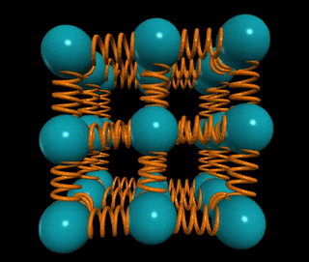
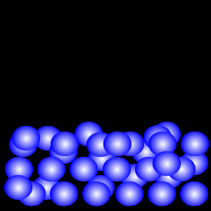
States of Matter
Solid: Particles are bound by bonds, though particles do wiggle and vibrate in place.
Liquid: The binding forces are weaker. The particles can slide around each other, but they can’t expand in volume
Gas: In a gas, the binding forces are even weaker. The particles expand away from each other to fill whatever container is available.

Slide 113
Moving Particles
In all 3 states, the particles are moving.
Thus they all have kinetic energy.
Thermal Energy (aka “Heat”): The sum total of the kinetic energies of all the particles in a body or sample.
Symbol: Q
Units: J (joules)
Temperature: A measure of the average kinetic energy of particles in a body or sample.
Symbol: T
Units: °C or K

Slide 114
Temperature Scales
 | Degrees Fahrenheit (°F) | Degrees Celsius (°C) | Kelvins (K)
Absolute Zero | -460° F | -273° C | 0 K
Freezing temperature of water | 32° F | 0° C | 273 K
“Room temperature” | 68° F | 20° C | 293 K
Boiling point of water | 212° F | 100° C | 373 K

Slide 115
The first question on all my tests over thermal physics:
As far as temperatures go, absolute zero is ___________.
a. O K
b. all right
c. fine
d. decent
e. good enough, I guess

Slide 116
The first question on all my tests over thermal physics:
As far as temperatures go, absolute zero is ___________.
a. O K
b. all right
c. fine
d. decent
e. good enough, I guess

Slide 117
Heat v. Temperature
Consider air in an oven set to 400° F and water in a pot boiling at 212° F on the stove.
Which is hotter? Which has more heat?
A. The oven is hotter and has more heat
B. The water is hotter and has more heat
C. The water is hotter; the oven has more heat
D. The oven is hotter; the water has more heat

Slide 118
Heat v. Temperature
Consider air in an oven set to 400° F and water in a pot boiling at 212° F on the stove.
Which is hotter? Which has more heat?
A. The oven is hotter and has more heat
B. The water is hotter and has more heat
C. The water is hotter; the oven has more heat
D. The oven is hotter; the water has more heat

Slide 119
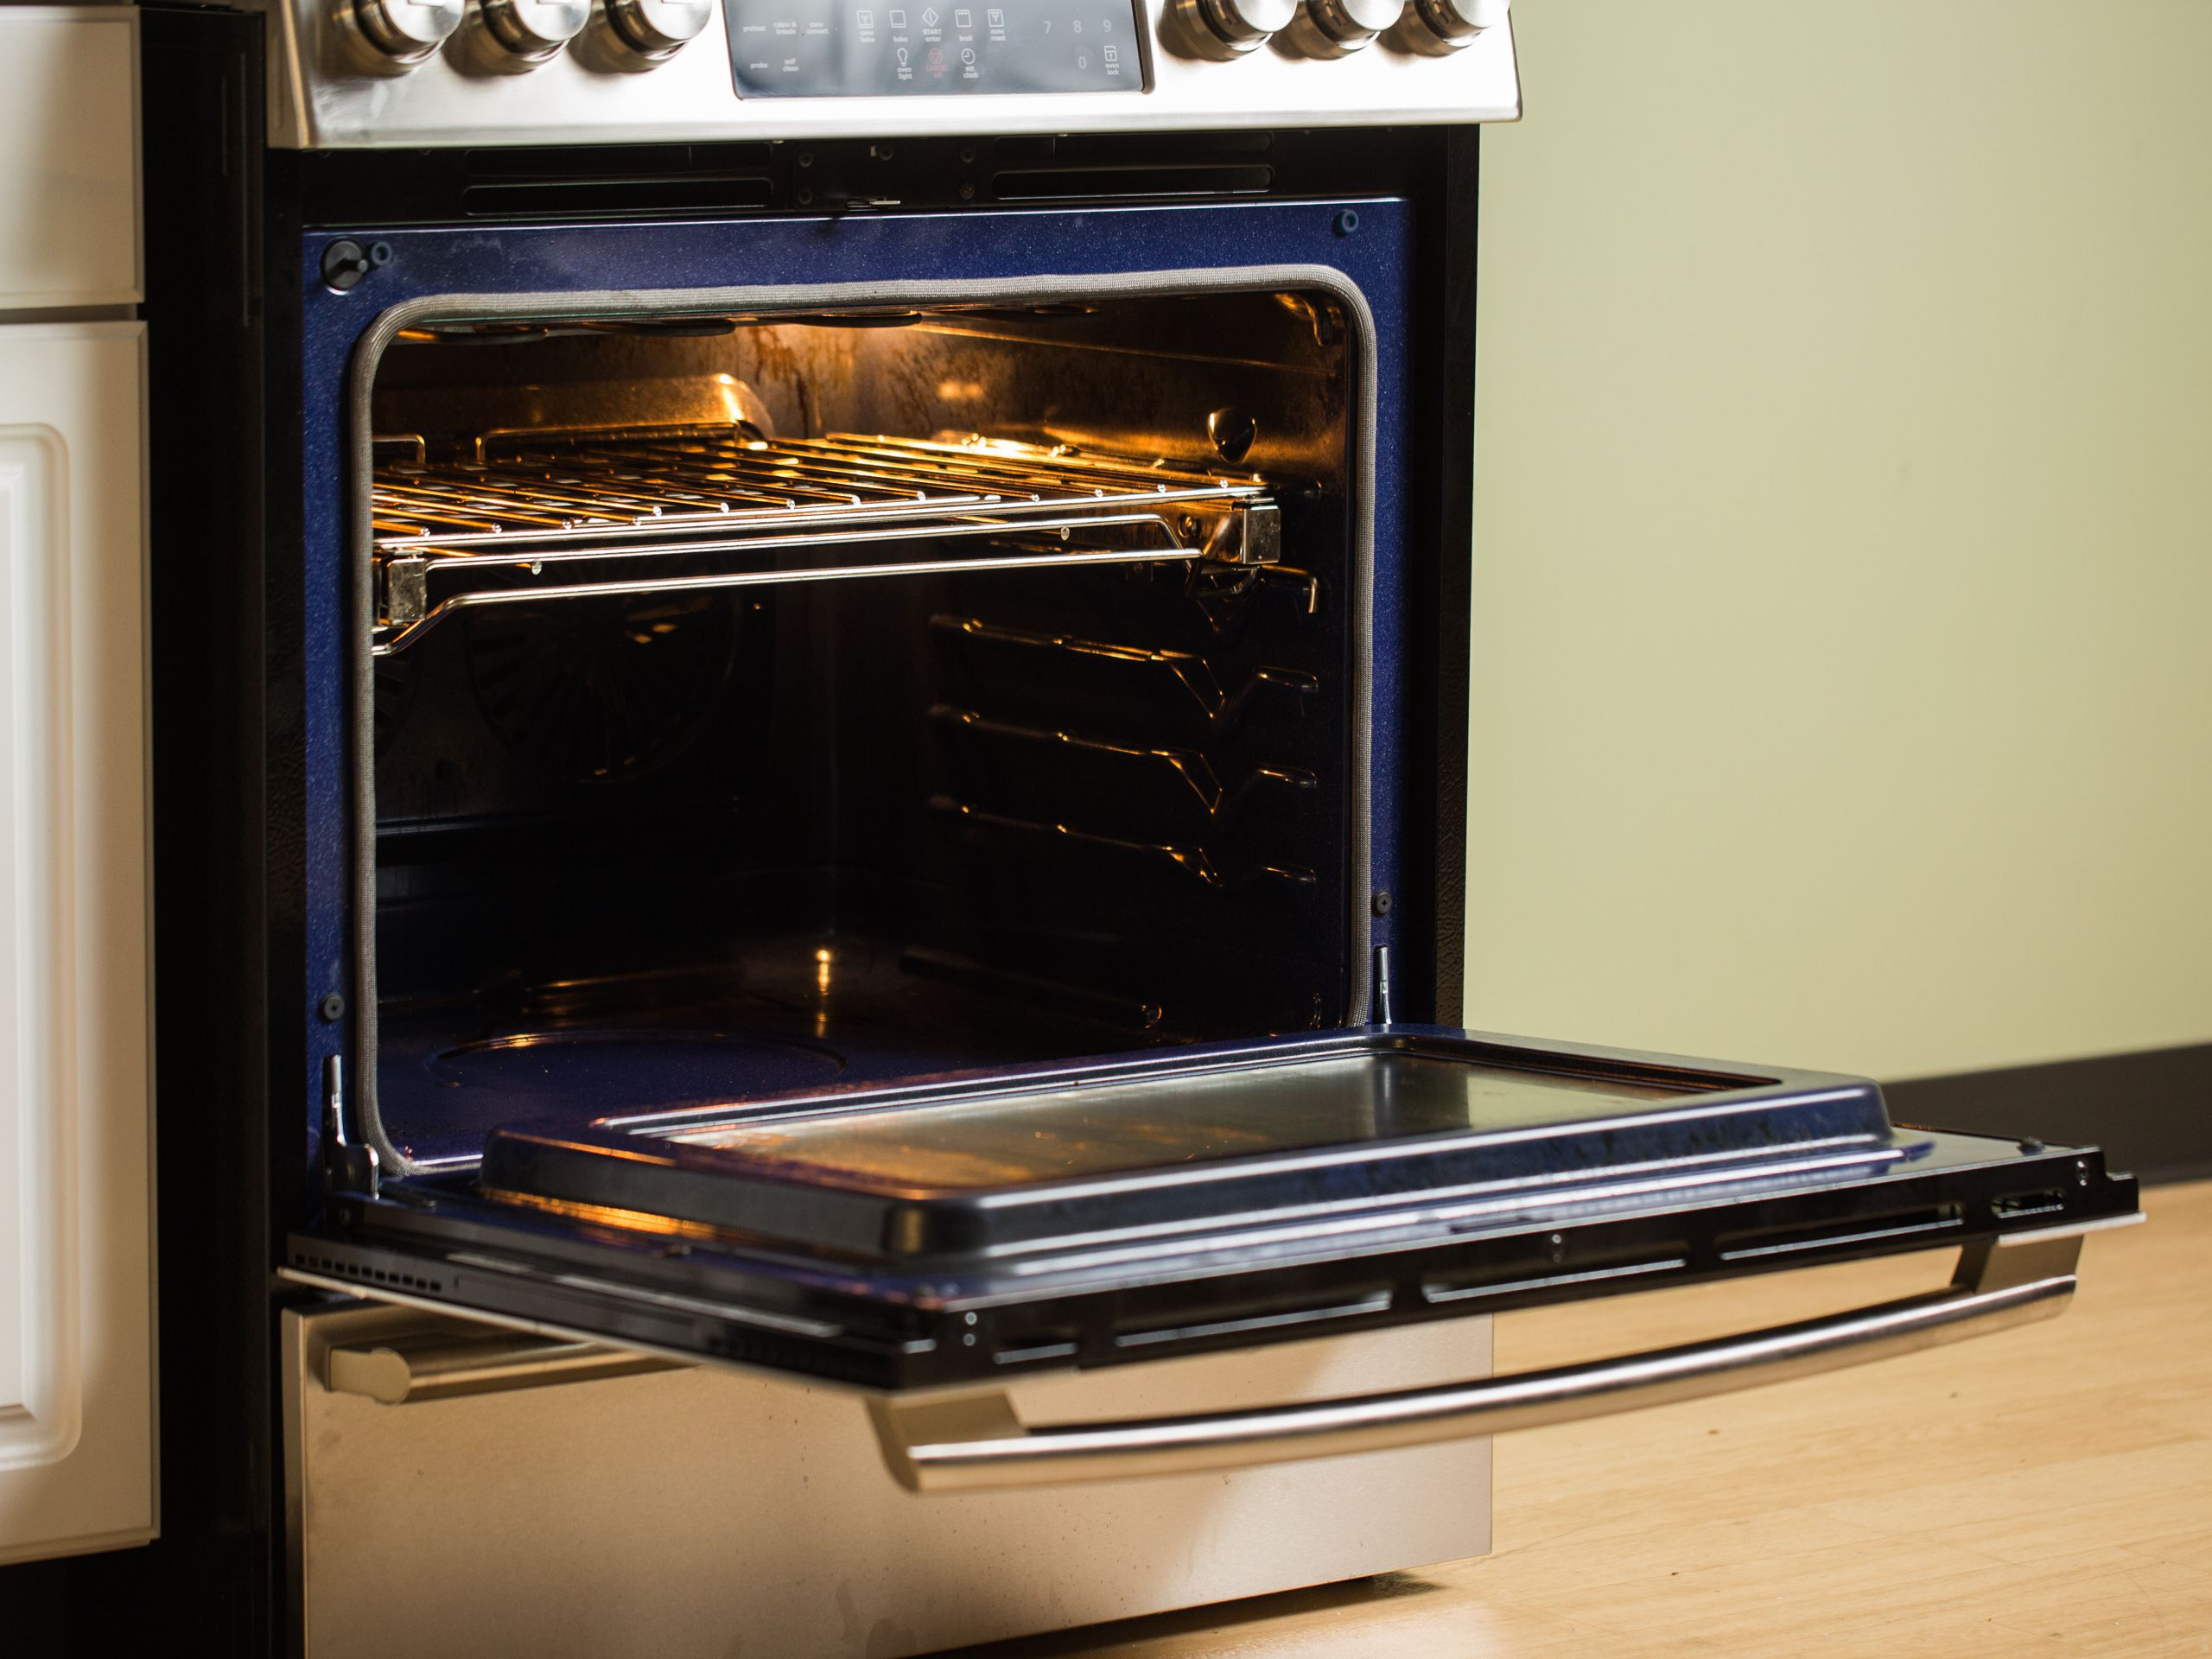
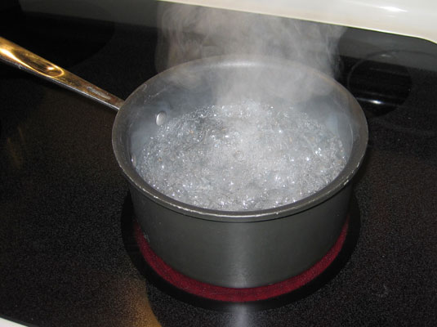
The Oven v. the Stove
The oven has a higher temperature than the water, so it’s hotter. This means the average individual particle in the air in the oven has more kinetic energy than the average individual molecule of water in the pot.
But there are a lot more molecules of water in the pot than there are particles of air in the oven. So while the average kinetic energy is higher in the oven, the total energy (and therefore heat) is greater in the water.

Slide 120
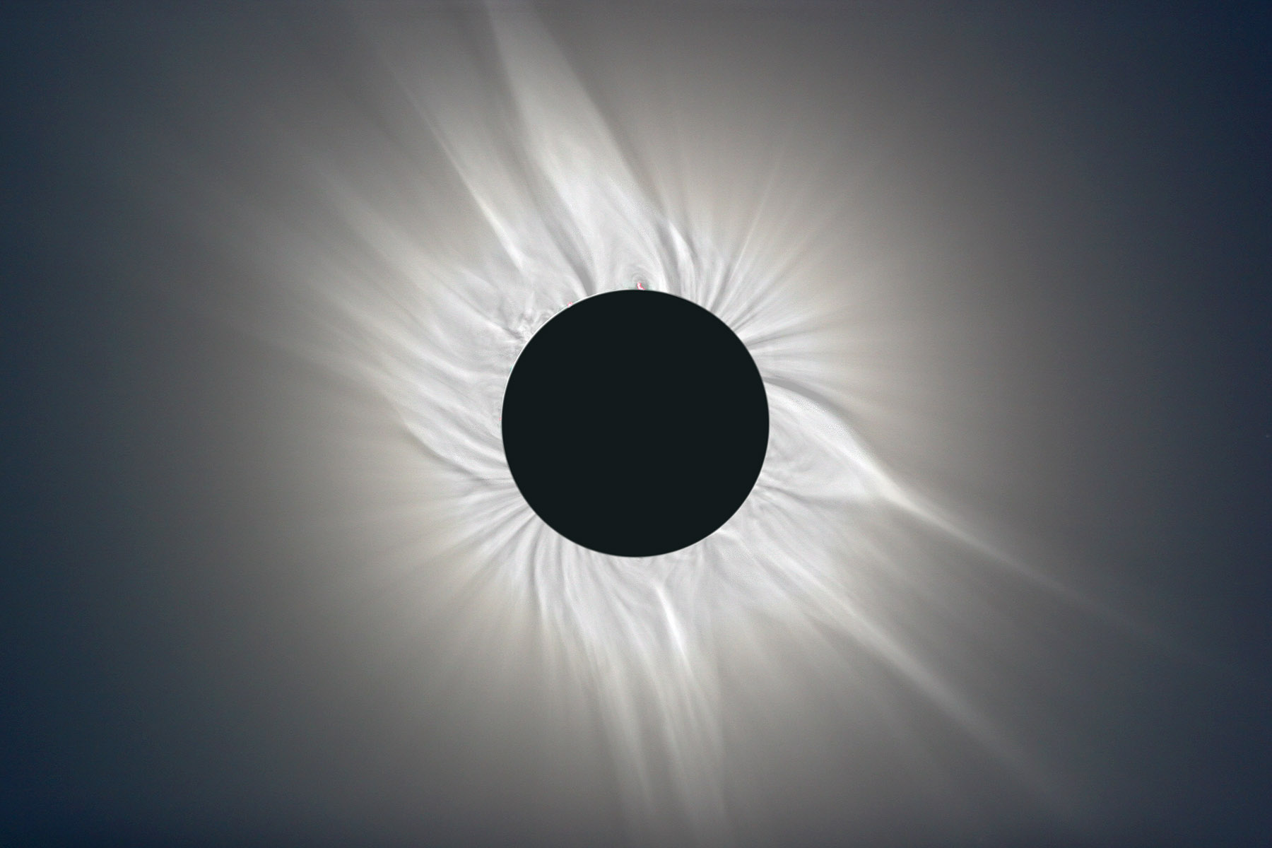
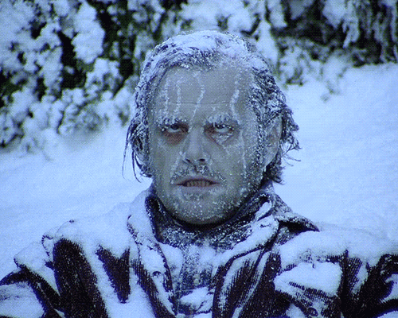
The corona of the Sun is a 1,000,000 K plasma
Yet someone right here would freeze to death because the particles in the corona are too few and far between

Slide 121
Thermal Equilibrium
When two objects of different temperature are brought together, thermal energy will flow from the hotter object to the cooler one until they reach the same temperature.
At this point, we say the system has reached thermal equilibrium.

Slide 123
When you change the thermal energy of a body, two things can happen:
Its temperature can change
Its phase can change.
If temperature changes:
The amount of thermal energy required to raise a mass m by a temperature ΔT is directly proportional to both m and ΔT:
Q ~ mΔT
Include a constant of proportionality to make this an equation:
Q = mcΔT
where c = “specific heat capacity”
Units: ^{J}/_{kg °C} or ^{J}/_{kg K}
Note: specific heat is a measure of how much energy it takes to heat 1 kg of a material by 1 °C

Slide 124
Specific Heat of Common Substances
Material | Specific Heat (J/kg K) | Material | Specific Heat (J/kg K)
Aluminum | 897 | Lead | 130
Brass | 376 | Methanol | 2450
Carbon | 710 | Silver | 235
Copper | 385 | Steam | 2020
Glass | 840 | Water (liquid) | 4180
Ice | 2060 | Zinc | 388
Iron | 450

Slide 125
If phase changes:
The amount of thermal energy required to change the phase of a mass m is directly proportional to m :
Q ~ m
Include a constant of proportionality to make this an equation:
Q = Hm
where H = H_{v} (“heat of vaporization”) , or
H = H_{f} (“heat of fusion”),
depending on what phase changes.
Units: ^{J}/_{kg} or ^{J}/_{kg}

Slide 126
Heats of Fusion and Vaporization of Common Substances
Material | Heat of Fusion (H_{f}) | Heat of Vaporization (H_{v})
Copper | 2.05 x 10⁵ | 5.07 x 10⁶
Mercury | 1.15 x 10⁴ | 2.72 x 10⁵
Gold | 6.30 x 10⁴ | 1.64 x 10⁶
Methanol | 1.09 x 10⁵ | 8.78 x 10⁵
Iron | 2.66 x 10⁵ | 6.29 x 10⁶
Silver | 1.04 x 10⁵ | 2.36 x 10⁶
Lead | 2.04 x 10⁴ | 8.64 x 10⁵
Water | 3.34 x 10⁵ | 2.26 x 10⁶

Slide 127
Example 1) How much energy does it take to heat 5.0 kg of ice from -12.0°C to 15°C?
Q_{total} = Q_{heat ice} + Q_{melt ice} + Q_{heat liquid water}
= mc_{ice}ΔT_{ice} + mH_{f} + mc_{liquid water}ΔT_{liquid water}
= (5.0 kg)(2200 J/kg°C)(12°C)
+ (5.0 kg)(334,000 J/kg)
+ (5.0 kg)(4180 J/kg°C)(15°C)
= 2,117,000J
≈ 2.2 MJ

Slide 128
Example 2) A copper bar with mass 285 g and temperature of 81°C is placed in a vat containing 785 g of water at 17°C. What’s the final temperature?
(Note default assumptions: No energy lost to surroundings; unless stated otherwise, assume containers incur negligible energy loss/gain)
Q_{lost by Cu} = Q_{gained by water}
m_{Cu}c_{Cu}ΔT_{Cu} = m_{water}c_{water}ΔT_{water}
(0.285 kg)(385 J/kg°C)(81°C – T_{final})
= (0.785 kg)(4180 J/kg°C)(T_{final} - 17°C)
Solve for T_{final}: 19°C

Slide 129
Example 3) 1.37 kg of molten lead at its melting point of 327°C is placed in a vat containing 6.20 kg of water at 15.0 °C. What is the final temperature once thermal equilibrium is reached?
(Note: There is a phase change this time)
Q_{lost by Pb} = Q_{gained by water}
Q_{freeze Pb} + Q_{cool Pb} = Q_{heat water}
m_{Pb}H_{f} + m_{Pb}c_{Pb}ΔT_{Pb} = m_{water}c_{water}ΔT_{water}
(1.37 kg)(23,000 J/kg) + (1.37 kg)(128 J/kg°C)(327°C – T_{final})
= (6.2 kg)(4180 J/kg°C)(T_{final} - 15°C)
Solve for T_{final}: 18.3°C

Slide 130
Student practice:
Example 4) How much heat is needed to change 3.00 x 10² g of ice at -30.0°C to steam at 130.0°C?
Example 5) A 100.0-g block at 100.0°C is placed in 100.0 g of water at 10.0°C. The final temperature after thermal equilibrium is reached is 25.9°C. Identify the material the block is made of.
Example 6) A 325-g iron block at 100.0°C is placed in a 181-g glass bowl containing 422 g of water at 8.0°C. What is the final temperature after everything has reached thermal equilibrium?
Example 7) A 71-g ice cube at -11.0°C is placed in a 325-g cup of water at 22.0°C. What is the final temperature?
Answers: 4) 940,000 J; 5) Aluminum; 6) 14.5°C; 7) 2.8°C

Slide 131
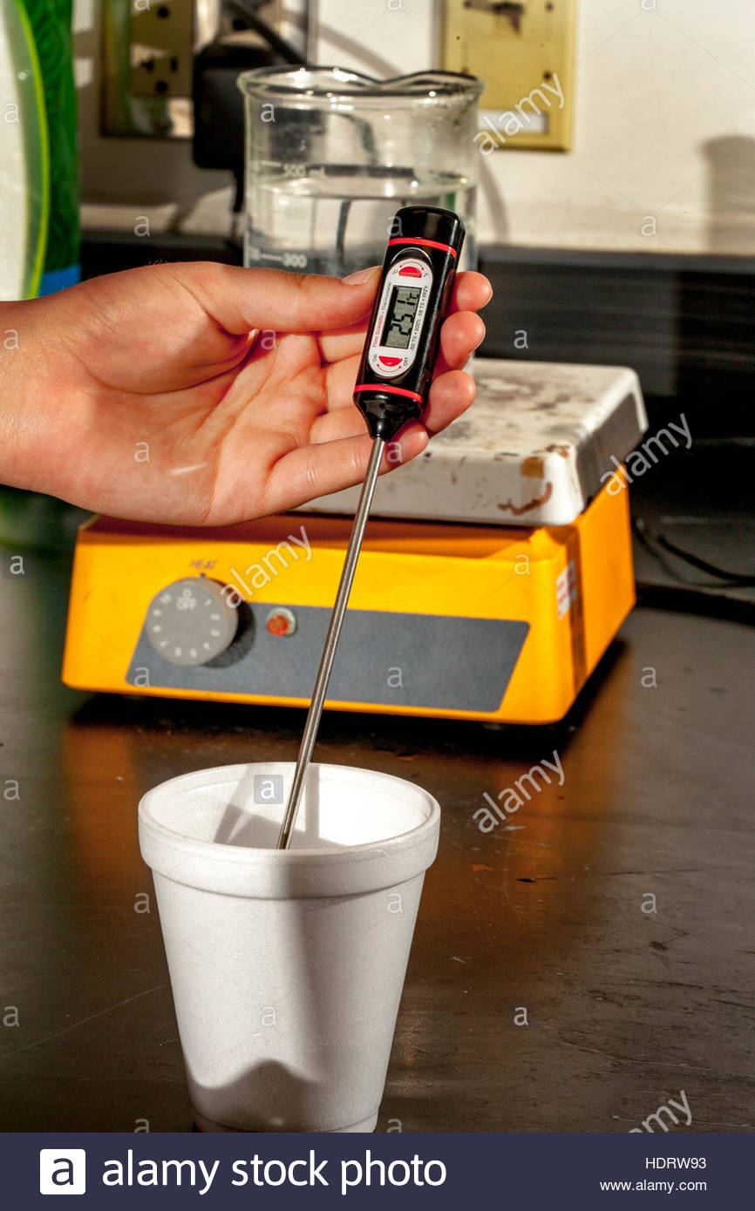
Lab: Calorimetry
Online simulation:
https://media.pearsoncmg.com/bc/bc_0media_chem/chem_sim/calorimetry/Calor.php

Slide 132
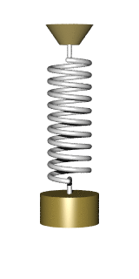
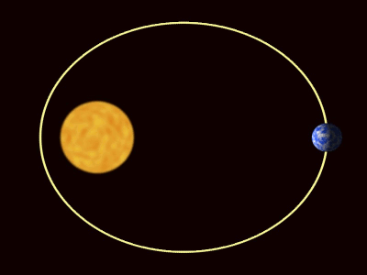
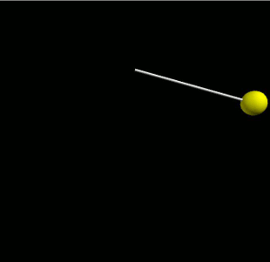
Oscillations
Periodic Motion: Movement that repeats in cycles with regular intervals.
Examples:
A planet orbiting the Sun
Mass swinging on the end of a string (pendulum)
Mass oscillating on the end of a spring

Slide 133
Simple Harmonic Oscillation
Special type of periodic motion: Simple Harmonic Motion
In Simple Harmonic Motion (SHM), oscillation is due to a restoring force
If mass is displaced from an equilibrium position, a force occurs, pulling the mass back toward the equilibrium position
The magnitude of this force is directly proportional to the magnitude of displacement but opposite in direction:
F ~ -x
(And since F = ma, a ~ -x too)

Slide 134
Which of these examples of periodic motion also serve as examples of Simple Harmonic Motion?
Examples:
A planet orbiting the Sun
Mass swinging on the end of a string (pendulum)
Mass oscillating on the end of a spring

Slide 135
Which of these examples of periodic motion also serve as examples of Simple Harmonic Motion?
Examples:
A planet orbiting the Sun
Mass swinging on the end of a string (pendulum)
Mass oscillating on the end of a spring

Slide 136
Ways to Quantify SHM
Period (T) – the amount of time one complete cycle takes.
Amplitude (x_{max} or θ_{max}) – The maximum displacement away from an equilibrium position.
Frequency (f) – A measure of how often each cycle repeats.
Note: frequency is the inverse of period: f = ¹/_{T}.
Units of frequency: sec⁻¹ (or Hz)

Slide 137
Equations
Here are equations for the periods of a pendulum and oscillating spring:
T_{pendulum} = 2π √(^{L}/_{g})
T_{spring} = 2π √(^{m}/_{k})
Note: mass affects the spring but NOT the pendulum.
Also note: neither is influenced by amplitude.

Slide 138
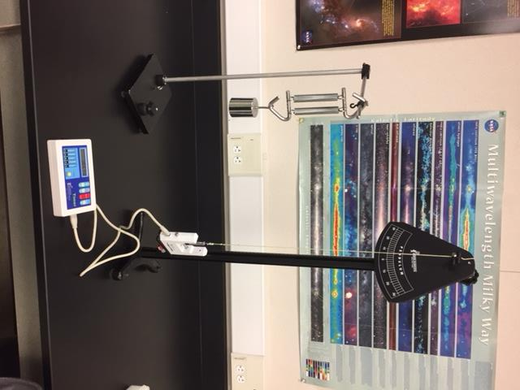
Oscillation Lab Ideas
What Affects the Period of a Pendulum?
Using a Pendulum to Measure g
Using Oscillation and Hooke’s Law to Determine Spring Constants
Here are URL’s for PhET simulations where you can do Distance Learning versions of these labs:
https://phet.colorado.edu/en/simulation/pendulum-lab
https://phet.colorado.edu/en/simulation/masses-and-springs-basics

Slide 139
Hallmarks of Simple Harmonic Motion
Period & amplitude are constant
Period is independent of amplitude
Displacement, velocity, and acceleration are all sine (or cosine) curves

Slide 140
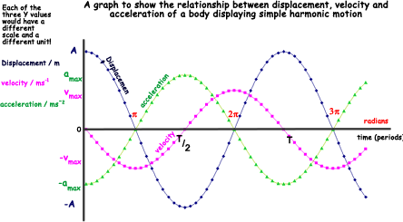
Note: velocity = 0 when displacement is a min or max
Also note: acceleration ~ -displacement

Slide 141
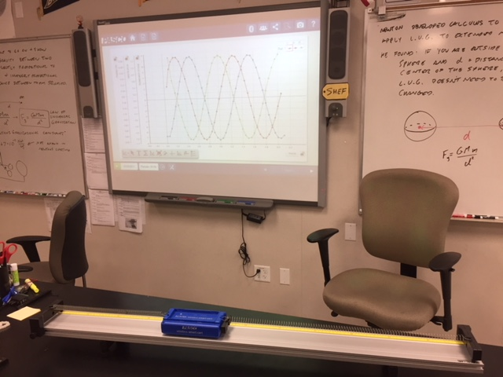
Smart Cart Demo

Slide 142
Waves
A wave is a rhythmic disturbance in which energy is conveyed through a medium
In the case of electromagnetic waves (i.e. light), the medium is space itself.
Though the energy of pulse or wave propagates through space, matter itself does NOT travel with the wave.

Slide 143
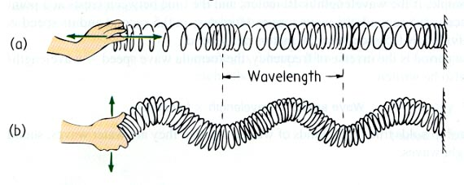
Longitudinal Wave: Wave in which particles in the medium vibrate in a direction parallel to the direction of wave propagation
Transverse Wave: Wave in which particles in the medium vibrate in a direction perpendicular to the direction of wave propagation.

Slide 144
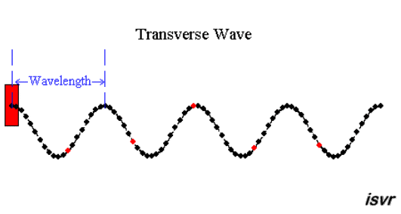
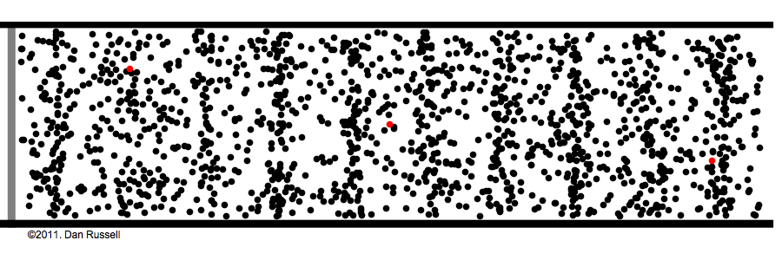
Longitudinal Wave

Slide 145
Earth Science Connection: Whether earthquake waves are longitudinal or transverse provides a window into Earth’s interior.
P-waves, which are pressure waves, can travel through liquid, but s-waves cannot.
Thus, when an earthquake occurs somewhere on Earth, if geologists around the world monitor the event and share their data, they can deduce the size of Earth’s liquid center!

Slide 146
P-Waves
P stands for “primary” or “pressure”.
These are longitudinal waves. This means that disturbed particles vibrate in the same direction as the motion of the wave.
In other words, the crests travel as compressions.
Sound waves are another example of longitudinal waves.

Slide 147
S-Waves
S stands for “secondary” or “seismic”.
S-waves are transverse waves, which means that disturbed particles vibrate in a direction perpendicular to the direction of wave travel, like ripples in a pond, or people “doing the wave” in a stadium.

Slide 149
Slinky Science activities for students:
http://swift.sonoma.edu/education/slinky_booklet/
This booklet, developed by NASA and Sonoma State University, includes activities where students explore wave propagation, standing waves, interference, and the relationships between wavelength, energy, and frequency of a wave, all using slinkies!

Slide 150
Representing Waves with Sine Curves
Crest: High point of a wave
Trough: Low point of a wave

Slide 151
Representing Waves with Sine Curves
Amplitude: Distance from wave’s midpoint to either crest or trough

Slide 152
Representing Waves with Sine Curves
λ
λ
λ
Wavelength: Length of one complete cycle

Slide 153
Other Wave Properties
Period: The amount of time it takes for one complete cycle to pass by a stationary point.
Symbol: T
Unit: seconds
Wave Speed: The speed of any given crest or trough of the wave.
Symbol: v
Unit: m/s
Frequency: The rate at which complete cycles pass by a stationary point. (For example: The number of crests that pass by a given spot per unit time)
Symbol: f
Unit: s⁻¹, or Hz

Slide 154
Wave equations
Basic formula for speed: v = ^{d}/_{t}
For a wave, the relevant distance is wavelength and time is period, so
v = λ/T
Frequency is the inverse of period, so
f = ¹/_{T}
If you substitute this expression into the equation for wave speed, you can write
v = λf

Slide 155
Example Problem: A sound wave has frequency 280 Hz and speed 343 m/s. a) What is the wavelength? b) What is the period? c) How long would it take to hear an echo from a canyon wall 250 away?
v = λf, so λ = ^{v}/_{f} = ^{343 m/s}/_{288 Hz} = 1.2 m
T = 1/_{f} = ¹/_{288 Hz} = 0.0036 s
v = ^{d}/_{t} = ^{500 m}/_{343 m/s} = 1.5 s (Note: 500 m is the round trip distance)

Slide 156
Principle of Superposition:
You will never see these two guys in the same location!
Oops! Wrong Principle of Superposition!

Slide 157
Principle of Superposition:
When two waves or pulses occupy the same position in space, their amplitudes add together.

Slide 158
When one wave or pulse reinforces another, resulting in greater amplitude, constructive interference occurs.
When one wave or pulse – either totally or partially – cancels out another, destructive interference occurs.

Slide 160
Standing Waves
If a wave interferes just right with its own reflection, a standing wave can occur.
A standing wave features nodes (where destructive interference constant occurs) and anti-nodes (where constructive interference constantly occurs.

Slide 161
Anti-Node
Node

Slide 162
Resonance
Most rigid, elastic bodies will vibrate at a natural frequency if disturbed.
This frequency will depend on the shape and composition of the body.
If an object is pushed at regular intervals such that the regularity of the force = the natural frequency of vibration, then amplitude of vibration will increase.
This phenomenon is called Resonance.

Slide 163
Suppose the natural frequency of a child playing on a swing is 0.50 Hz. That is, the period of oscillation is 2.0 s.
How often should the child’s mother push the child?
Every 2.0 s, duh!
Would pushing half as often, i.e. every 4.0 s work?
Sure!
How about twice as often?
Absolutely not!

Slide 164
Resonance Demo

Slide 165
More Examples of Resonance…

Slide 167
Finding the Beat
If two tuning forks with different frequencies are sounded together, a beat is heard.

Slide 168
Finding the Beat
The frequency of the beat is equal to the difference in the frequencies of the two tuning forks:
F_{beat} = F_{higher} – F_{lower}
Since the period of a recurrent phenomenon is equal to 1 over the frequency, this formula may be rewritten:

Slide 169
Earth Science Connection: Using the Beat to Measure Orbital Periods
This formula doesn’t just apply to sounds or musical notes – it applies to any recurring period phenomena, from cars whose turn signals blink at different rates, to planets orbiting the sun.
It was known for centuries that the Sun, Earth, and Mars align every 779 days.
(How could a patient person discover this?)
Answer: This is often Mars rises exactly at sunset.
Each such alignment can be thought of as a beat – the coinciding of two recurring phenomena, in this case, the orbits of two planets.

Slide 170
A Martian Year
So, T_{beat} = 779 days.
T_{short} must = T_{earth} since Earth is closer to the Sun than mars, so T_{short} = 365 days.
Finally T_{long} = T_{mars}.
T_{mars} = 687 days.

Slide 171
Stationary Sound emitting object
λ
λ
λ
Circularly expanding crests of sound waves, traveling outward at 343 m/s

Slide 172
Sound emitting object moving towards the right
Wavelengths are spread out behind the sound emitting object.
λ
λ
Wavelengths are bunched together in front of the sound emitting object.

Slide 174
Consider three individuals, Person A, Person B, and Person C, standing relative to a sound-emitting object moving to the right.
λ
λ
Compare the wavelengths perceived by Person B and Person C.
A
B
C
Person B perceives a longer wavelength than Person C

Slide 175
Consider three individuals, Person A, Person B, and Person C, standing relative to a sound-emitting object moving to the right.
λ
λ
Compare the frequencies perceived by Person B and Person C.
A
B
C
Person B perceives a lower frequency than Person C

Slide 176
Consider three individuals, Person A, Person B, and Person C, standing relative to a sound-emitting object moving to the right.
λ
λ
λ
Compare the frequencies perceived by Person A and Person B.
A
B
C
Person A and Person B perceive the same frequency since they perceive the same wavelength

Slide 177
Consider three individuals, Person A, Person B, and Person C, standing relative to a sound-emitting object moving to the right.
Compare the speed of sound perceived by Persons A, B and C
A
B
C
Persons A, B, and C all perceive the same speed of sound since the speed of sound is set by the medium, not by the movement of the object.

Slide 178
Sonic Booms
If a sound emitting object is moving at the speed of sound (“mach 1”) then it is exactly keeping pace with the crests of the sound waves it has emitted.
Where these crests overlap, constructive interference occurs.
Where constructive interference occurs, amplitude increases.
Where amplitude increases, loudness intensifies.
This creates a “sonic boom”

Slide 179
I don’t hear anything yet

Slide 180
YOW!!! I’M HEARING A SONIC BOOM!!!
I don’t hear anything yet

Slide 181
YOW!!! I’M HEARING A SONIC BOOM!!!
My ears are
still ringing from the sonic boom
I don’t hear anything yet

Slide 182
If a sound emitting object, such as a supersonic jet, is moving faster than the speed of sound, then the shock wave that causes the sonic boom takes the shape of a cone trailing behind the moving object…

Slide 183
Cone-shaped shockwave
YOW!!! I’M HEARING A SONIC BOOM!!!
My ears are
still ringing from the sonic boom
I don’t hear anything yet. It must be a stealth plane!!

Slide 184
Here’s a good website for illustrating how the Doppler Effect and sonic booms work:
https://iwant2study.org/ospsg/index.php/interactive-resources/physics/04-waves/05-sound/366-dopplerxywee01

