Slide 1
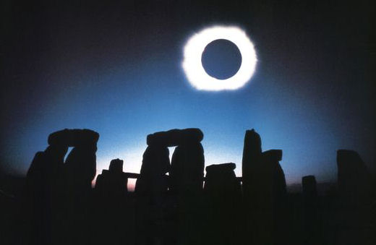
Astronomy
Lecture 4: The Sky, Part III –
The Moon

Slide 2
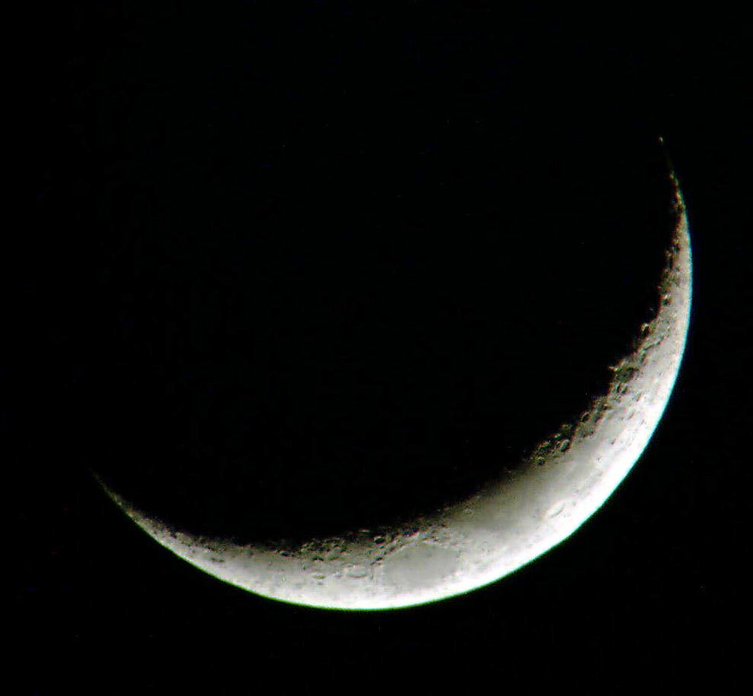
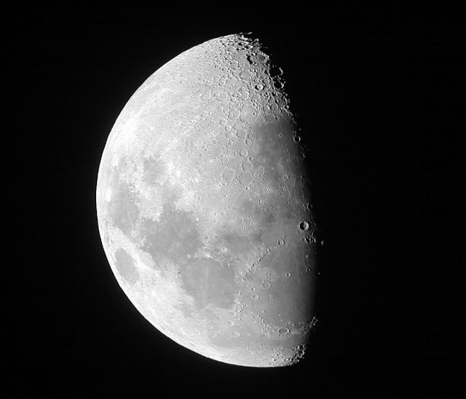
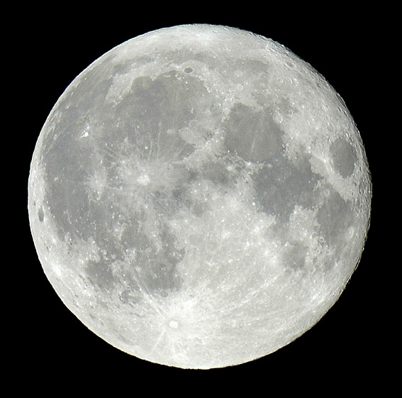
Phases of the Moon
Every 29.5 days, the Moon goes through a complete cycle of phases.
Discuss this phenomenon with your neighbor. Try to determine two explanations for lunar phases – one you believe is correct, and one that you believe is incorrect, yet plausible.

Slide 3
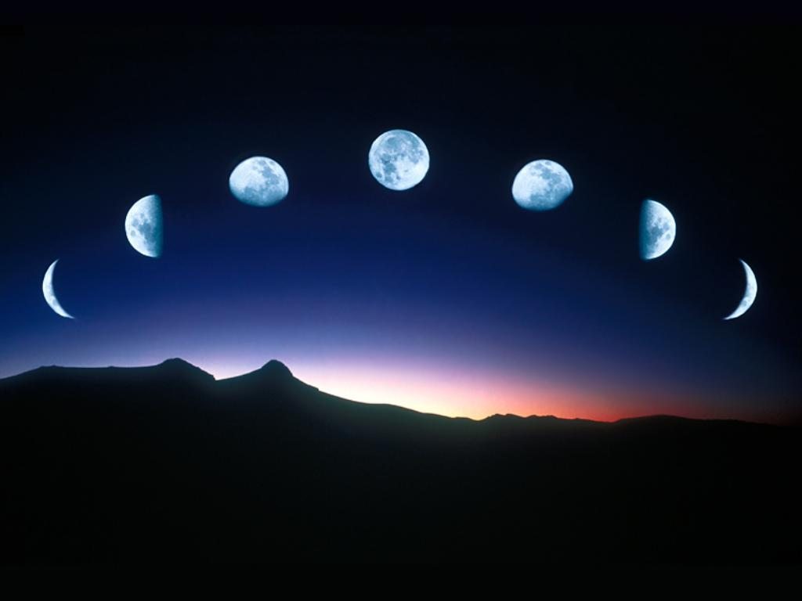
So the phases of the Moon are due to the light side of the Moon facing in different directions, relative to the Earth, as it orbits our planet.
When the moon is full, it’s on the far side of the Earth from the Sun, and we see the lit half. When we see a crescent moon, the Moon is relatively near the Sun in the sky, and most of the lit half is facing away from the Earth.

Slide 5
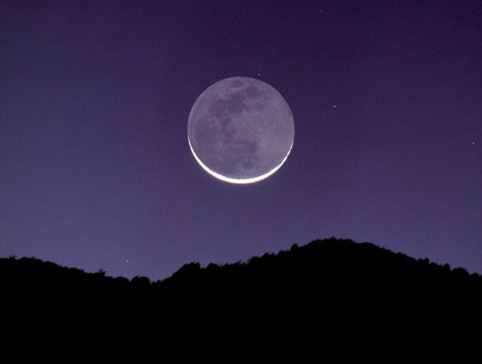
Sometimes, you may notice you can seen the whole disk of the moon even when it’s a crescent. The dark half of the moon, which is facing us, seems to be lit slightly. What could be lighting it?
Hint: If you were standing on the Moon, looking back at Earth during the time the Moon were crescent, what phase would the Earth appear?
The Moon in this photo is reflecting the light of the nearly “full Earth”.
This phenomenon is called “Earthshine.”

Slide 6
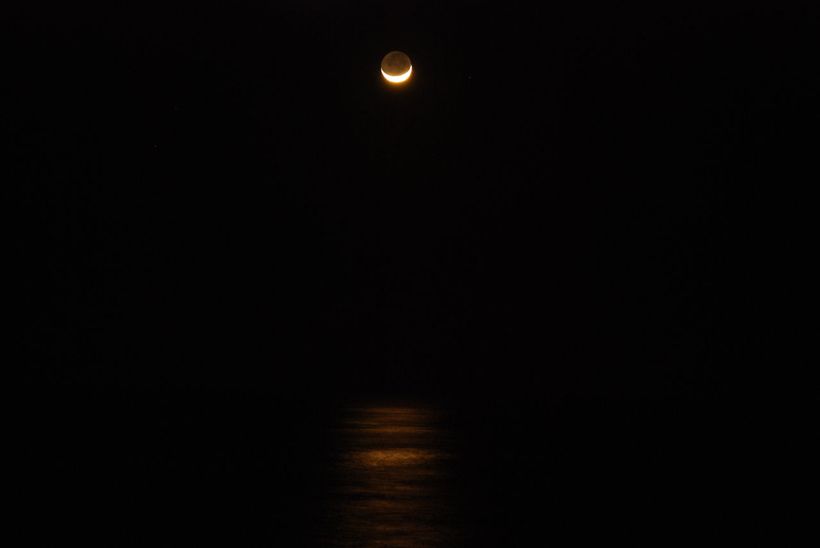

Slide 7
Synodic vs. Sidereal Month
The 29.5 day cycle of the phases is called a Synodic Month. This is the time it takes for the Moon to orbit Earth once, relative to the Sun
It takes only 27.3 days for the Moon to complete one orbit relative to the background stars in space. This is called a Sidereal Month.
The 2.2 day discrepancy is due to the the fact that while the Moon is orbiting the Earth, the Earth is also busy orbiting the Sun

Slide 8
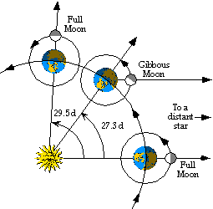
Day 1: The Moon is full, and directly to the right of the Earth, as shown below.
27.3 days later, the Moon has completed one full orbit, and is to the right of the Earth again, but it is not yet full – only gibbous.
2.2 days later, or 29.5 days since the beginning, the Moon is now full again.

Slide 9
Finding the Beat of the Moon’s Orbit
How do we know it takes the Moon 27.3 days to orbit the Earth if we see it go through a set of phases every 29.5 days?
The key to relating the Moon’s synodic and sidereal periods lies in a physics formula relating to sound and music.
If two tuning forks with different frequencies are sounded together, a beat is heard. The frequency of the beat is equal to the difference in the frequencies of the two tuning forks:
F_{beat} = F_{higher} – F_{lower}
Since the period of a recurrent phenomenon is equal to
1 over the frequency, this formula may be rewritten:

Slide 10
Using the Beat
This formula doesn’t just apply to sounds or musical notes – it applies to any recurring period phenomena, from cars whose turn signals blink at different rates, to planets orbiting the sun.
The alignment of any three bodies in space can be considered a beat.
What are the two regularly repeating phenomena which give rise to the Moon’s synodic period?
Answer: The Moon’s orbit around Earth, and the Earth’s orbit around the Sun

Slide 11
Calculating the Sidereal Month
So, T_{beat} = 29.5 days.
T_{short} must = T_{sidereal} since the Moon orbits Earth more often than Earth orbits the Sun.
So, T_{long} = 365 days.
Let’s set up the beat equation and find T_{sidereal}!

Slide 12
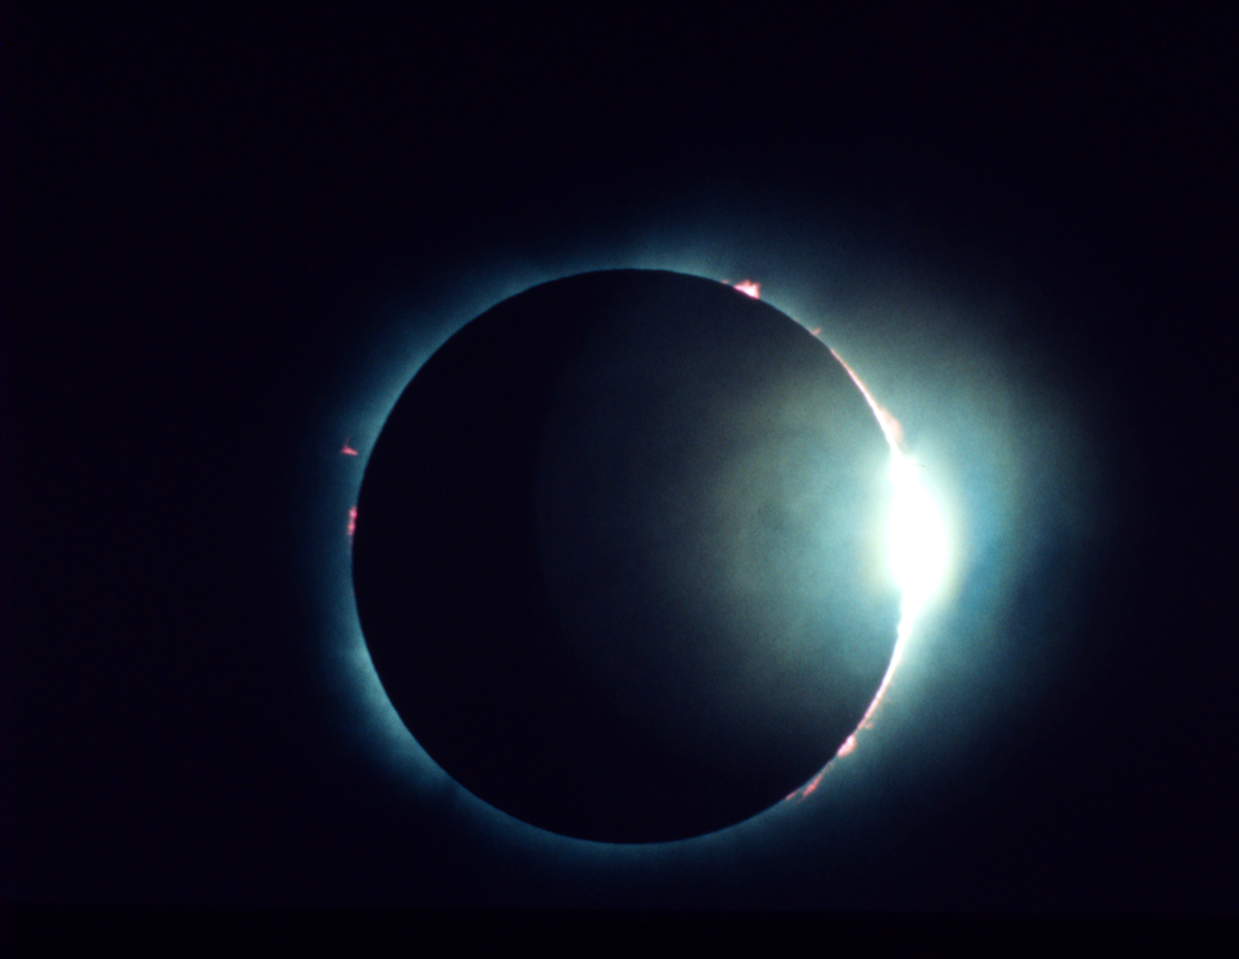
Solar Eclipses
Solar eclipses occur when the Moon passes directly between the Sun and Earth, blocking our view of the Sun.

Slide 13
Just the Right Size
The Sun is about 390 times wider than the Moon.
Coincidentally, it is also about 390 times farther from Earth than the Moon is.
That’s why they both appear about the same size in the sky (about half a degree across).
Thus, during an eclipse, the Moon almost exactly covers up the Sun.

Slide 14
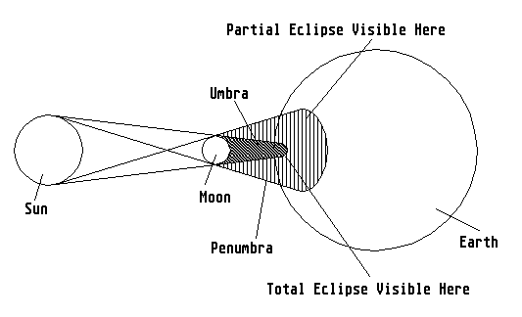

Slide 15
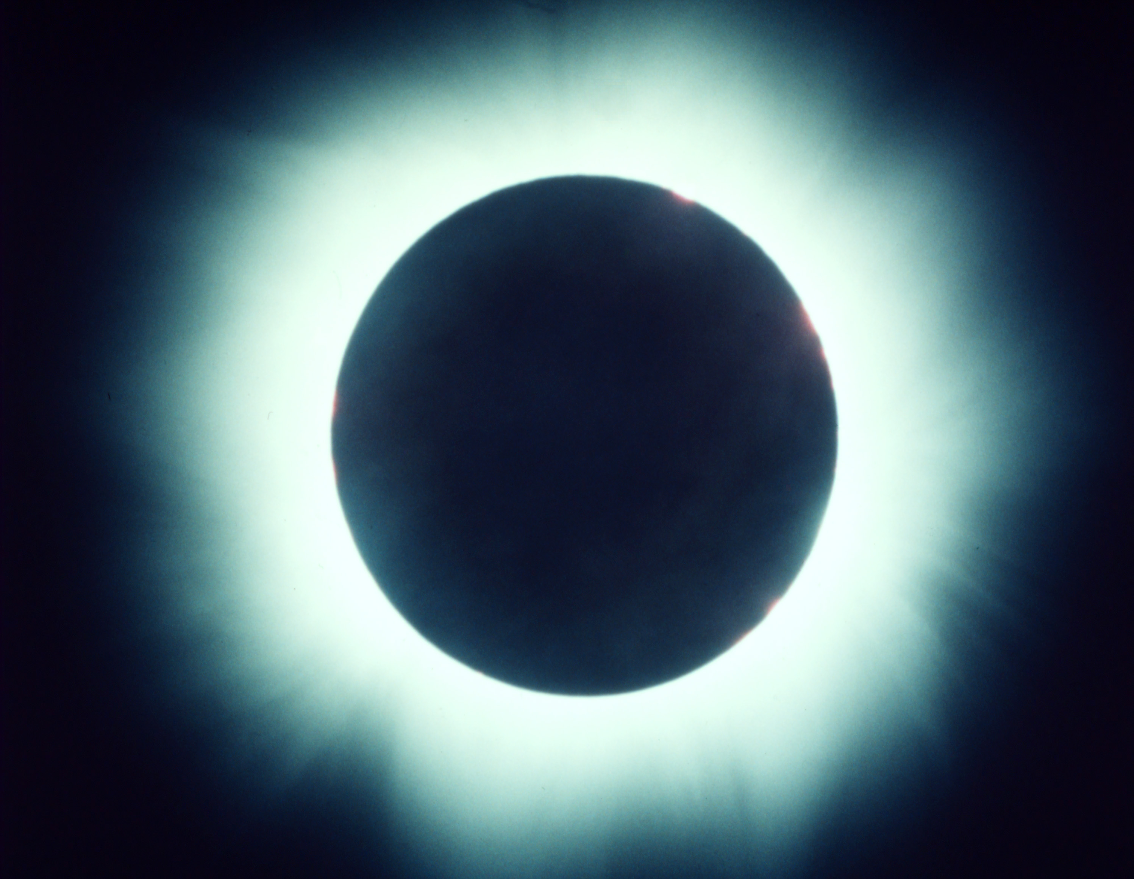
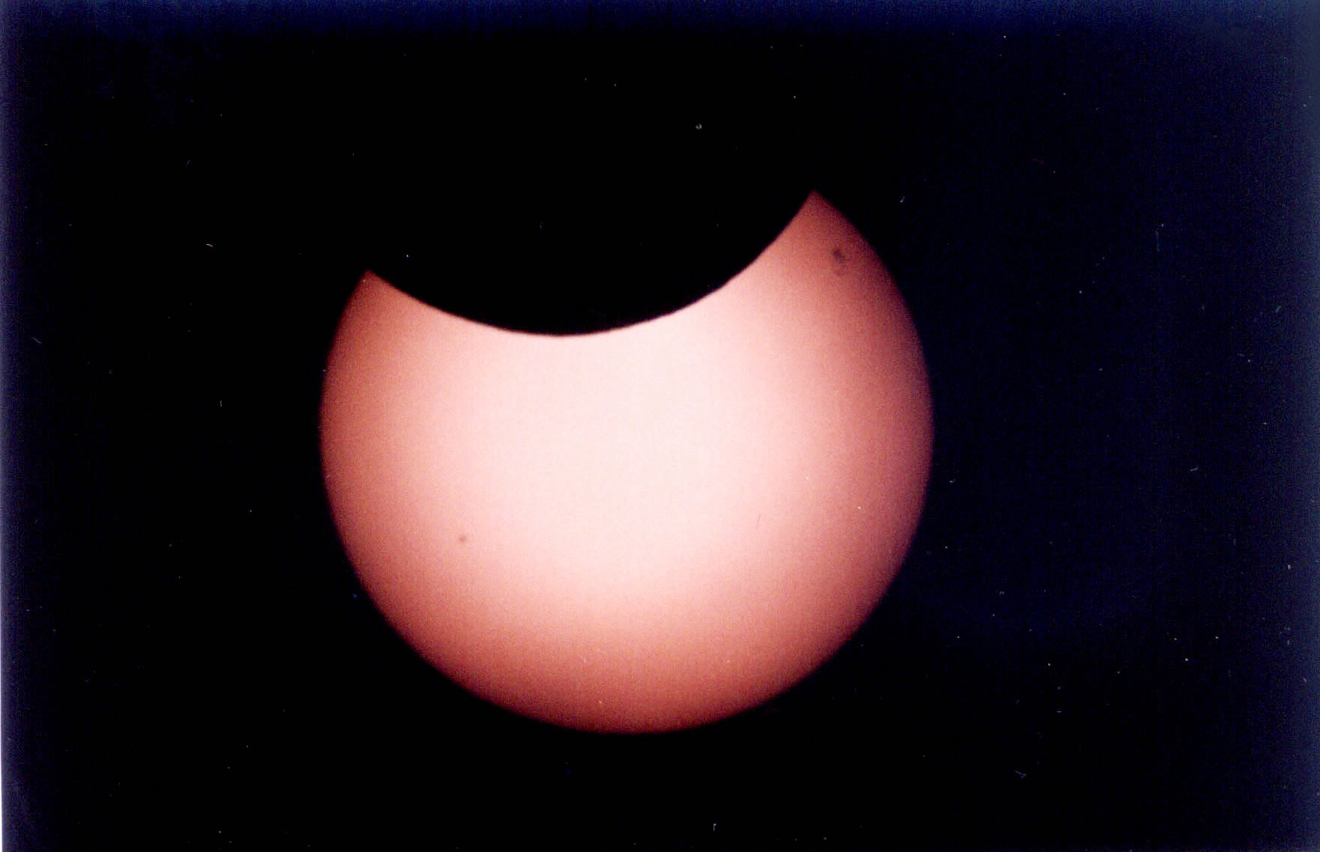
Only a Privileged Few…
…get to see a solar eclipse when one occurs.
This is because the size of the Moon’s umbra (or complete shadow) only touches the surface of the Earth in a small region.
The penumbra (or partial shadow) covers a larger region, so more people get to see a partial eclipse.

Slide 16
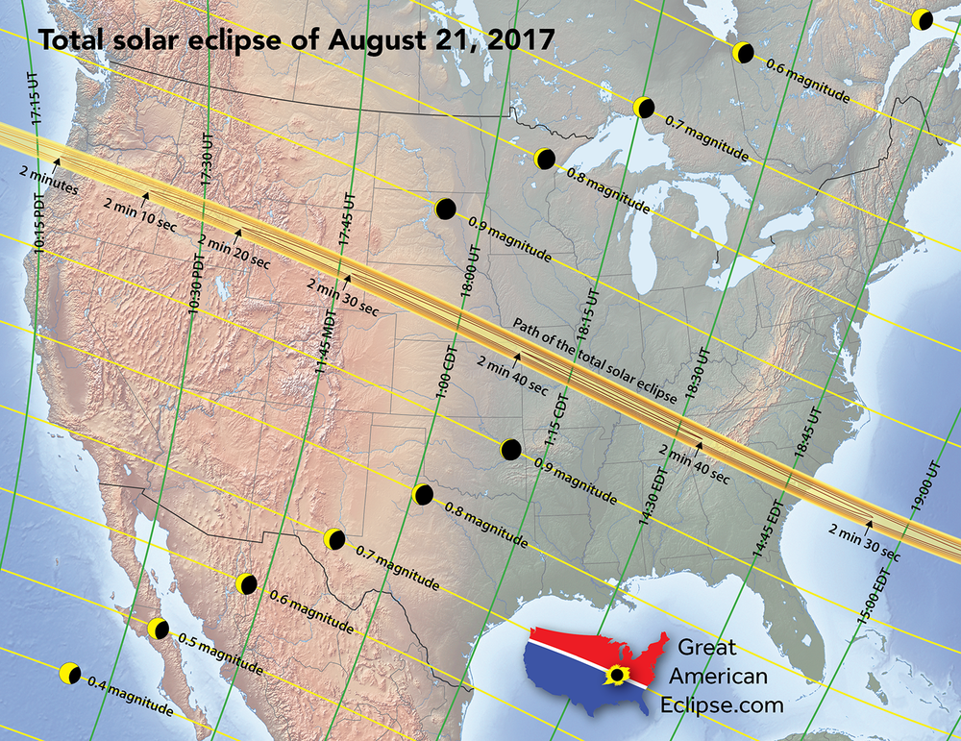

Slide 17
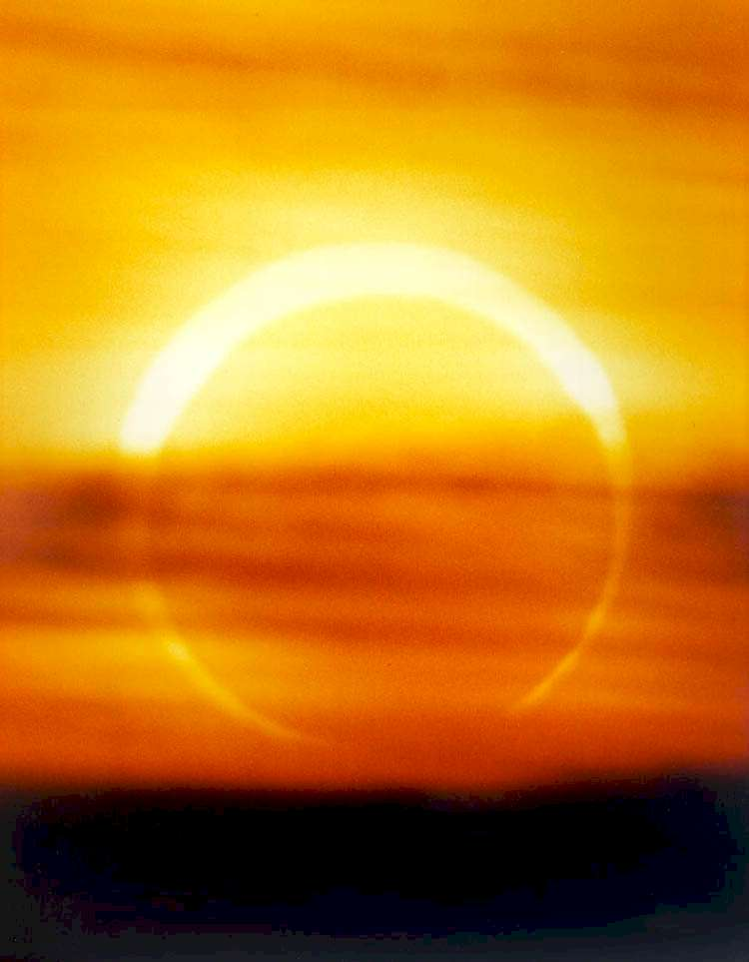
Annular Eclipses
The Moon has a slightly elliptical orbit.
When the Moon is at its greatest distance from the Earth, it appears too small in the sky to completely cover up the sun during an eclipse.
The Sun appears as a ring of light in the sky. The geometrical name for a ring shape is “annulus” so this type of eclipse is called an annular eclipse.

Slide 18
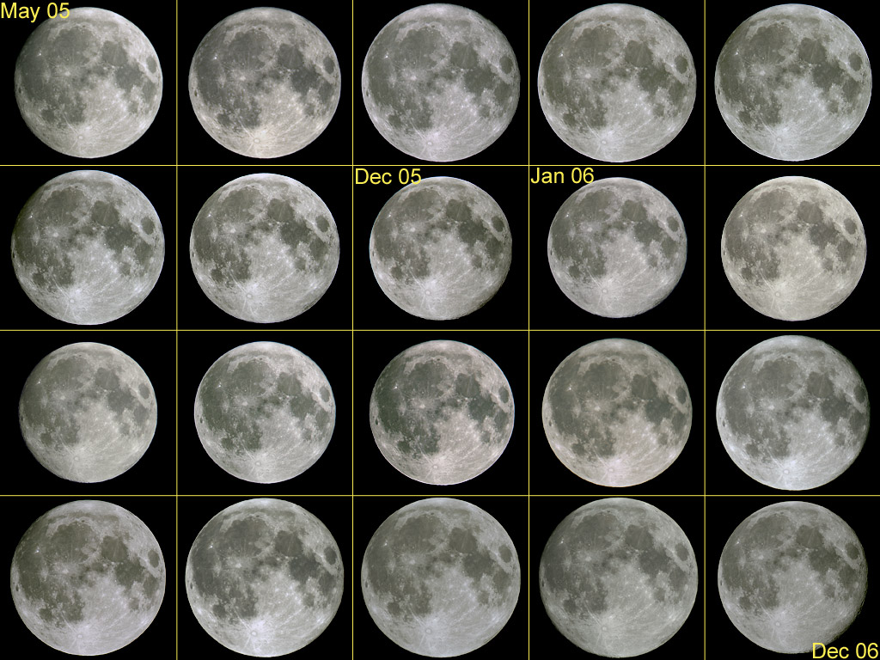

Slide 19
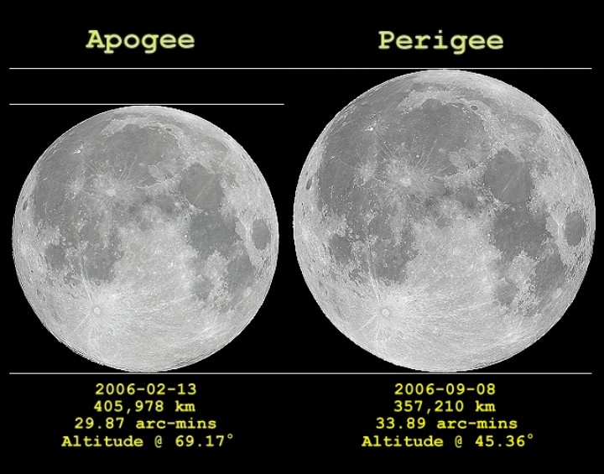

Slide 20
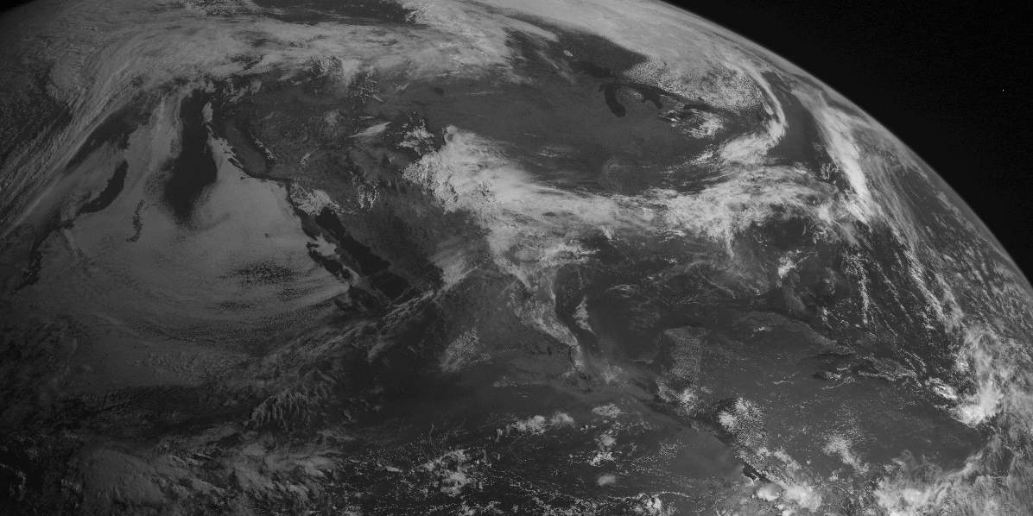
Annular Eclipse of May, 1994

Slide 21
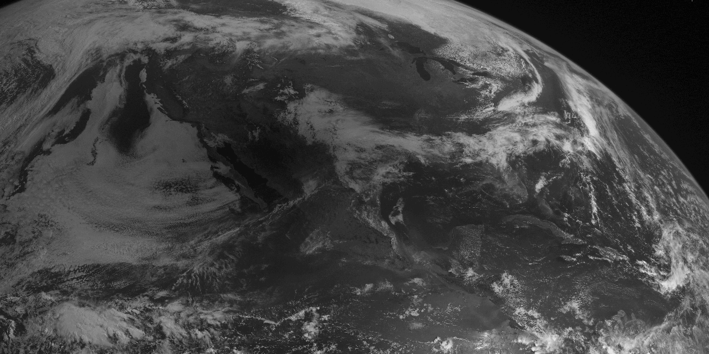

Slide 22
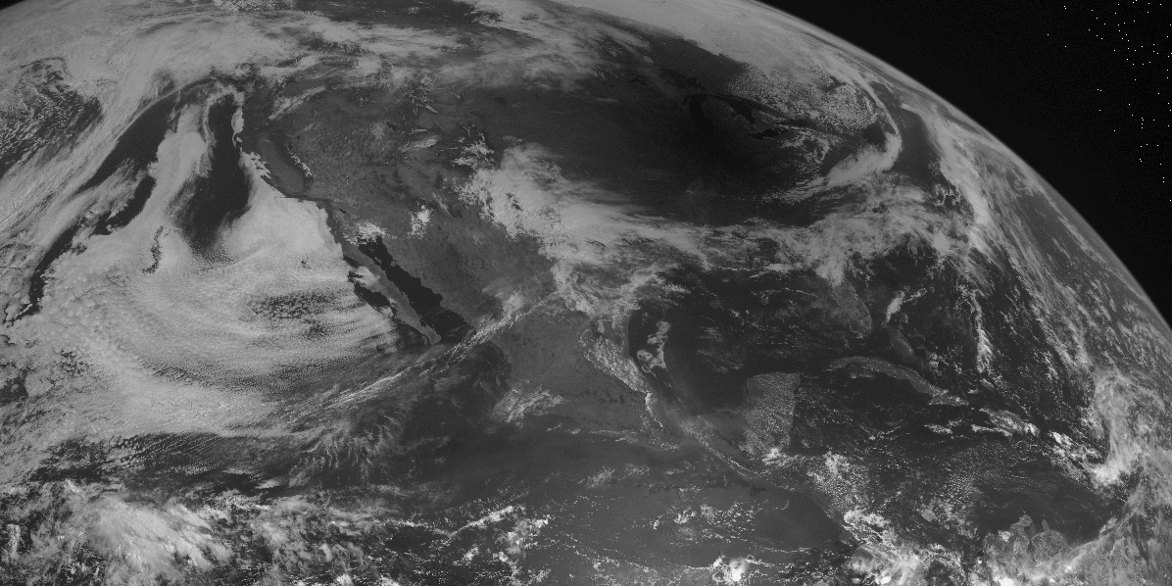

Slide 23
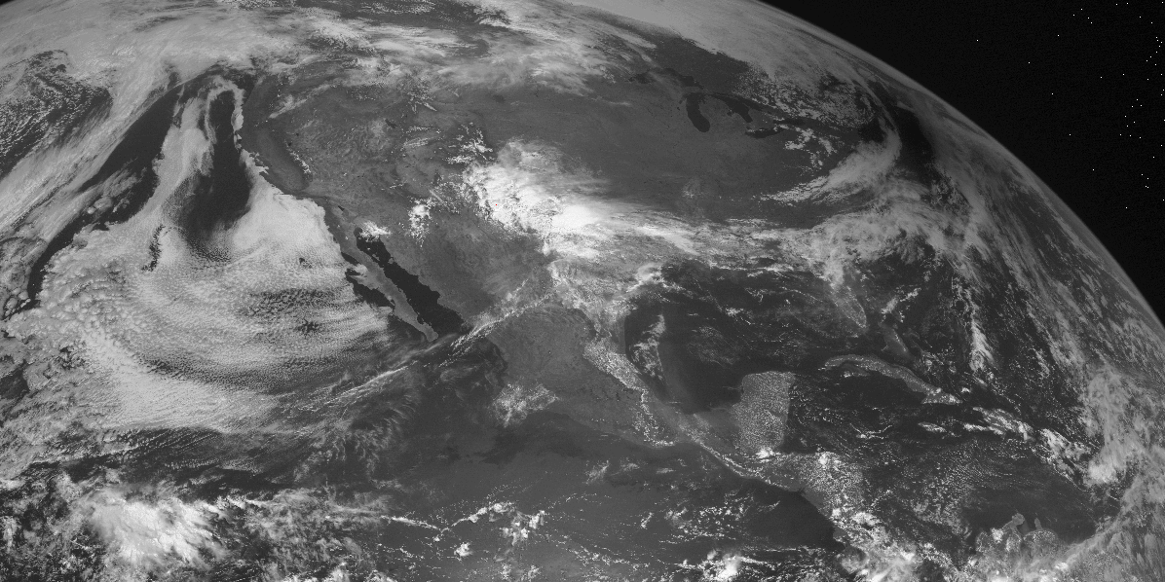

Slide 25
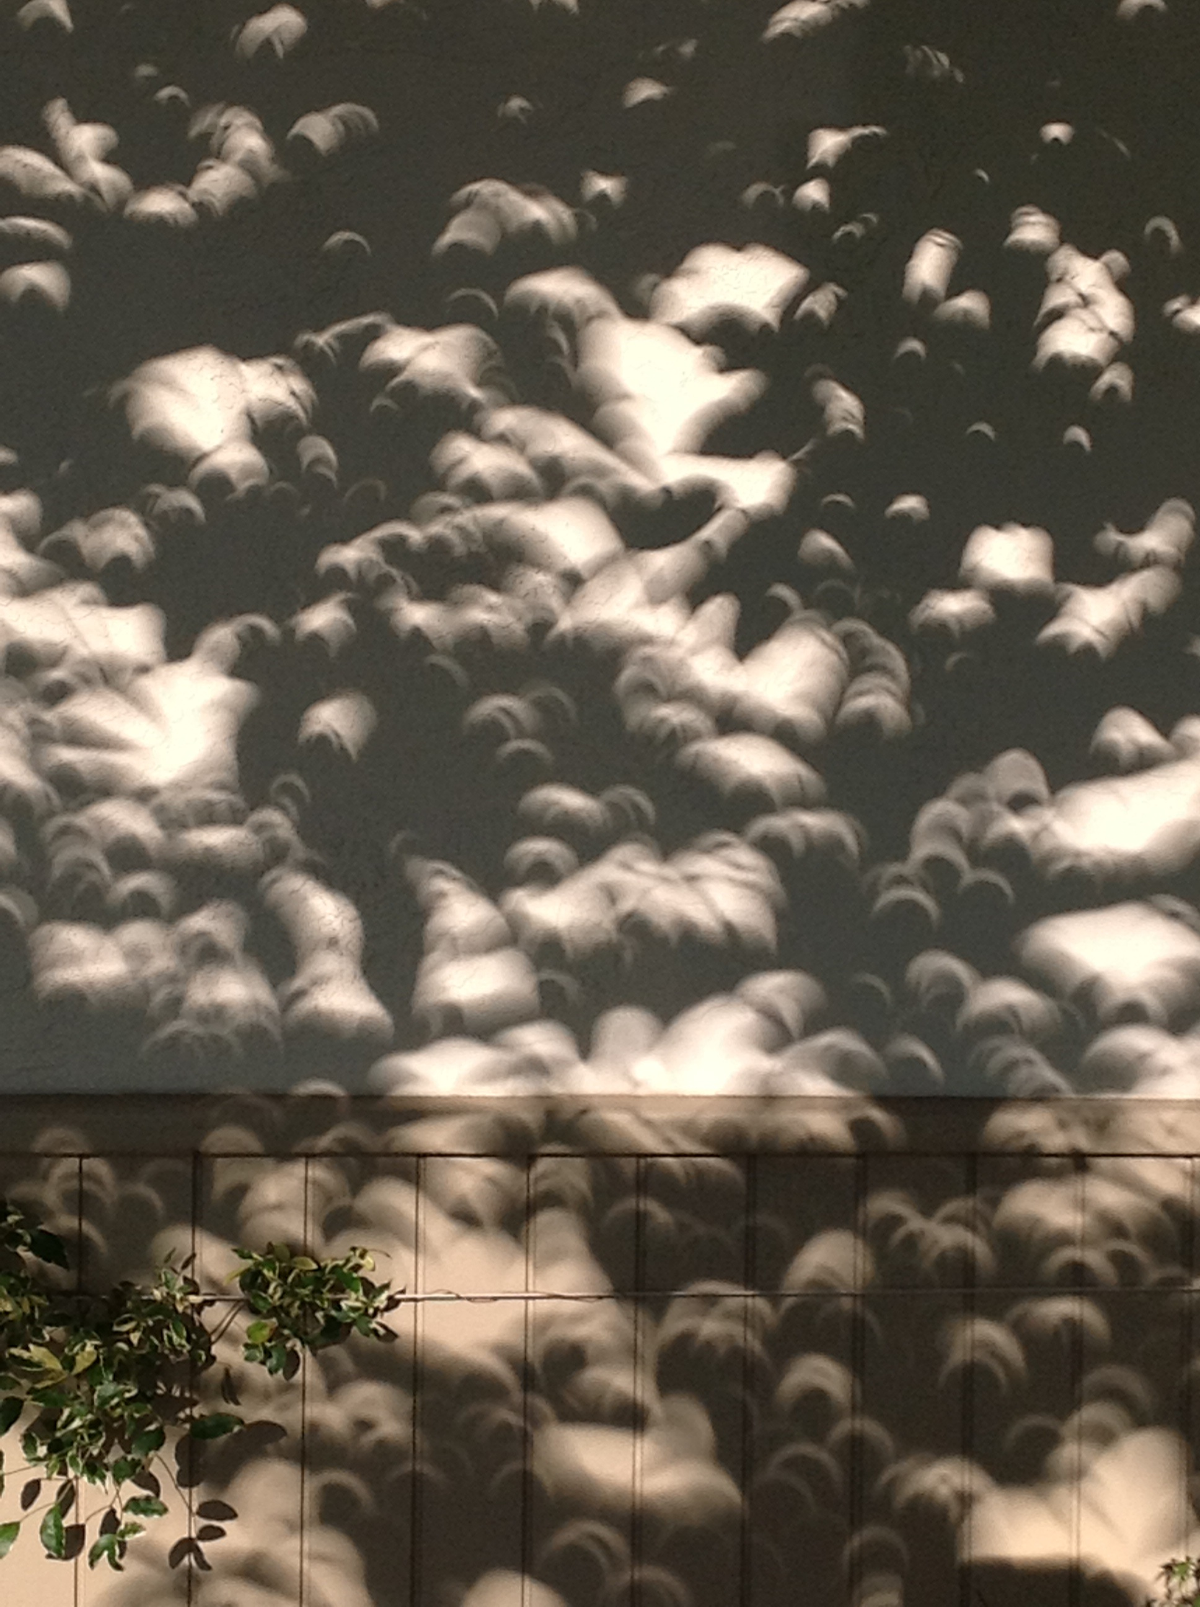

Slide 26
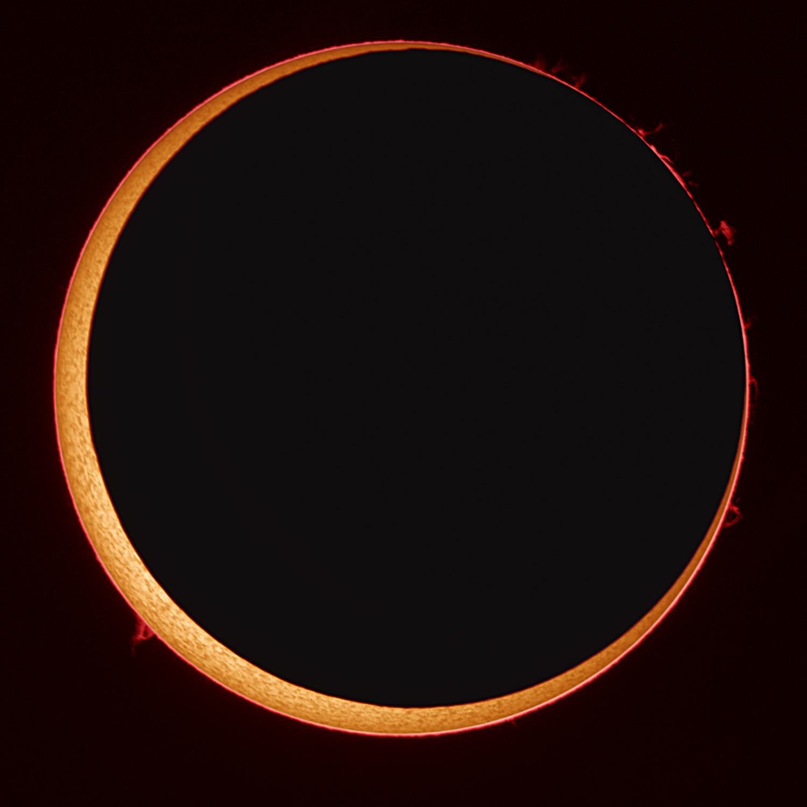
Annular Eclipse of October, 2005

Slide 27
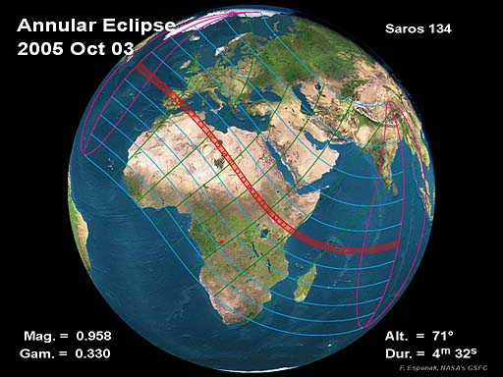

Slide 28
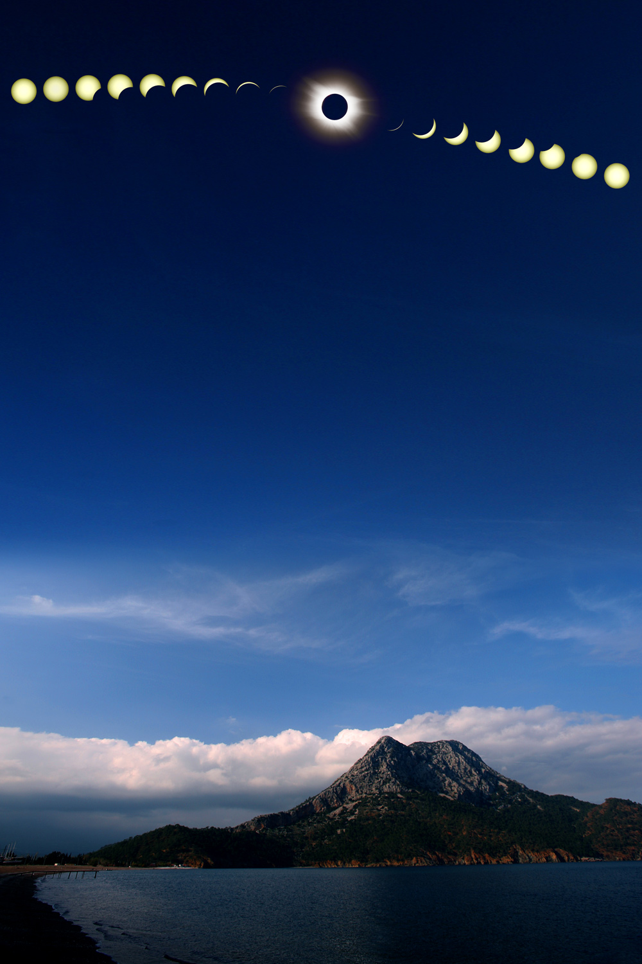

Slide 29
Studying the Outer Layers of the Sun
The bright surface of the Sun is called the ‘photosphere.’
Just above the photosphere is a region called the ‘chromosphere’, and above that is the ‘corona.’
Normally astronomers have a very difficult time studying these regions because of the overwhelming glare of the photosphere.
During solar eclipses, the photosphere is blocked, giving a clear view of the corona and chromosphere

Slide 30
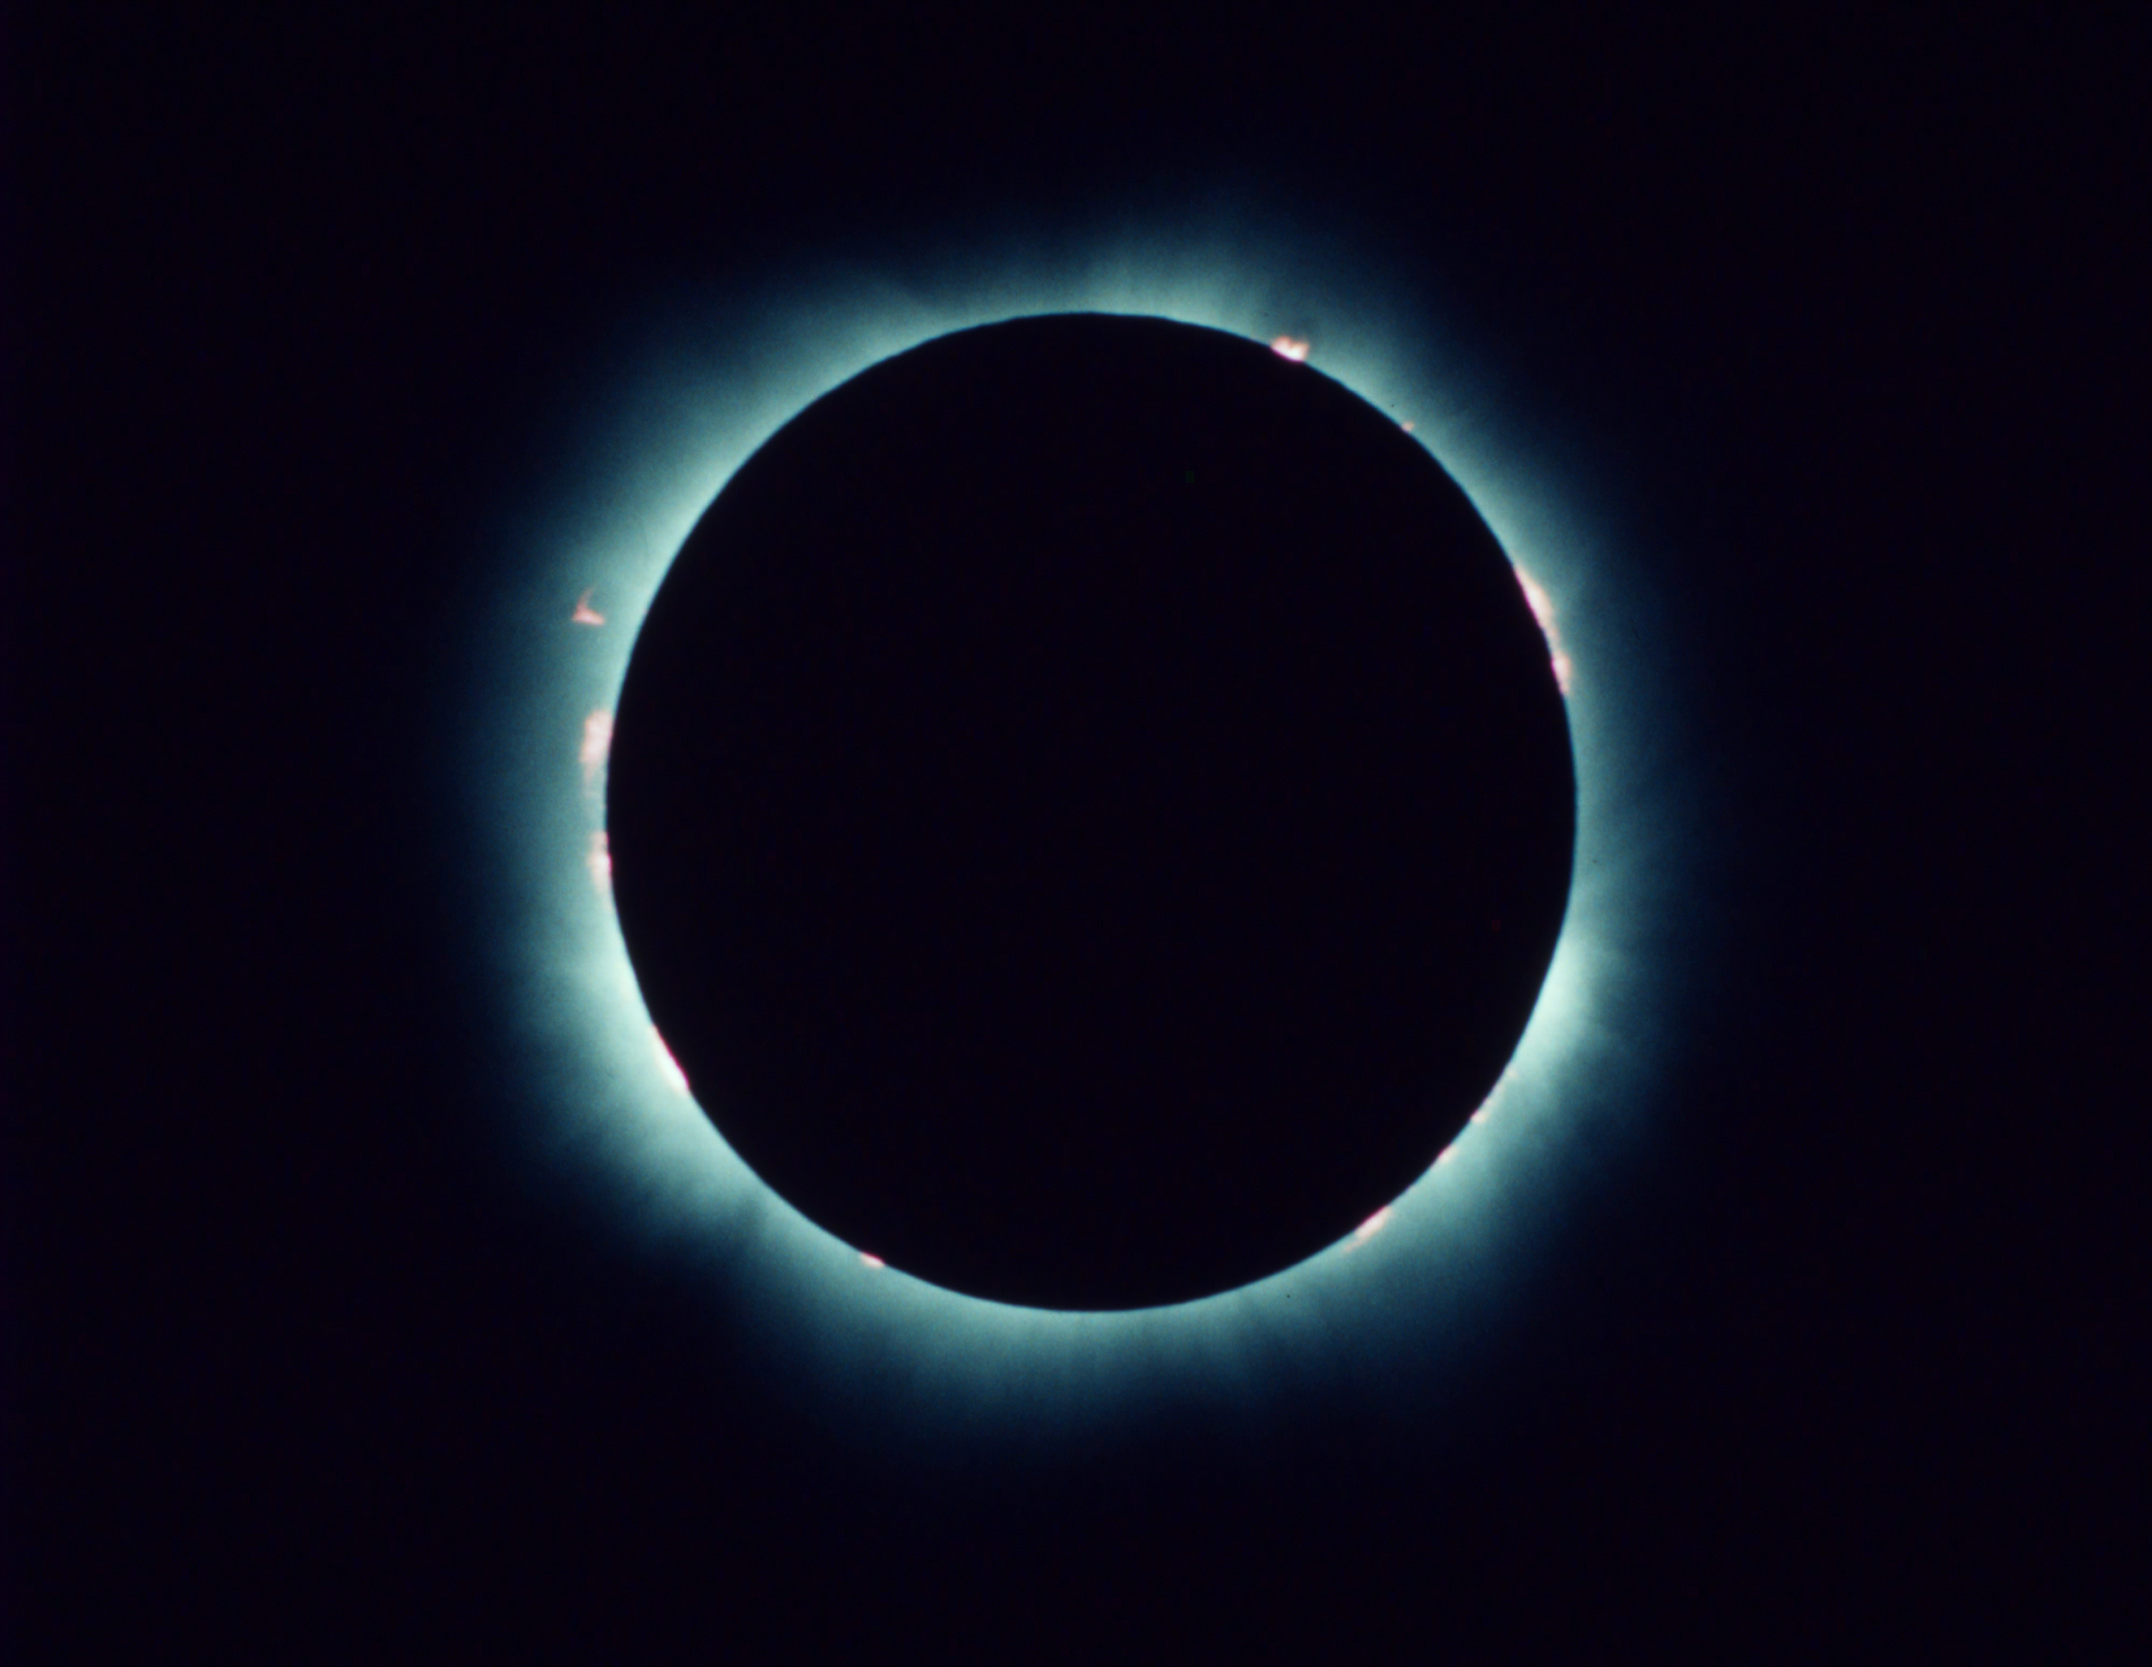

Slide 31
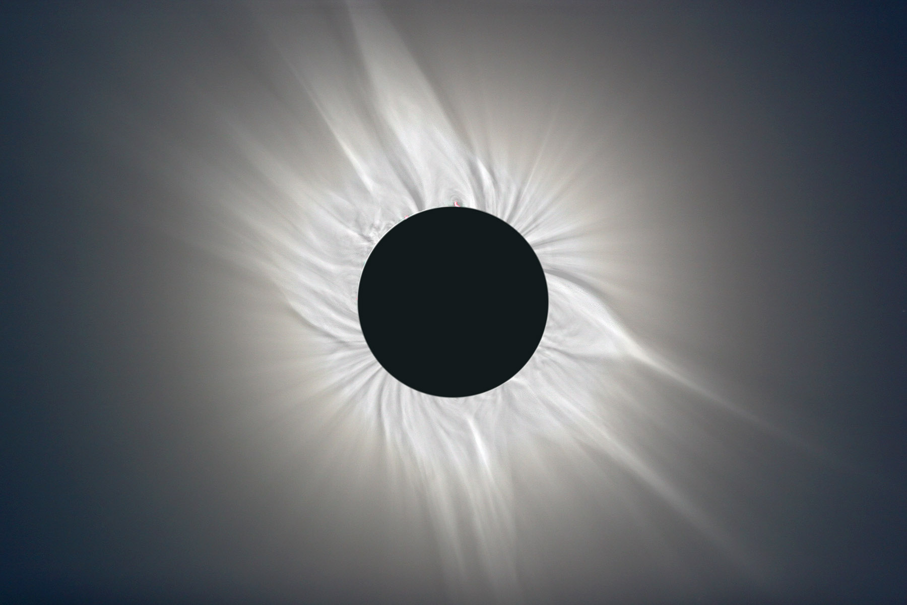

Slide 32
The Famous Eclipse of 1919.
The total solar eclipse of 1919 is one of the most important events in the history of physics – it provided the first observational confirmation of Einstein’s General Theory of Relativity.
Einstein calculated that the presence of mass (and therefore gravity) bends the fabric of space itself.
Light normally travels in a straight line, but if space itself is bent, light should (according to Einstein) follow the bend.
Thus a star which is behind the Sun from our point of view may nevertheless be visible.

Slide 33
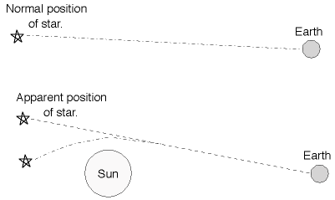

Slide 34
Einstein Vindicated!
This effect is normally impossible to detect since the Sun’s glare blocks out the light of any nearby stars.
But when an eclipse occurs, the glare of the Sun is blocked.
The first total eclipse that occurred after Einstein published his paper on general relativity happened in 1919.
Scientists took very careful photographs of stars near the eclipsed Sun, and indeed detected stars which should have been hidden behind the Sun!

Slide 35
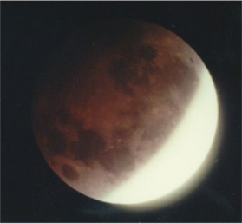
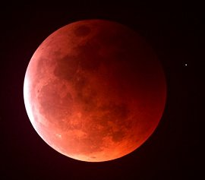
Lunar Eclipses
Lunar eclipses occur when the Earth passes directly between the Sun and the Moon, and Earth’s shadow falls on the Moon.
During a total lunar eclipse, the Moon actually looks reddish brown. This is because red light from the Sun is bent around the Earth by Earth’s own atmosphere, and then strikes the Moon.

Slide 36
Why Don’t Eclipses Happen Every Month?
The Moon’s orbit is tilted slightly with respect to Earth’s orbit.
Normally, the full moon is just a little too high or a too low to pass through Earth’s shadow, for example.
Only at the right time of the year does the Moon pass through the Ecliptic. It is during these times that eclipses are possible.
Hence the name ‘ecliptic’.

Slide 37
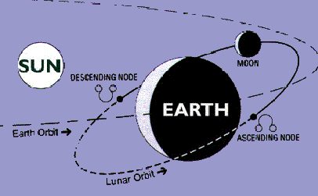
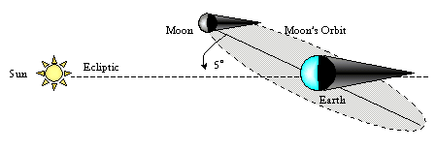

Slide 38
When’s the next one?
Let’s say it’s been a while since any eclipse, and a solar eclipse occurred today.
When would you expect the next possible solar eclipse?
When would you expect the next possible lunar eclipse?
Answers: 6 months; 2 weeks.

Slide 39
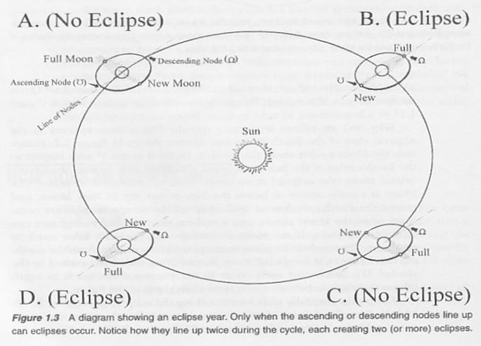

Slide 40
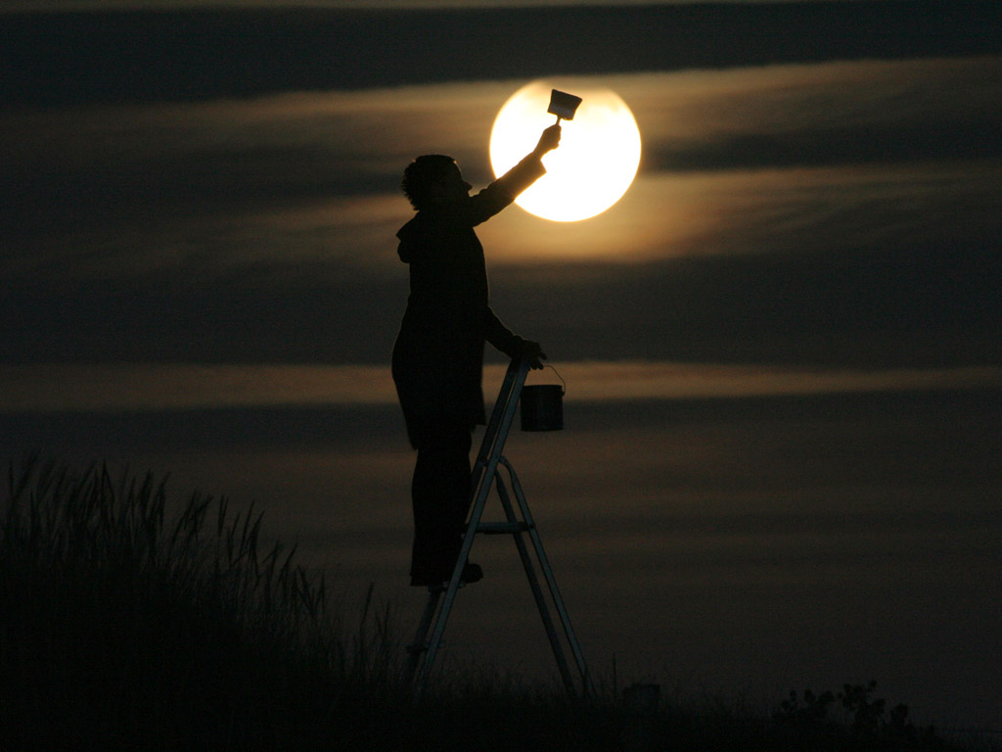

Slide 41
