Slide 1
Climate & Fusion
Part 2 – Discovery of the Nuclear Atom

Slide 2
Turn of the Century Picture of the Atom
By 1897, thanks to JJ Thomson, we knew that negatively charged electrons existed and could be stripped away from initially neutrally charged atoms by a strong enough force.
Thomson then measured the charge-to-mass ratio of these electrons.
12 years later, in 1909, Millikan measured the charge of the electron in his famous oil drop experiment.
Since the charge-to-mass ratio was already known, Millikan’s experiment also revealed the mass of electrons.
While we knew a fair amount about electrons by this point, our understanding of the rest of the atom was quite murky.

Slide 3
The Plum Pudding Model
By the early 1910’s, the accepted model for an atom was a sphere, about 10⁻¹⁰ m wide. The sphere was made of positively charged matter. Embedded within were negatively charged electrons, like raisins or plums embedded in a pudding.
This model of the atom is often called “Thomson’s model” or the “plum pudding model”.

Slide 5
Rutherford’s Experiment
In 1911, Ernest Rutherford, Hans Geiger, and Ernest Marsden performed an experiment challenging this model of the atom.
They fired a ray of alpha particles (recall: these are high-energy helium nuclei) at a thin gold foil in a vacuum chamber, and then recorded the angles at which the alpha particles were deflected by the gold.

Slide 6
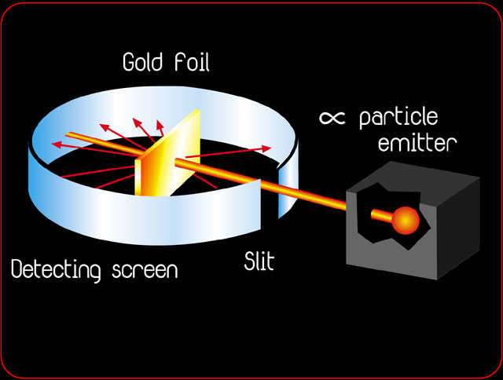

Slide 7
Expectations vs. Results
If Thomson’s model was correct, most of the alpha rays should have simply “passed through the pudding” and hit the detector on the far side of the gold.
Instead, while most alpha particles went straight through, or deflected slightly, some were scattered back at very large angles!

Slide 8
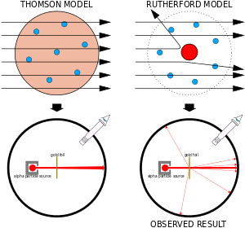

Slide 9
Implications
Rutherford was shocked at the backscattering of some of the alpha particles: “It was as if you fired a 15-inch shell at tissue paper and it came back and hit you!”
It must have taken tremendous force to reverse the direction of the alpha particles.
This force must have been electric repulsion between the positively charged alphas and the positive charge in the gold atoms.
Recall electrical force is given by Coulomb’s law: F = Kq₁q₂/(r²)
Given the amount of positive charge in an alpha particle and in a gold atom, Rutherford calculated that in order to achieve the force needed for backscattering, the alpha particle had to get within 10⁻¹⁵ m of the gold atom’s positive charge. Any larger distance would result in only minor deflection

Slide 10
The Nuclear Atom
So Rutherford found that the positive charge of the gold atom must be condensed in a region ~10⁻¹⁵ m in size.
This is 100,000 times smaller than the 10⁻¹⁰–m diameter of the atom itself!
So the positive charge of an atom isn’t “pudding” that fills the volume of the atom.
Instead, the positive charge resides in a small nucleus at the center of the atom!

Slide 11
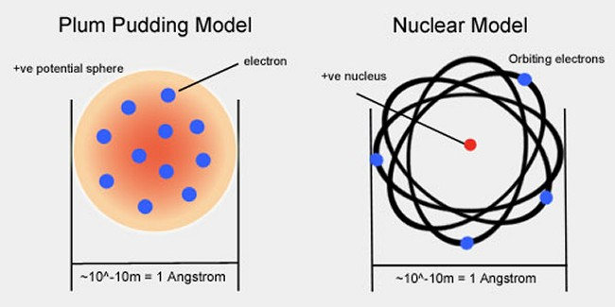

Slide 12
Building Blocks: A Timeline
1897 – The electron was discovered (and its charge-to-mass ratio was measured)
1905 – Einstein showed that light comes in discrete chunks: the photon was discovered
1911 – The nucleus was discovered (by Rutherford, et. al.)
1920 - The proton was discovered (also by Rutherford, who showed that hydrogen nuclei can be obtained from heavier nuclei)
1930 – The neutrino was hypothesized to exist in order to explain how to balance energy before and after beta decays
1931 – The neutron is discovered by James Chadwick, who showed that when an alpha particle strikes beryllium, boron, or lithium, radiation is given off that is neutral in charge, but comparable in mass to a proton
1956 – The neutrino is experimentally verified.

